Slide 1
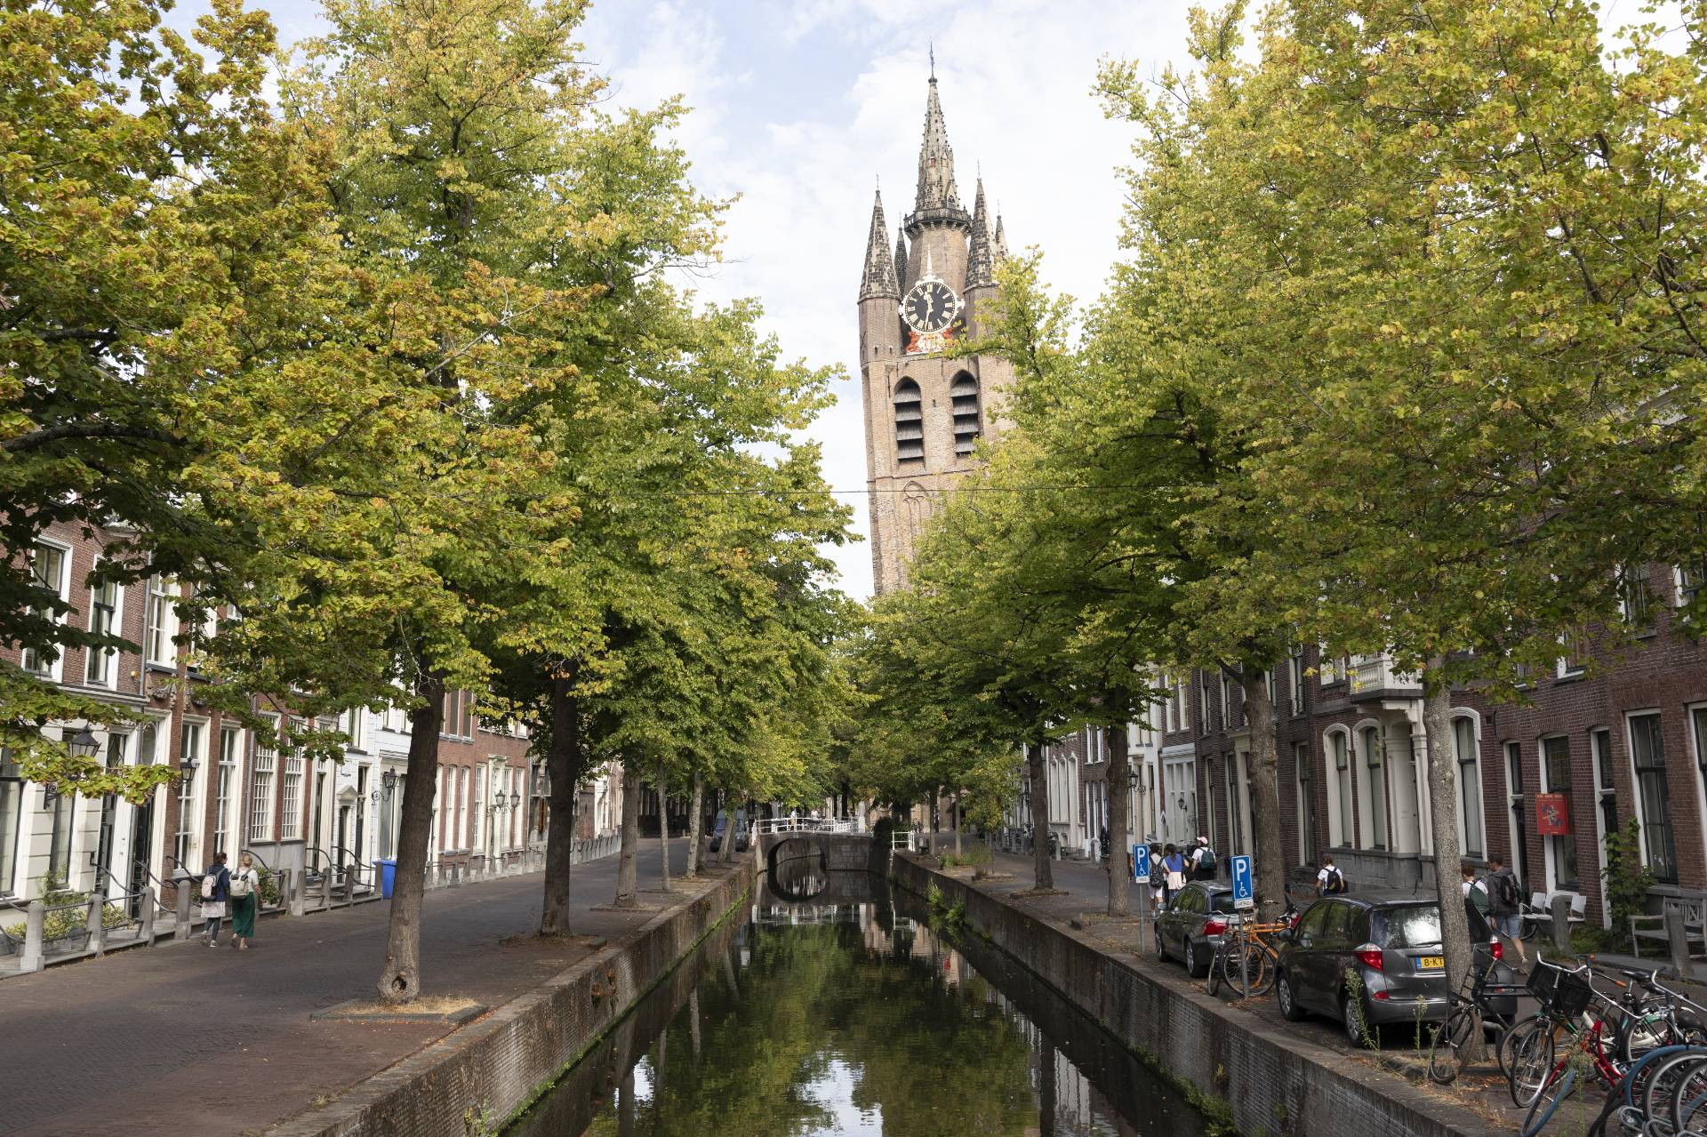
Title slide + image
11th European Storm Workshop
Delft University of Technology, The Netherlands
Martina Messmer
Niklaus Merz
Christoph C. Raible
David Stephenson

Slide 2
11th European Storm Workshop
Create/edit a Hyperlink TO A SLIDE
1
Go to the tab ‘Insert’ and click on the button ‘Shapes’. Choose the shape ‘Rectangle’ and drag the mouse over the slide to create a shape.
Shapes
2
Drag the shape over the menu button and scale the shape as large as the button. Click with the right mouse button on the shape and choose ‘Edit shape’.
Size and position…
Edit shape…
3
Click on the paint bucket icon, click on ‘Shape Fill’ and drag the ‘Transparency’ slider to 100%. Now the shape is completely transparent.
01
02
03
Delft and the Netherlands
The European Storm Workshop
Housekeeping
Transparency
100%
4
Click on the transparent shape and use the shortcut Ctrl + K to add a hyperlink. At the left side of the window, click on ‘Place in this document’ and select the preferred slide
in the list. Then click on ‘OK’.
5
Copy the transparent shape and repeat
step 4. Do this for all menu buttons.
Want to know more?
Go to the tab 'SLIDEBUILDER’ and click
on the button ‘Inspiration'
Inspiration

Slide 3
Chapter | dark mode
01
Delft and the Netherlands

Slide 4
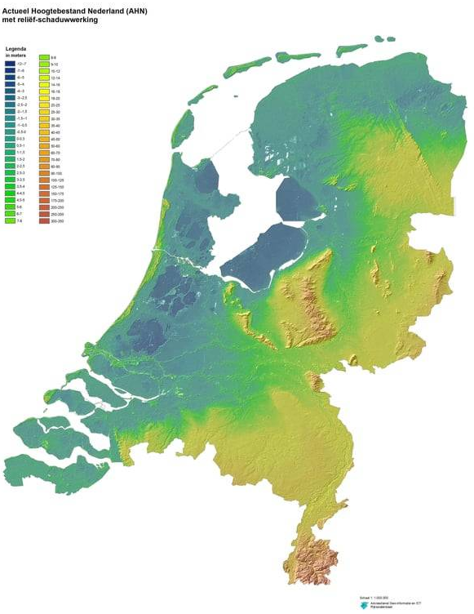
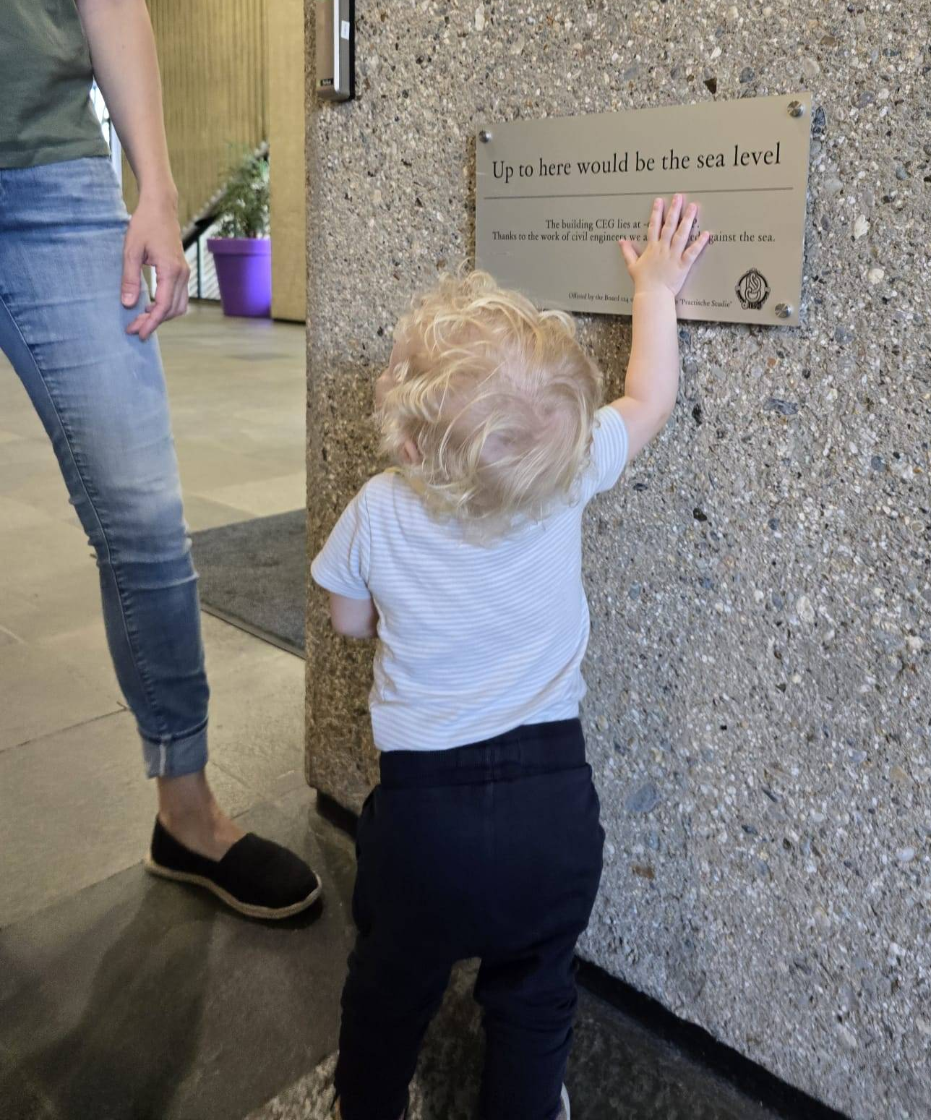
Topography
Garmestani et al. (2019). The Role of Social-Ecological Resilience in Coastal Zone Management: A Comparative Law Approach to Three Coastal Nations. Frontiers in Ecology and Evolution. 7. 10.3389/fevo.2019.00410.

Slide 5
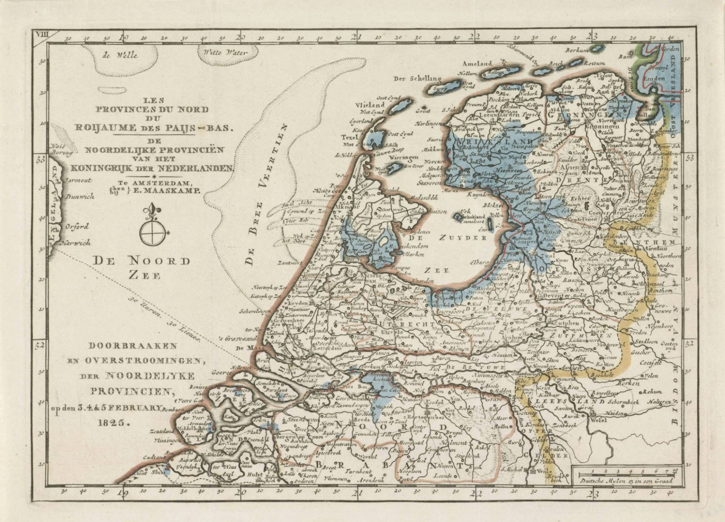
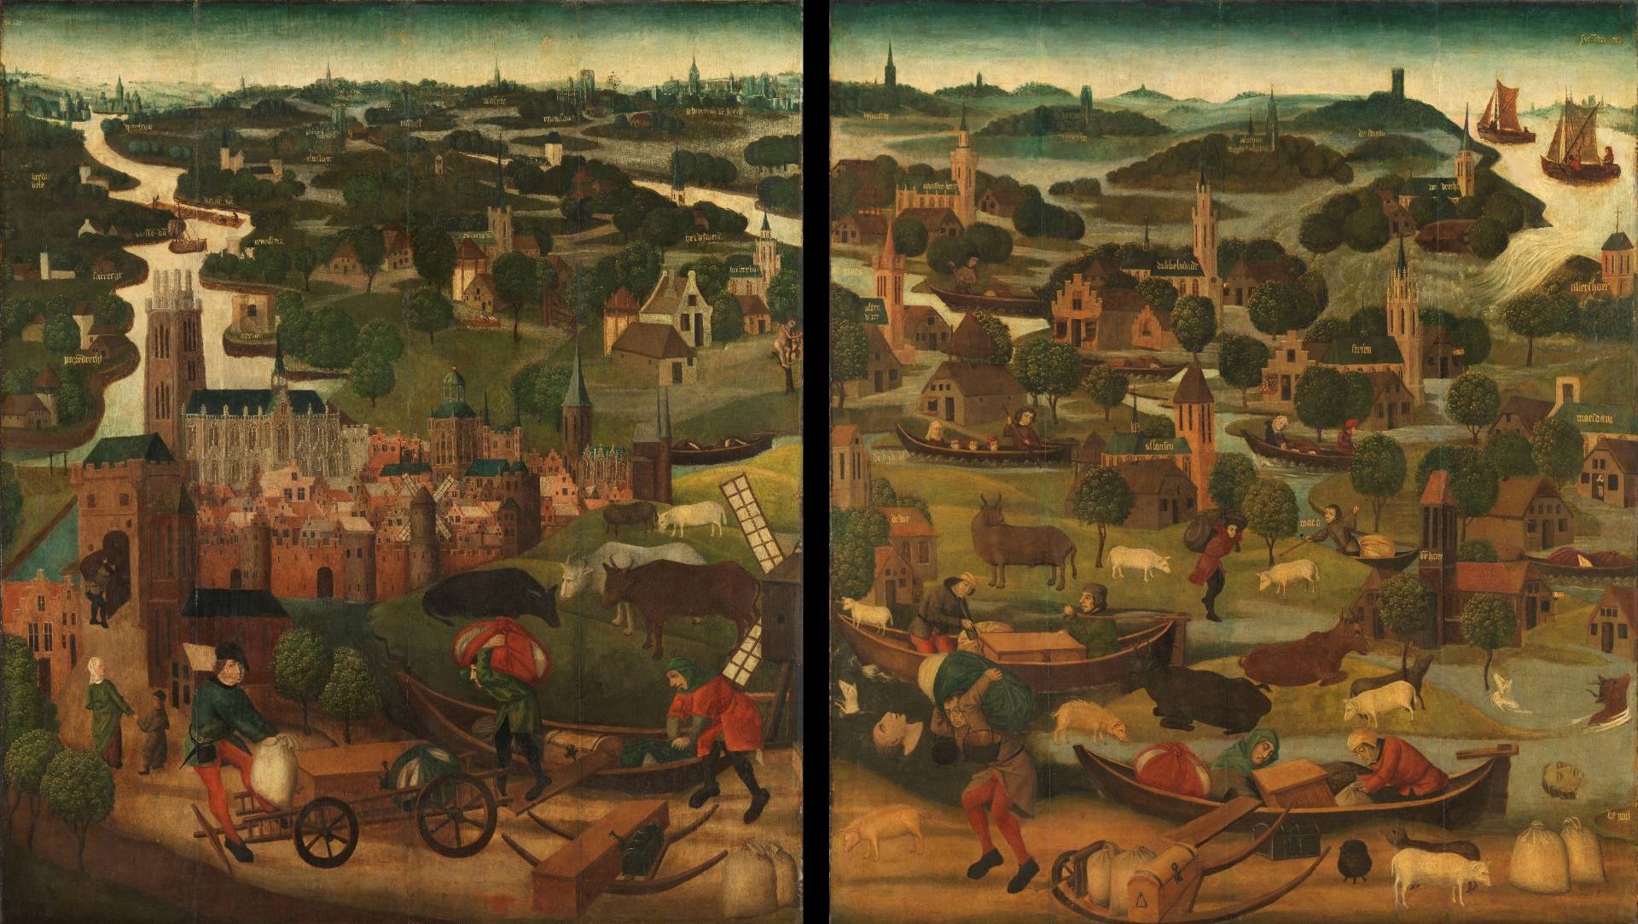
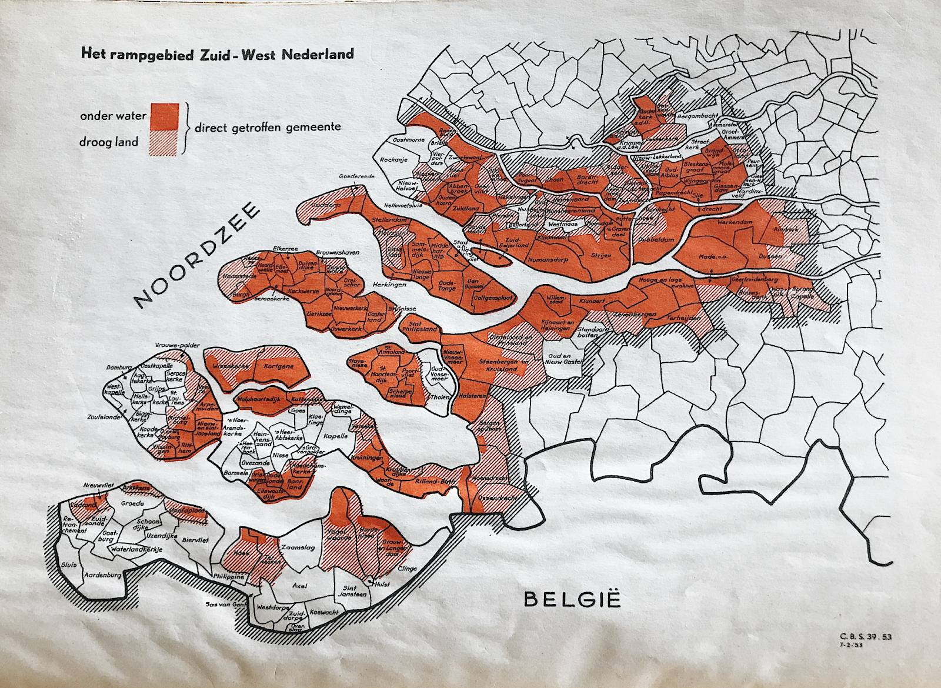
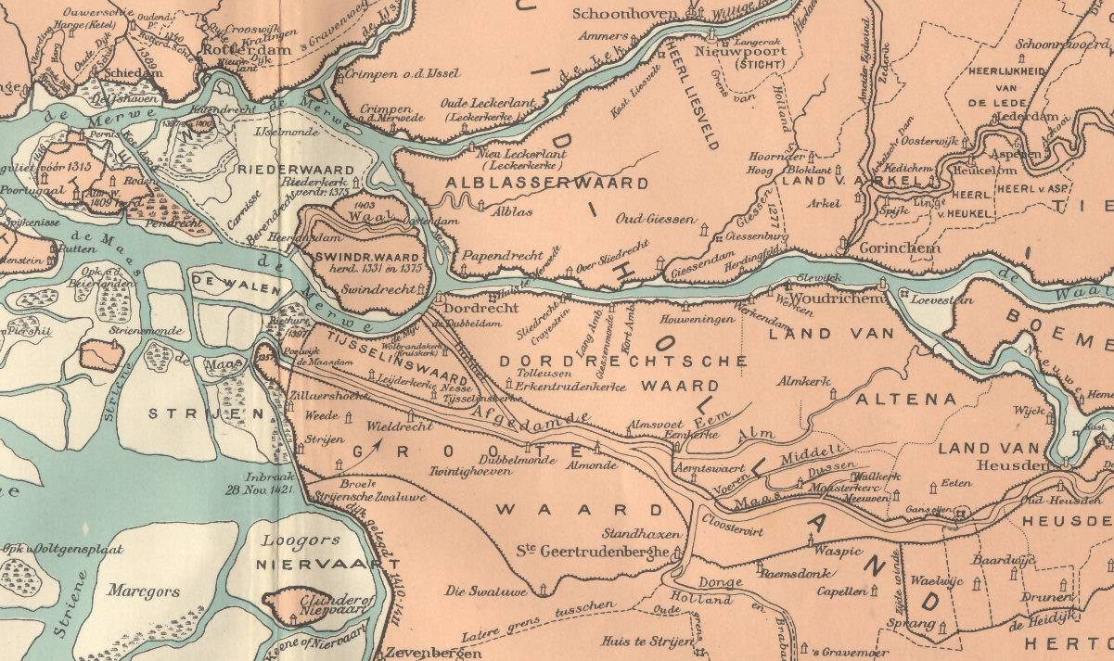
Historical Floods
St. Elisabeth’s Flood (1421)
Flood of 1825
North Sea flood (1953)
https://envhistnow.com/2023/02/01/when-the-dikes-broke/
https://nl.wikipedia.org/wiki/Sint-Elisabethsvloed_(1421), https://en.wikipedia.org/wiki/St._Elizabeth%27s_flood_(1421)
https://www.rijkswaterstaat.nl/en/news/archive/2025/02/the-forgotten-flood-disaster-of-1825
Notes:
A heavy storm in the North Sea coast caused the dikes to break in a number of places and the lower-lying polder land was flooded. A number of villages were flooded and lost causing thousands (2000 to 10’000) of casualities. Most of land has been reclaimed, but some areas remain flooded (National park). The cause of the storm was who would have guessed it an extratropical cyclone and resulting storm surges that lead to overflow and breakage of dikes.
The flood of 1825 affected the Ijsselmeer region and also the Zealand region: 22 dikes breaches, 6 flooded provinces, 60% of Friesland under water, causing hundreds of (379) fatalities. In 1932, the Zuiderzee was closed off by a 32.5 km-long barrier protecting the Netherlands from flooding. Since then, the Zuiderzee has been known as the Ijsselmeer or Lake Ijssel.
North Sea flood of 1953, affected the Netherlands, Belgium and United Kingdom. A combination of a high spring tide and a severe European windstorm caused a storm tide of the North Sea. Most sea defences facing the surge were overwhelmed, resulting in extensive flooding. Which resulted in the death of 1835 people and around 200.000 animals. The Netherlands developed the Delta Works, an extensive system of dams and storm surge barriers

Slide 6
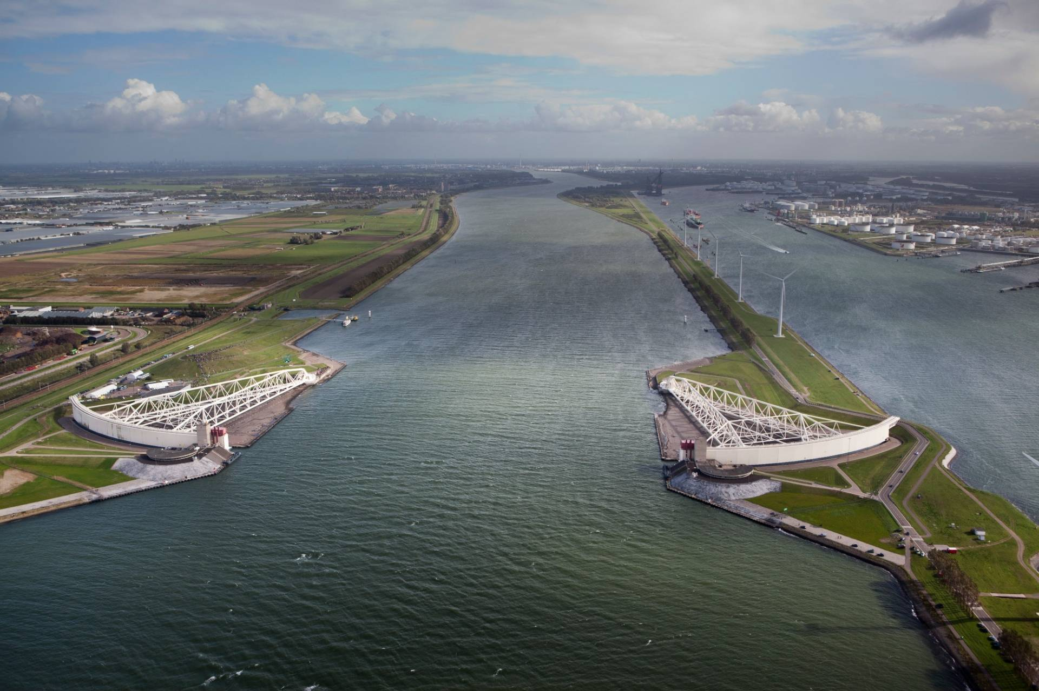
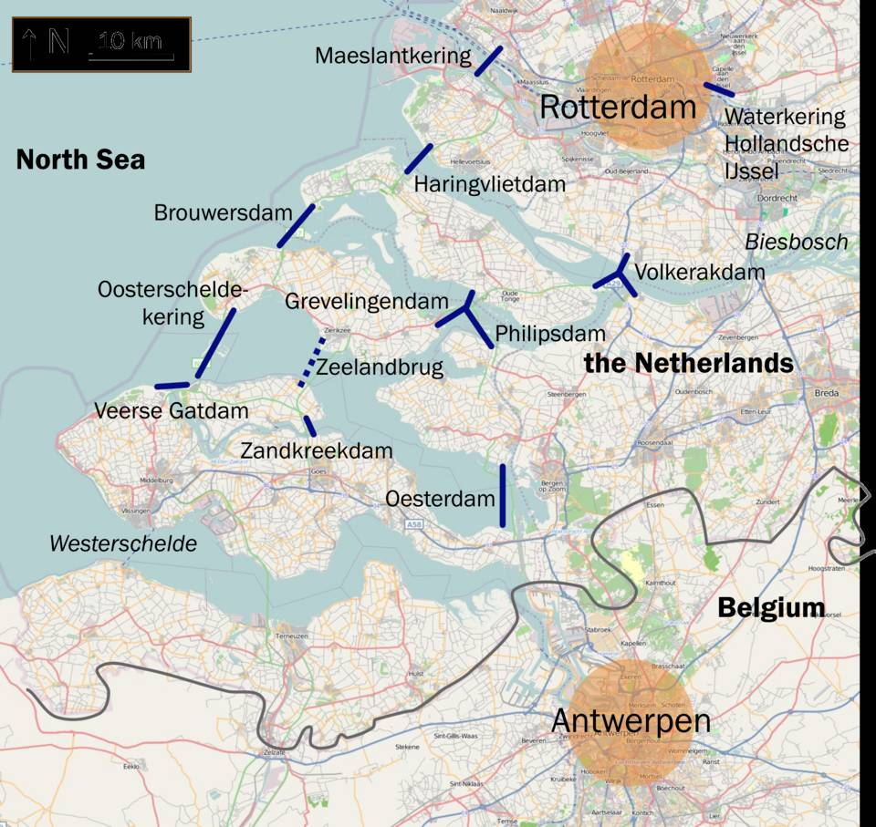
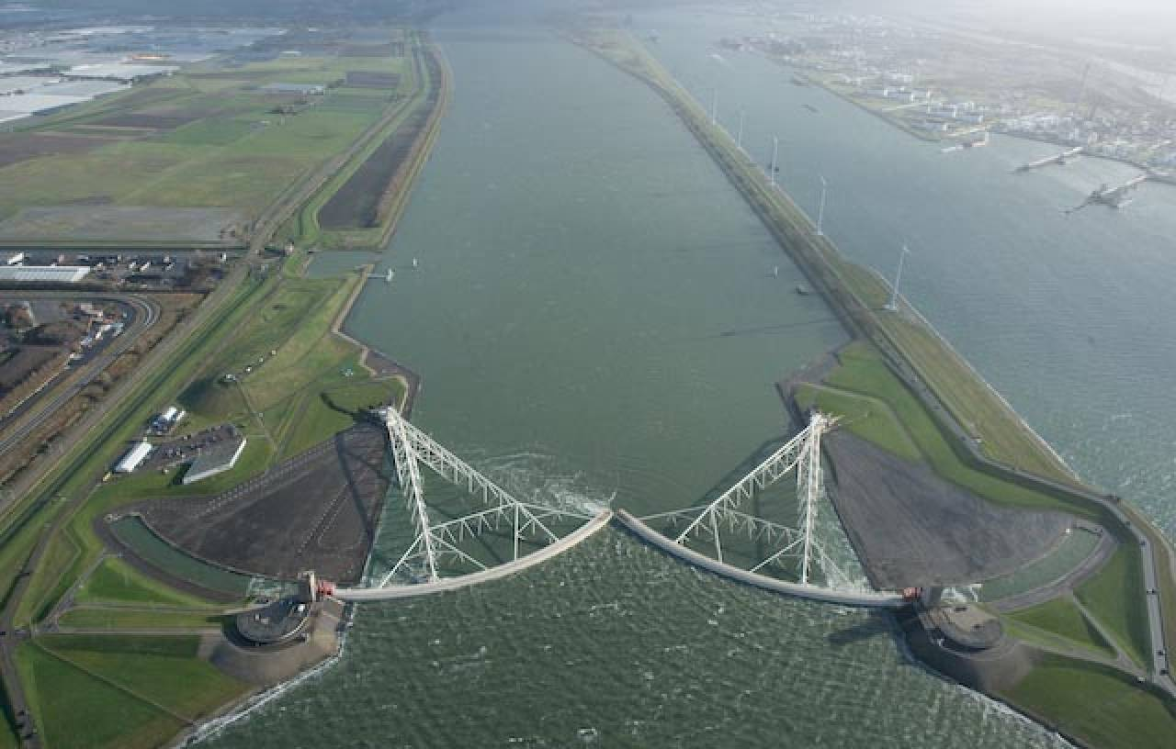
The 1953 Storm Surge:
A Turning Point in Modern Dutch Flood Protection
https://www.nu.nl/binnenland/6295147/maeslantkering-voor-het-eerst-automatisch-dicht-vanwege-hoogwater.html
https://commons.wikimedia.org/wiki/File:Deltawerken_na.png#/media/File:Deltawerken_na.png
https://www.keringhuis.nl/ontdek-het-keringhuis
Notes:
The Delta Works consist of a total of 13 major structures. They are considered one of the largest hydraulic engineering projects in the world and were built between the 1950s and the 1990s.
Maeslantkerring: Maeslant barrier

Slide 7
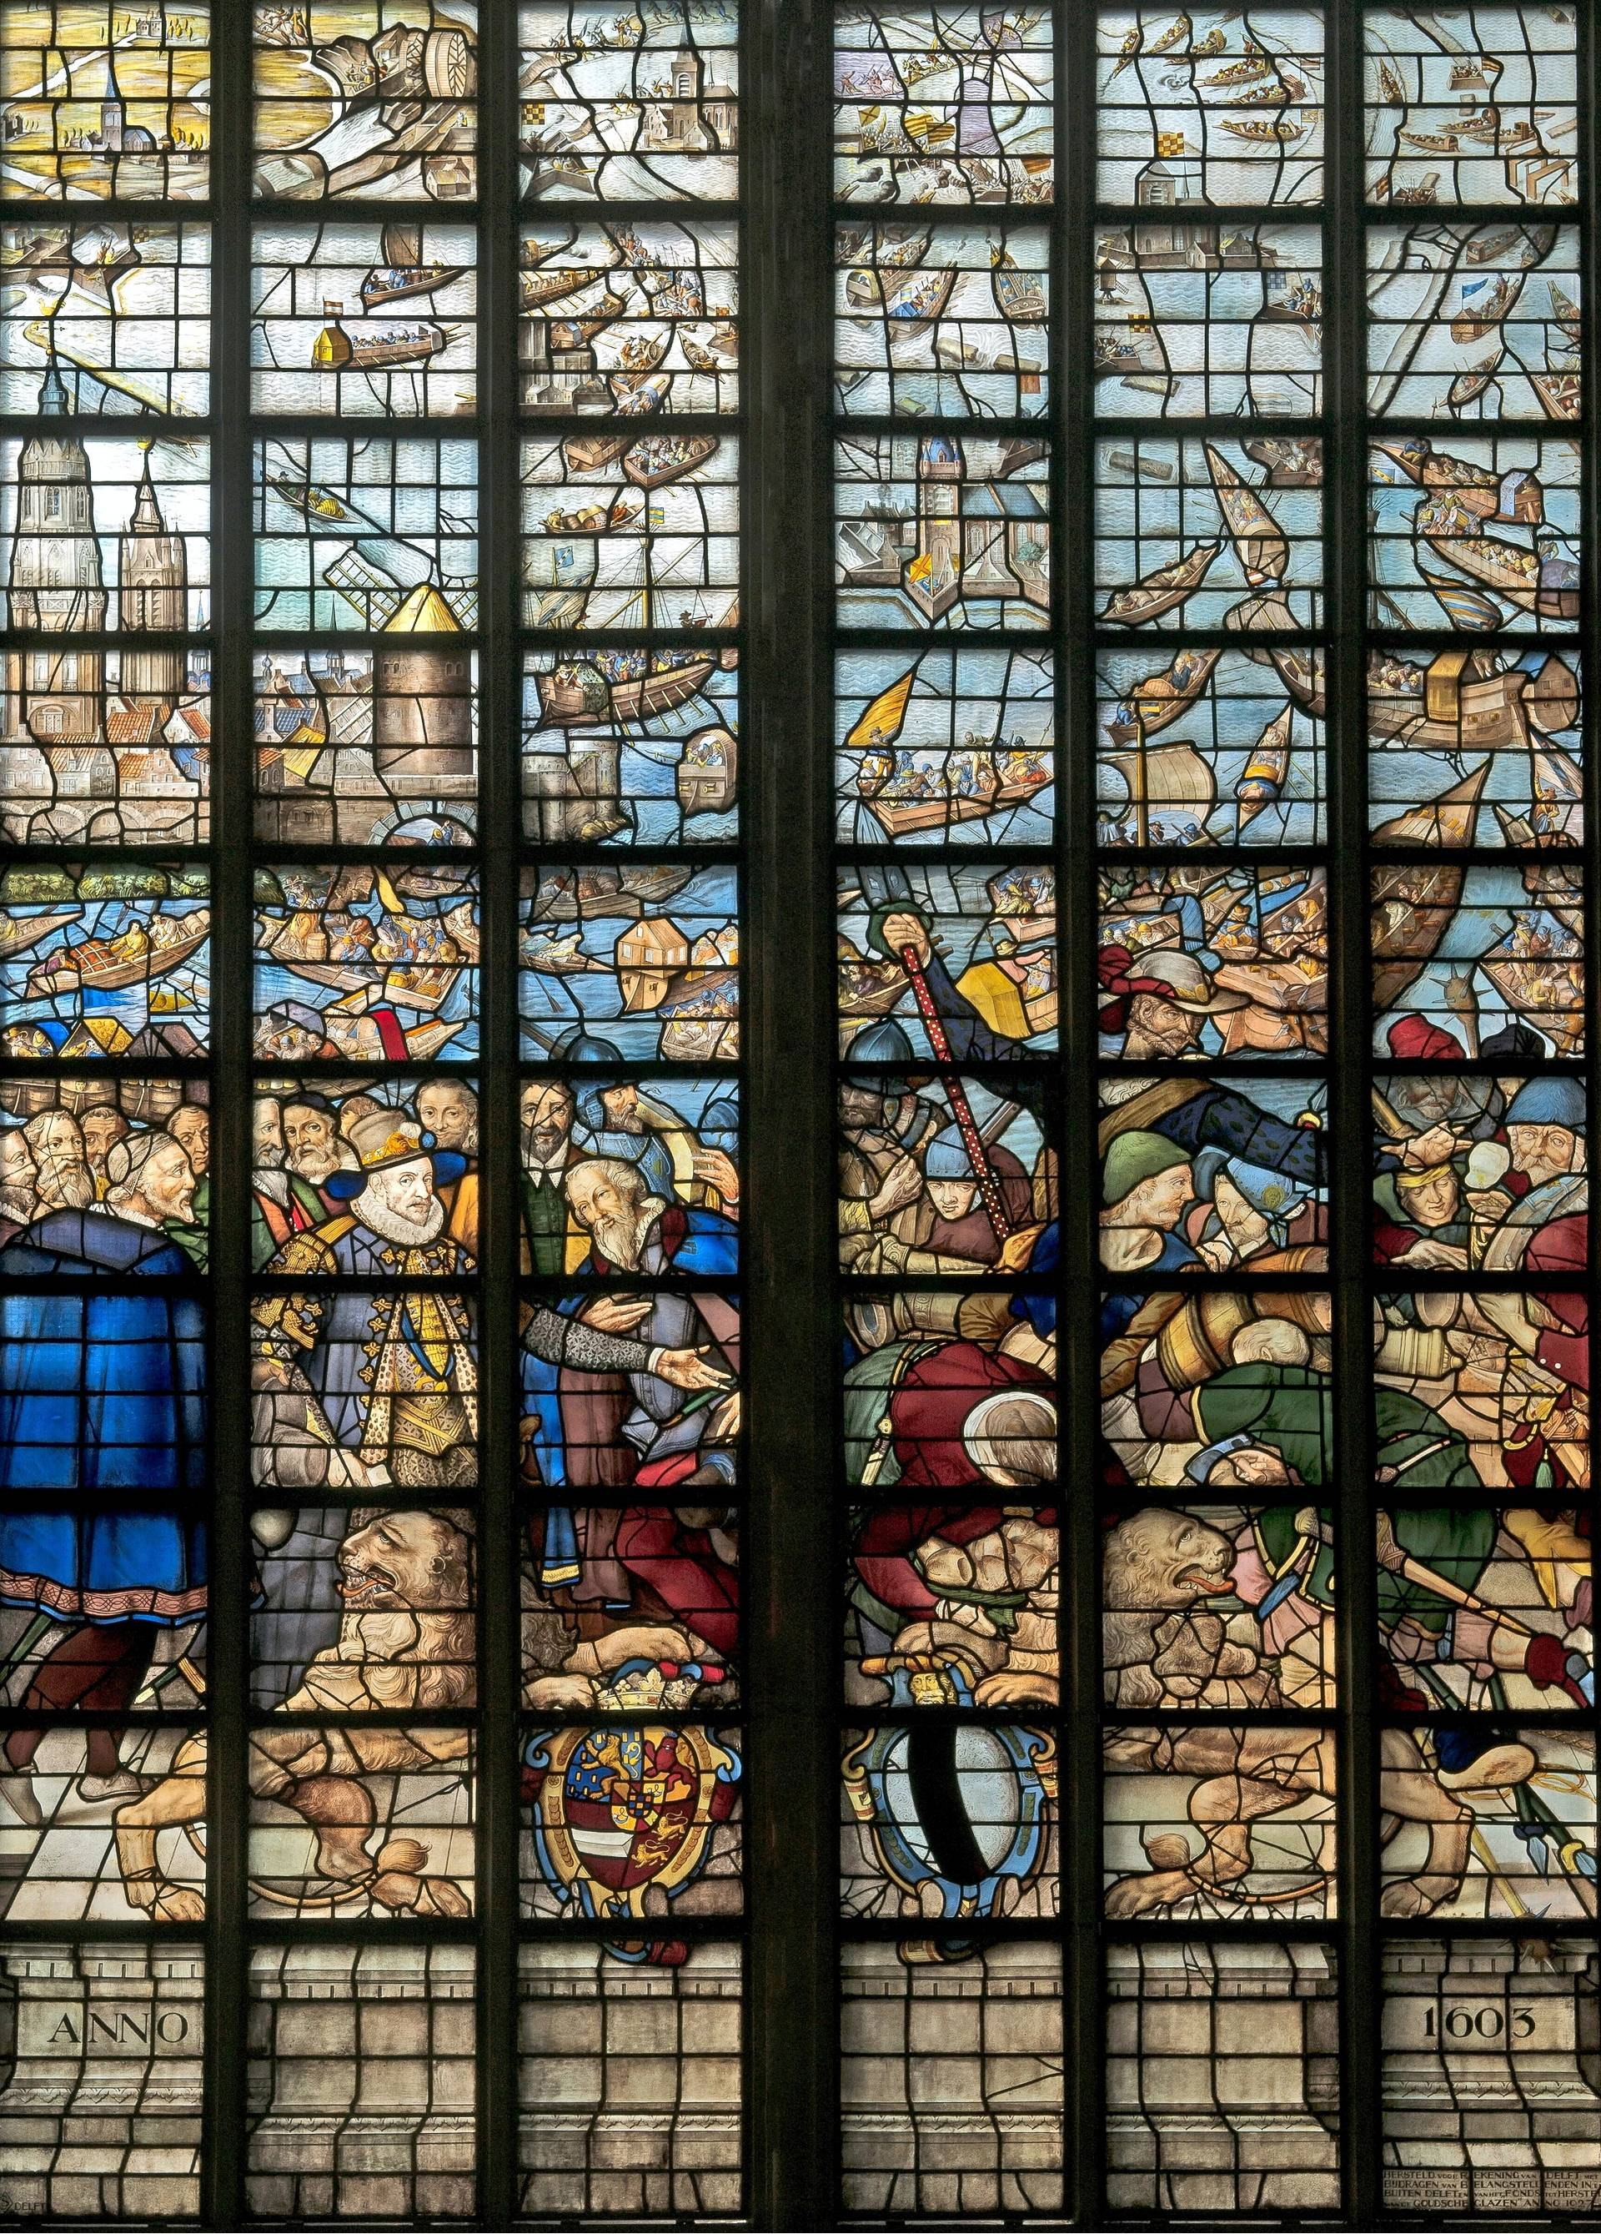
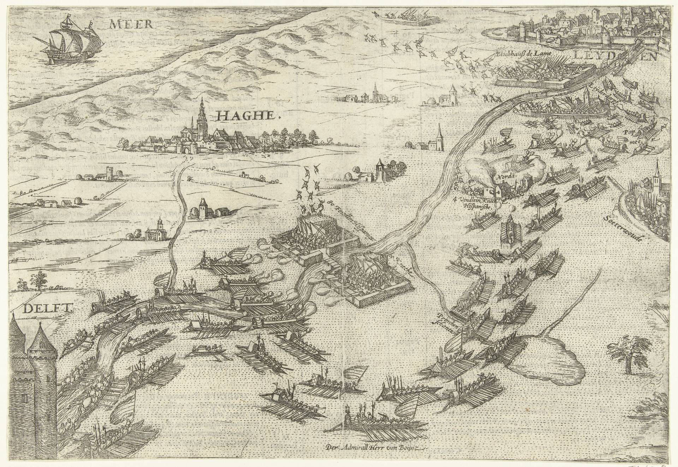
Flooding for Defense
Water represents not only a threat, but also a strategic instrument
The siege of Leiden 1574:
  The Spanish (Habsburg) against Dutch rebels (leader: William of Orange)
  Spanish tried to starve Leiden into surrender
  Relief effort by deliberately breaching dikes
  a military turning point in the struggle for independence, and a symbolic moment in the emergence of the Dutch Republic
The Prinsenhof in Delft was the political and military headquarters of William of Orange during the Dutch Revolt. He remained there until his assassination in 1584.
https://upload.wikimedia.org/wikipedia/commons/a/aa/Ontzet_van_Leiden%2C_1574%2C_RP-P-AO-11-15C.jpg
https://commons.wikimedia.org/wiki/File:Gouda,_Glas_25,_Die_Befreiung_von_Leiden.jpg
Notes:
The siege of Leiden occurred between 1573 and 1574, when the Spanish (Habsburg) attempted to capture the rebellious city of Leiden. During the Siege of Leiden, Leiden became trapped between the advancing Spanish forces and the Dutch rebels. While the Spanish attempted to starve the city into surrender, the rebels under William of Orange coordinated a relief effort from Delft, deliberately breaching dikes to flood the polders between the two fronts. The rising water allowed the rebel fleet to advance toward Leiden and ultimately break the siege on 3 October 1574.
stained-glass windows in the Sint Janskerk in Gouda

Slide 8
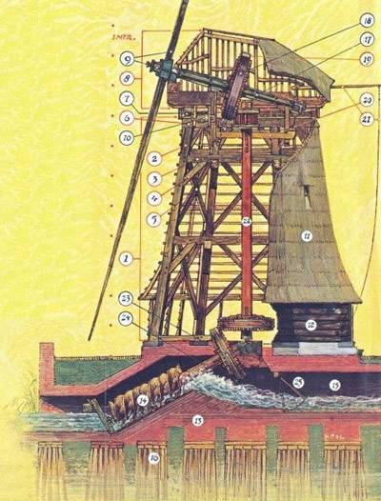
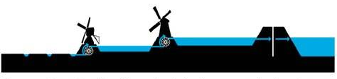
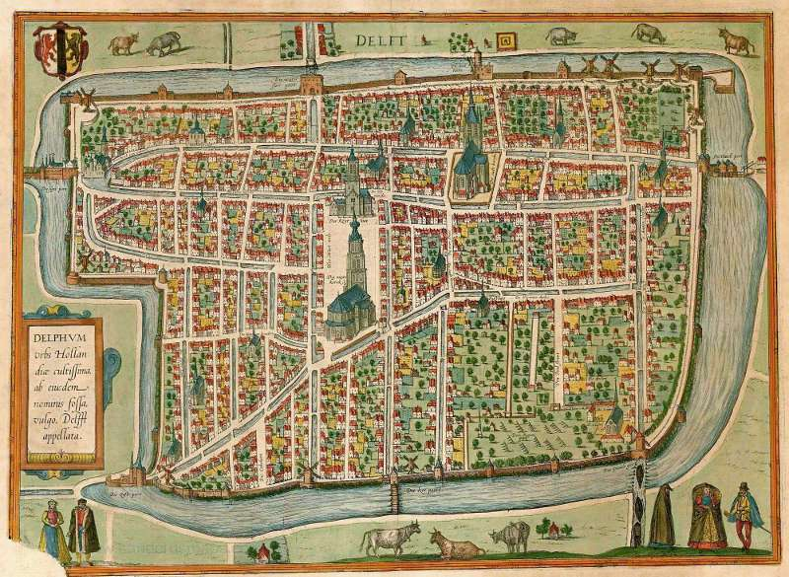
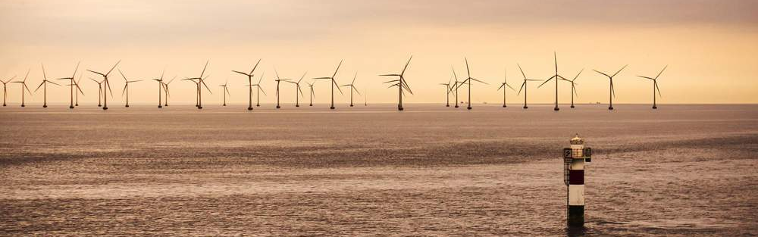
Wind as a driver of Dutch development
https://www.zaans-industrieel-erfgoed.nl/index.html?pages_4/rep_big_stuf_gemalen_02.html&main_frame
Main purpose of Dutch windmills was water management
Made large-scale land reclamation possible
Dutch windmills also had important economic and industrial functions
In Delft, only the historic De Roos windmill remains as a reminder of this heritage
Nowadays, large-scale wind turbines have become an important source of renewable energy generation
https://hnsland.nl/en/projects/regional-vision-kinderdijk/
https://www.vintage-maps.com/de/antike-landkarten/europa/niederlande/braun-hogenberg-niederlande-delft-1581::12733
https://www.energie-klimaschutz.de/wind-offshore-wettlauf-um-groesste-windenergieanlage/
Notes:
The main purpose of traditional Dutch windmills was water management. In the Netherlands, windmills were primarily used to:
pump water out of low-lying land, drain lakes, marshes, and polders and to protect settlements and farmland from flooding
This made large-scale land reclamation possible and allowed much of the Netherlands to exist below sea level.
Archimedes' screw
Dutch windmills also had important economic and industrial functions (grinding grain, pressing oil, sawing timber, etc.)
Today, in Delft, only the historic De Roos windmill remains as a reminder of this heritage
In more recent times, large-scale wind turbines have become an important source of renewable energy generation

Slide 9
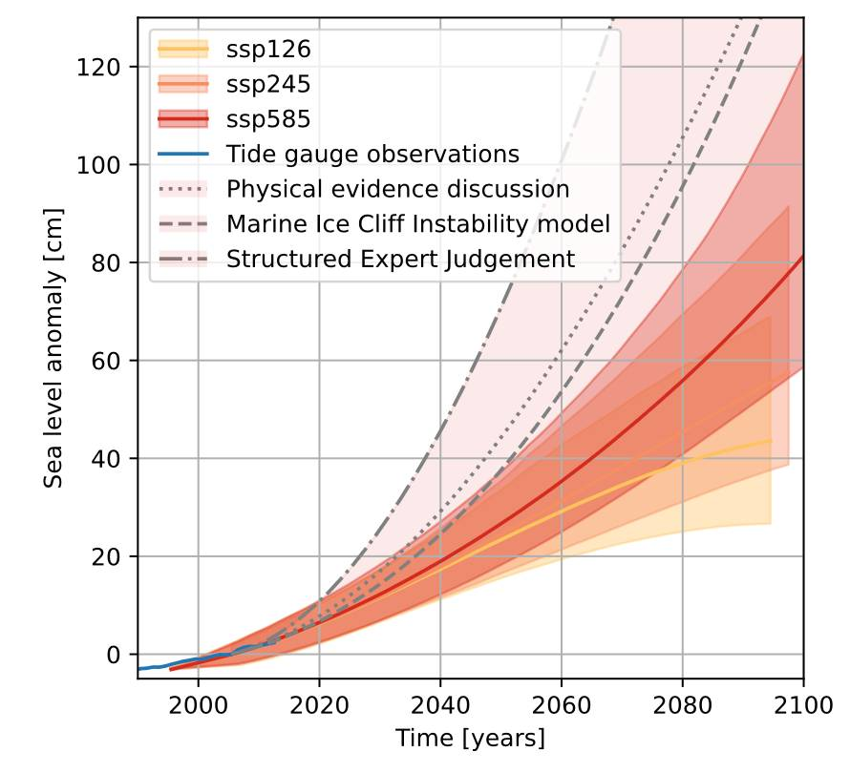
Future challenges
With rising sea levels, we can expect:
  more storm surges along the North Sea coast
  higher river water levels
  greater pressure on dikes and storm surge barriers
KNMI National Climate Scenarios 2023 for the Netherlands, Fig. 4.7

Slide 10
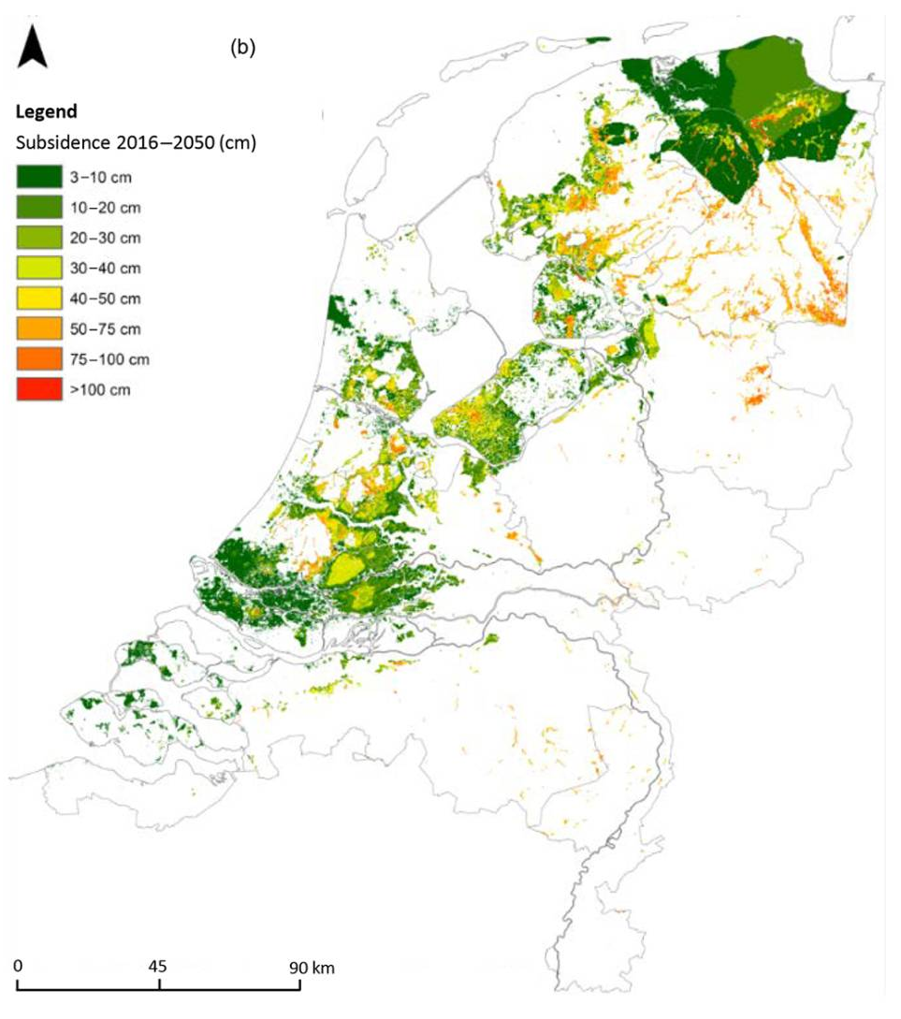
Future challenges
With rising sea levels, we can expect:
  more storm surges along the North Sea coast
  higher river water levels
  greater pressure on dikes and storm surge barriers
Aggravation due to land subsidence:
  peat soil oxidation and drainage
  groundwater extraction
  natural soil compaction
  weight of urban infrastructure.
Velsink, H., Backhausen, U., and Roovers, G. J.: Developing a digital platform for knowledge disclosure of land subsidence, Proc. IAHS, 382, 851–855, https://doi.org/10.5194/piahs-382-851-2020, 2020
Notes:
Parts of the Netherlands are gradually sinking due to:
peat soil oxidation and drainage,
groundwater extraction,
natural soil compaction,
and the weight of urban infrastructure.
In some regions, the land is subsiding by several millimeters to centimeters per year.

Slide 11
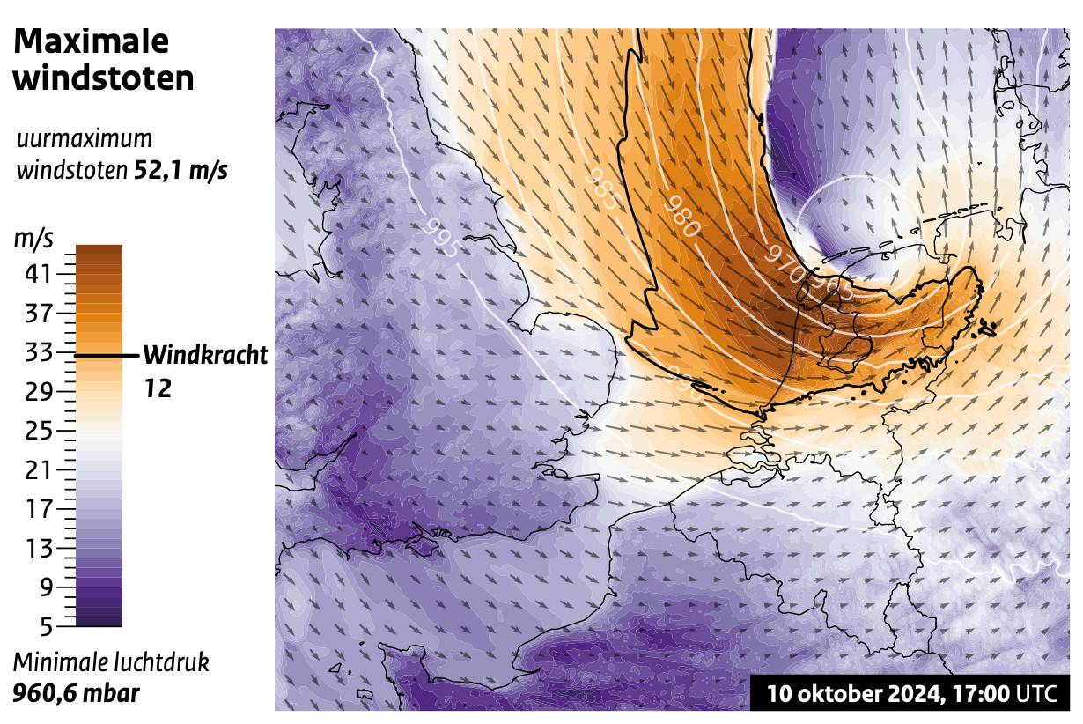
Future challenges
Stronger wind extremes
More intense precipitation events
More frequent occurrence of compound extremes
Een Extreem Rapport, page 32, Hylke de Vries (KNMI) and Maria del Socorro Fonseca-Cerda (Vrije Universiteit Amsterdam), https://www.knmi.nl/over-het-knmi/nieuws/een-extreem-rapport/
Notes:
with no futher ado, I would like to give the floor to our presenters.

Slide 12
Chapter | dark mode
02
The European Storm Workshop

Slide 13
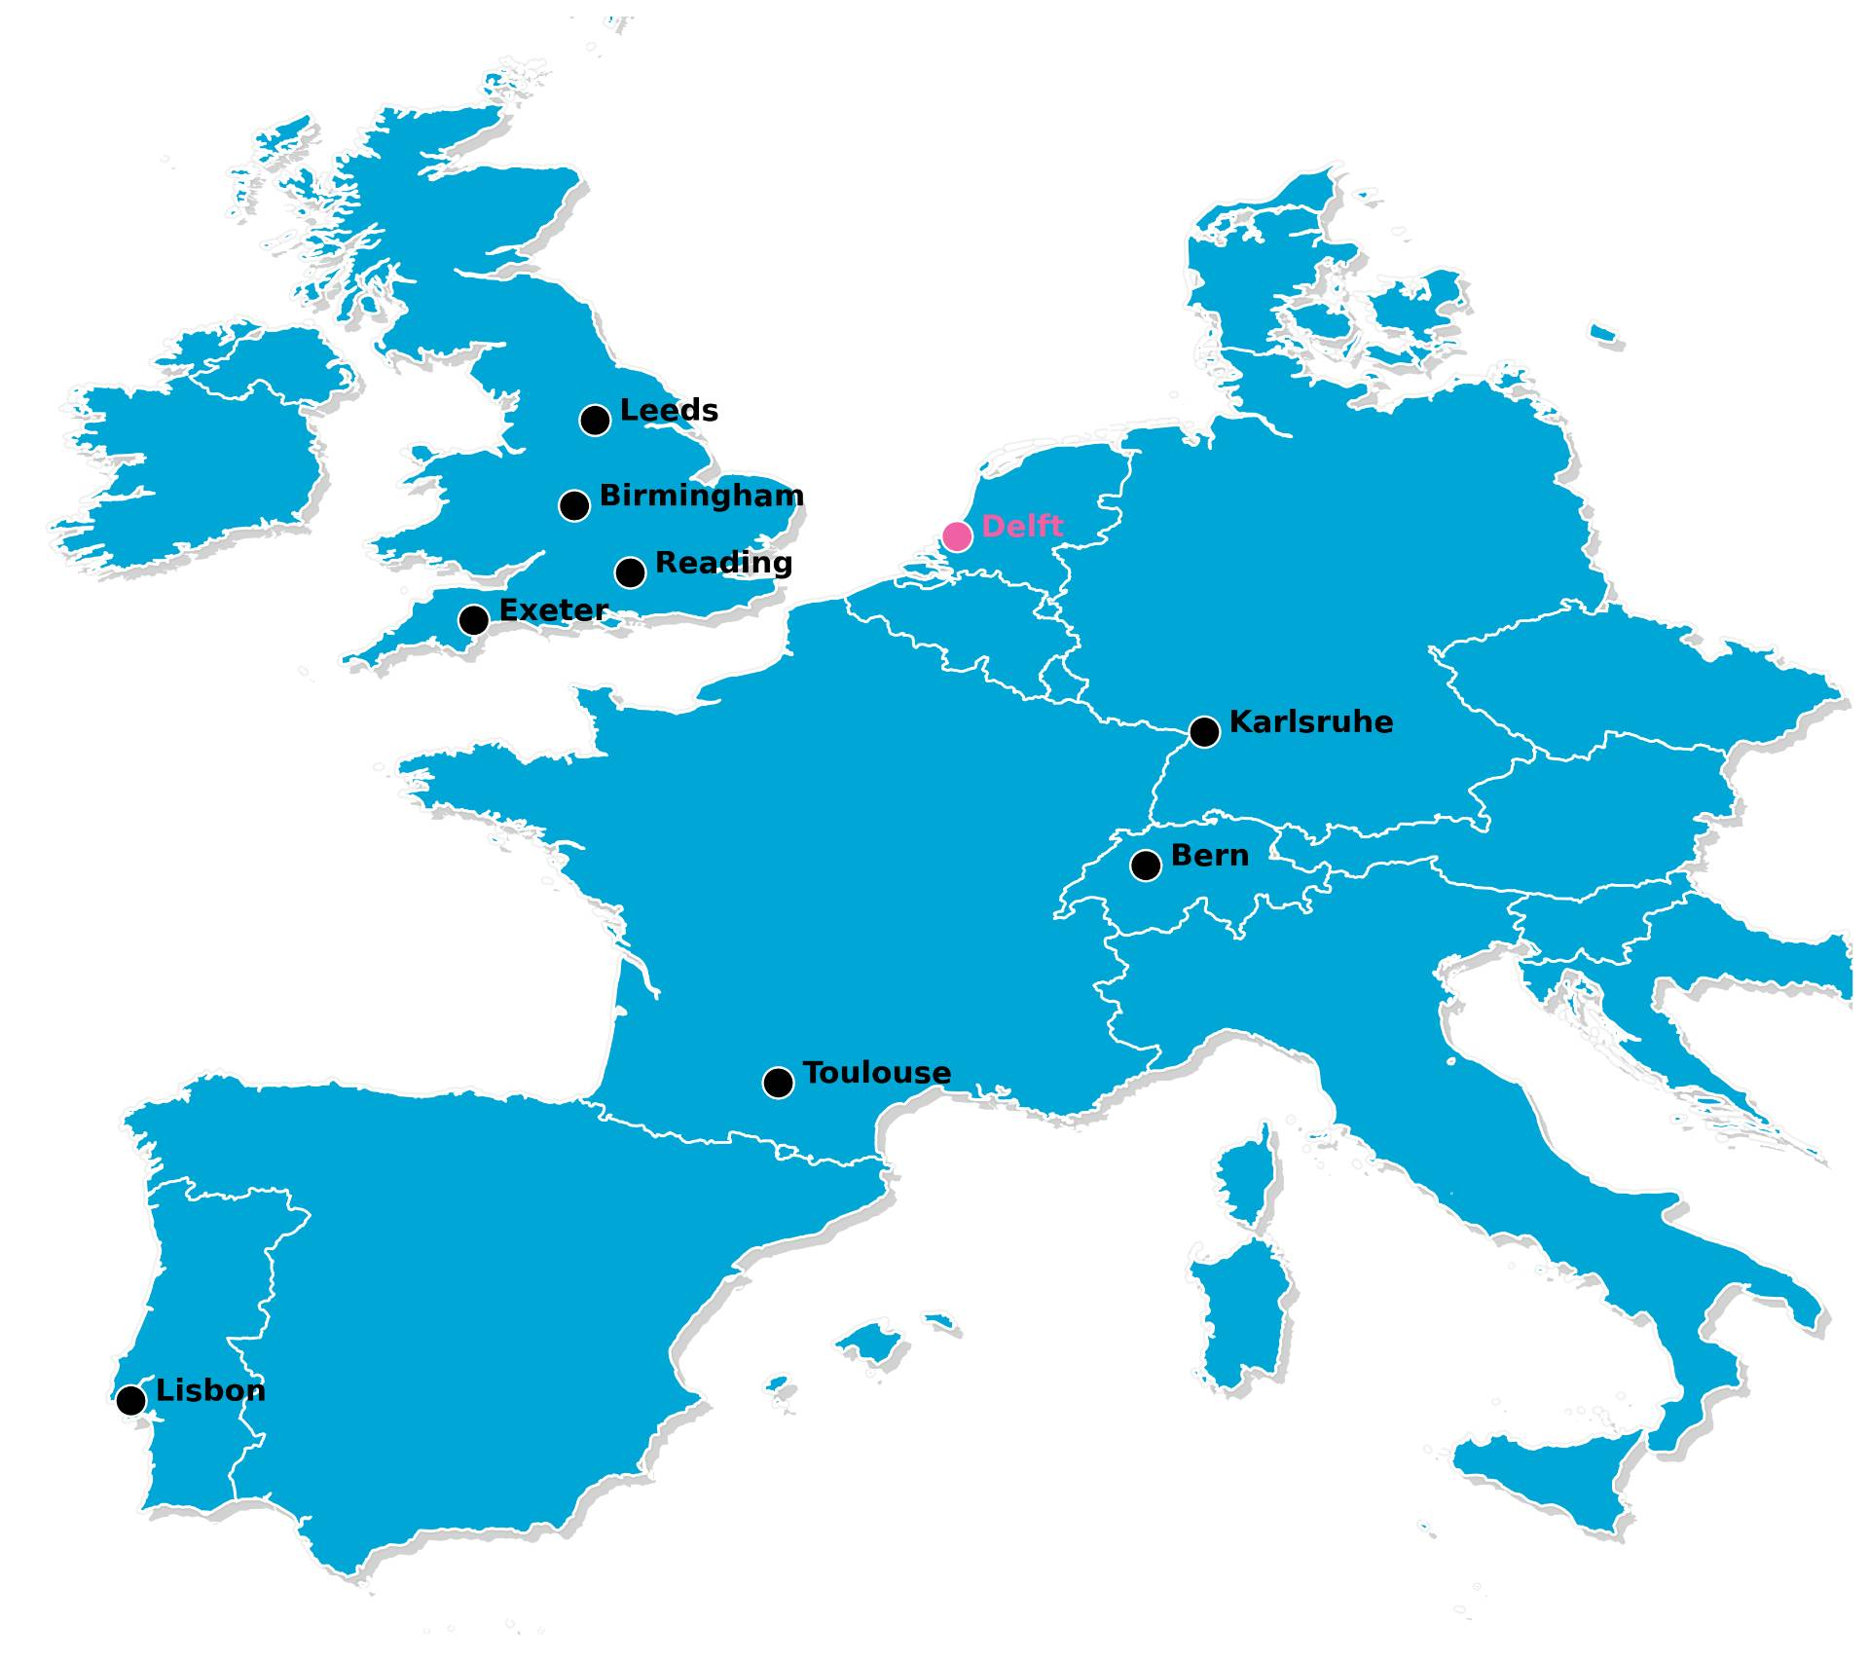
The 11th European Storm Workshop
2011
2012
2013
2014
2015
2017
2018
2019
2023
2025
Exeter, UK
Leeds, UK
Exeter/Met Office, UK
Lisbon, PT
Bern, CH
Reading, UK
Karlsruhe, DE
Birmingham, UK
Toulouse, FR
Bern, CH
Notes:
Who has attended 10 or more of the workshops?

Slide 14
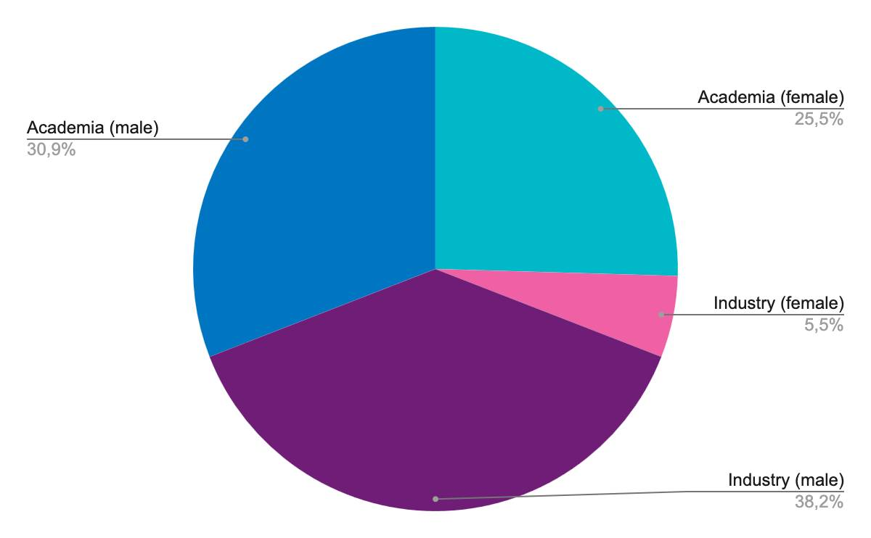
The 11th European Storm Workshop
We have 54 participants:
  31 from academia
  24 from the industry
  18 female
  38 male
We have 34 contributions:
  25 oral presentations
  9 poster presentations

Slide 15
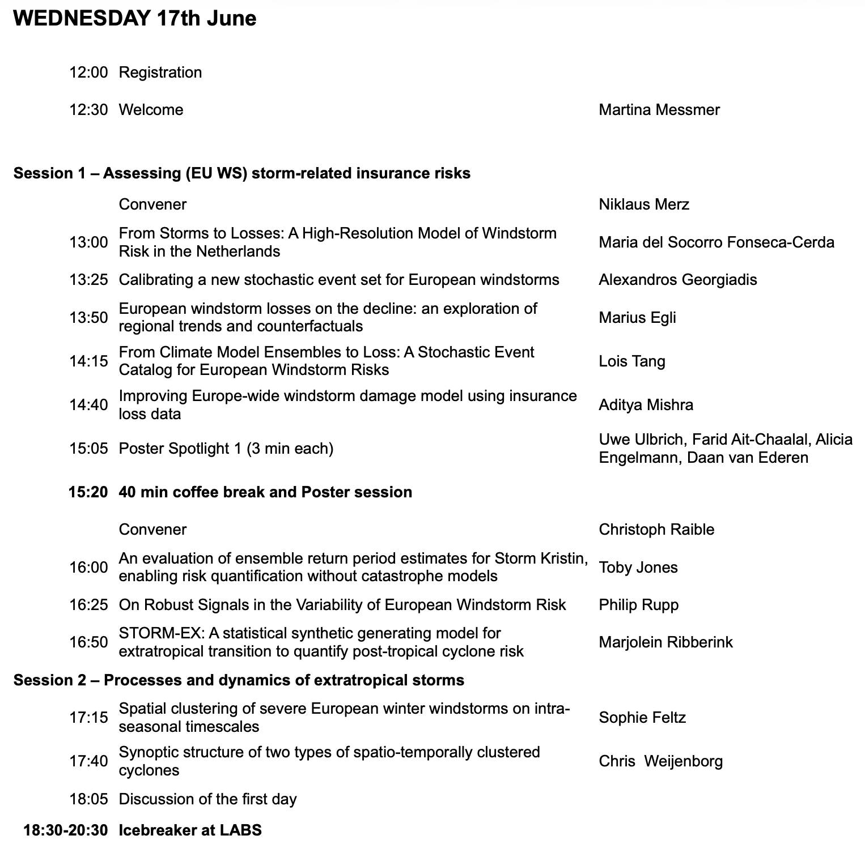
Programme

Slide 16
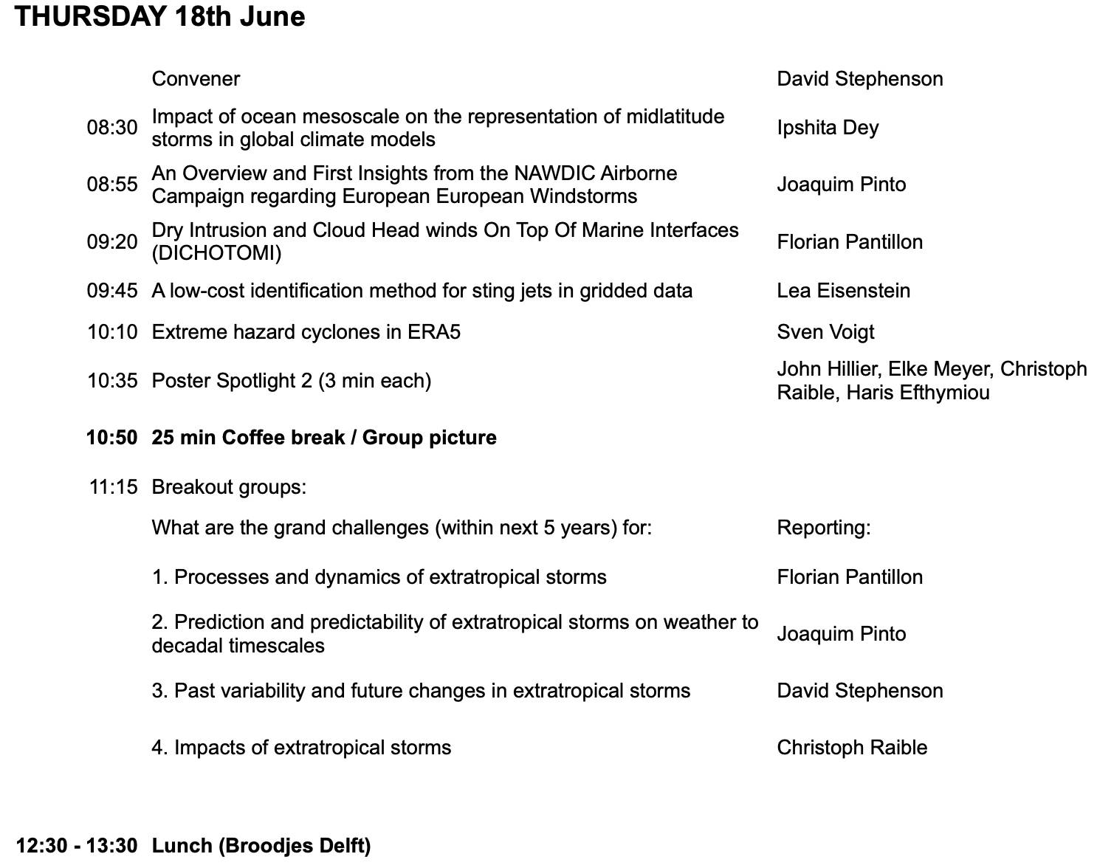
Programme

Slide 17
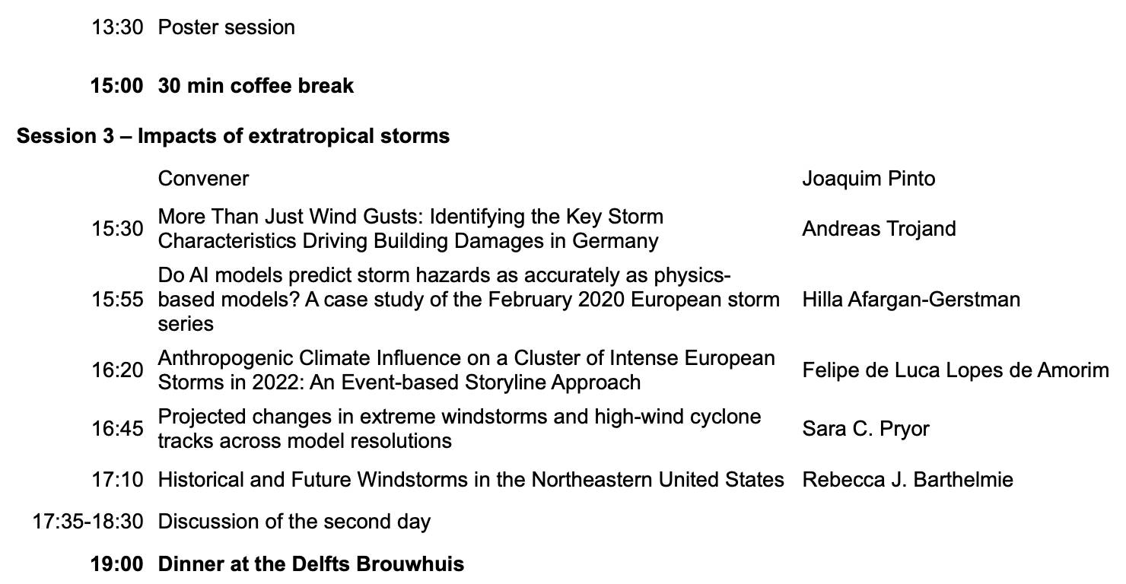
Programme

Slide 18
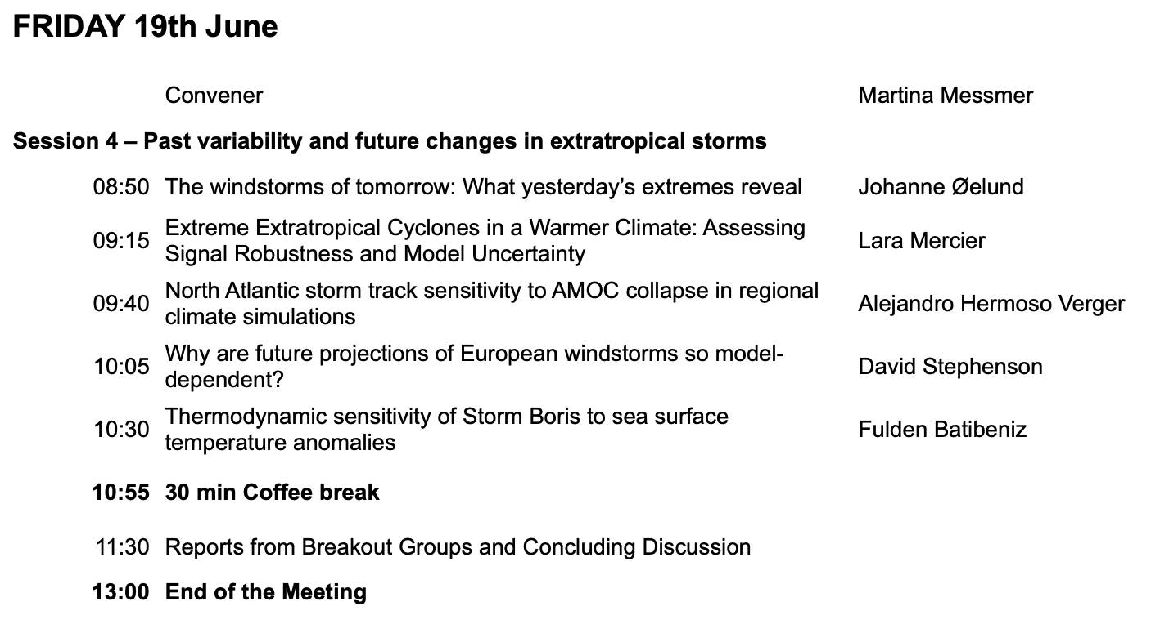
Programme

Slide 19
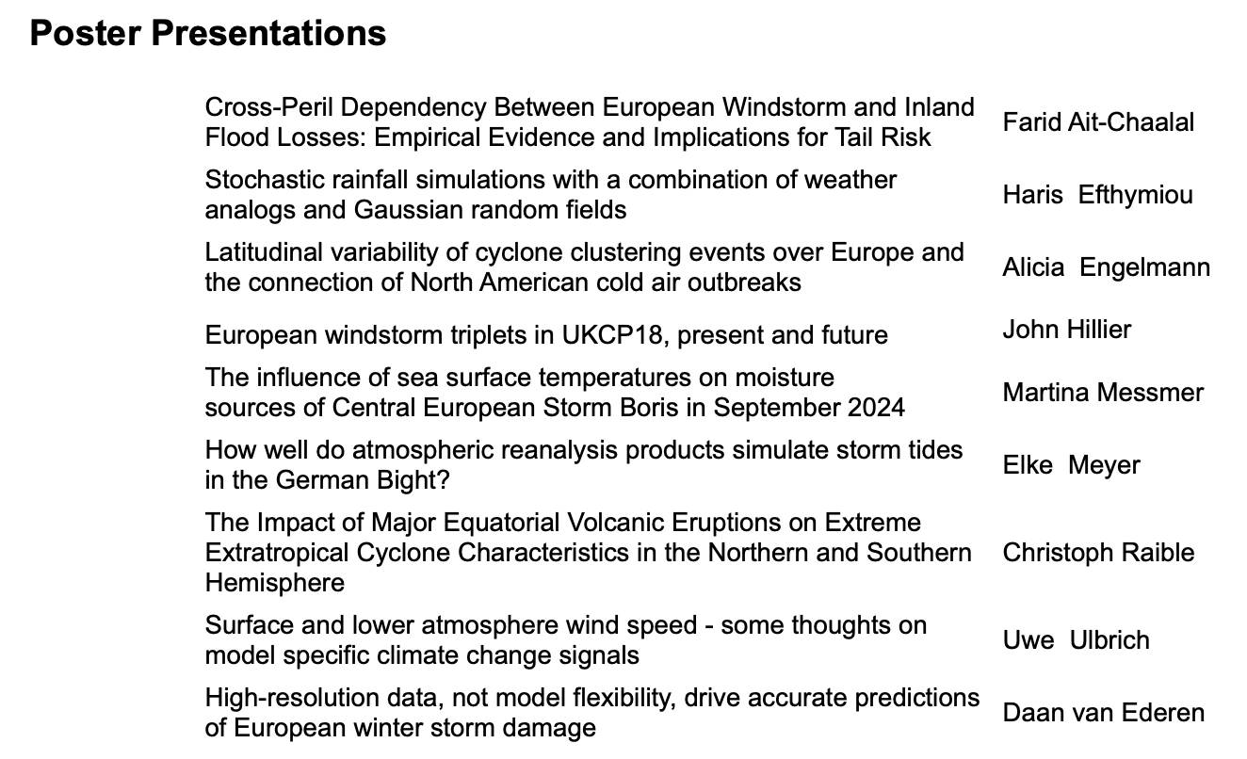
Poster Spotlights
Wednesday: 15:05
Thursday: 10:35

Slide 20

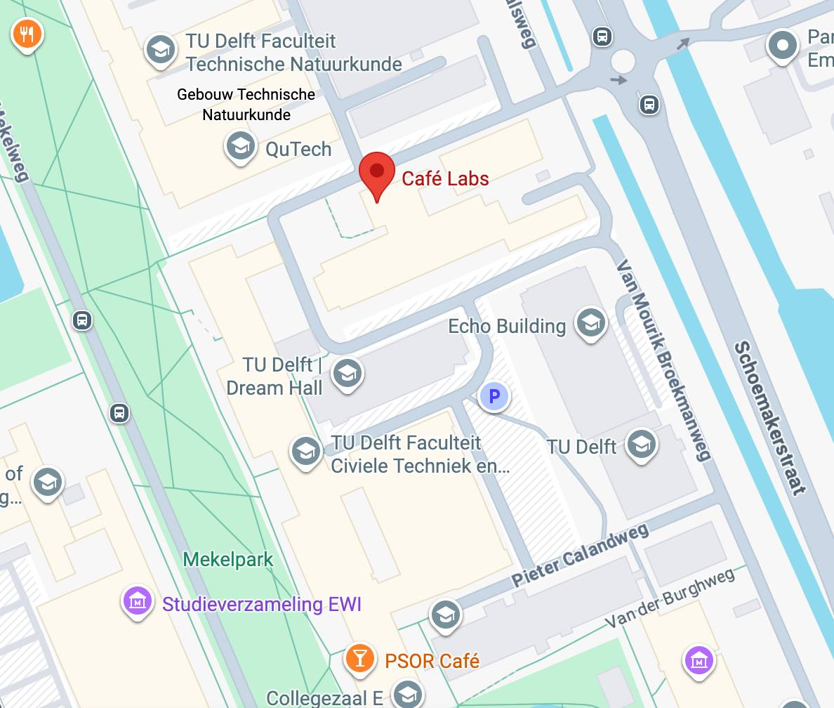
Reception, Wednesday 17th June (18:30–20:30)
Notes:
Beer, wine and sodas
Nuts, dips and bites

Slide 21

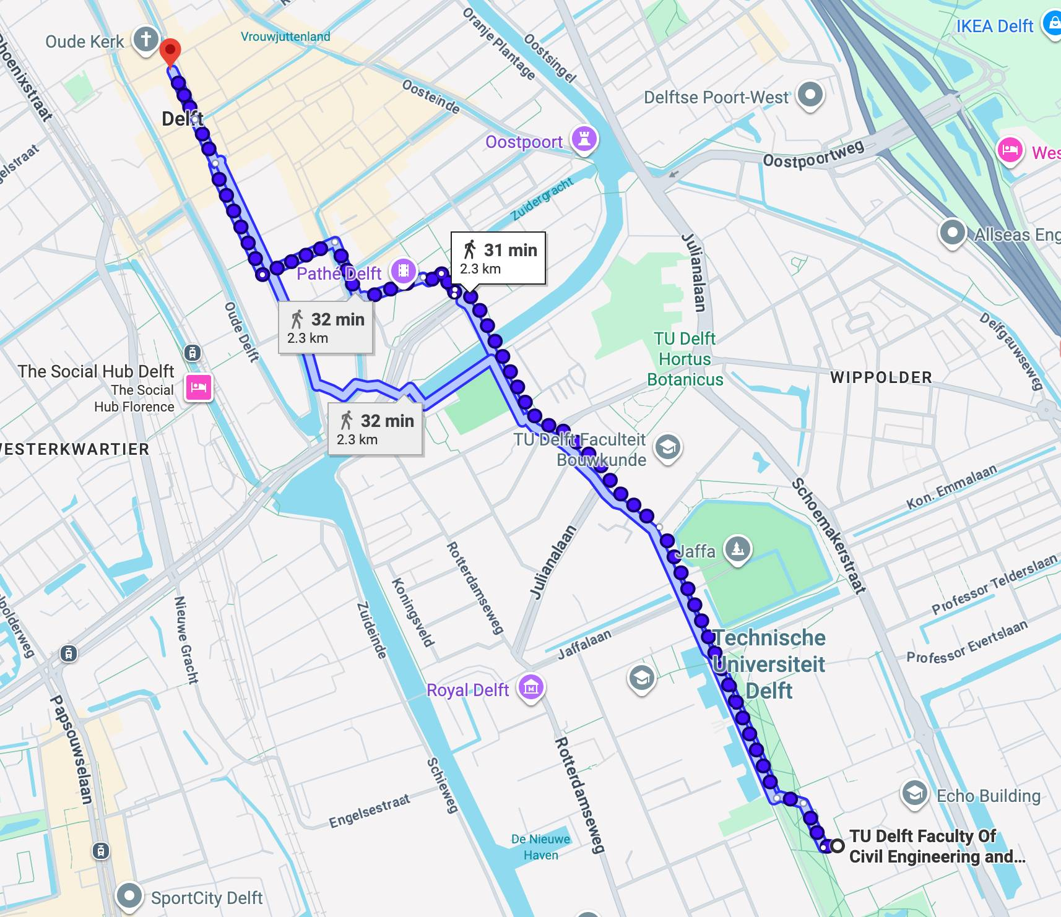
Conference Dinner, Thursday 18th June (19:00)
Delfts Brouwhuis, Hippolytusbuurt 43, 2611 HM Delft

Slide 22
Coffee Breaks and Posters
Coffee breaks and lunch will be served in Room 0.96
If you want, you can take the coffee and lunch outside
The posters will be displayed in between Room 0.96 and Lecture Hall E
Thursday at around 11 am we will take a group picture

Slide 23
Chapter | dark mode
03
Housekeeping

Slide 24
Housekeeping
WiFi-access:
  For academics, eduroam should work
  For the industry there is a daily code for the login to eduroam
Restrooms are located just outside Lecture Hall E (on both floors)
Assembly point is at the main entrance
If you want to use social media, please use #EuropeanStorms
We encourage questions during the Q&A and not during the presentation itself. Please use the microphone (catch box) to ask your question.
If you need assistance at any point, please approach me
Presentation will be made available on the homepage after the conference
As this is exam week, please be mindful of noise levels when walking through the building

Slide 25
Afsluiter
We look forward to insightful presentations and stimulating discussions!
Notes:
With no further ado, I would like to give the floor to our presenters. And I hand over to Niklaus.

