Slide 1

Impact of ocean mesoscale on the representation of midlatitude storms in global climate models
Ipshita Dey, Pier Luigi Vidale, Kevin Hodges, and Malcolm Roberts
18 June 2026
11th Workshop on European Storms

Slide 2
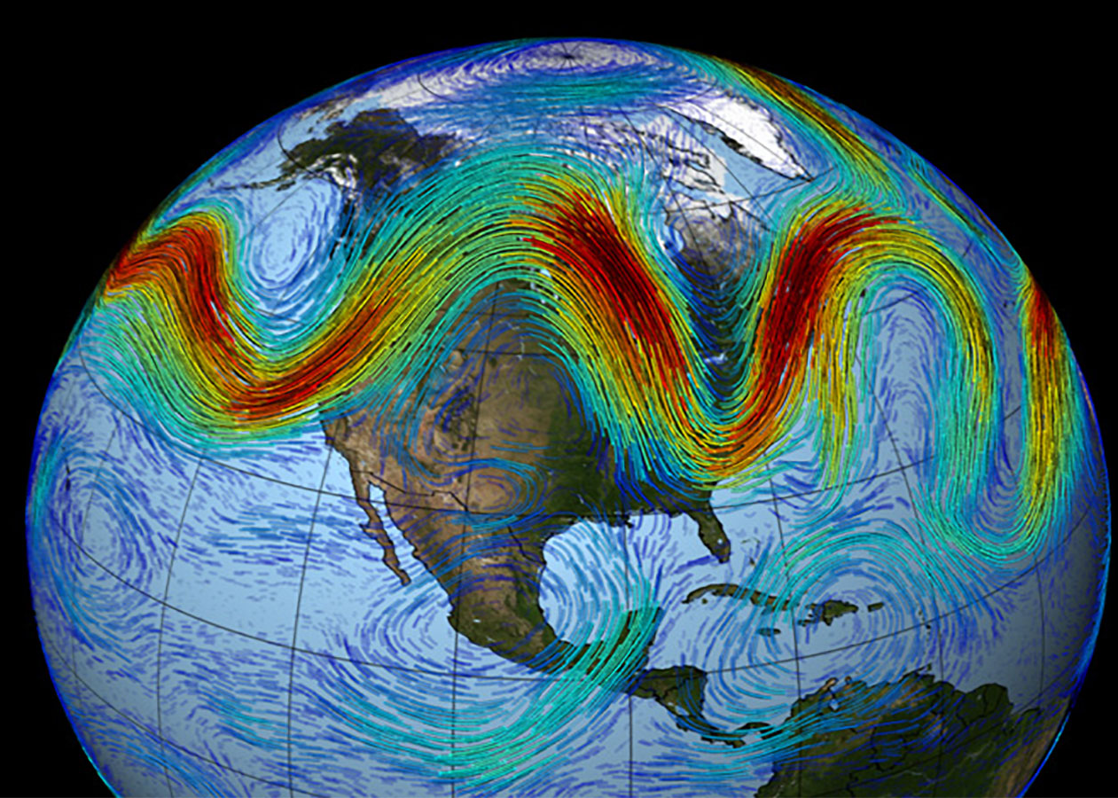
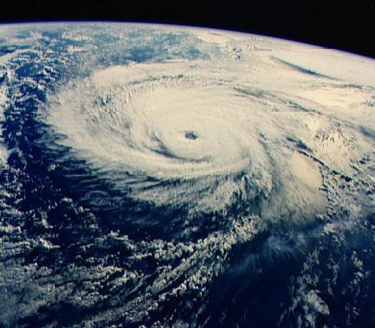
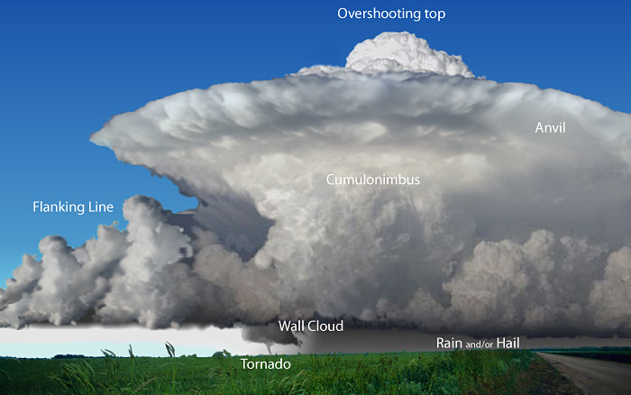
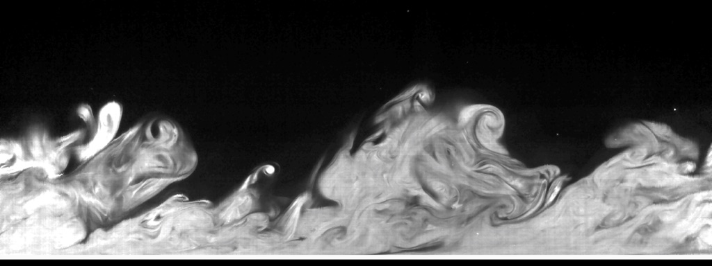
Extratropical Cyclones (ETCs) are important drivers of midlatitude weather and extremes
Global Climate models
1 month
Accurate representation of ETCs in global climate models (GCMs) is crucial for current and future risk assessments. Current GCMs are plagued by:
Underestimation of ETC frequencies or storm track densities
Underestimation of ETC intensities or wind speeds
Storm tracks too zonal and equatorward
1 day
Time scales
1 hour
1 min
1 s
Micro
scale
Turbulent scale
Convective scale
Synoptic scale
1 cm
1 m
1 km
1000 km
Spatial scales
Notes:
Some of the errors are due to (a) insufficient resolutions (b) missing physics and maybe linked to other model biases

Slide 3
Extratropical Cyclones (ETCs) are important drivers of midlatitude weather and extremes
Global Climate models
            Impact of increasing model resolutions
            Reduction in North Atlantic, Arctic, and equatorial Pacific temperature biases, decrease in southern ocean warm biases [1]
            Improvements in Gulf Stream separation [1-3]
            Increase in precipitation extremes [2]
            Improvements blocking and for the realism of the jet’s trimodality [4-5]
1 month
1 day
Time scales
1 hour
1 min
1 s
Micro
scale
Turbulent scale
Convective scale
Synoptic scale
1. Roberts, C. D., et al., 2018b.​
2. Moreno-Chamarro, E., et al., 2021.​
3. Gutjahr, O., et al., 2019.
4. Athanasiadis et al. 2022;
5. Schiemann et al. 2020
1 cm
1 m
1 km
1000 km
Spatial scales
Notes:
Some of the errors are due to (a) insufficient resolutions (b) missing physics and maybe linked to other model biases

Slide 4
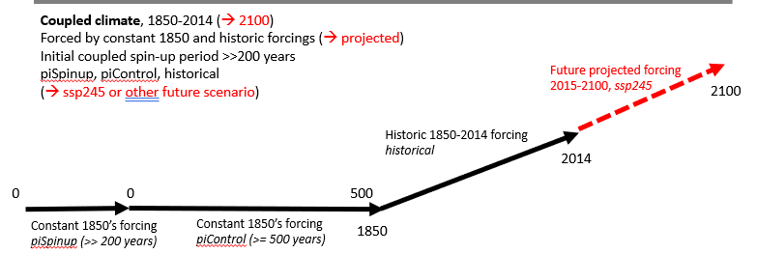
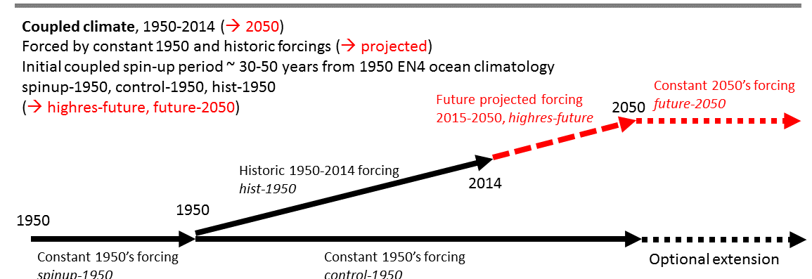
Existing simulation protocols
Within Coupled Model Intercomparison Project (CMIP)
  Standard DECK (e.g. piSpinup, piControl, historical, future scenarios 2014-2100) – coupled
  HighResMIP (e.g. spinup-1950, control-1950, historical, future scenarios 2023-2100) ^{[1,2]}
  AMIP atmosphere-only
CMIP6 DECK
CMIP6 HighResMIP
Haarsma et al., 2016
Roberts et al., 2025
Notes:
CMIP
DECK etc – many years of simulation required (>1000 years), also testing/tuning etc
Makes it pretty unaffordable for high resolution models (which maybe run at a speed of 1-a few simulated years per day, so a long time to run too)
piControl is useful to look at “unforced” variability, but less useful if interested in present-day/future weather/extremes
AMIP – uses monthly mean sea surface temperatures and sea-ice, not so conducive if interested in extremes
Short spinup
models will still be drifting, making it difficult to disentangle forced changes from model drift, though the control-1950 simulation slightly helps
spinup
spinup in 1950 means net TOA (top of atmosphere radiation balance) is non-zero, so the longer the spinup, the more warming goes in the ocean
forcing
In CMIP6 HighResMIP, we chose to have idealised aerosol forcing (to make models more comparable), but we have later found this had quite some impact on the mean state
shorter simulations
hence more difficult to look at (multi-)decadal variability

Slide 5
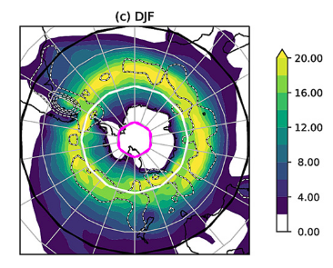
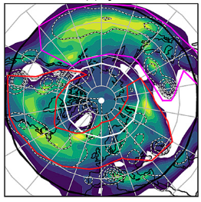
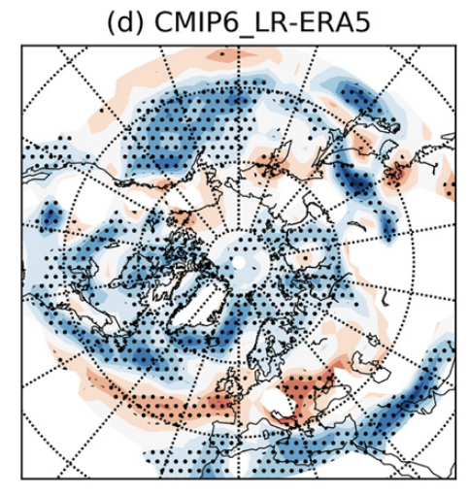
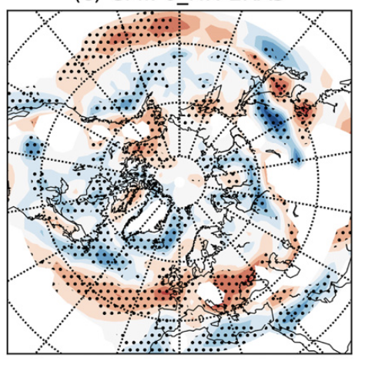

Storm track density climatology (1980-2014): CMIP6
ERA-5
CMIP6_LR - ERA
CMIP6_HR - ERA
Preistley et al. 2020
Track densities, defined as the number of individual cyclone tracks in 6ºx6º spherical cap, in North Hemisphere (DJF) using 850 hPa vorticity

Slide 6
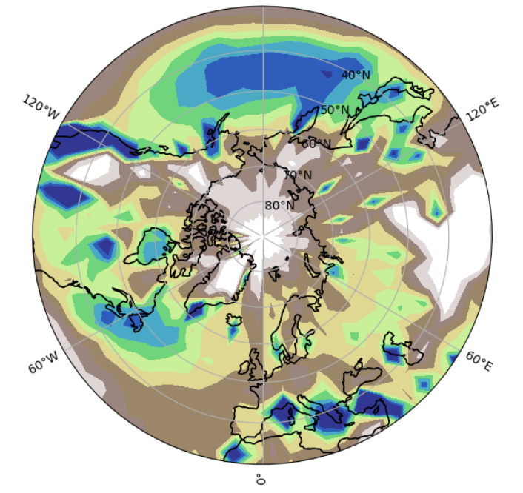
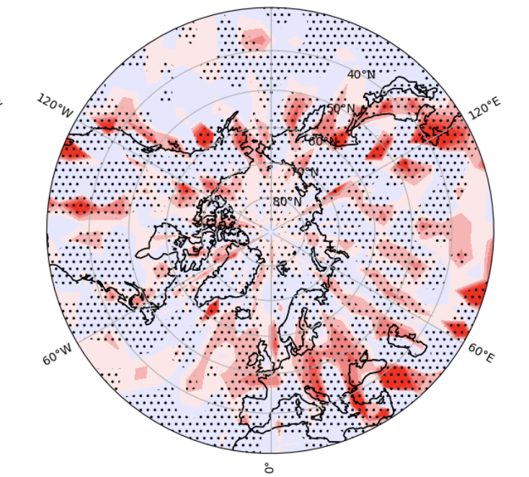
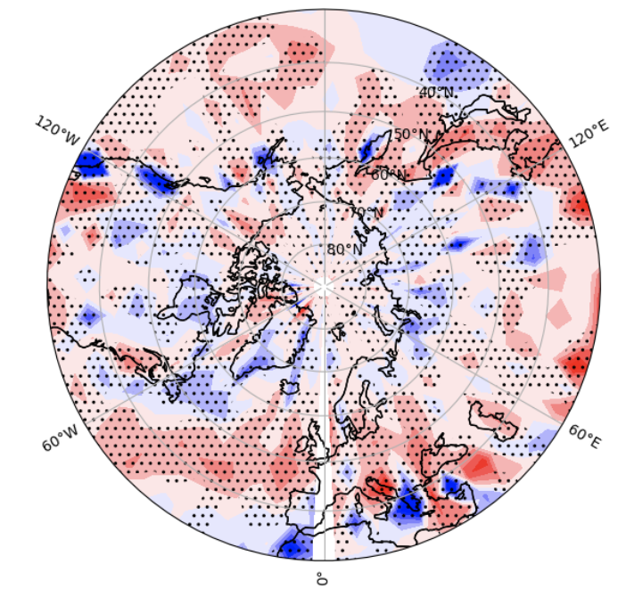
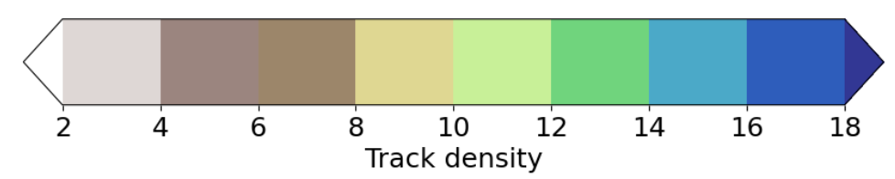
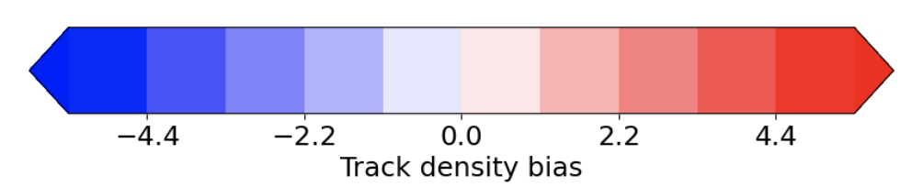
Storm track density climatology (1980-2014): HighResMIP
ERA-5
HighResMIP-LR
HighResMIP-HR
Track densities, defined as the number of individual cyclone tracks in 6ºx6º spherical cap, in North Hemisphere (DJF) using 850 hPa vorticity

Slide 7
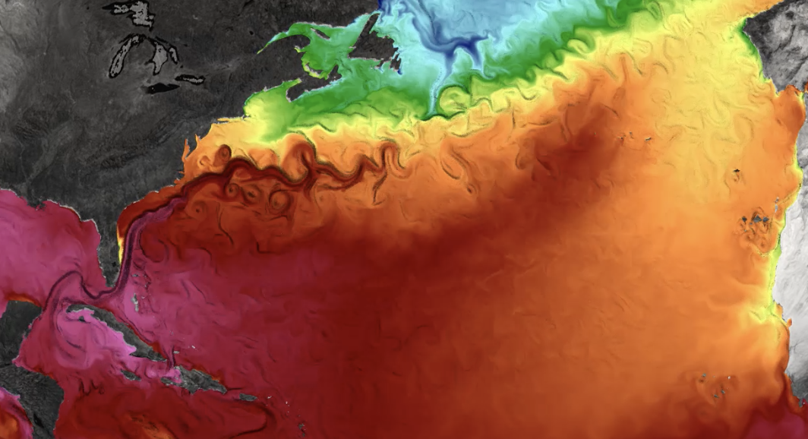
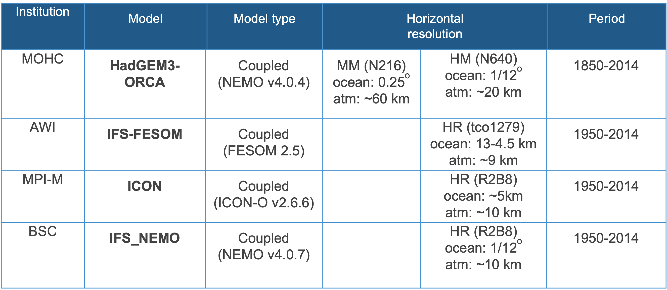
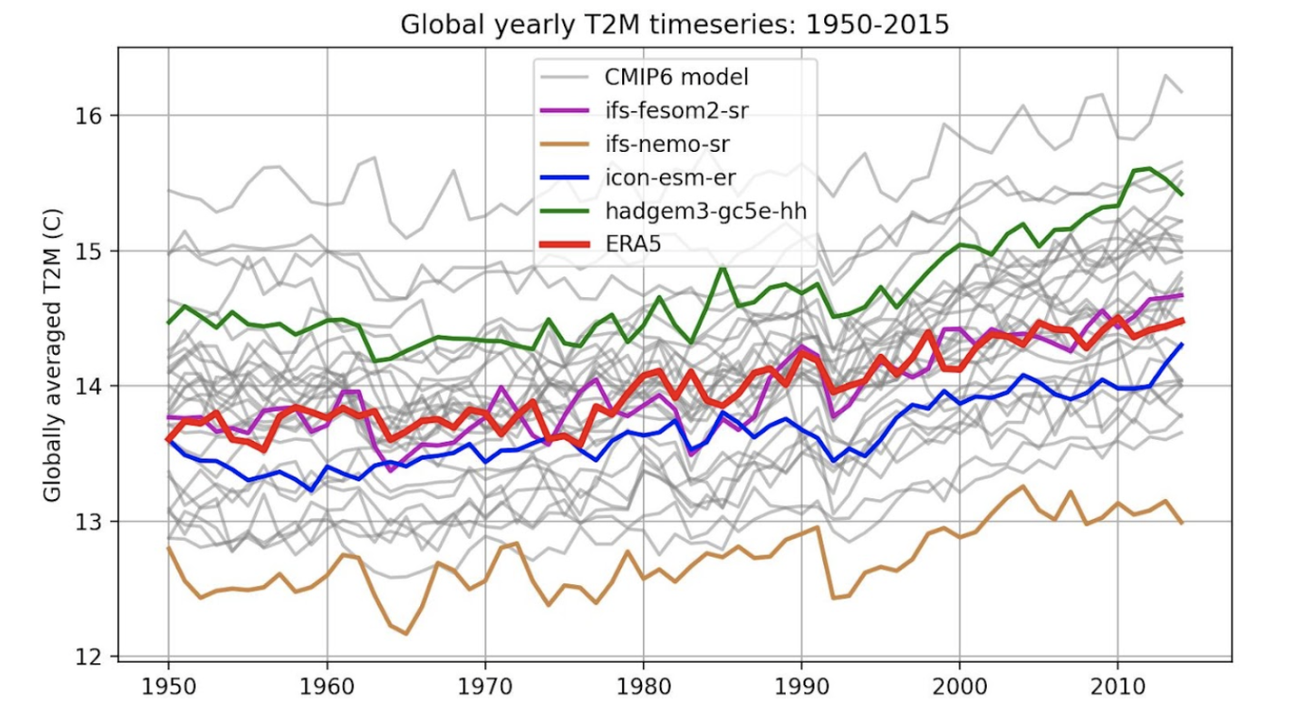
European Eddy-Rich Earth System Models (EERIE)
A new generation of coupled GCMs using HIGHRESMIP protocol (except HadGEM3)
Explicitly resolves ocean mesoscale features such as fronts, eddies, and other meandering filaments are predominantly found near the WBC
Strong SST gradients contribute to an increased, low-level baroclinicity, anchoring the ETC tracks to these regions
Ocean resolutions ~ 1/12º , atmospheric resolutions ~ 10 km

Slide 8
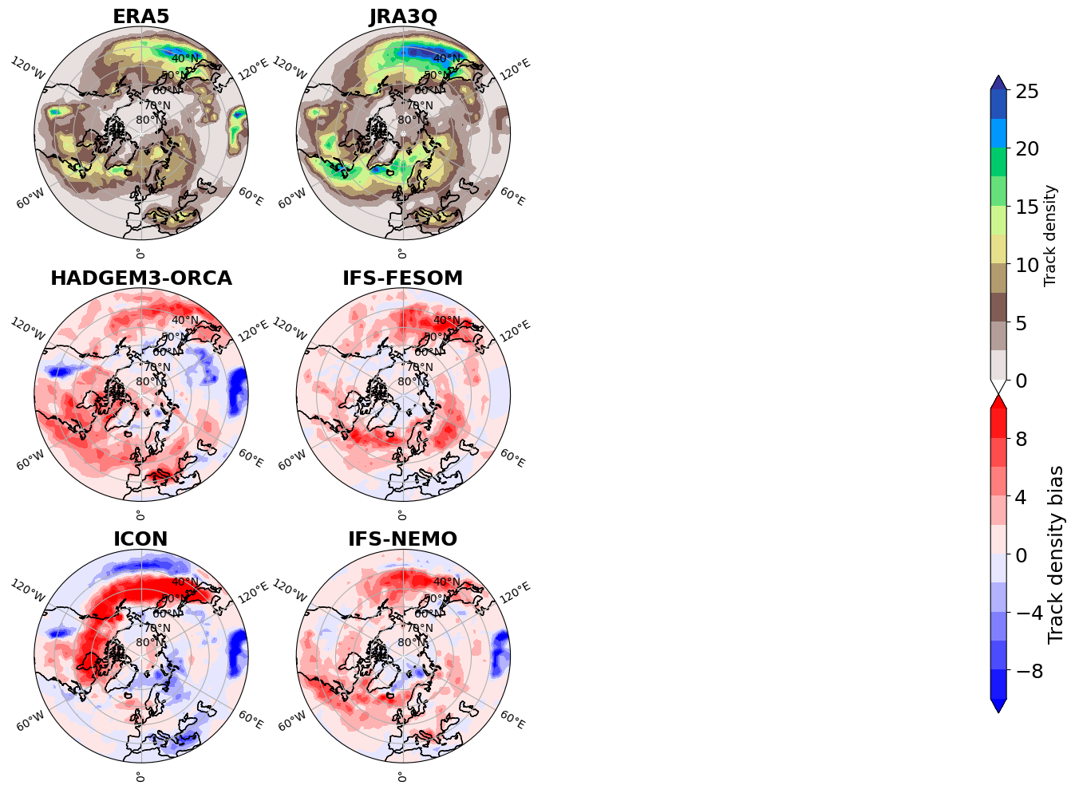
Storm track density climatology (1980-2014): EERIE
ETCs tracked using feature-tracking algorithm of Ullrich et al. 2021 (TempestExtremes)
Candidate cyclonic storms are identified using sea-level pressure minima, which must be enclosed by a closed contour of 200 Pa within 6.0º of cyclone center.

Slide 9
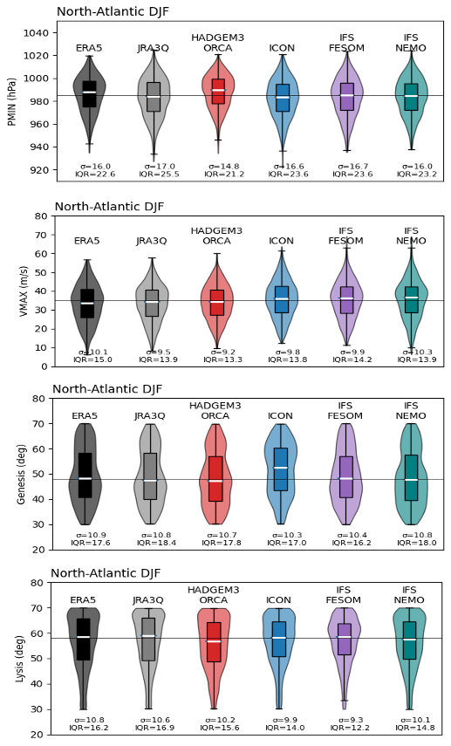
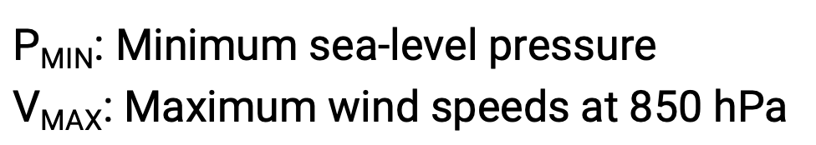
Mean characteristics of simulated ETCs in North Atlantic
P_{MIN}
All models perform reasonably well in representing the mean ETC intensities, except HadGEM3 which simulates weaker storms and could be due to lower resolutions.
V_{MAX}

Slide 10
Mean characteristics of simulated ETCs in North Atlantic
Genesis latitude
All models perform reasonably well in representing the mean ETC locations, except ICON which simulates more poleward genesis.
Lysis latitude

Slide 11
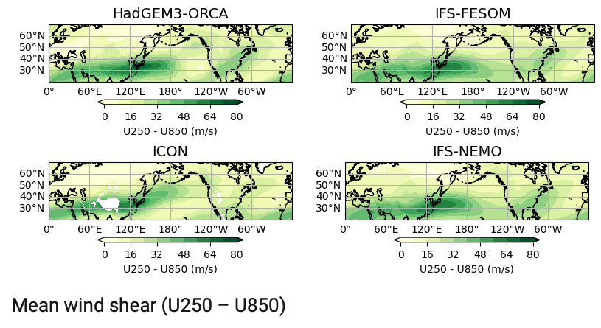
Mean climatology of vertical wind shear (1980-2014)

Slide 12
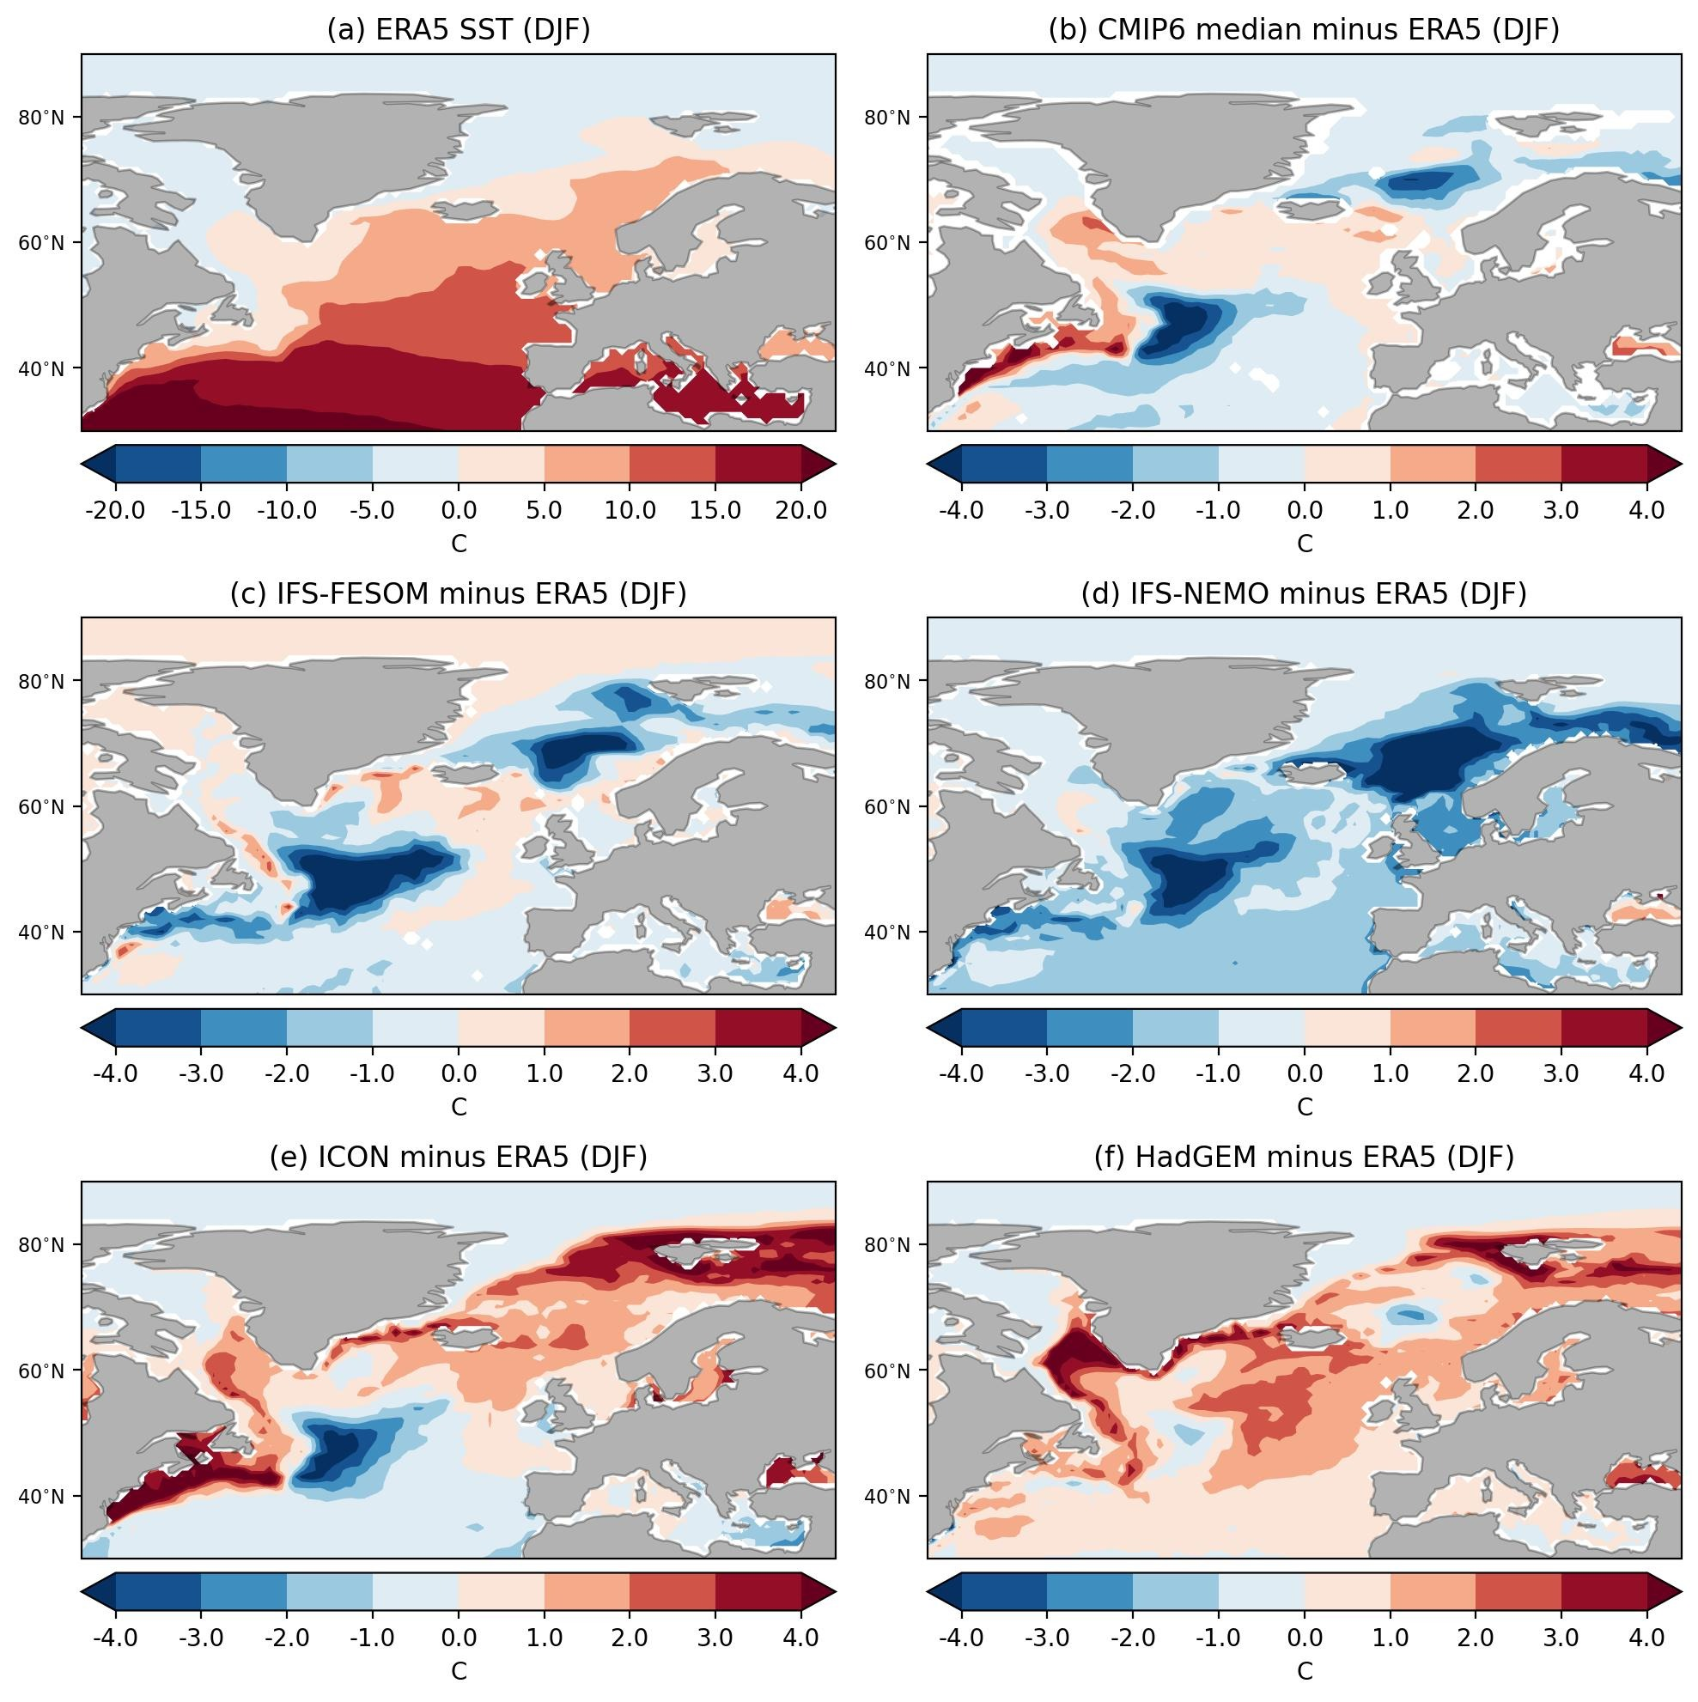
Large-scale biases can contribute to the track density biases
The North Atlantic SST bias is characterized by:
Gulf stream separation bias, which is strongly related to horizontal resolution [1,2]
“cold blob” bias in the central North Atlantic related related to biases in bathymetry [3].
Tsartsali et al. 2022
Zhang et al. 2023
Chassignet and Marshall 2008
Notes:
North Atlantic biases characteristic of a poorly resolved Gulf Stream (Tsartsali et al. 2022; Zhang et al. 2023). The latter Gulf Stream bias can be viewed as a combination of two separate issues: an SST gradient bias near the coast of North America related to the failure of the simulated Gulf Stream to separate from the continent properly, and a ``cold blob’’ bias in the central North Atlantic related to the failure of the model’s Gulf Stream simulating the ``northwest corner’’, whereby the Gulf Stream turns north due to bottom topography after leaving the continent. The first of these issues (the ``separation bias’’) is likely strongly related to horizontal model resolution, while the second issue (the ``northwest corner bias’’) is very likely related to biases in bathymetry (Chassignet and Marshall 2008).

Slide 13
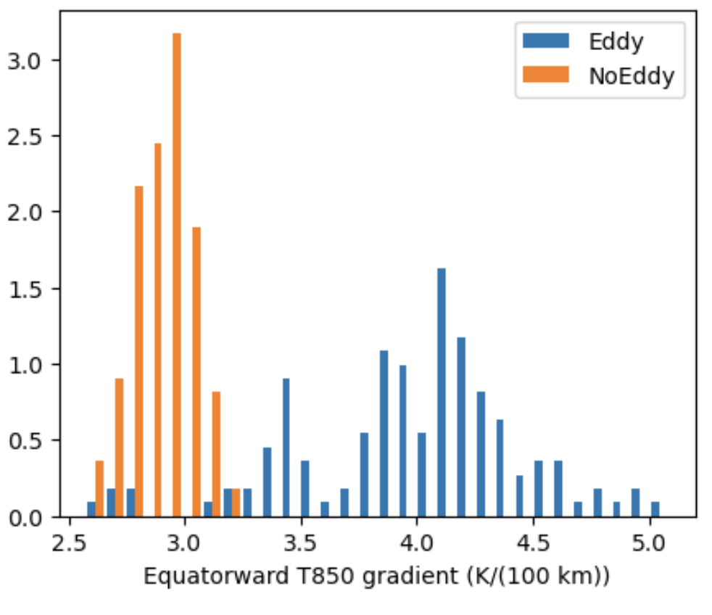
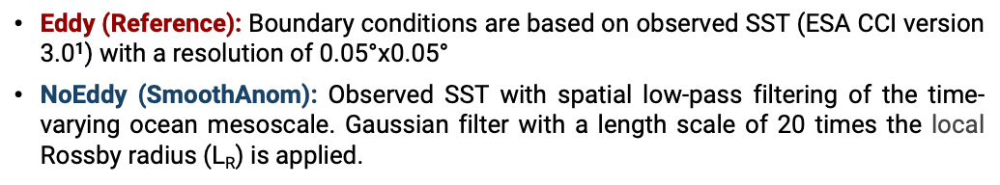
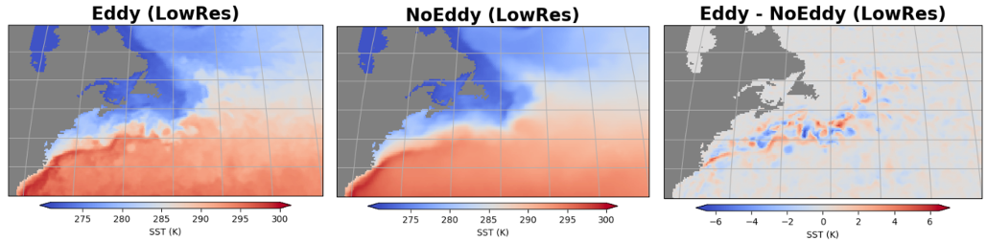
Idealized experiments (atm-only) to isolate impact of mesoscale eddies

Slide 14
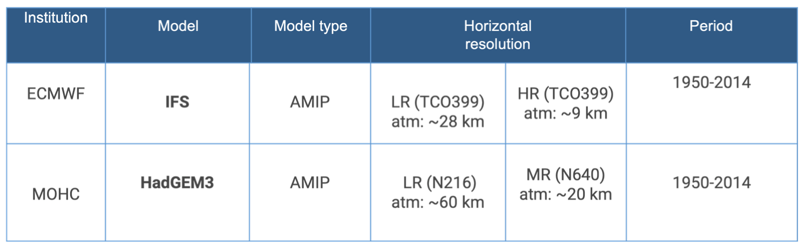
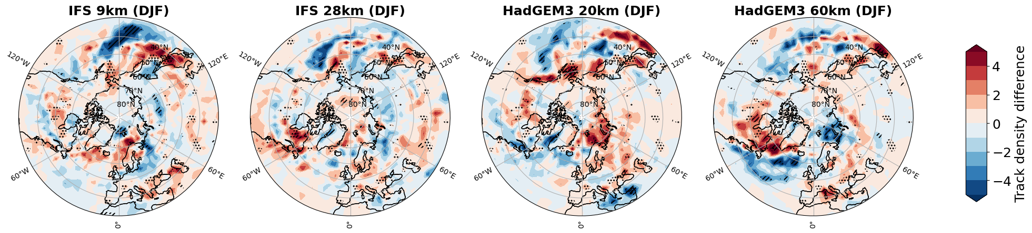
Idealized experiments (atm-only) to isolate impact of mesoscale eddies
Impact of ocean eddies ➔ Eddy - NoEddy

Slide 15
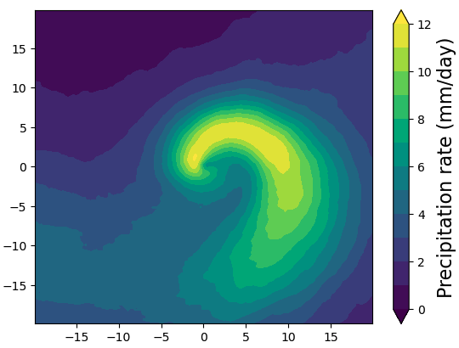
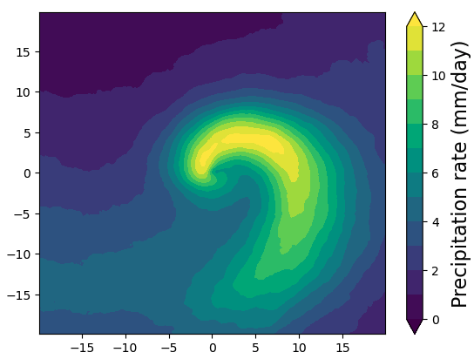
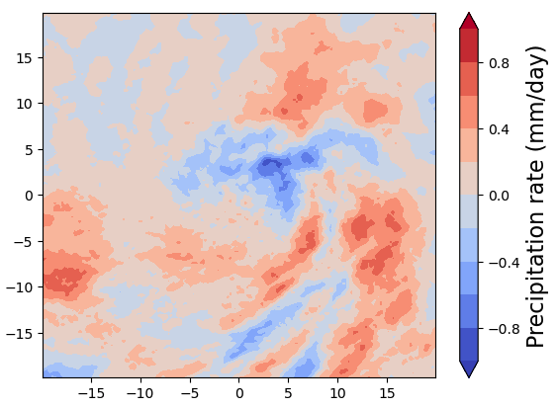
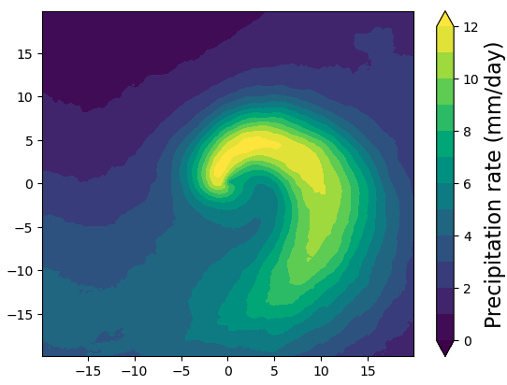
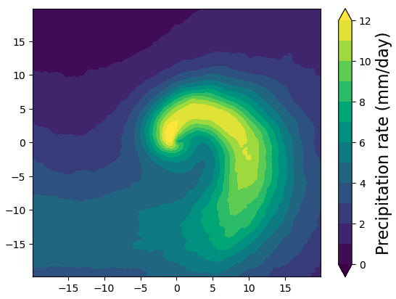
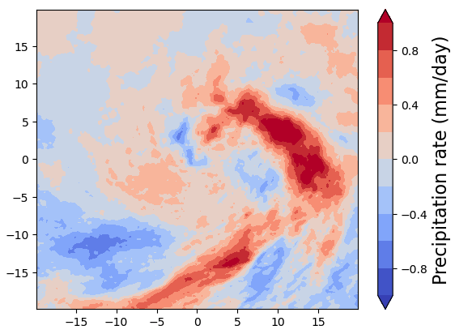
Idealized experiments: Cyclone-centered precipitation composites (1980-2014)
IFS-LR, Eddy
IFS-LR, NoEddy
IFS-LR, Eddy - NoEddy
IFS-HR, Eddy
IFS-HR, NoEddy
IFS-HR, Eddy - NoEddy

Slide 16
Summary
New generation of eddy-resolving GCMs (EERIE) offer improvements in ETC frequencies, position and intensities:
Higher resolutions improve some of the large-scale biases related to Gulf stream separation, as well as the negative biases in storm track densities.
Ocean mesoscale have significant imprints on the local scale by enhancing the air-sea fluxes and precipitation, however the large-scale model SST biases overwhelm the small-scale SST features.
The direct impact of ocean mesoscale on ETC / storm track densities is very modest compared to its interannual variability, however it improves the mean ocean biases, which leads to improved ETC representation.

Slide 17
https://eerie-project.eu/
Questions?
Contact: i.dey@reading.ac.uk

Slide 18
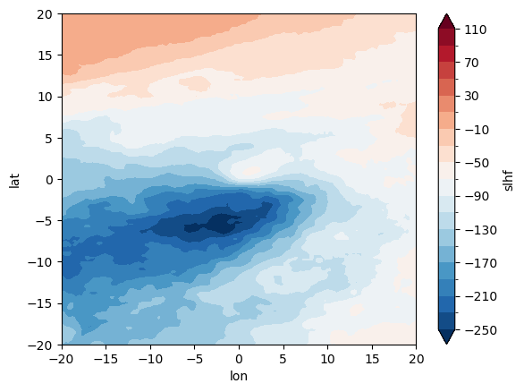
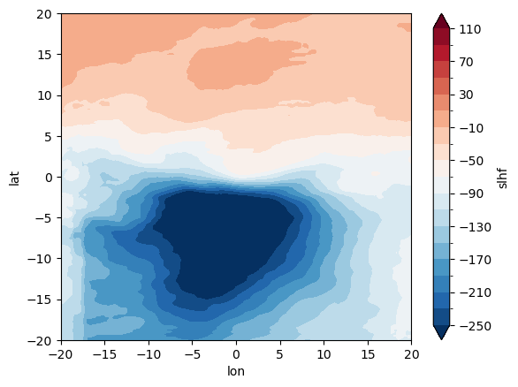
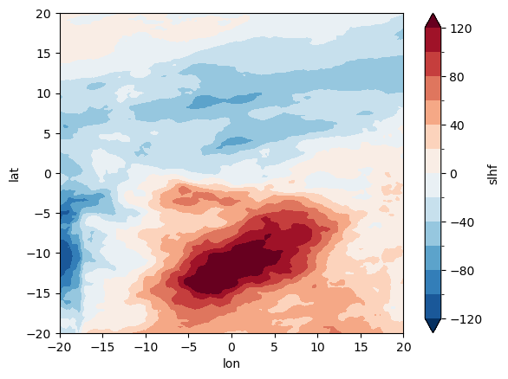
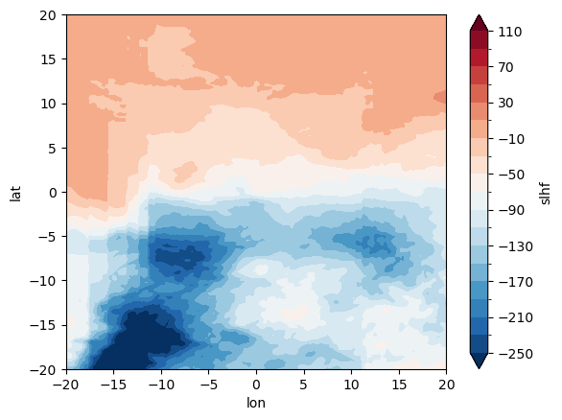
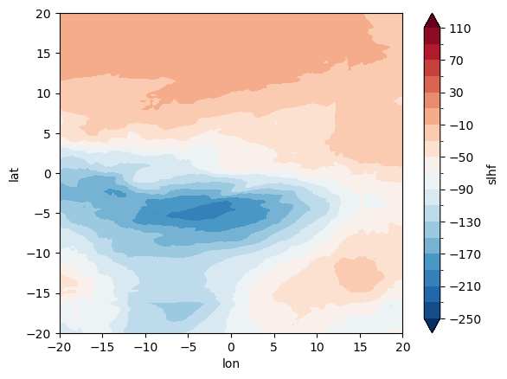
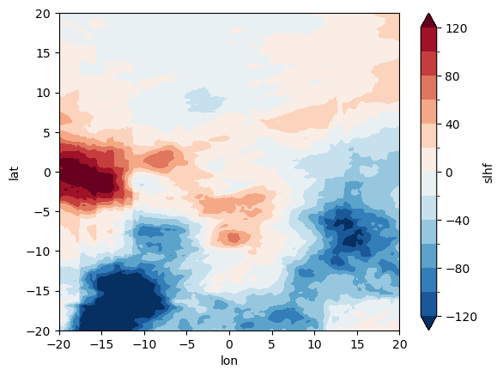
ETC latent heat fluxes composites (DJF, 2023): Storms with mslp < 960 hPa (no warm cores)
IFS-LR, Reference
IFS-LR, SmoothAnom
IFS-LR, Ref - SmoothAnom
IFS-HR, Reference
IFS-HR. SmoothAnom
IFS-HR, Ref - SmoothAnom

Slide 19
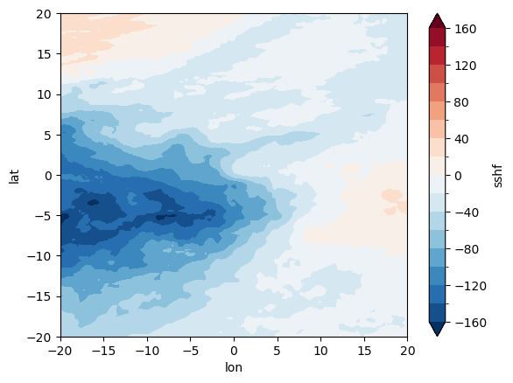
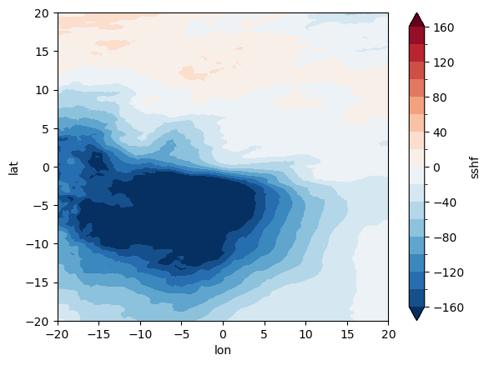
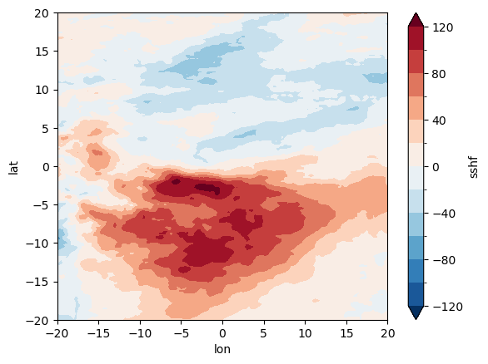
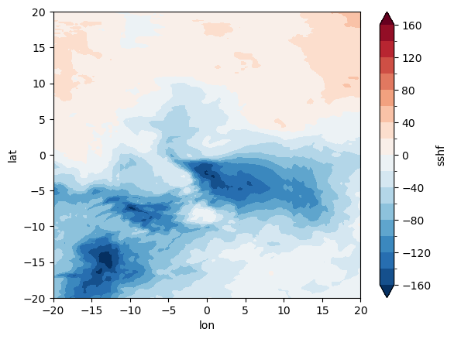
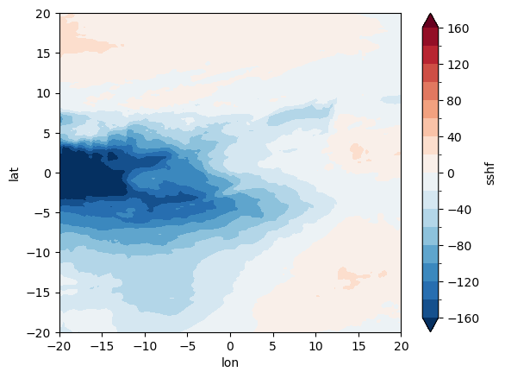
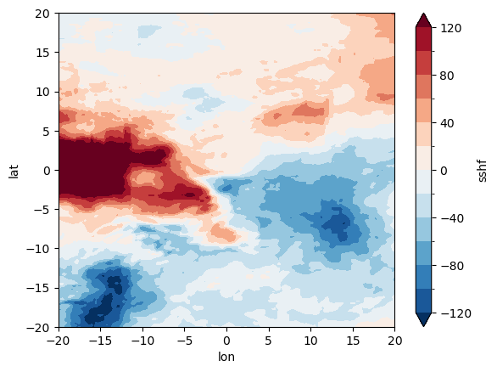
ETC sensible heat fluxes composites (DJF, 2023): Storms with mslp < 960 hPa (no warm cores)
IFS-LR, Reference
IFS-LR, SmoothAnom
IFS-LR, Ref - SmoothAnom
IFS-HR, Reference
IFS-HR. SmoothAnom
IFS-HR, Ref - SmoothAnom

