Slide 1
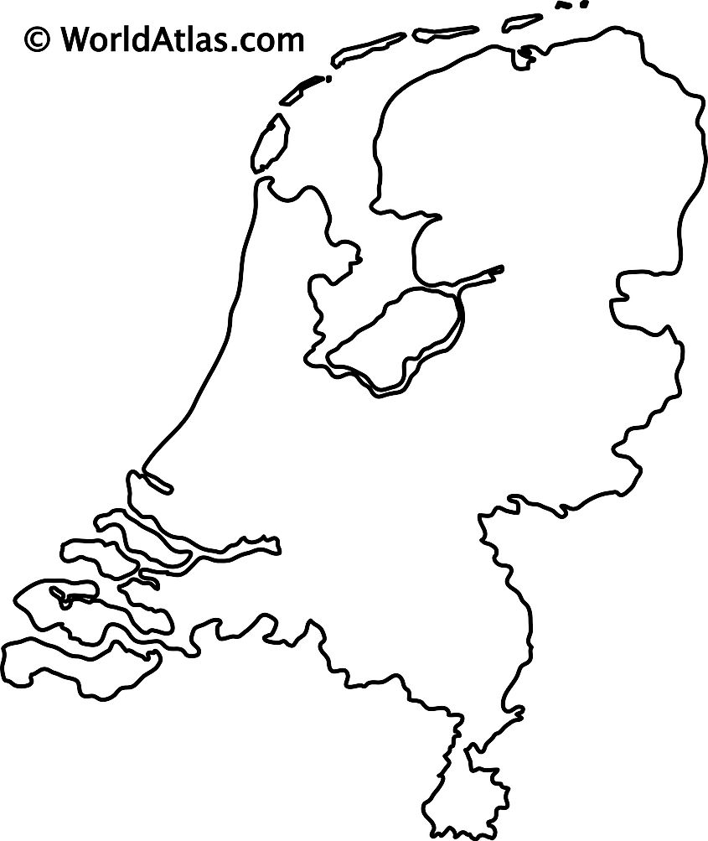




From Storms to Losses: A High-Resolution Model of Windstorm Risk in the Netherlands
Maria Fonseca-Cerda, H. de Moel, J.C.J.H. Aerts, W.J.W. Botzen, T. Haer
11th Workshop on European Storms, June 17th, Delft
m.d.s.fonseca.cerda@vu.nl

Slide 2
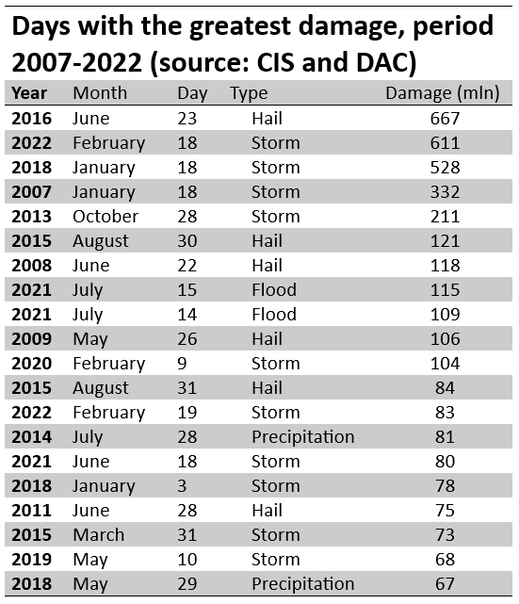


10 out of the 20 most damaging events in the Netherlands are associated with Windstorms
Klimaatschademonitor, VvV (2023)
m.d.s.fonseca.cerda@vu.nl

Slide 3


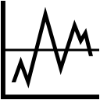
If we compare historical records at a proper resolution of both, the characteristics of storms and the damage they have caused, we can get valuable prediction power.
Hazard
Damage
Expected damage
1980
2100
1980
Notes:
Understand the Hazard-Loss relationship

Slide 4
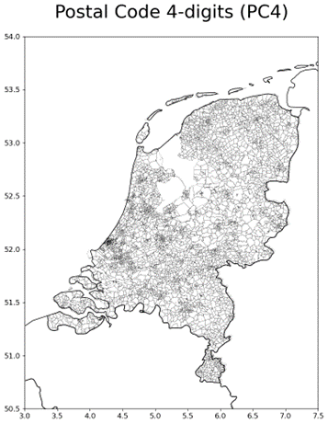
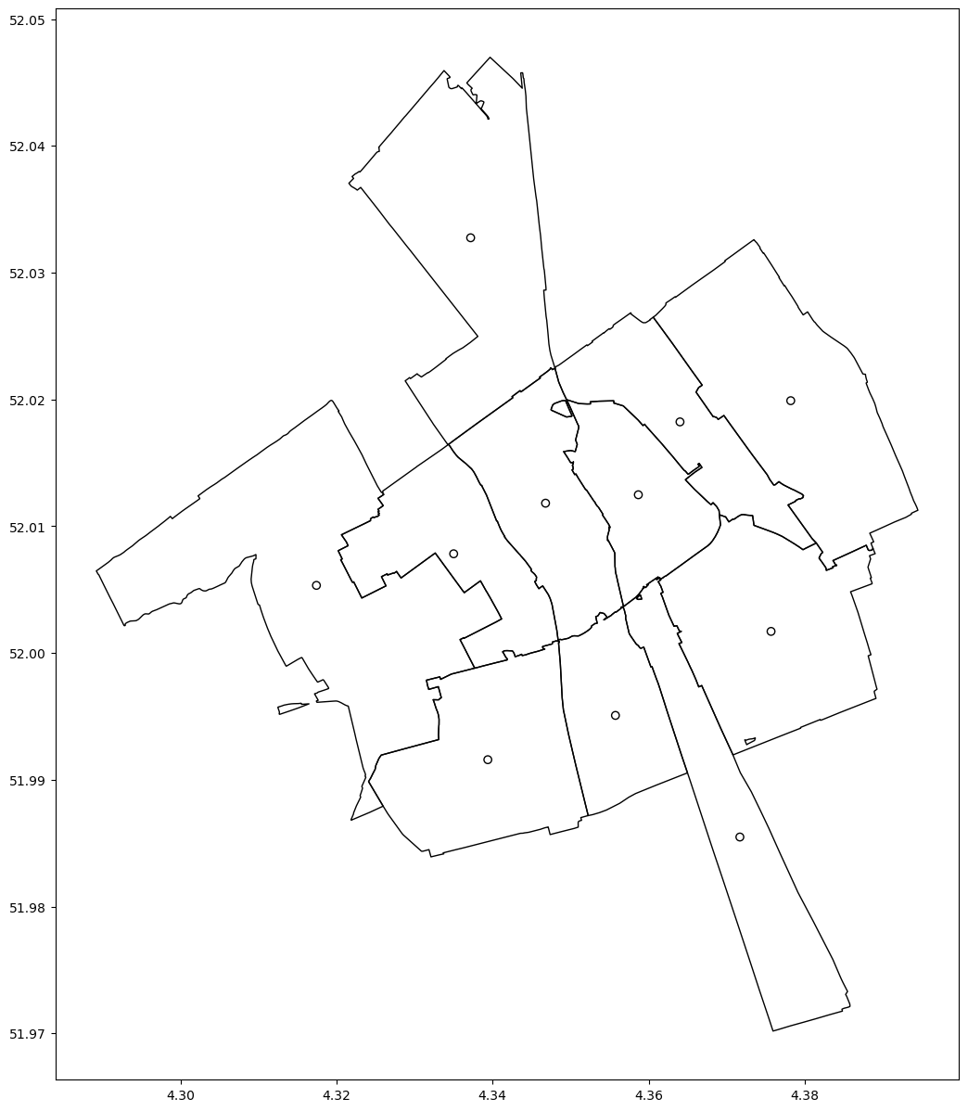
Damage records
Damage
Total Damage
=
Loss ratio
Total Insured value
#
Claims
=
Claim ratio
#
Postal Code 4-digits (PC4)
Policy holders
Notes:
Access to insurance data
One of the largest insurance company with coverage throughout the NL

Slide 5
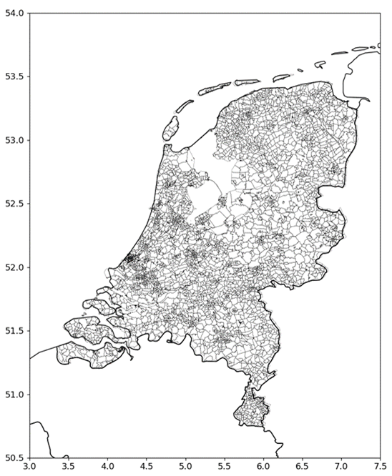
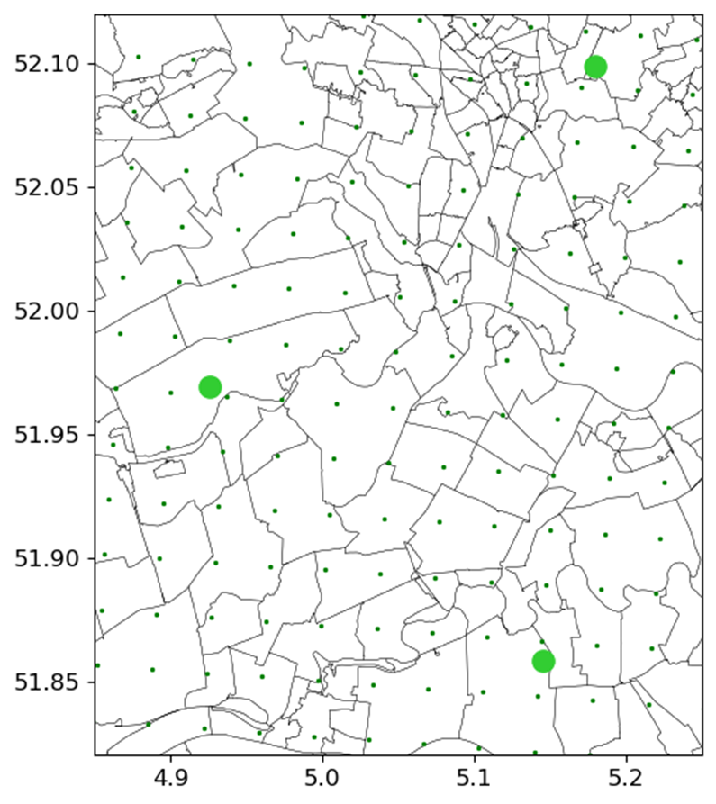




Hazard data
Hazard
2.5 X 2.5 km
1980
Reanalysis wind climatology
D – Wind from direction
F – Wind speed
G – Gust wind speed (parametrization)
P – Air pressure
Q – Specific humidity
T – Air temperature
Notes:
Met. Institution data
From ERA5 → Harmonie (numerical model) → downscale reanalysis

Slide 6
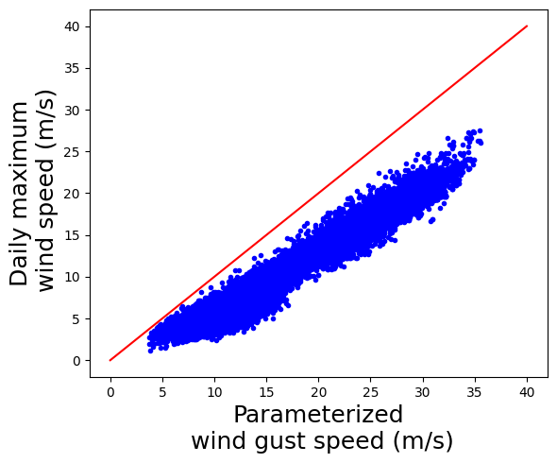
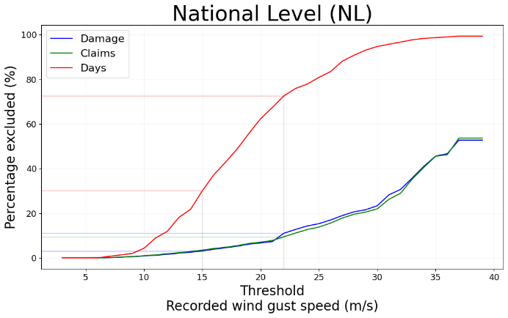
Hazard
Damage
D – Wind from direction
F – Wins speed
G – Gust wind speed
P – Air pressure
Q – Specific humidity
T – Air temperature
Damage
Loss ratio
Claims
Claim ratio
#
Notes:
Wind variables correlate well with damage variables
Daily maxima or gust, shouldn’t be used in exchange
Understanding the hazard-loss relation, allows to determine the thresholds where damage starts
Could guide the decisions for modelling damage
Very extreme events (low frequency & high intensity) or high frequency & low intensity

Slide 7
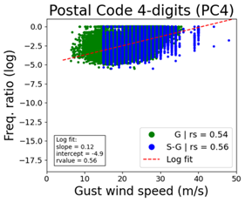
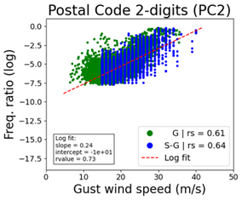
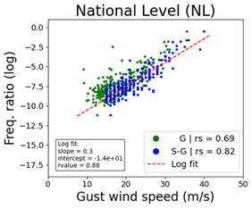

If we compare historical records at a proper resolution of both, the characteristics of storms and the damage they have caused, we can get valuable prediction power.
Hazard
Damage
Spatial analysis
#
Wind speed
Gust
Daily maxima
Loss ratio
Claim ratio
Higher wind speed → more damage in a building & more buildings with damage
#
Notes:
Not only loss ratio is important but also the claim ratio
Not all buildings are damage in a storm
National level the relationship is log-linear → indication for the resolution of the analysis

Slide 8
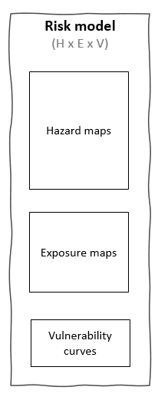
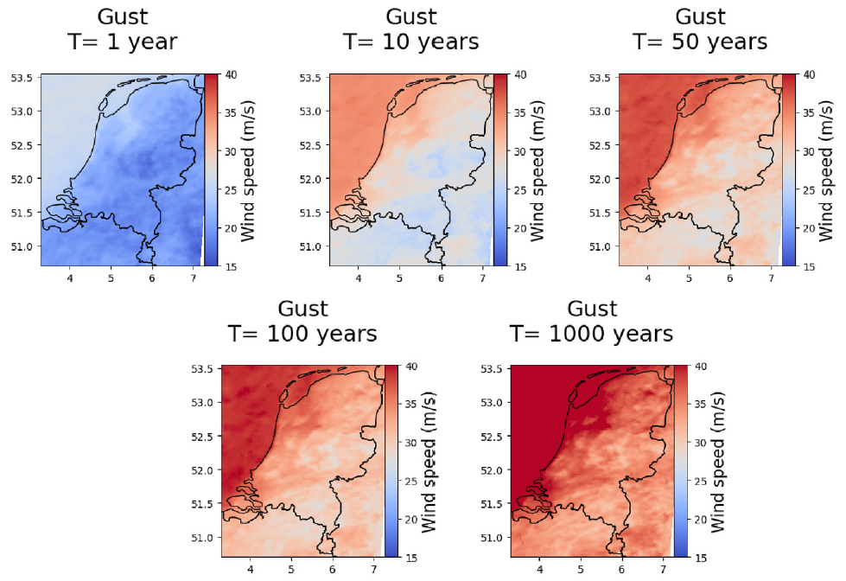
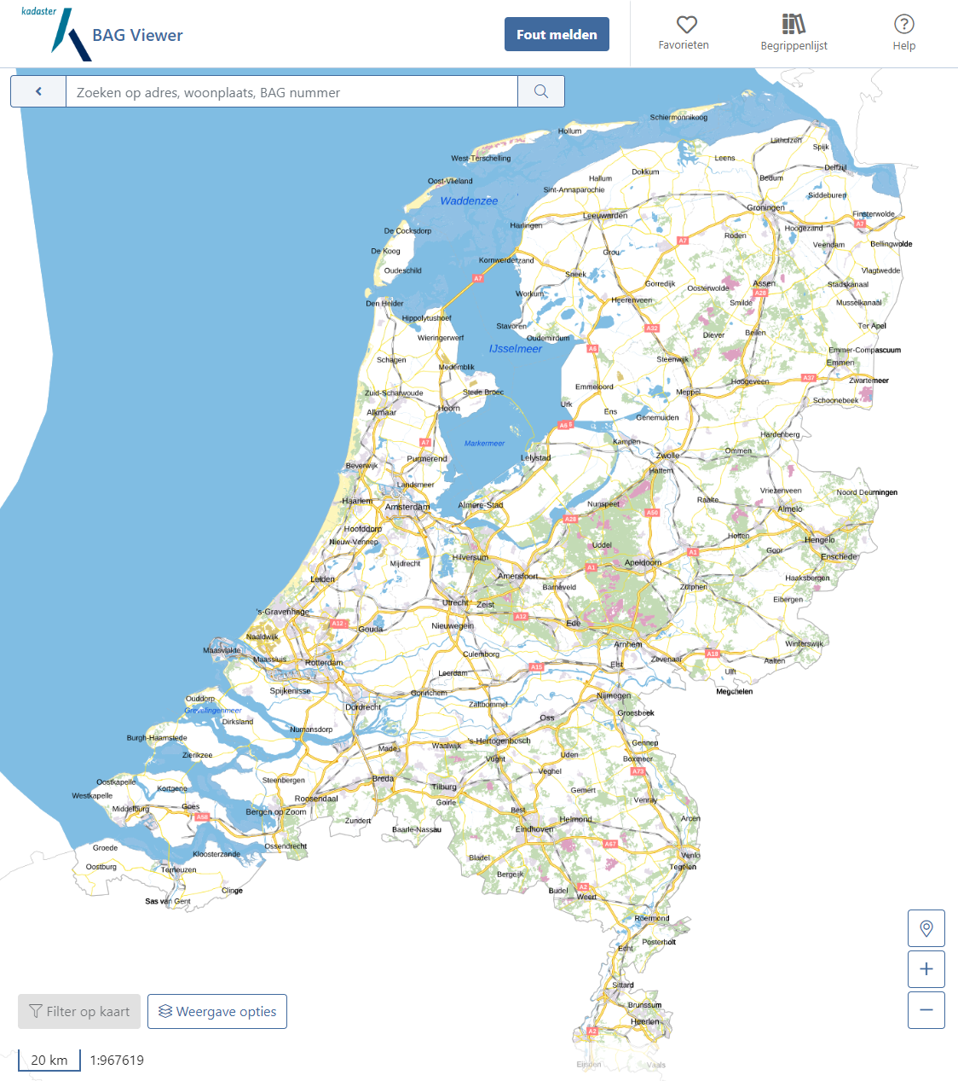
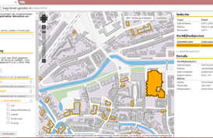

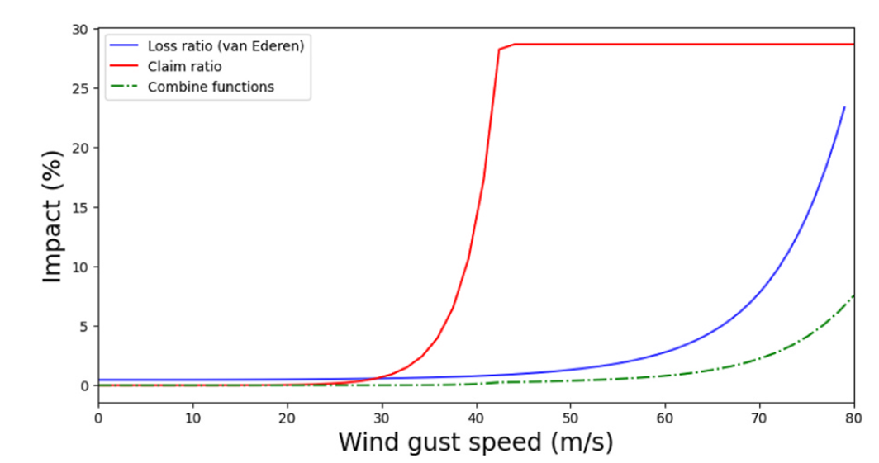
Expected damage
T

Slide 9
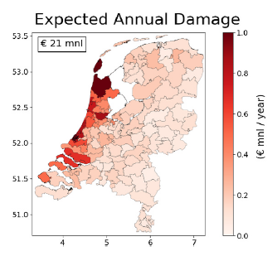
Expected damage
T
€49 million per year
(Excl. 1000-years return period)
Notes:
Map shows comb. Intensity of the hazard and exposed assets (& their characteristics)
Higher resolution map
Identify areas where adaptation should be prioritized

Slide 10
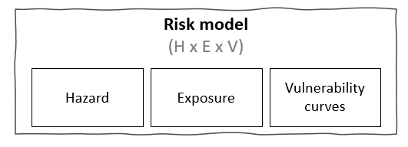
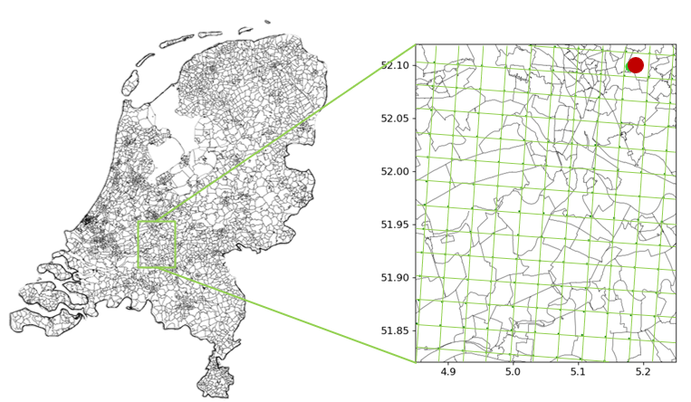

Hazard evaluation
Extreme Value Analysis
G – Gust wind speed (parametrization)
Extreme Value Analysis
(van den Brink, 2020)
Reanalysis wind climatology
40 years (1979-2019)
Winter months

Slide 11
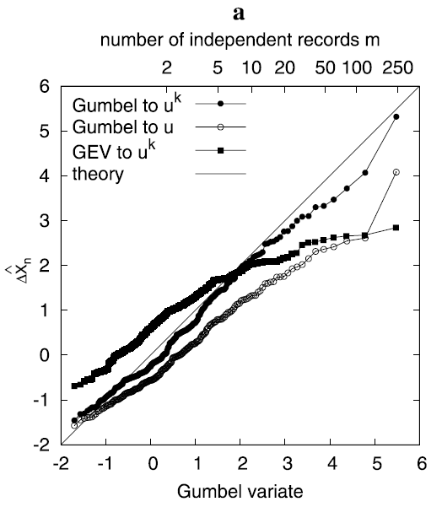
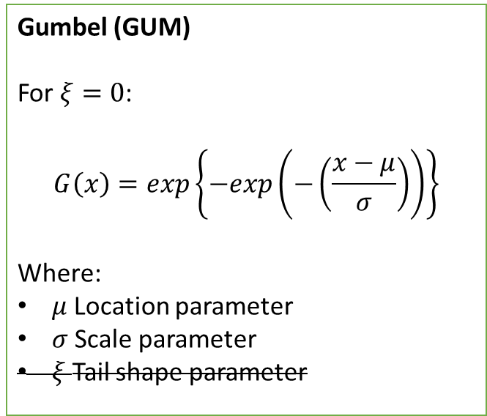
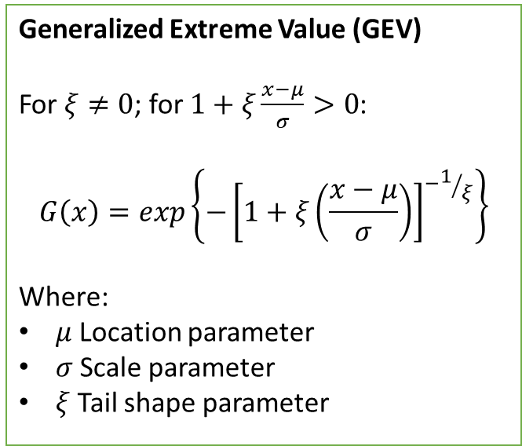

Extreme Value Analysis
Annual Maxima
Gumbel Fit
X^{k}
X^{1/k}
Generalized Extreme Value (GEV)
For $ξ≠0$; for $1+ξ\frac{x−μ}{σ}>0$:
$$G\left(x\right)=exp\left\{−{\left[1+ξ\left(\frac{x−μ}{σ}\right)\right]}^{−1/ξ}\right\}$$
Where:
$μ$Location parameter
$σ$Scale parameter
$ξ$Tail shape parameter
Gumbel (GUM)
For $ξ=0$:
$$G\left(x\right)=exp\left\{−exp\left(−\left(\frac{x−μ}{σ}\right)\right)\right\}$$
Where:
$μ$Location parameter
$σ$Scale parameter
$ξ$Tail shape parameter
(van den Brink & Können, 2008)
The Netherlands
$k$=1.75
(van den Bosch et al., 2025)
Notes:
Reduce uncertainty related to fitting the parameters
Reduce uncertainty due to the tail shape parameter → specially for higher return periods

Slide 12
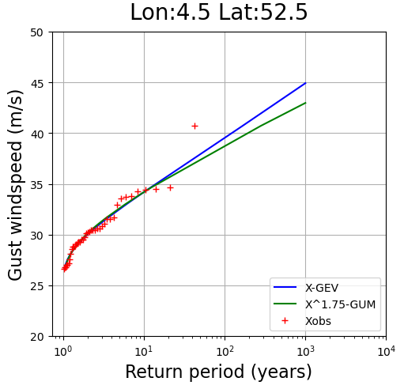
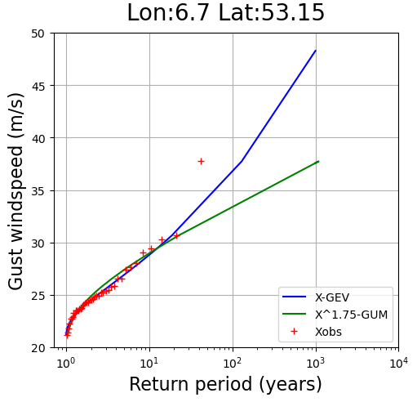

Extreme Value Analysis
Annual Maxima
Gumbel Fit
X^{k}
X^{1/k}
(van den Brink & Können, 2008)
The Netherlands
$k$=1.75
(van den Bosch et al., 2025)
Notes:
Differences in tail (e.g. 1000-years return period)
Gum is more conservative

Slide 13
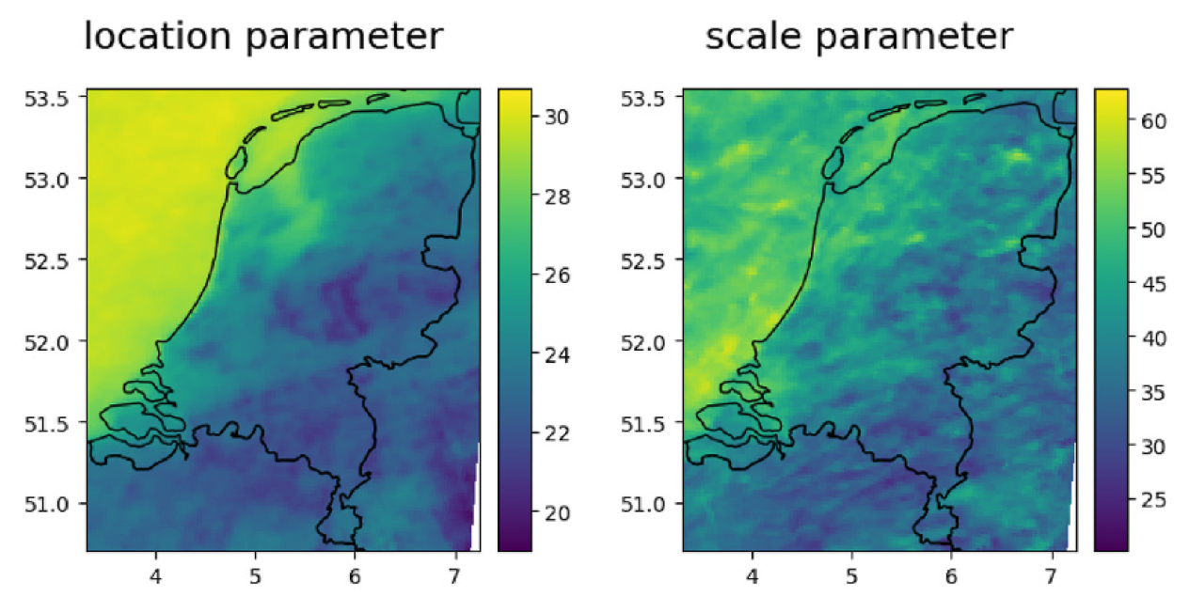
Hazard evaluation
G – Gust wind speed (parametrization)
Extreme Value Analysis
Annual Maxima
Gumbel Fit
X^{k}
X^{1/k}
(van den Brink, 2020)
Reanalysis wind climatology
40 years (1979-2019)
Winter months
Notes:
Location & shape parameter per grid cell

Slide 14
Hazard maps
Extreme Value Analysis
Annual Maxima
Gumbel Fit
X^{k}
X^{1/k}
14
Notes:
Intensity associated with a probability (in this case with a return period)

Slide 15
Hazard maps
Notes:
It is not ‘a storm’, as we are not generating synthetic events
Captures the characteristics of the observe wind speeds during a storm
Sea – land transition (roughness of the land & urbanization)
Coast-inland patterns
Veluwe (wooded area) pattern
Help informing/guiding decision-making

Slide 16
Expected damage
T
€49 million per year
(Excl. 1000-years return period)

Slide 17
Basisregistratie Adressen en Gebouwen (BAG)
8,521,658 Residential buildings
(van den Broecke , 2020)
Notes:
BAG – eng: Basic Register of Addresses and Buildings
Data of all buildings in NL
Building characteristics → Allow for estimating the Reconstruction Value of the properties
Year of construction
Surface area

Slide 18
Expected damage
T
€49 million per year
(Excl. 1000-years return period)

Slide 19
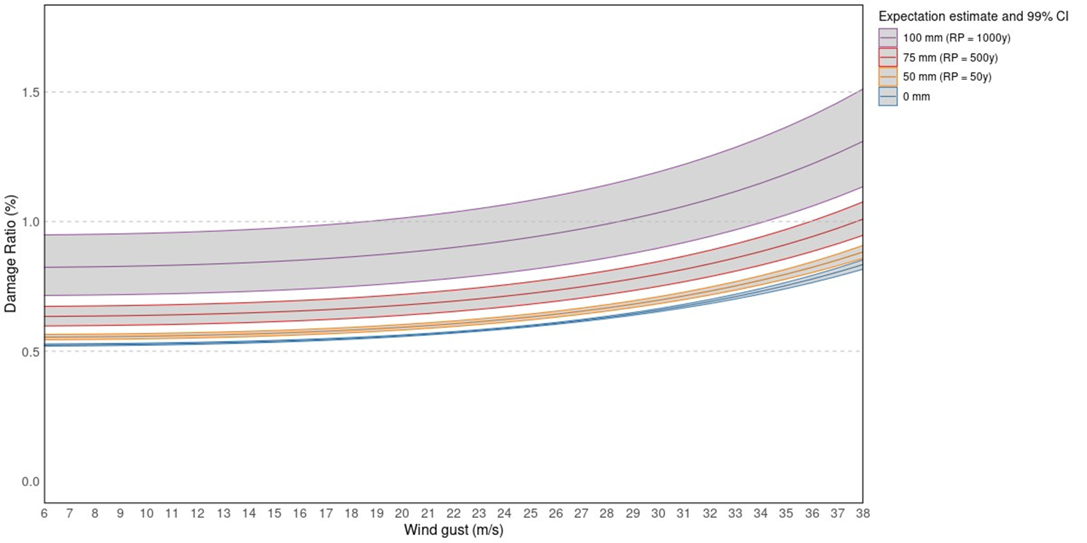
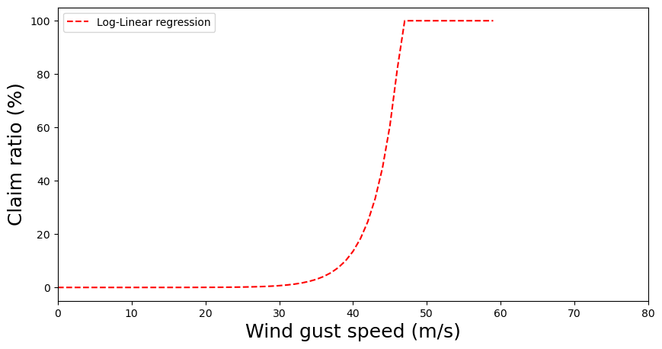
Vulnerability
Loss function
Damage
Hazard
(van Ederen et al., 2025)
Wind speed
Gust
Daily maxima
Loss ratio
Probability of loss
#
Claim ratio
#
(Fonseca-Cerda et al., 2024)
Notes:
Loss function:
Asset-level
RV (building characteristics)
Estimate of expected loss per property by a given wind gust speed
Claim function:
Aggregated
Percentage of damaged properties by a given wind gust speed

Slide 20
Vulnerability
Loss function
Probability of loss
Combined function
#
(van Ederen et al., 2025)
(Fonseca-Cerda et al., 2024)
Notes:
Loss function:
Potential loss of any building
Claim function:
Percentage of buildings with damage
Combined function
Total loss

Slide 21
Vulnerability
Combined function

Slide 22
Expected damage
T
€49 million per year
(Excl. 1000-years return period)

Slide 23
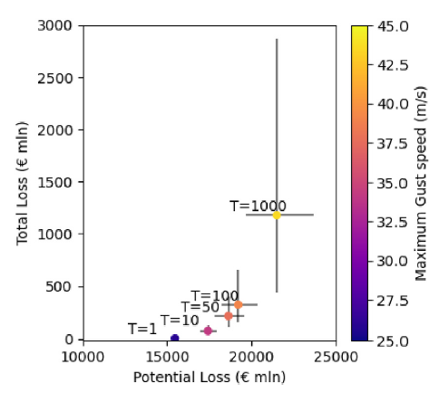
€49 million per year
(Excl. 1000-years return period)
Notes:
X-axis (Loss function):
Potential loss of any building
Y-axis (Combined function)
Total expected loss
Uncertainty bounds due to the Hazard estimates (per return period)
The larger the T, the larger the Uncertainty (due to the tail behaviour)

Slide 24
Model validation
Historical damage recorded (VvV)
Twelve most damaging storms
Comparison
Recorded vs Modelled
Modelled risk

Slide 25
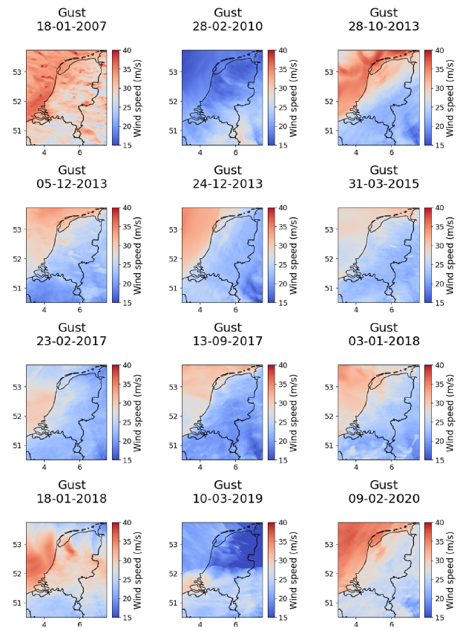
Model validation
Tendency to underestimate total losses (- 16.17%)
Average absolute deviation of 20.67% between the modelled and recorded event losses.
Date | VvV¹ (€ mln) | Model (€ mln) | Relative error (%) | Relative error (%)
18-01-2007 | 156.17 | 145.45 | -6.86 | -6.86
28-02-2010 | 7.40 | 6.97 | -5.75 | -5.75
28-10-2013 | 92.66 | 51.57 | -44.34 | -44.34
05-12-2013 | 13.92 | 22.06 | 58.48 | 58.48
24-12-2013 | 9.14 | 15.75 | 72.41 | 72.41
31-03-2015 | 32.19 | 18.63 | -42.12 | -42.12
23-02-2017 | 24.80 | 24.84 | 0.18 | 0.18
13-09-2017 | 11.75 | 10.85 | -7.62 | -7.62
03-01-2018 | 34.37 | 27.29 | -20.59 | -20.59
18-01-2018 | 235.34 | 102.08 | -56.62 | -56.62
10-03-2019 | 30.02 | 15.96 | -46.83 | -46.83
09-02-2020 | 46.11 | 58.32 | 26.48 | 26.48
Mean Error (ME) |  |  |  | -16.17
Mean Absolute Error (MAE) |  |  |  | 20.67
1 - Total damage, including business and property insurance claims; 50% of content, and 13% of auto has been removed (VvV, 2023).

Slide 26
Limitations
& Opportunities
Uncertainty in hazard estimates propagates into risk estimates, and changes in hazard are not linearly translated into losses.
High-resolution exposure data, but aggregated loss estimates. Further refinement of claim ratio functions could enable higher-resolution and asset-level loss estimation.
Alternative approaches (e.g., machine learning) could be explored to estimate asset-level losses.
Access to more detailed data for calibration and validation would improve model performance and reliability.
The choice of model should be guided by the intended application and decision context.

Slide 27


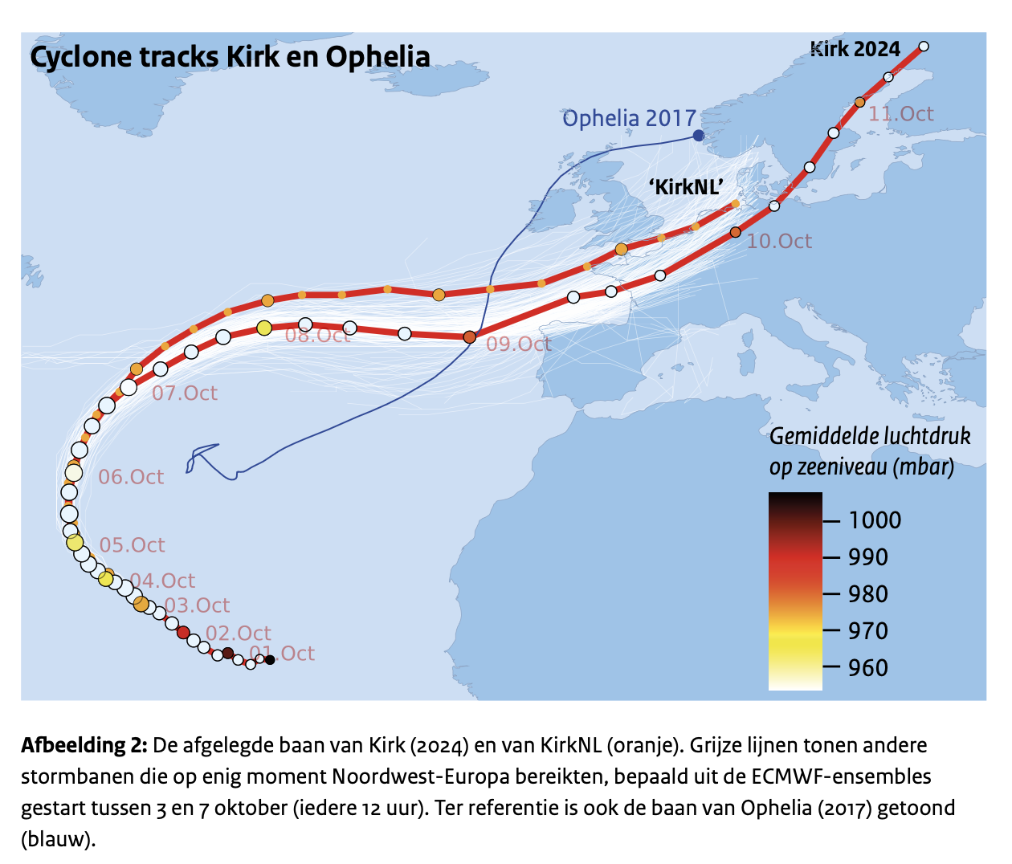
A case study of hurricane Kirk (2024)
Different tracks
Plausibly different
Collaboration
Hylke de Vries (KNMI)
Maria Fonseca-Cerda (IVM/VU)
Manuscript in preparation
Notes:
9 extreme situation that could already have large impacts (due to CC)
Hurricane Kirk – fast transition from the tropics to the extra-tropics (mid-latitude)
KNMI, data:
ECMWF ensembles
Downscaling with HCLIM43 (2.5km resolution)
Estimate the highest gust → losses

Slide 28
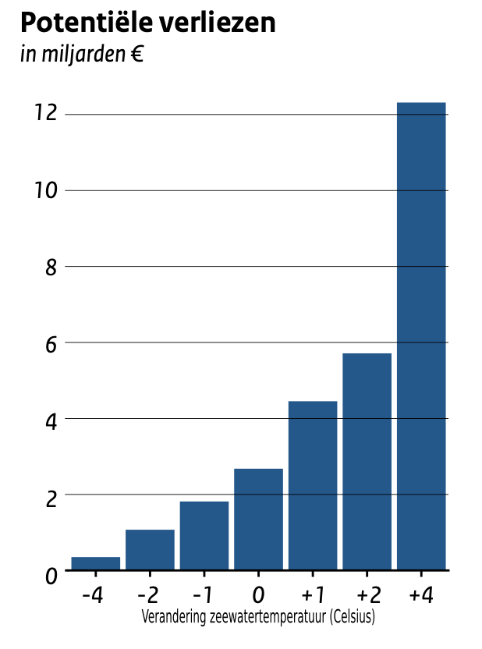
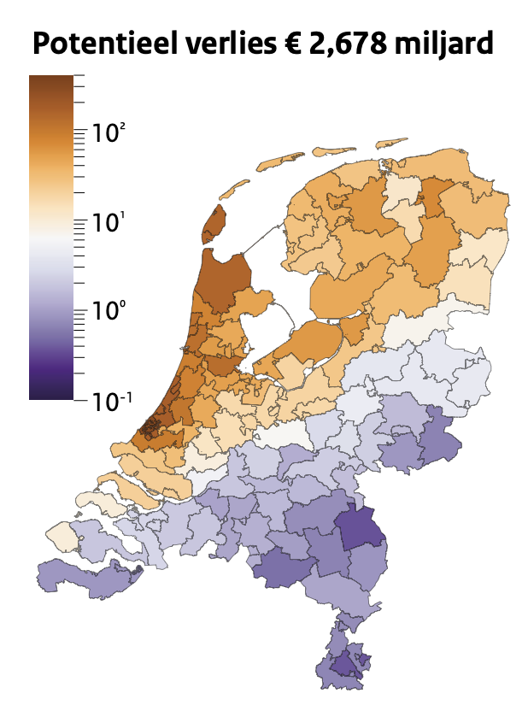
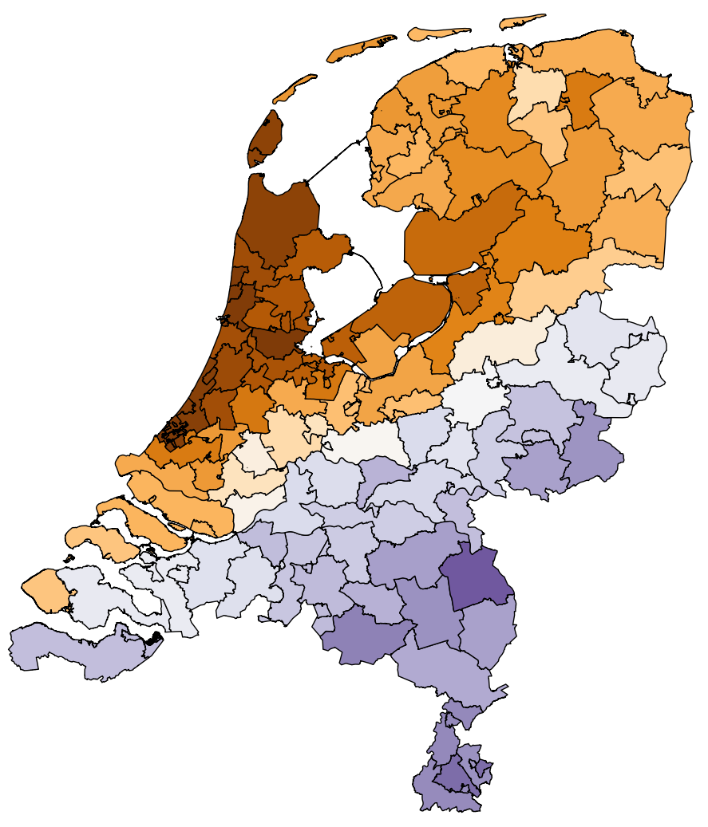
Climate change
Sea Surface Temperature changes (re-simulate with HCLIM43)
Potential Losses
in Billions of Euros
=> Strong response on changes in SST
(lower pressure, stronger wind gusts, more rain)
Current climate
SST+2K
Potential losses
€ 2.7 billion
Change in SST (degrees)
~ 10 Million people experienced
>= Bf12 wind gusts
Manuscript in preparation
Notes:
The potential losses estimated using the ‘current climate’ scenario are already very large….
Strong response on changes in SST
Model changes in sea surface temperature to model changes in hazard due to CC
Model losses associated with the hazard changes
Not linear changes

Slide 29


From Storms to Losses: A High-Resolution Model of Windstorm Risk in the Netherlands
Maria Fonseca-Cerda, H. de Moel, J.C.J.H. Aerts, W.J.W. Botzen, T. Haer
11th Workshop on European Storms, June 17th, Delft
m.d.s.fonseca.cerda@vu.nl

Slide 30
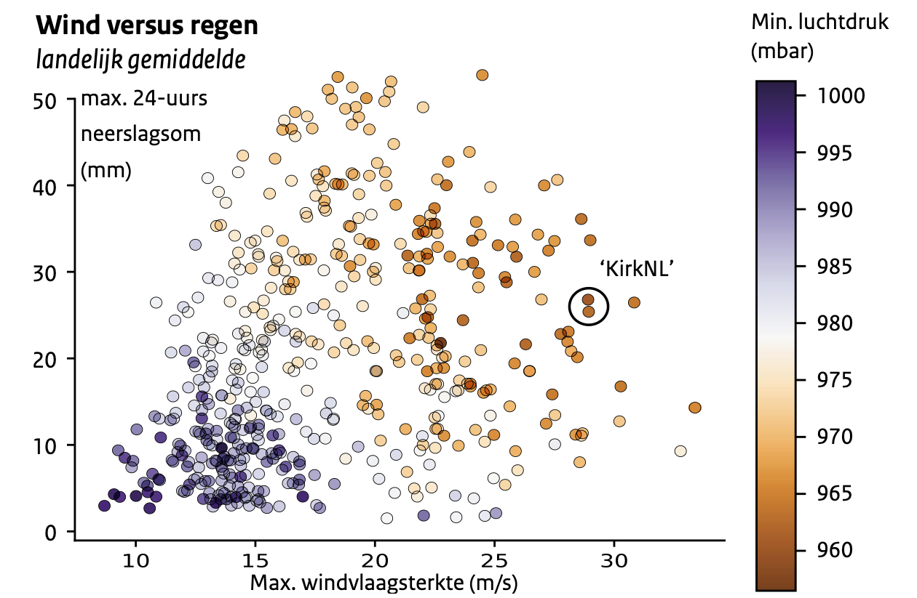
Different intensities every Kirk-variant differs
Average over Netherlands
Min MSLP
(hPa)
=> The lower the pressure, the more wind & rain
Max 24h rainsum (mm)
Data: ECMWF ensembles
Max windgust (m/s)
Notes:
Rain not exceptional (most rain over the sea)

Slide 31
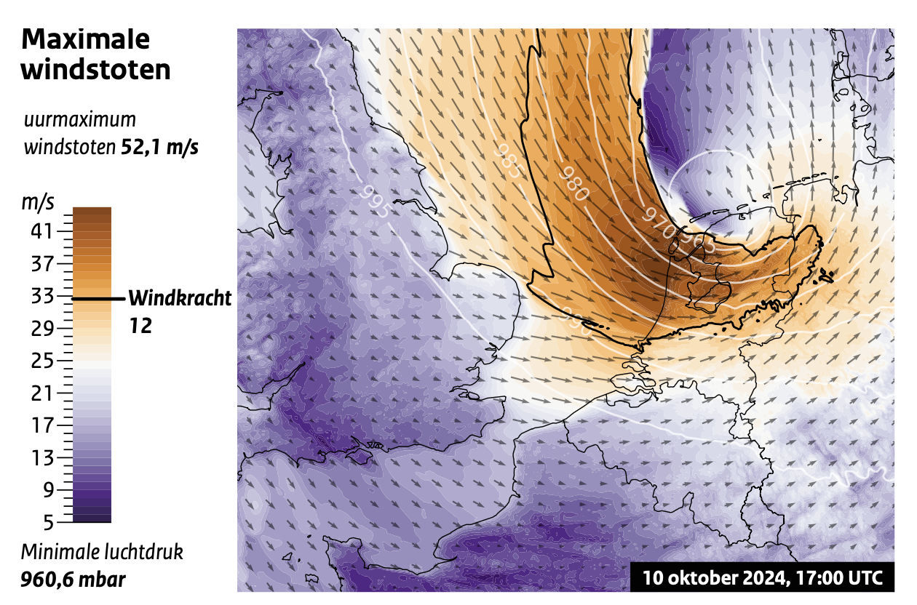
Strongest wind gusts
Downscaling with HCLIM43 (2.5km resolution)
Average over Netherlands
Min MSLP
(hPa)
Maximal
Wind gusts
Max 24h rainsum (mm)
Maximal recorded 52,1 m/s
Data: ECMWF ensembles
Max windgust (m/s)
Beaufort
Minimal MSLP
960,6 hPa

Slide 32
Costly
Impact modelling using VU/IVM. Potential losses to houses and buildings (Fonseca-Cerda et al., 2026)
Potential losses houses & buildings
€ 2.7 billion
Maximal
Wind gusts
Maximal recorded 52,1 m/s
Beaufort
~ 10 Million people experienced
>= Bf12 wind gusts
Comparison
Winter storm Eunice (02/2022)
Model € 210 Million
~ €750 million in total
Summer storm Poly (07/2023)
~ €70 million in total
Minimal MSLP
960,6 hPa

Slide 33
Model validation
Date | VvV¹ (€ mln) | Model (€ mln) | Relative error (%) | Relative error (%)
18-01-2007 | 156.17 | 145.45 | -6.86 | -6.86
28-02-2010 | 7.40 | 6.97 | -5.75 | -5.75
28-10-2013 | 92.66 | 51.57 | -44.34 | -44.34
05-12-2013 | 13.92 | 22.06 | 58.48 | 58.48
24-12-2013 | 9.14 | 15.75 | 72.41 | 72.41
31-03-2015 | 32.19 | 18.63 | -42.12 | -42.12
23-02-2017 | 24.80 | 24.84 | 0.18 | 0.18
13-09-2017 | 11.75 | 10.85 | -7.62 | -7.62
03-01-2018 | 34.37 | 27.29 | -20.59 | -20.59
18-01-2018 | 235.34 | 102.08 | -56.62 | -56.62
10-03-2019 | 30.02 | 15.96 | -46.83 | -46.83
09-02-2020 | 46.11 | 58.32 | 26.48 | 26.48
Mean Error (ME) |  |  |  | -16.17
Mean Absolute Error (MAE) |  |  |  | 20.67
1 - Total damage, including business and property insurance claims; 50% of content, and 13% of auto has been removed (VvV, 2023).
Notes:
Potential explanations are that the hazard component is underestimated or that other storm factors (such as duration of the storm) drive losses, which are not captured by our model. On the other hand, it might be that in such events, the content loss of the insurance records corresponds to more than the 50% that is assumed in this study or that businesses present more losses in large and strong events.

Slide 34
Model validation
Date | VvV¹ (€ mln) | Model (€ mln) | Relative error (%) | Relative error (%)
18-01-2007 | 156.17 | 145.45 | -6.86 | -6.86
28-02-2010 | 7.40 | 6.97 | -5.75 | -5.75
28-10-2013 | 92.66 | 51.57 | -44.34 | -44.34
05-12-2013 | 13.92 | 22.06 | 58.48 | 58.48
24-12-2013 | 9.14 | 15.75 | 72.41 | 72.41
31-03-2015 | 32.19 | 18.63 | -42.12 | -42.12
23-02-2017 | 24.80 | 24.84 | 0.18 | 0.18
13-09-2017 | 11.75 | 10.85 | -7.62 | -7.62
03-01-2018 | 34.37 | 27.29 | -20.59 | -20.59
18-01-2018 | 235.34 | 102.08 | -56.62 | -56.62
10-03-2019 | 30.02 | 15.96 | -46.83 | -46.83
09-02-2020 | 46.11 | 58.32 | 26.48 | 26.48
Mean Error (ME) |  |  |  | -16.17
Mean Absolute Error (MAE) |  |  |  | 20.67
1 - Total damage, including business and property insurance claims; 50% of content, and 13% of auto has been removed (VvV, 2023).
Notes:
Considering the lower wind gust speeds, it might be that less properties present damages, and our claim ratio function might lead to an overestimation of losses. On the other hand, it might be that in such events, the content loss of the insurance records corresponds to less than the 50% that is assumed in this study

Slide 35




Hazard maps

