Slide 1
  Calibrating a new stochastic event set for European windstorms
  7 June 2026

Slide 2

Agenda
Workflow overview
Stochastic hazard @ 25km
Downscaling
Stochastic hazard @ 3km
Conclusions

Slide 3

1
workflow overview

Slide 4
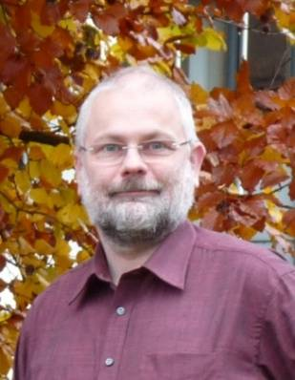
Building a stochastic event set
Workflow overview
    Stochastic events extracted from GCM output: MPI-ESM / LAERTES EU @25km
    Five events per year, thus 100yrs = 500 storms, 10,000yrs = 50K events, etc…
    Event selection/extraction based on two SSI metrics:
      Met Index (MI): to capture the storm climatology
      Loss Index (LI): to capture strums in fringe geographies
    Ranking of the LAERTES-EU data, then selecting the top 5 x years events: 12,500 MPI-ESM / LAERTES EU yrs = 62,450 events
    Downscaling between from 25km to 3km
      M/L model trained on a limited historical set
        310 ERA5 events @ 25km
        310 ICON simulated (dynamically downscaled events) @ 3km
      The trained M/L model is applied to the 62,450 LAERTES-EU storms
    The stochastic downscaled events are validated/calibrated against timeseries of met-stations gusts
MPI-ESM / LAERTES EU
EVENT SET @25km
storm selection
Hist Storms @25 & 3km
  Hendrick Feldmann
  Research Assistant
DOWNSCALING
training M/L tool
EVENT SET @3km
CALIBRATION
EVENT SET
Final product

Slide 5
2
Course Resolution data

Slide 6

Stochastic hazard data @25km
RCM data - 1183 simulation runs, 1900 to 2028
 | Data Block 1 | Data Block 2 | Data Block 3 | Data Block 4
Forcing | 20CR via MPI-ESM-LR | MPI-ESM-LR droughtclip | MPI-ESM-HR historical | MPI-ESM-HR CMIP5 MPI-ESM-HR CMIP6
Period | 1900-2009 | 1910-2019 | 1900-2005 1960-2005 | 1960-2026 1960-2028
Type | Long-term | decadals | Long-term | decadals
Members | 3 | 3 (100 decades) | 3 2 | 5 (57 decades) 10 (59 decades)
Years | 330 | 3000 | 410 | 8750

Slide 7
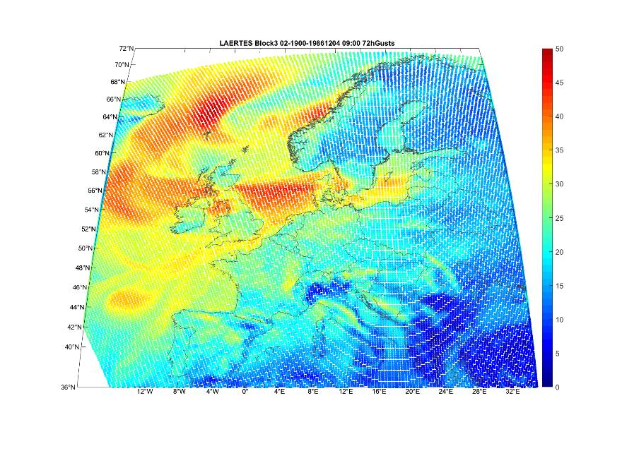
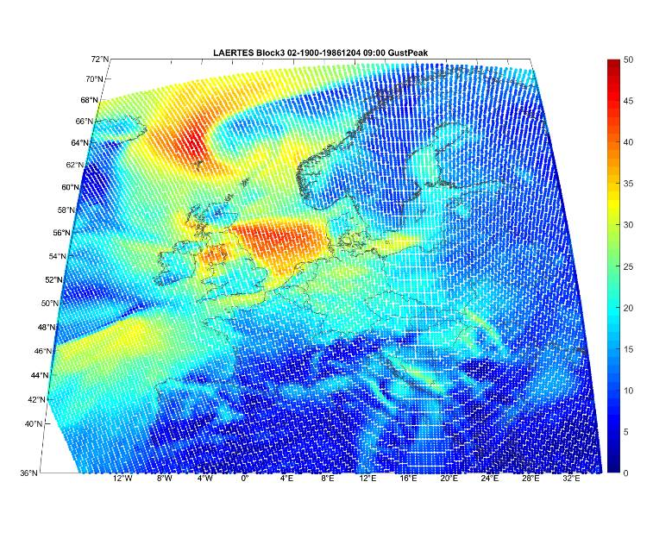
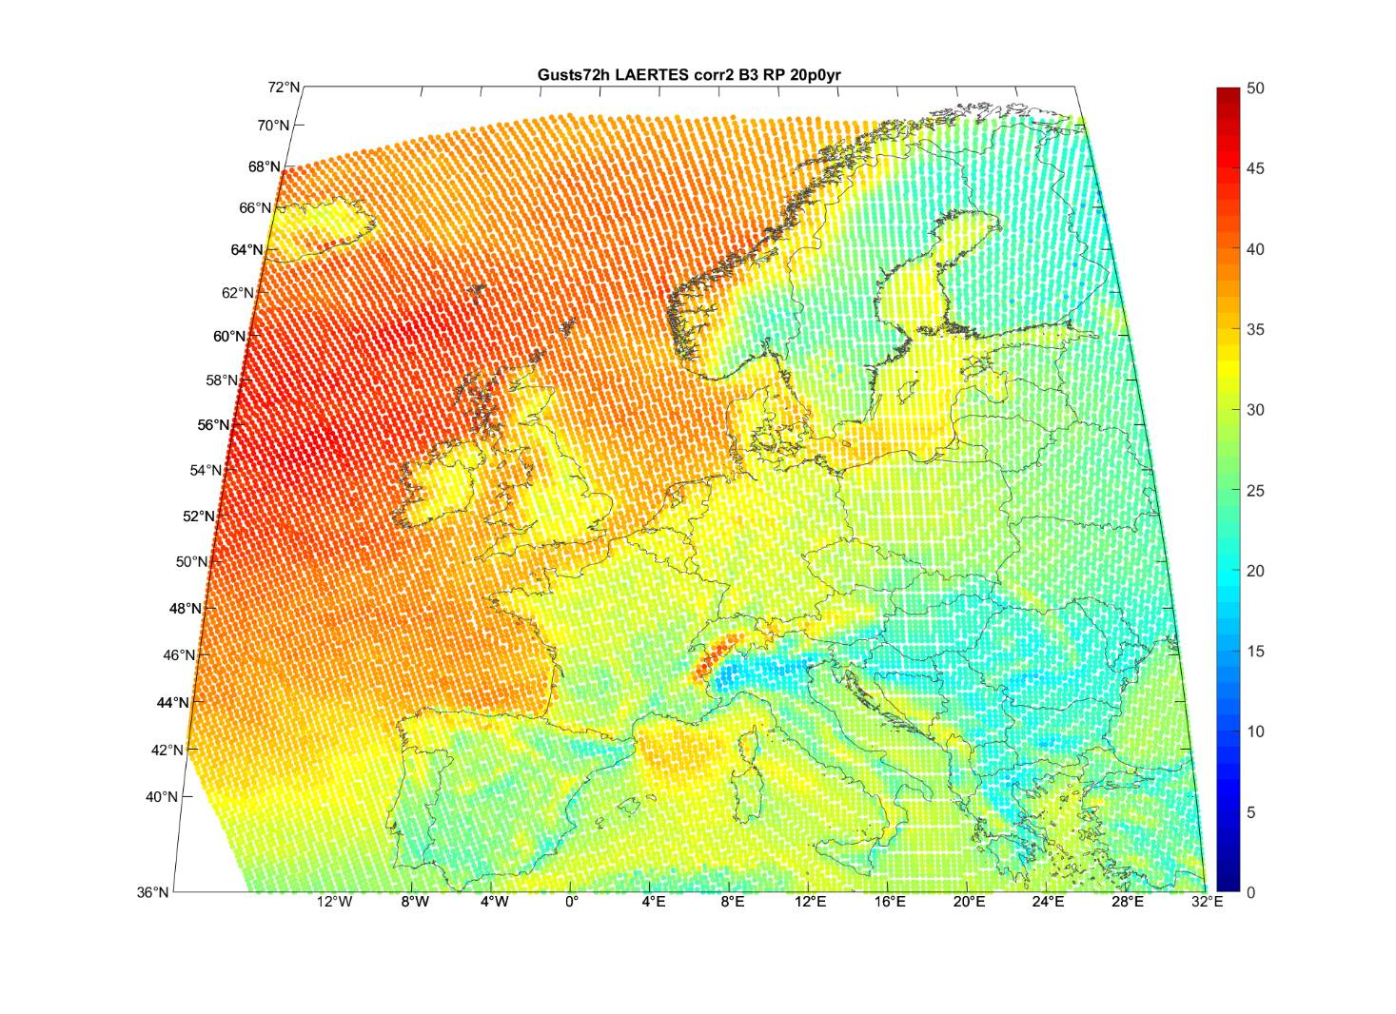
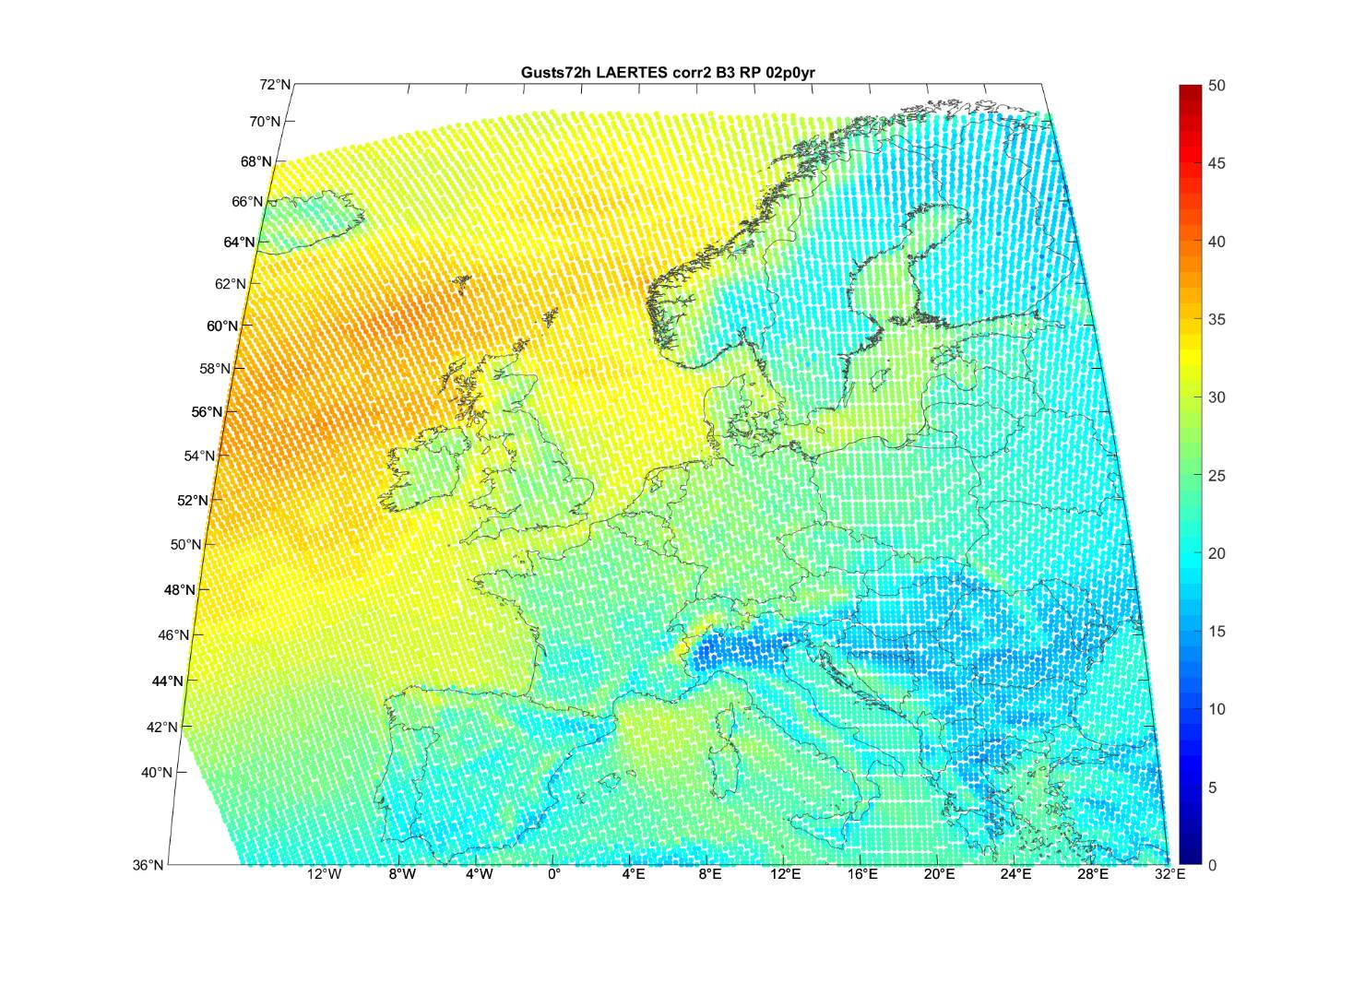
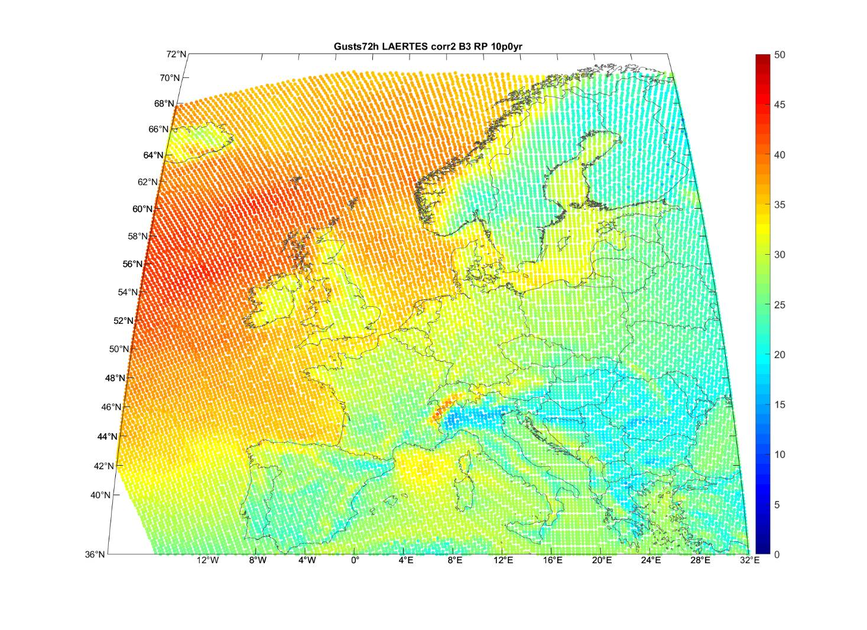
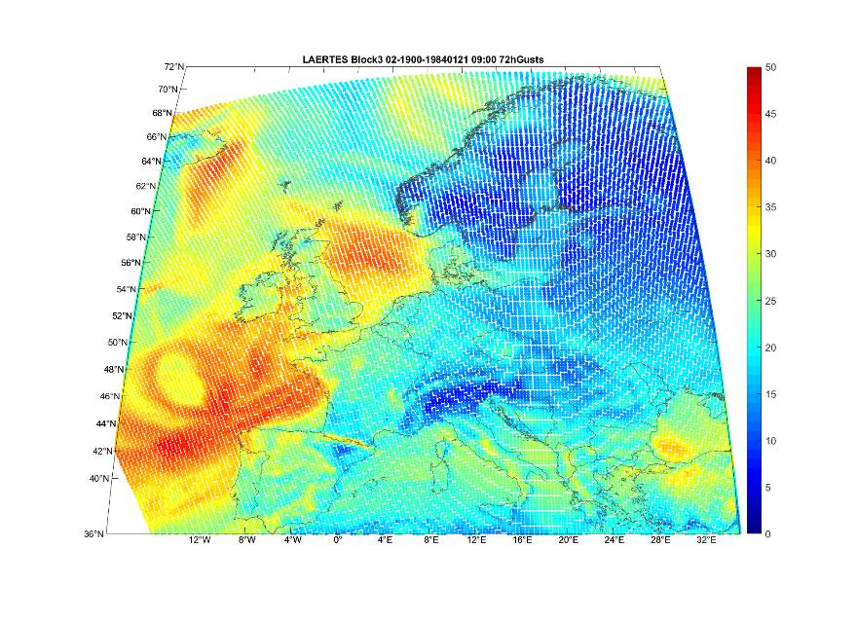
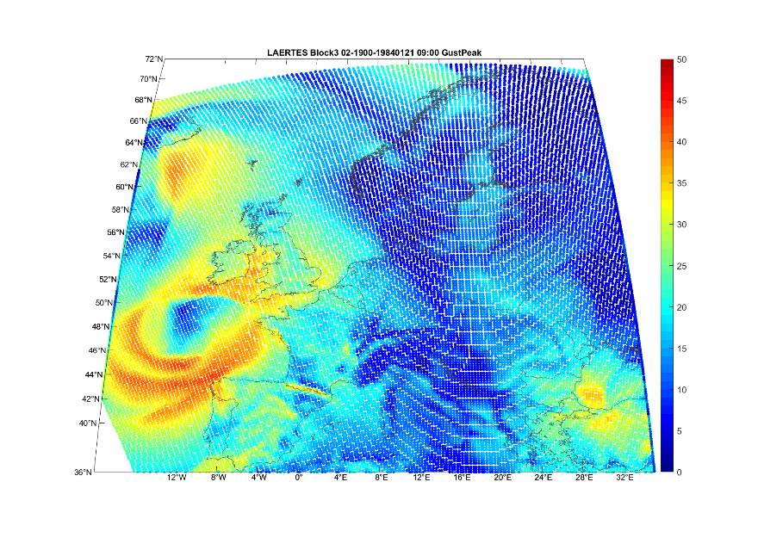
Stochastic hazard @25 km
LAERTES footprints: Block 3 example 410 years (2,050 storms)

Slide 8
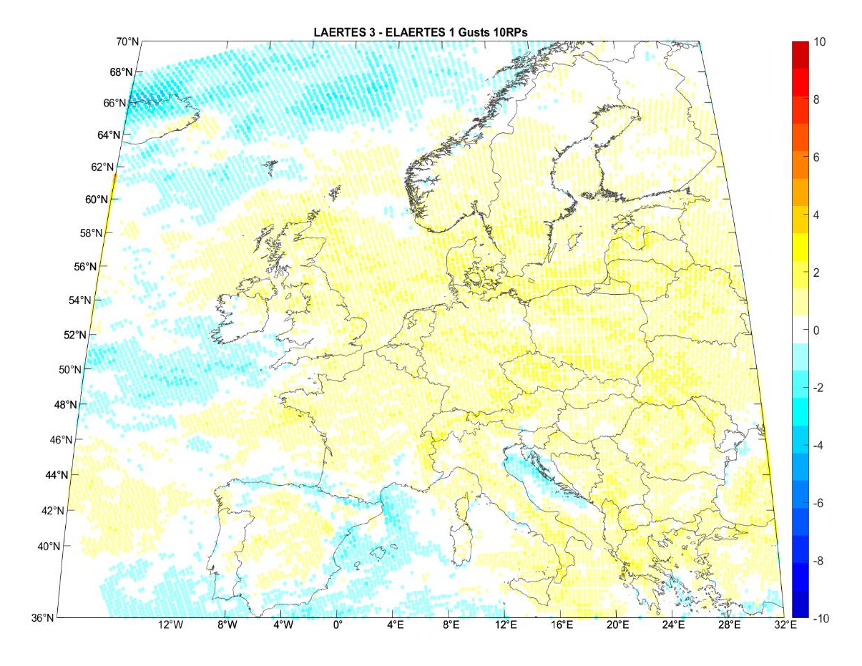
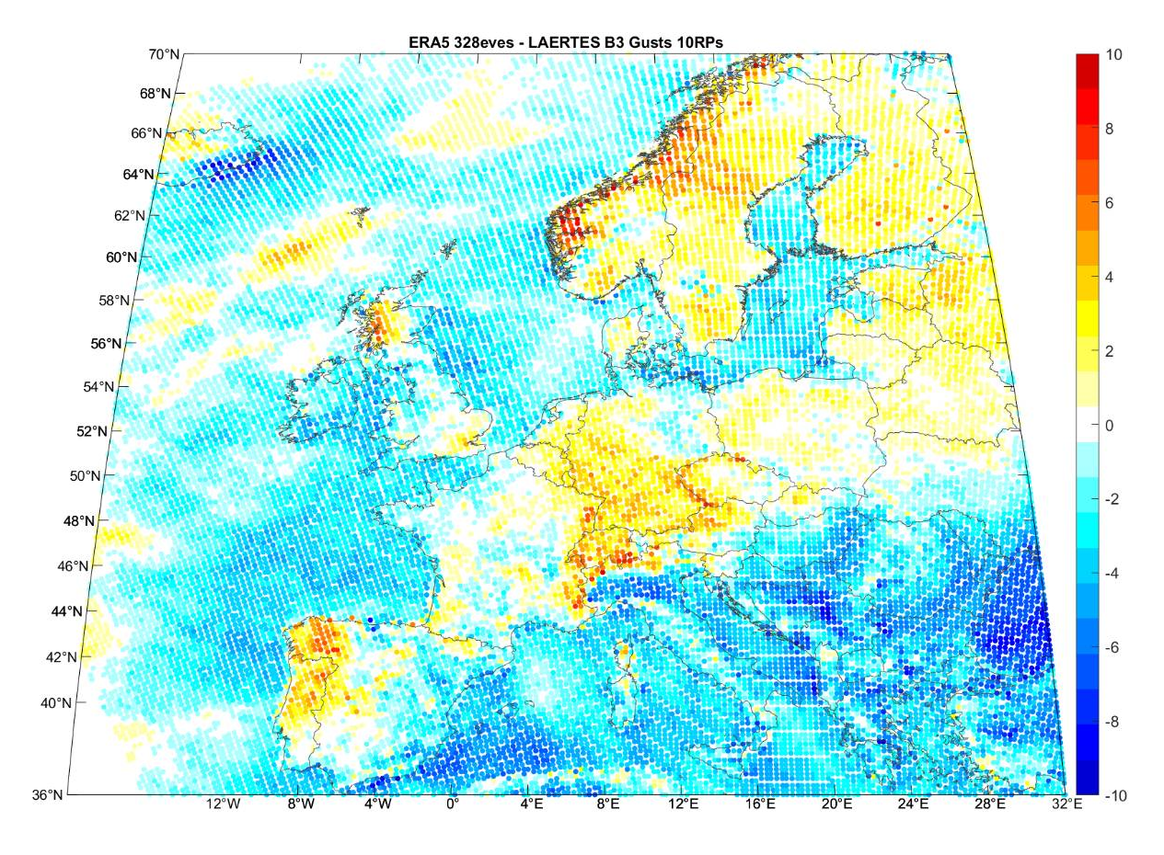
Climatology evaluation @ 25km
Between blocks
L/HR – L/LR
ERA5 - L/HR

Slide 9
Climatology evaluation @ 25km
Historic Vs stochastic
 | LAERTES | ERA-5
No. of Years | 12,459 | 64
Avr no. Eve/Yr | 5.0 | 5.0
Max no. Eve/Yr | 20.0 | 11.0
Dispersion stat | 0.37 | 0.20
Max MI 36hr | 33,866 | 27,157
Mean MI 36hr | 11,430 | 12,439
Med MI 36hr | 10,646 | 11,697
Min MI 36hr | 7,897 | 9,022
Max NAO idx | 6.41 | 4.12
Med NAO idx | 0.72 | 1.18
Min MI NAO idx | -7.42 | -3.78

Slide 10
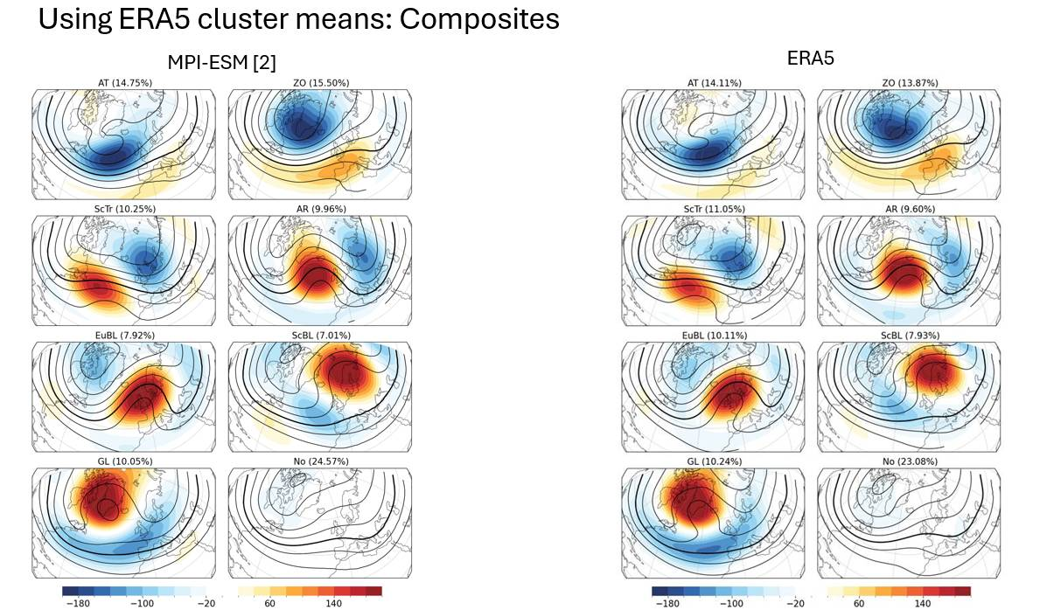
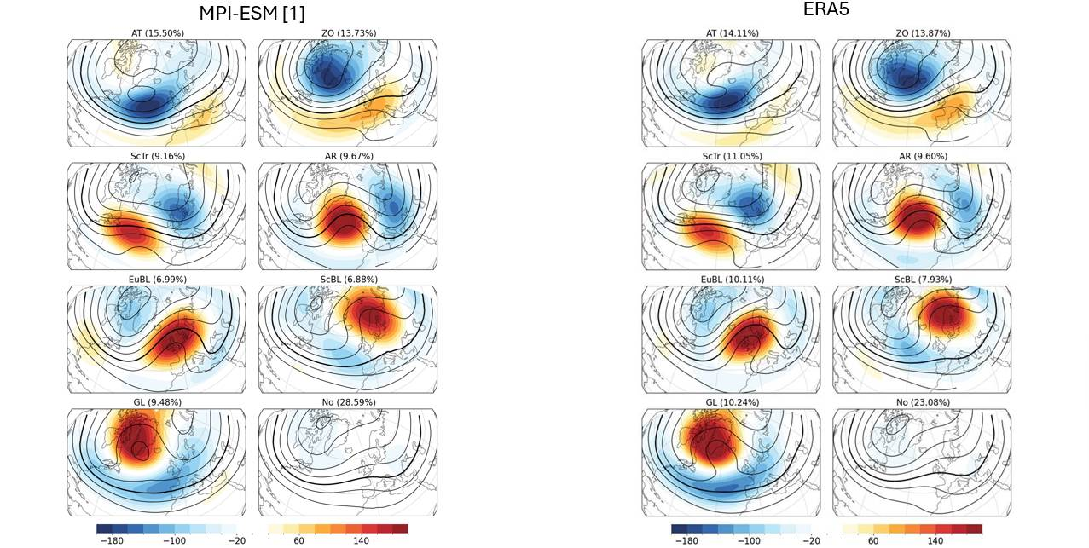
Climatology evaluation @ 25km
Historic Vs stochastic
Hochman, A., Messori, G., Quinting, J. F., Pinto, J. G., & Grams, C. M. (2021).
Do Atlantic-European weather regimes physically exist?
Geophysical Research Letters, 48. https://doi.org/10.1029/2021GL095574

Slide 11
3
Downscaling

Slide 12


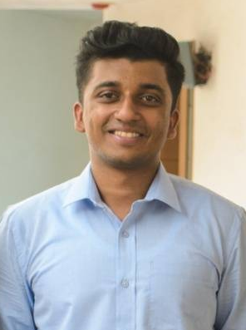
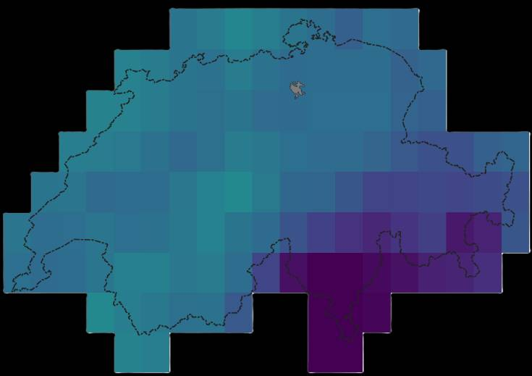
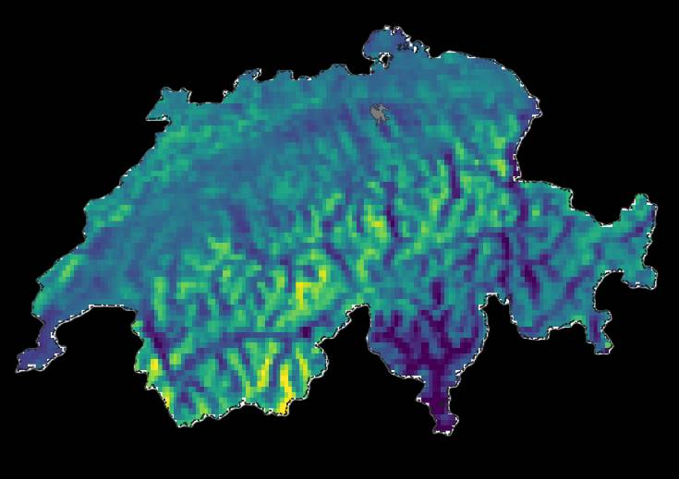
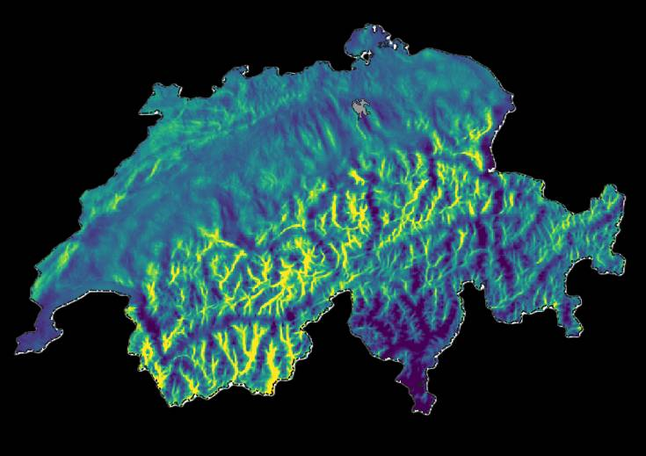
Downscaling
25 km resolution
3 km resolution
Lukas Braun
  Weather Risk model development Lead - Prague
Lubos Sokol
  Catastrophe Model Specialist
  Dr. Athul R. Satheesh
  Post-Doctoral Researcher
Final 500 m resolution

Slide 13
4
High resolution data

Slide 14
Stochastic hazard @ 3km
Meteorological station data

Slide 15
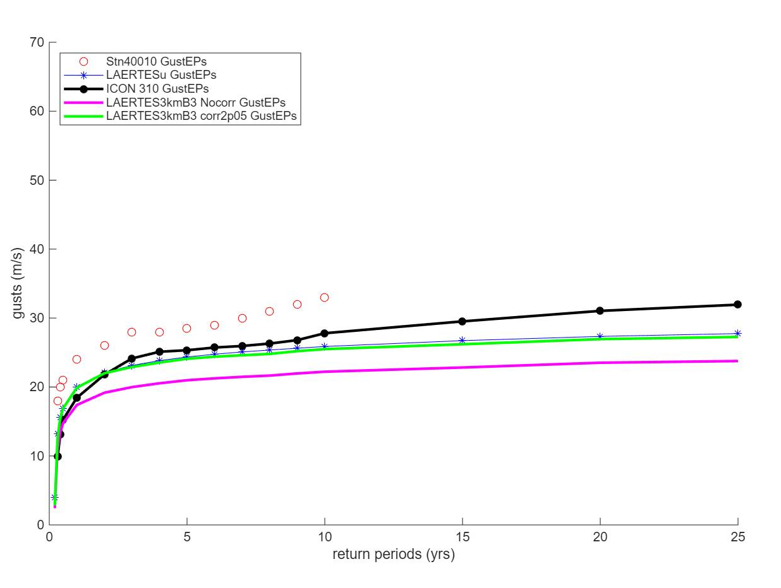
Stochastic hazard @ 3km
Meteorological station data

Slide 16
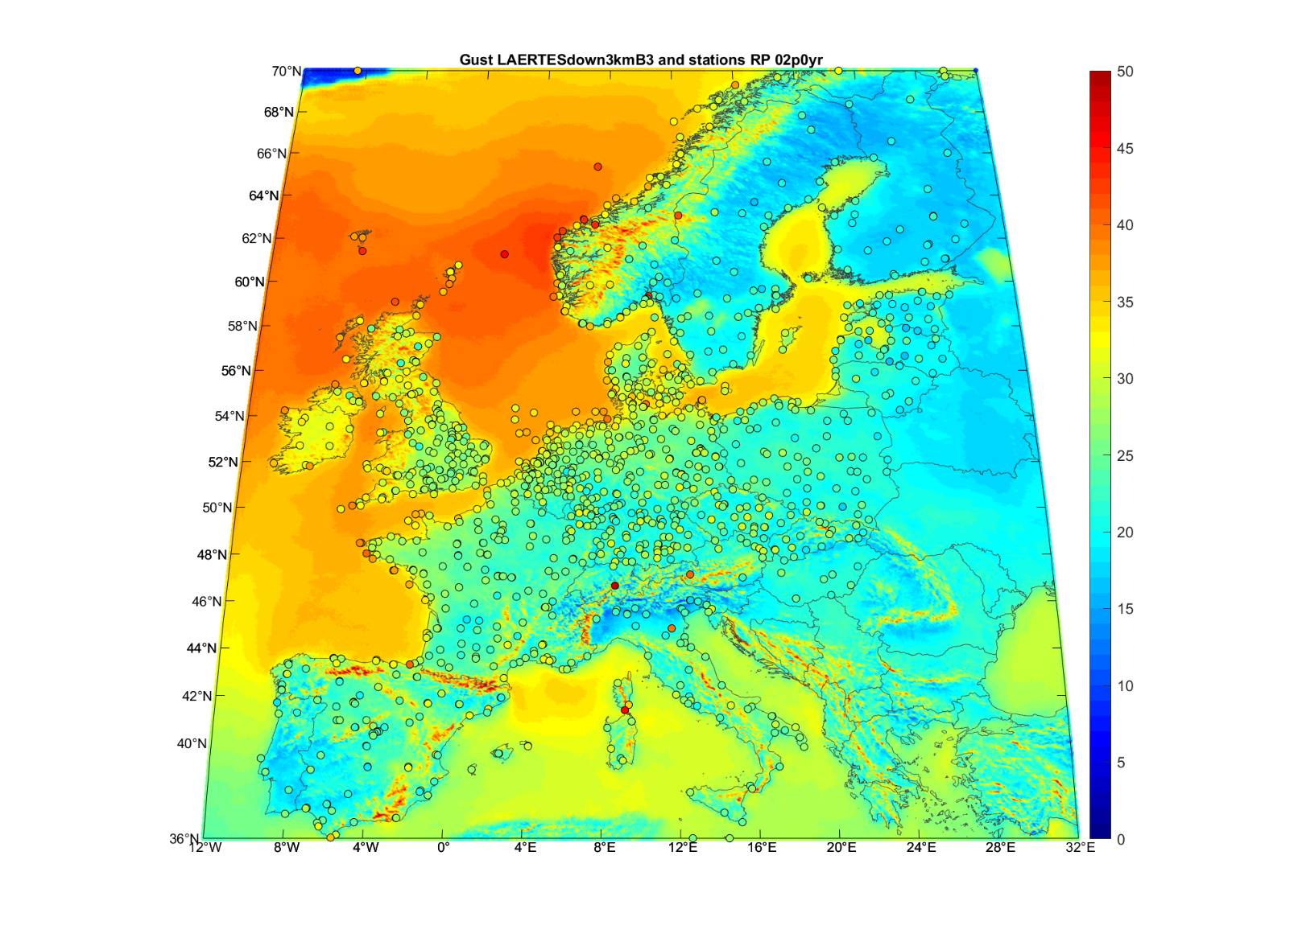
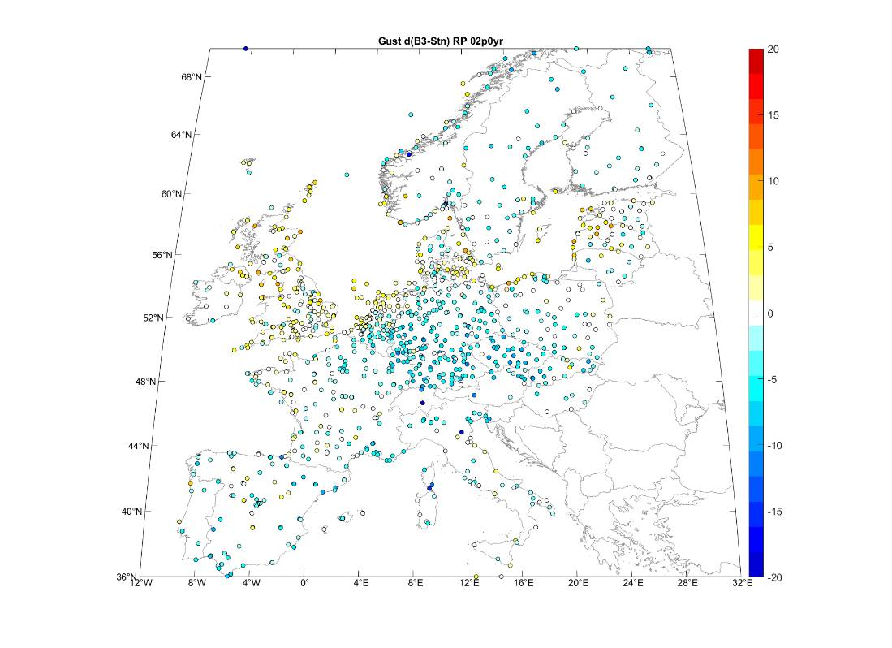
Stochastic hazard @ 3km
Block 3 - 410 years sample, 2050 storms Evaluation

Slide 17
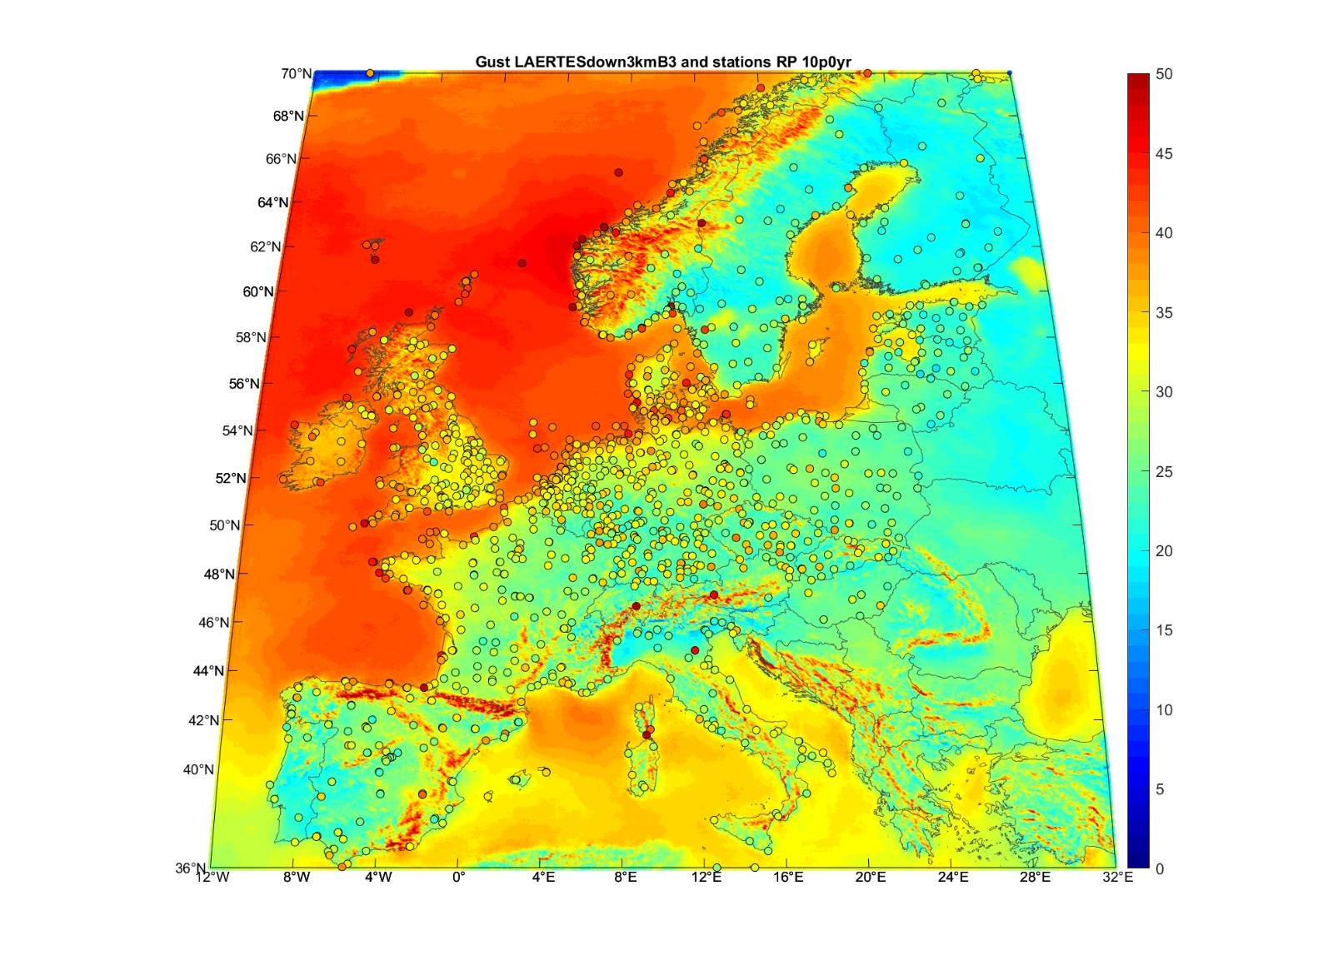
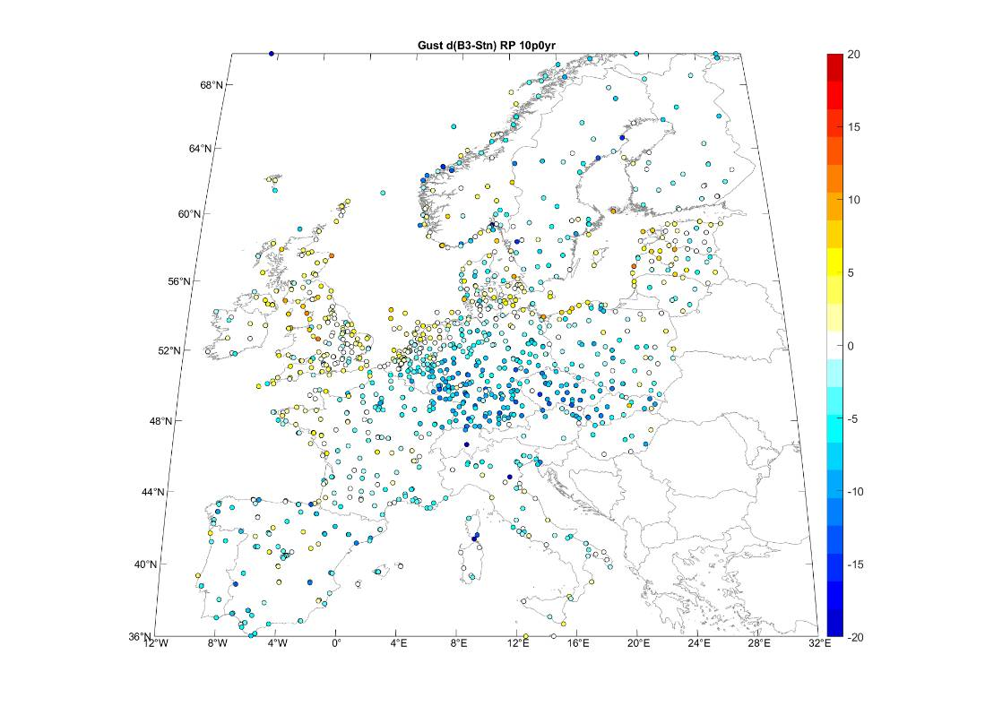
Stochastic hazard @ 3km
Block 3 - 410 years sample, 2050 storms Evaluation

Slide 18
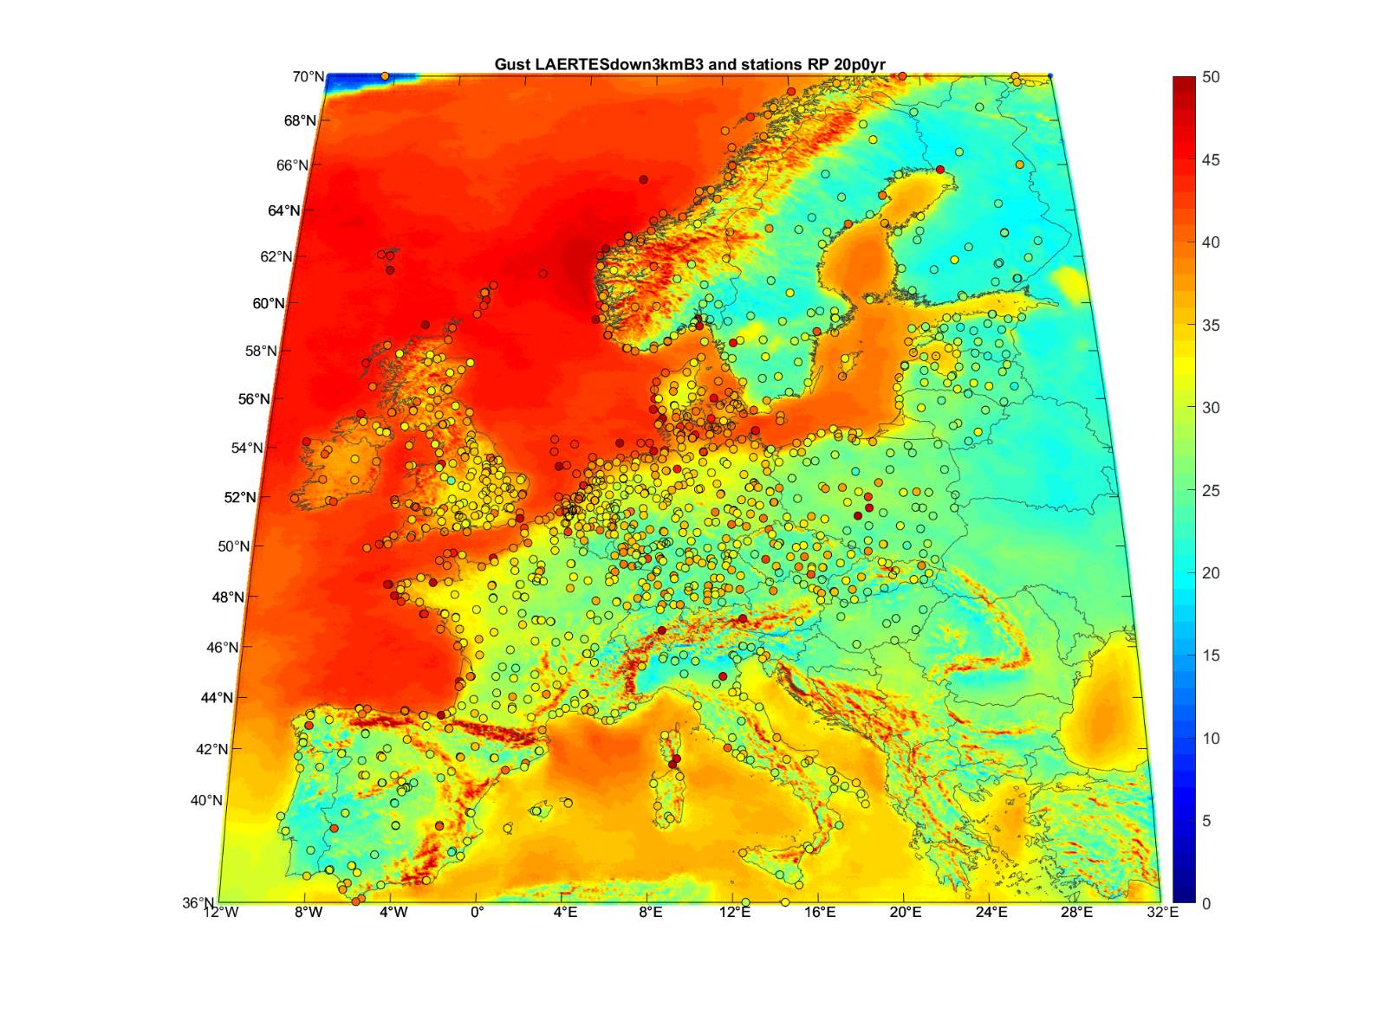
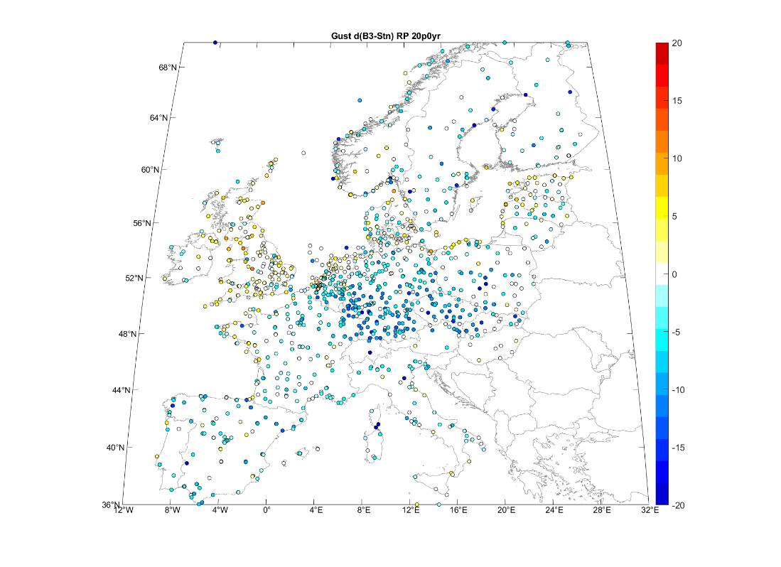
Stochastic hazard @ 3km
Block 3 - 410 years sample, 2050 storms Evaluation

Slide 19
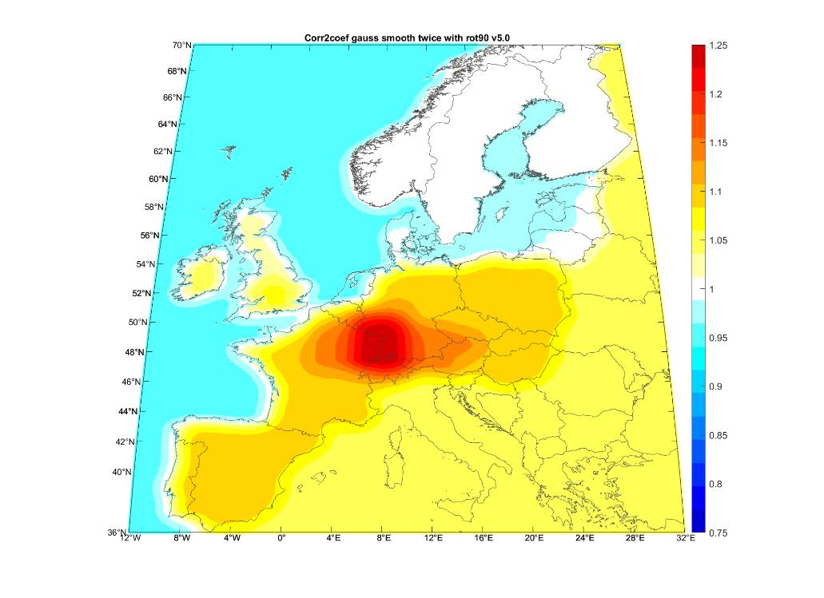
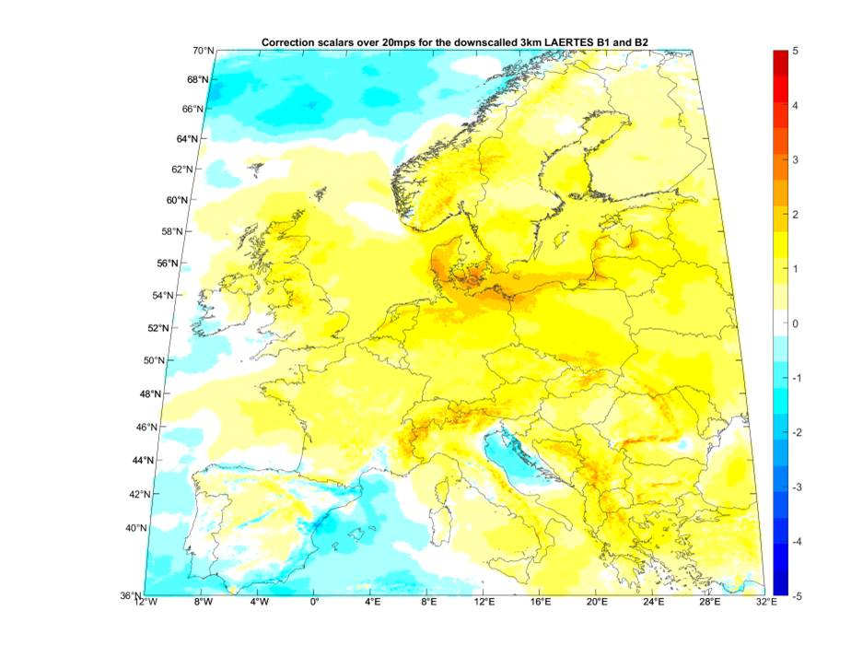
Stochastic hazard – gust intensity calibration in 2 steps
Calibration matrices
Gust offsets (L/HR – L/LR)
L/HR – L/LR
    Fist Step
    Intensity correction of MPI-LR storms against the MPI-HR
    Gust Offsets map
    Applicable > 20mps
    Second Step
    Intensity correction of the LAERTES storms (at MPI-HR level) against meteorological stations
    Gust Coefficients map
    Coefficients: 0.75-1.25
Gust coefficients (ERA5 - L/HR)
ERA5 - L/HR

Slide 20
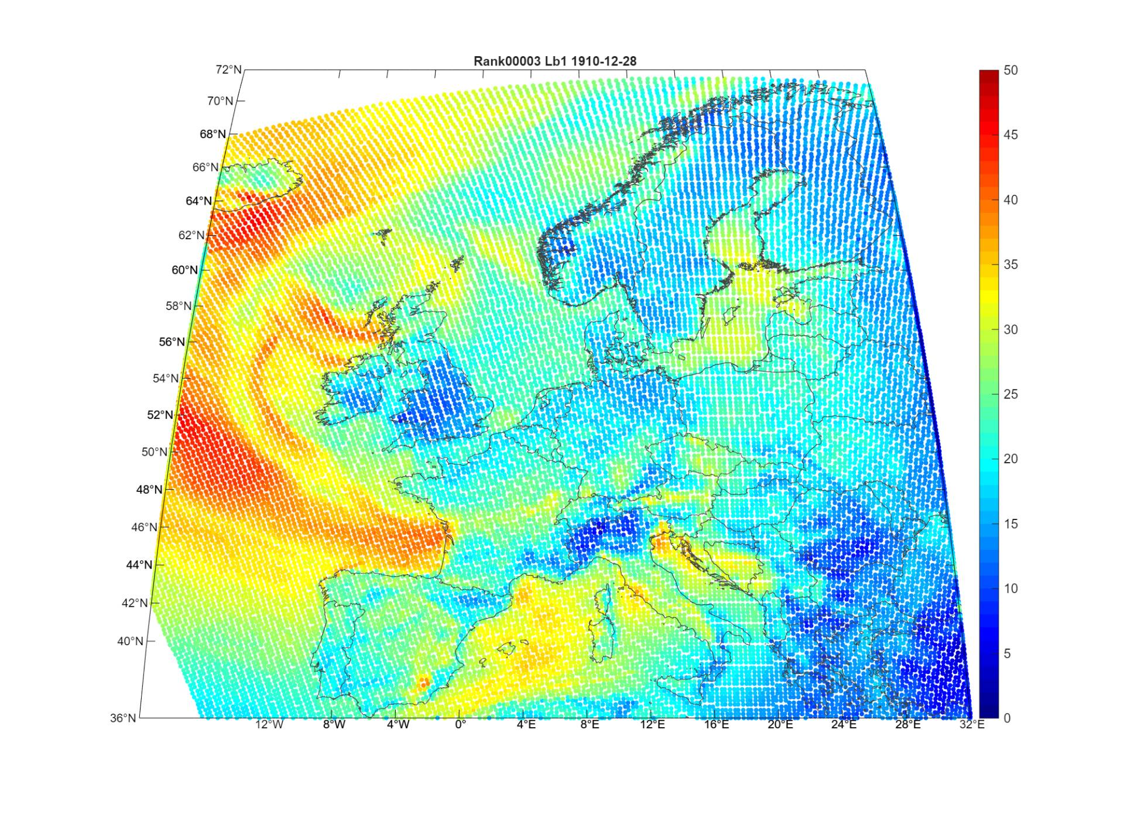
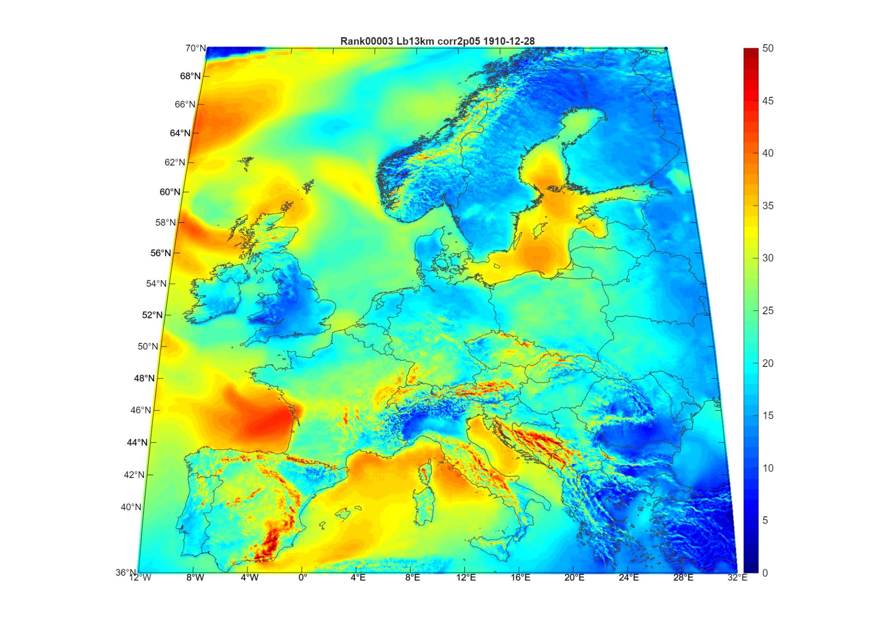
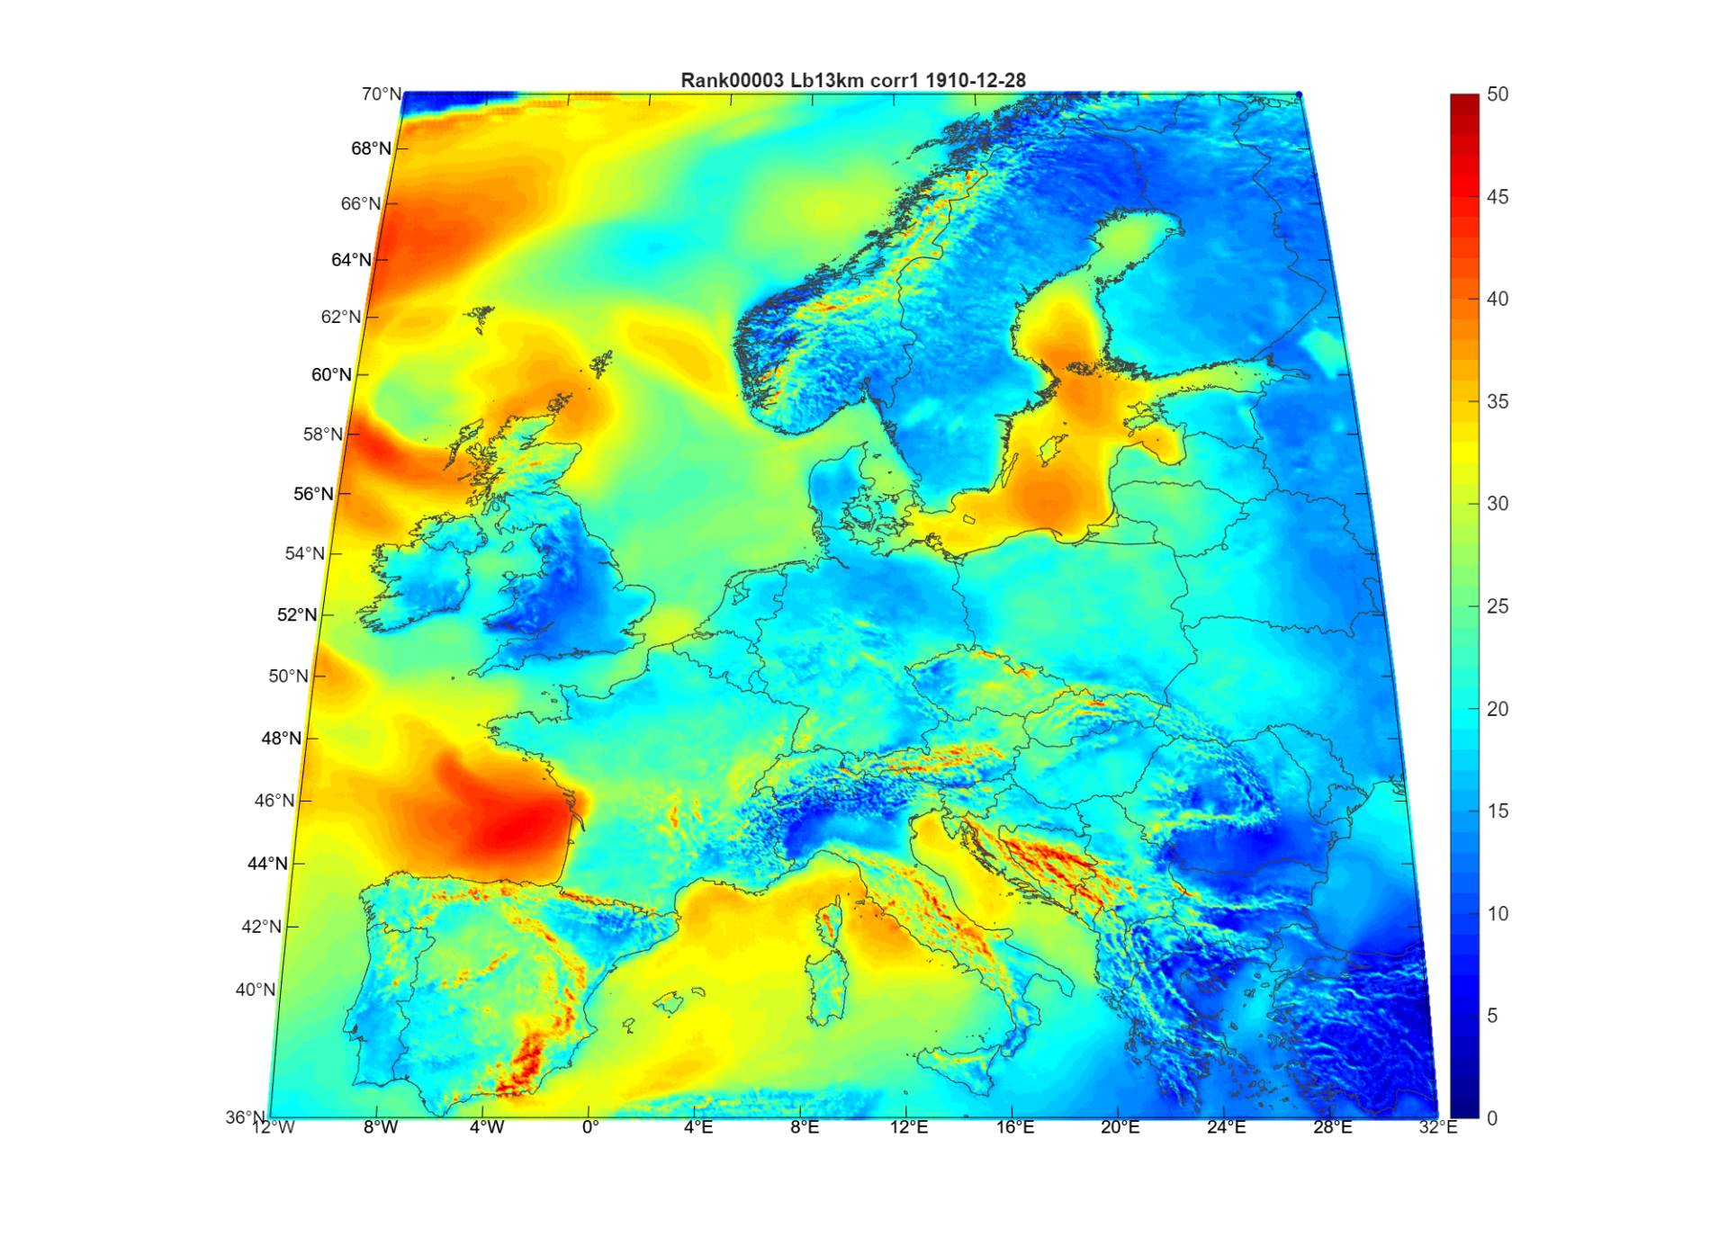
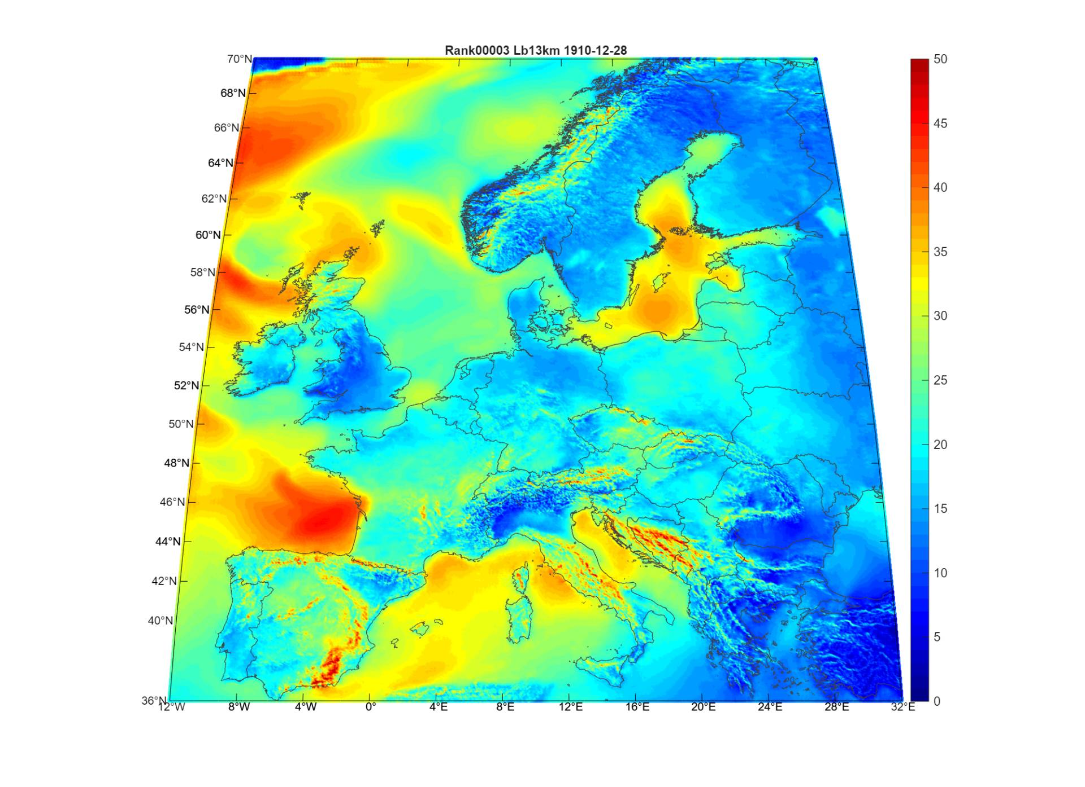
Stochastic hazard – post calibration evaluation
Block 1 – selected storms examples

Slide 21
Stochastic hazard – post calibration evaluation
Block 3 - 410 years sample, 2050 storms: Correction 2 impact

Slide 22
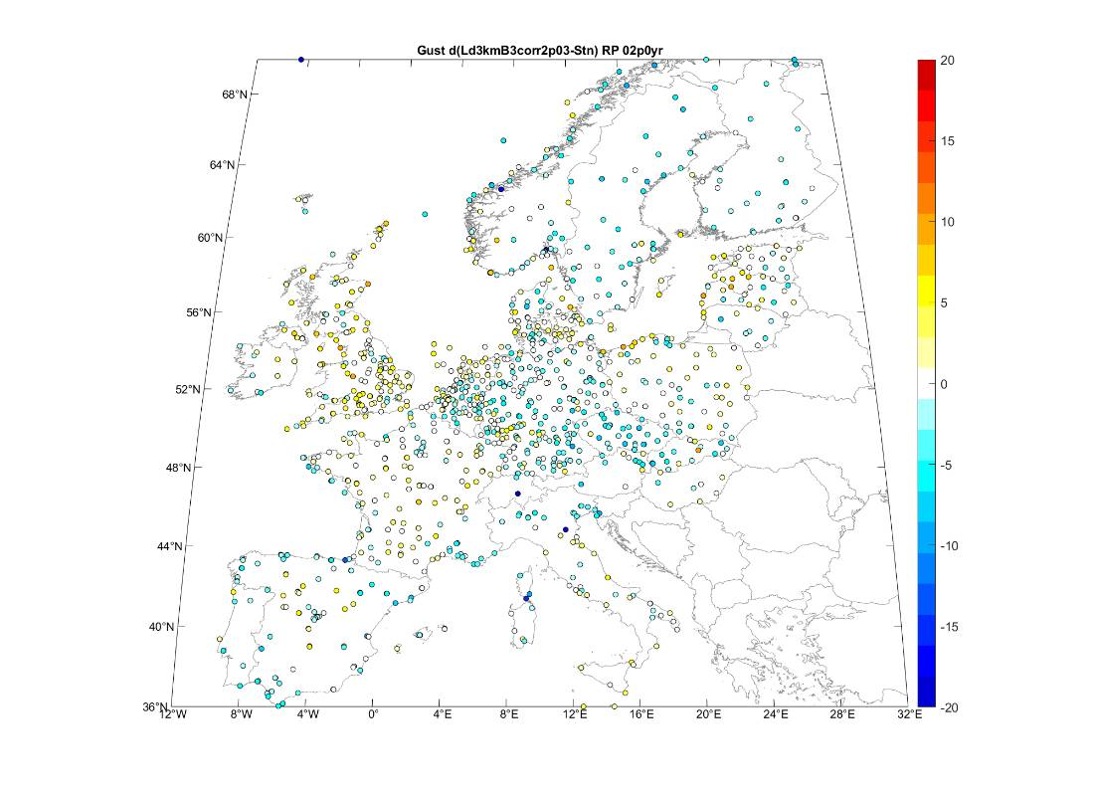

Stochastic hazard – post calibration evaluation
Block 3 - 410 years sample, 2050 storms: Correction 2 impact

Slide 23
Stochastic hazard – post calibration evaluation
Block 3 - 410 years sample, 2050 storms: Correction 2 impact
RMSE B3 = 4.4
RMSE B3 corr2 = 3.7
RMSE B3 = 5.3
RMSE B3 corr2 = 4.4

Slide 24
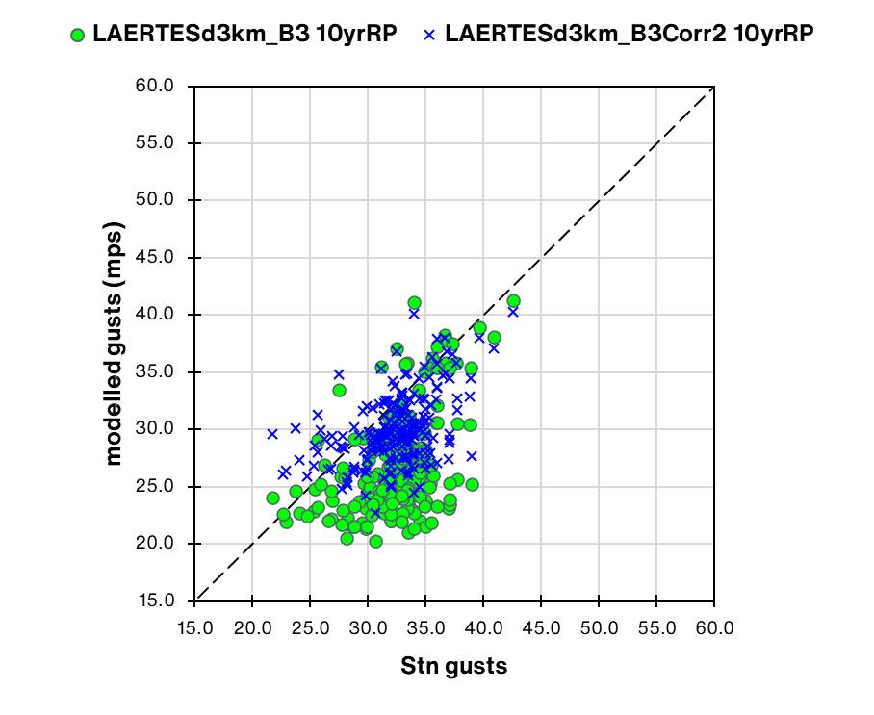
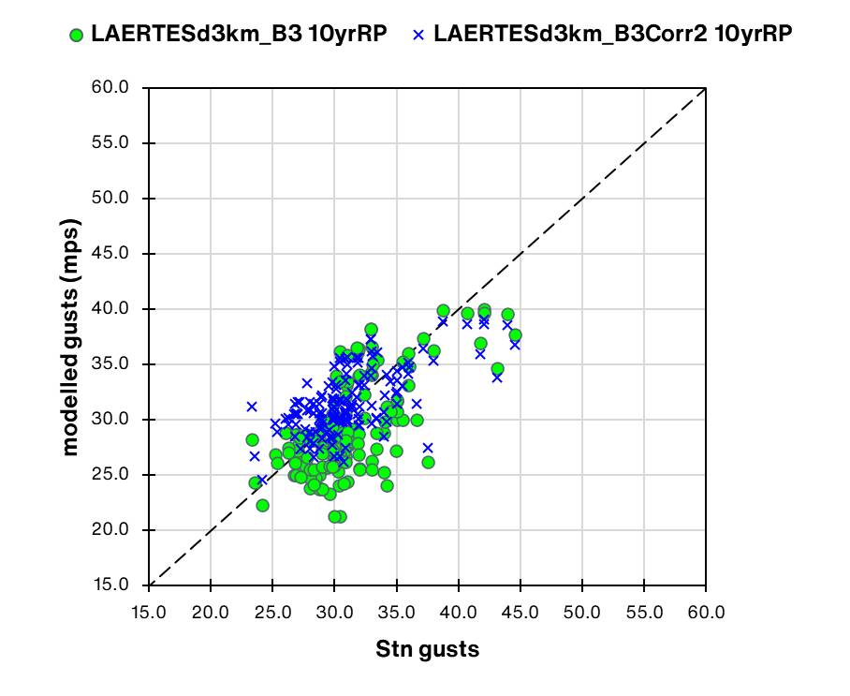
Stochastic hazard – post calibration evaluation
Block 3 - 410 years sample, 2050 storms: Correction 2 impact (regional)
Germany
France
R_rank = 0.41
RMSE B3 = 6.8
R_rank B3 corr2 = 0.42
RMSE B3 corr2 = 4.0
R_rank = 0.58
RMSE B3 = 3.9
R_rank B3 corr2 = 0.57
RMSE B3 corr2 = 3.0

Slide 25
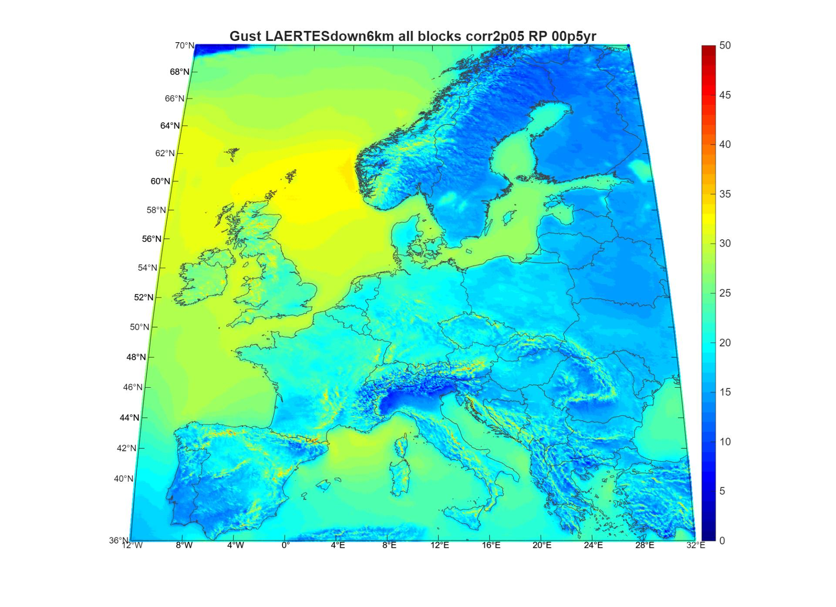
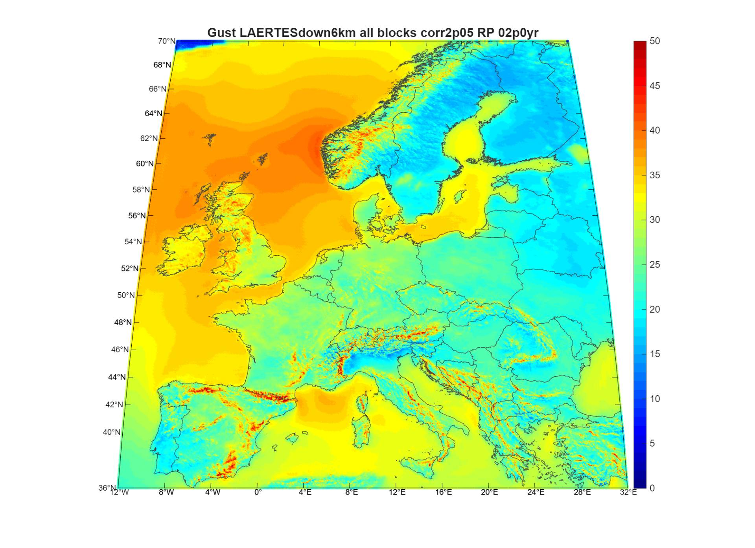
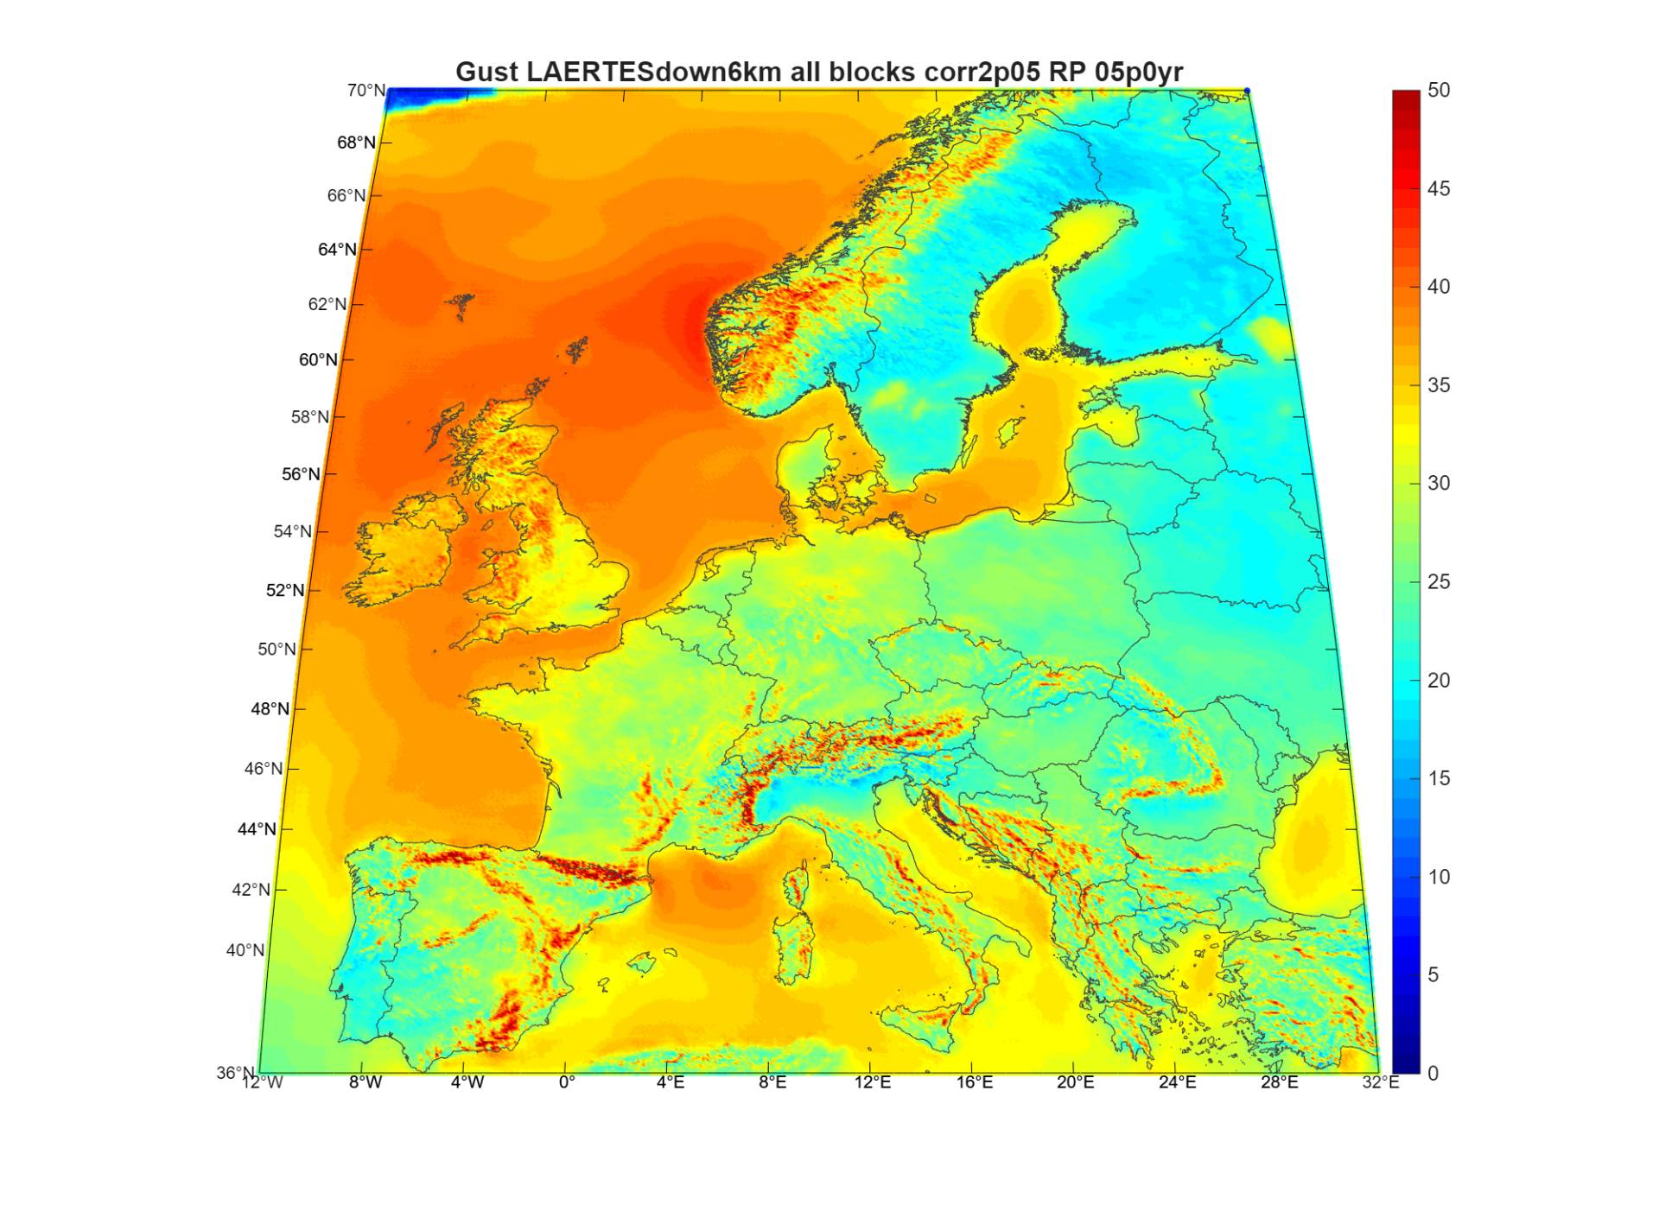
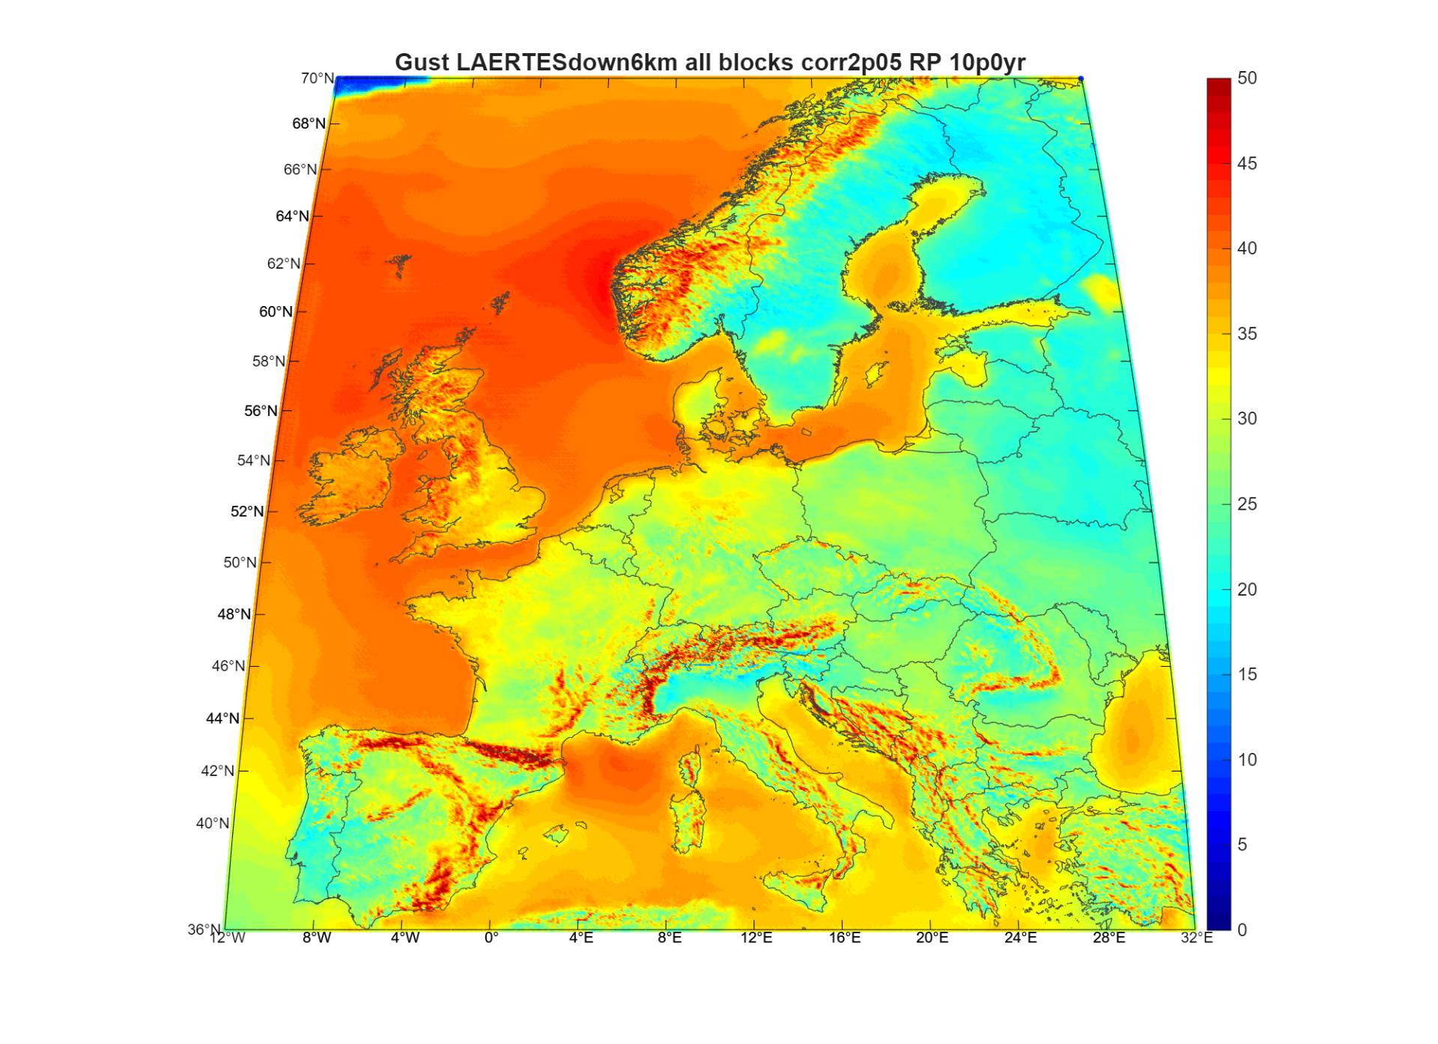
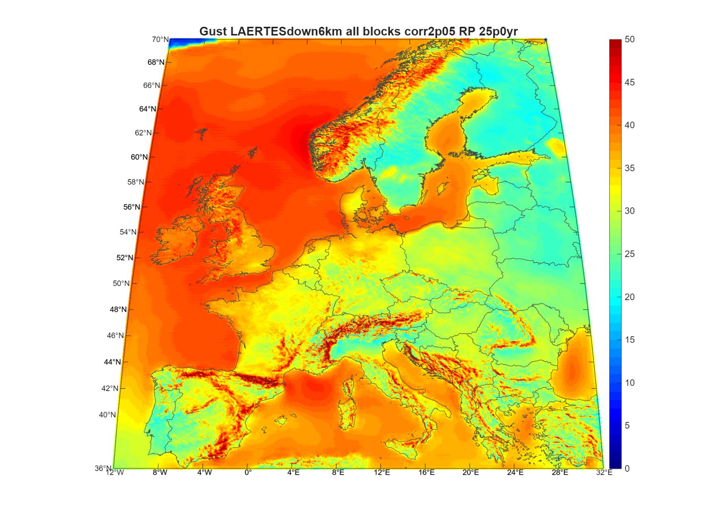
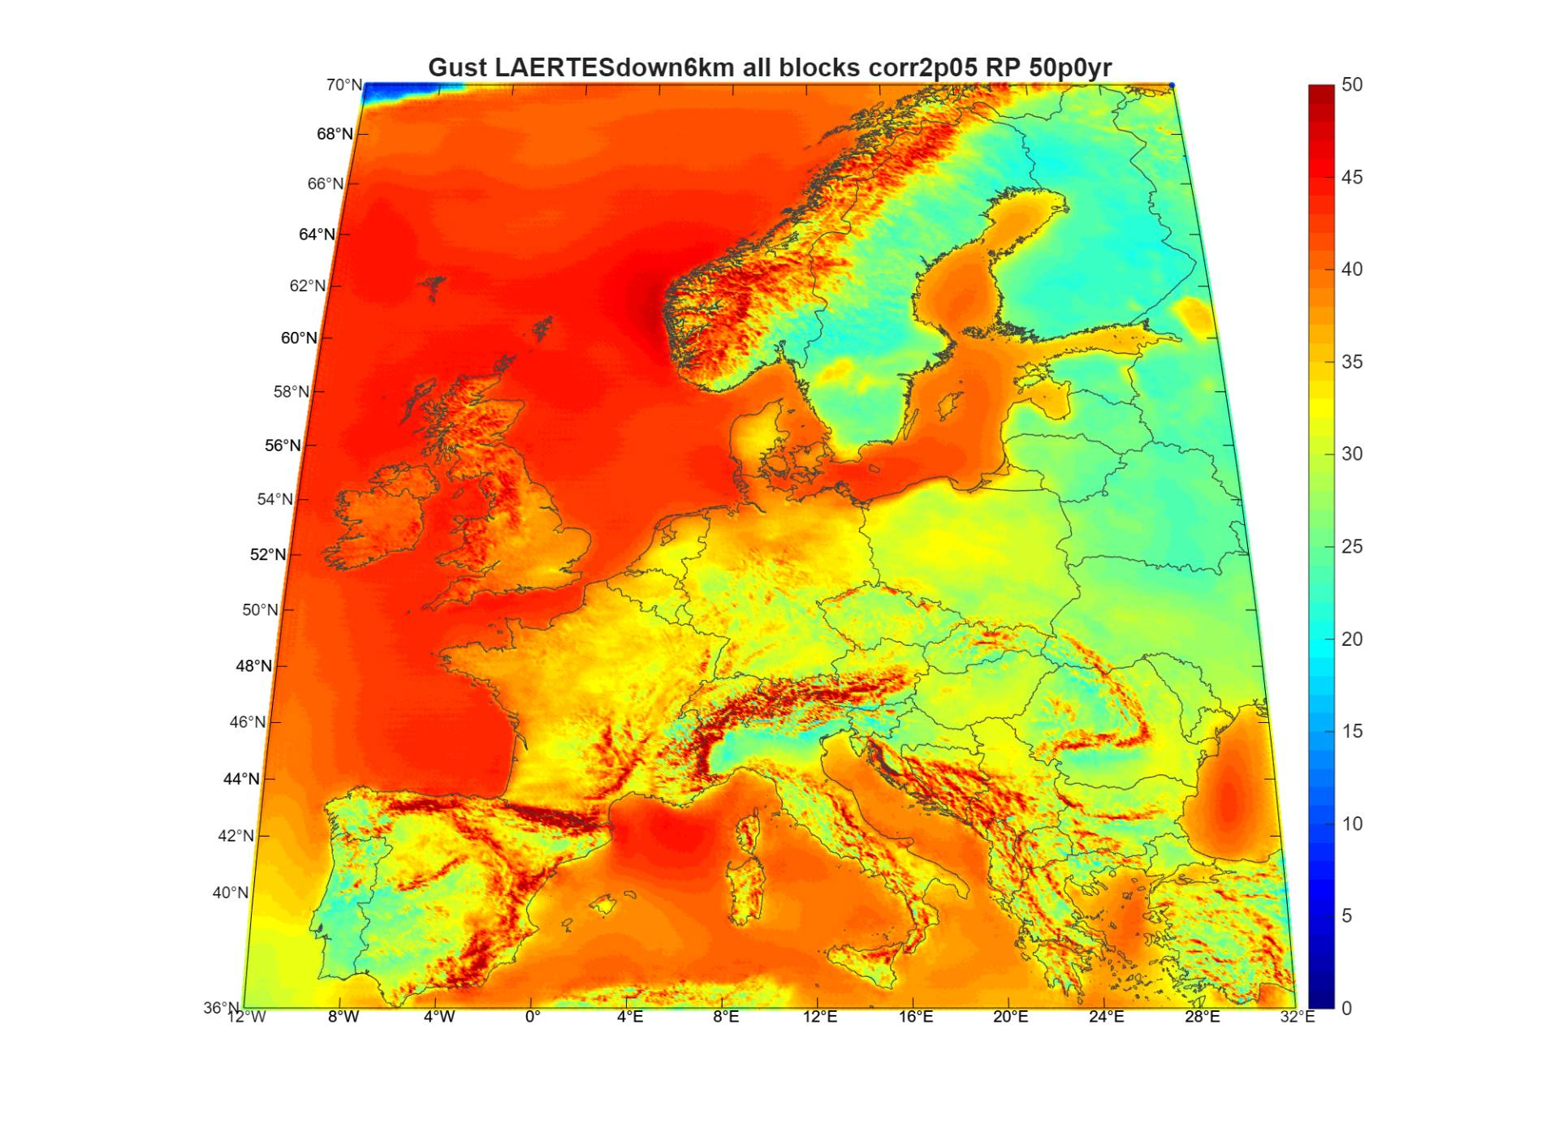
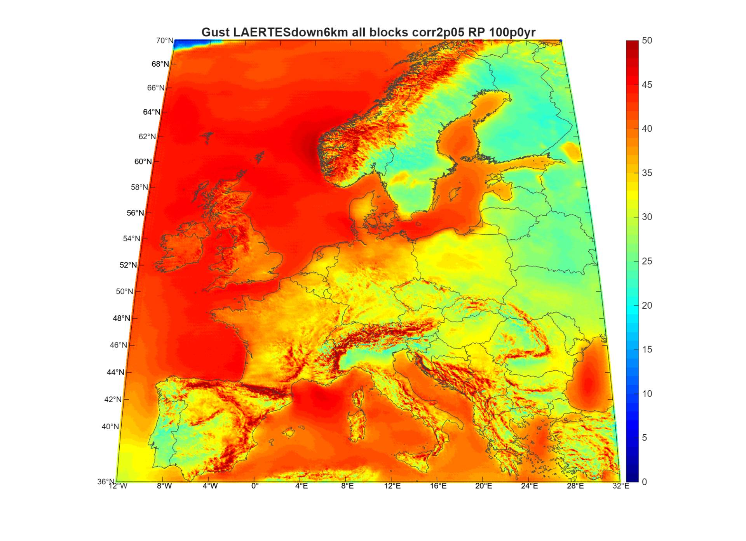
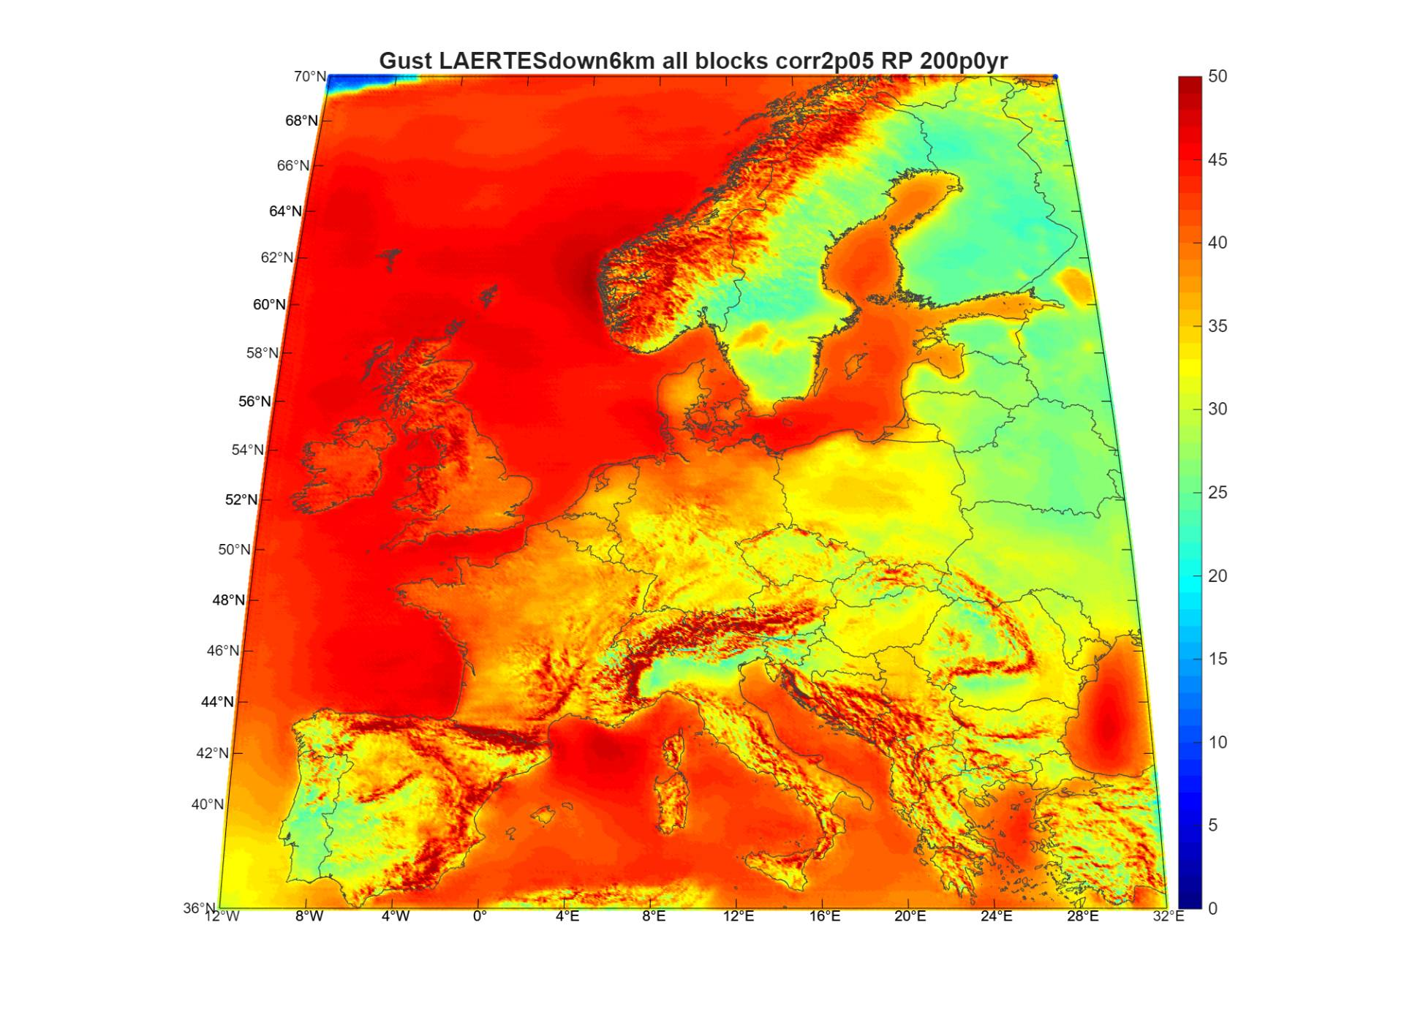
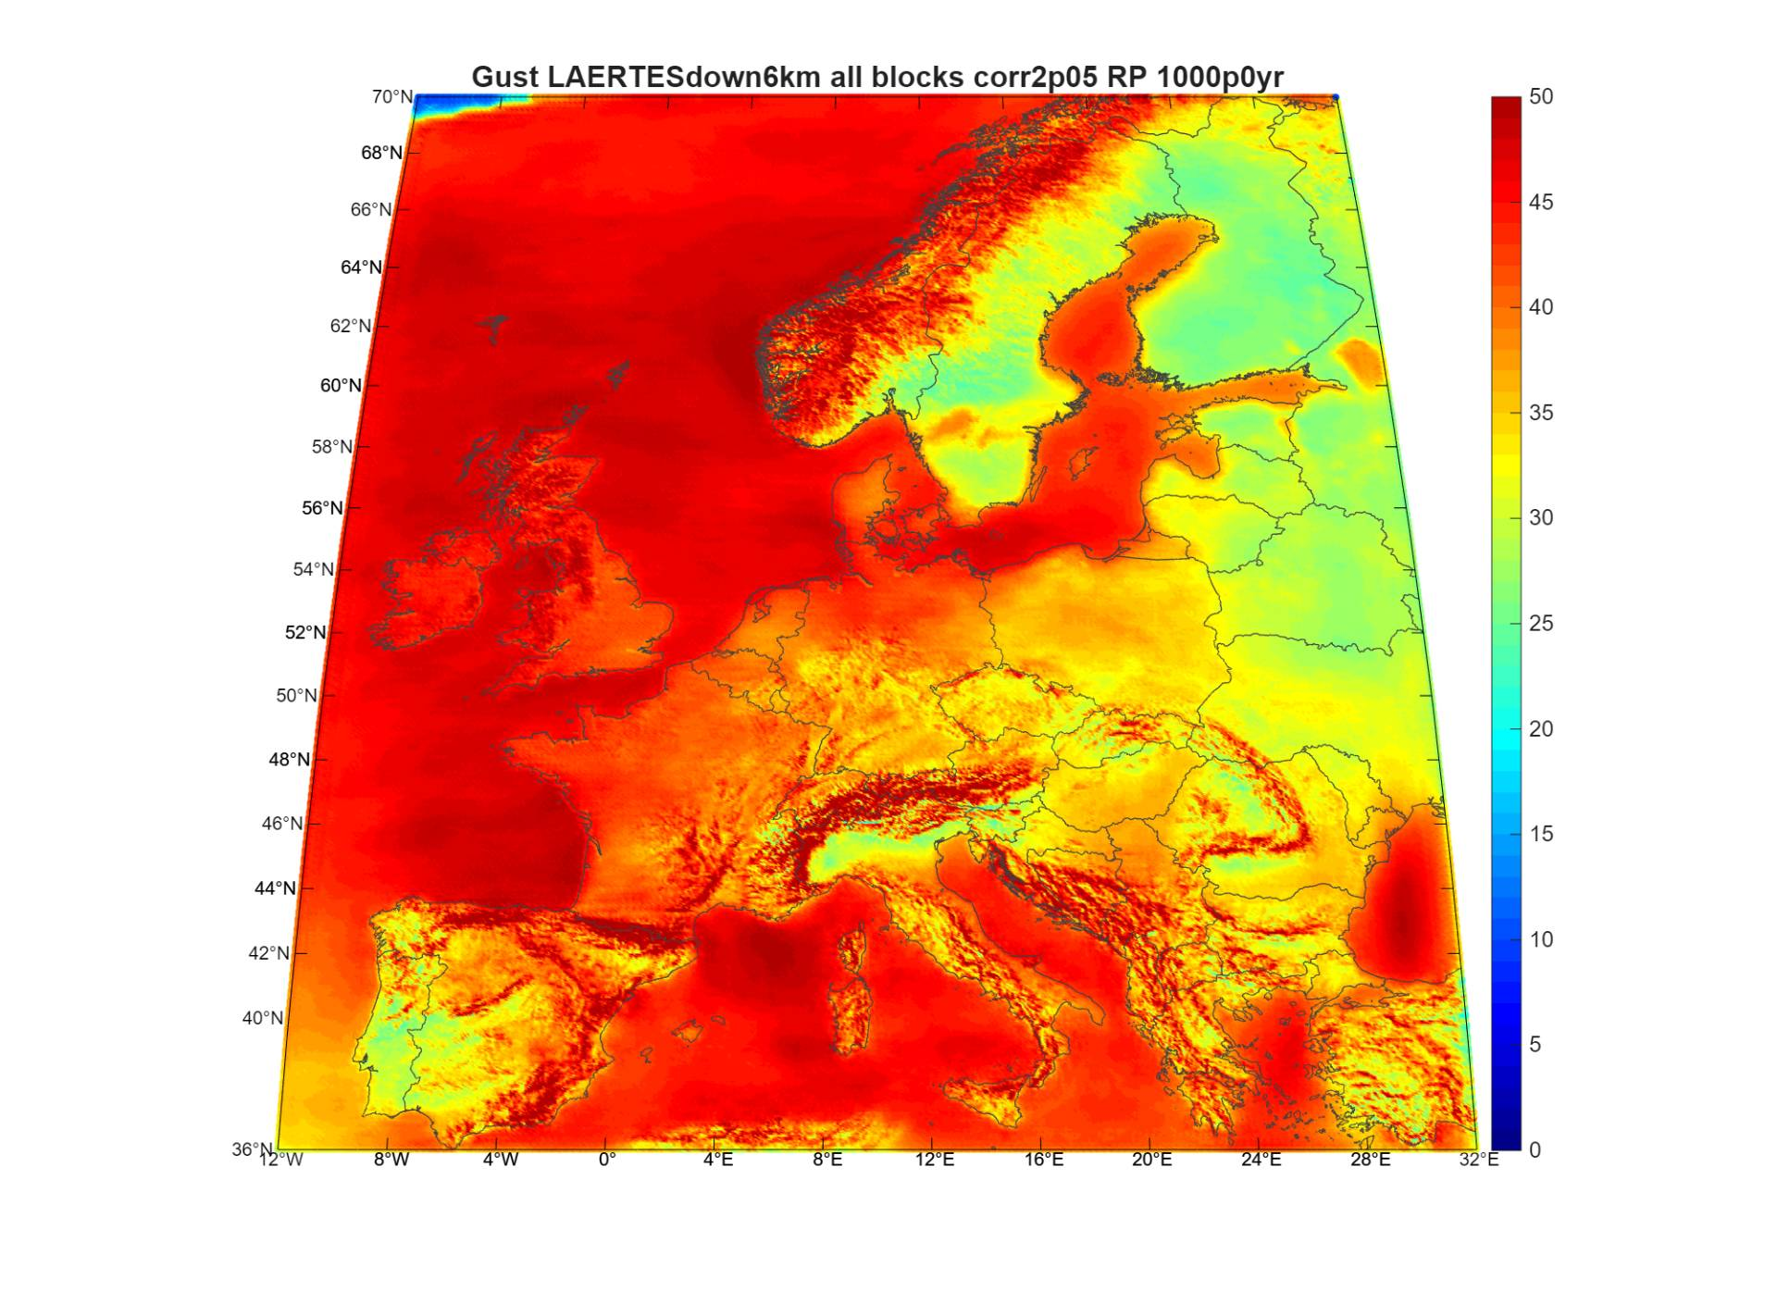
Stochastic hazard – final look
Gusts return periods from all 56,657 events
    Top market losses (Stochastic for 13 core countries)
    Top event at 100B EUR
    5 events > 60B EURs
    10 events > 50B EURs
    50 events > 30B EURs
    100 events > 20B EURs
    550 events > 10B EURS
    Top market losses (historical for 13 core countries)
    Daria at 16B EUR
    Lothar at 10B EUR

Slide 26
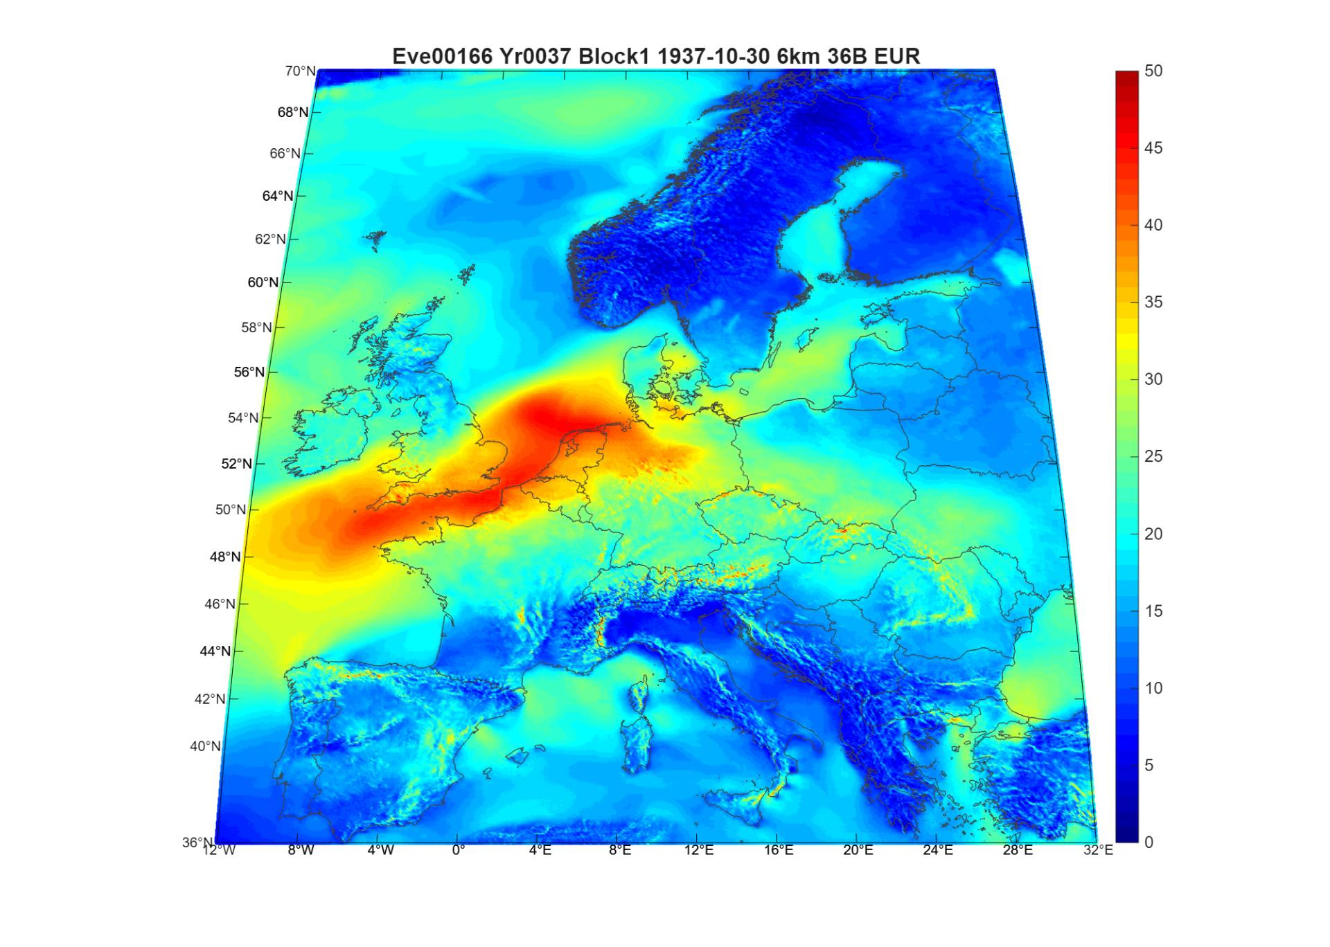
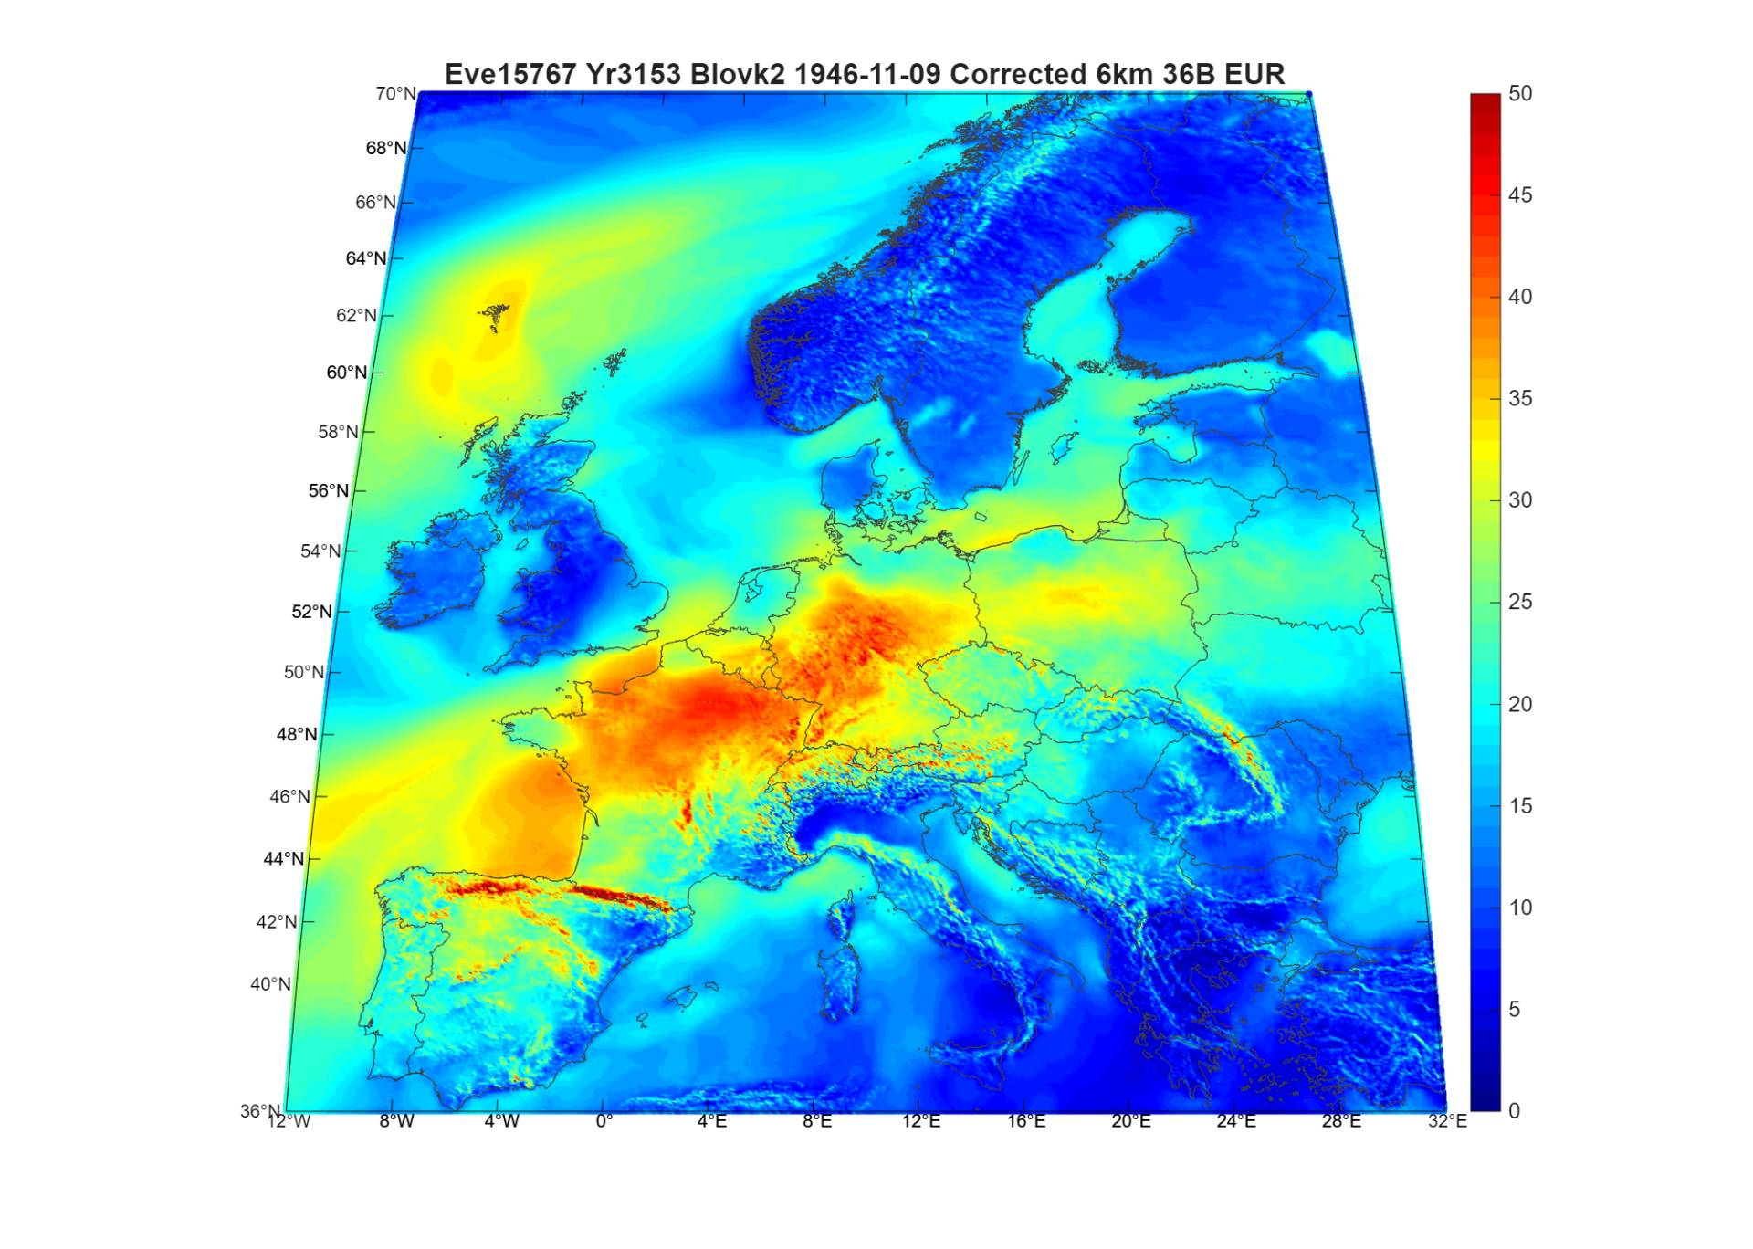
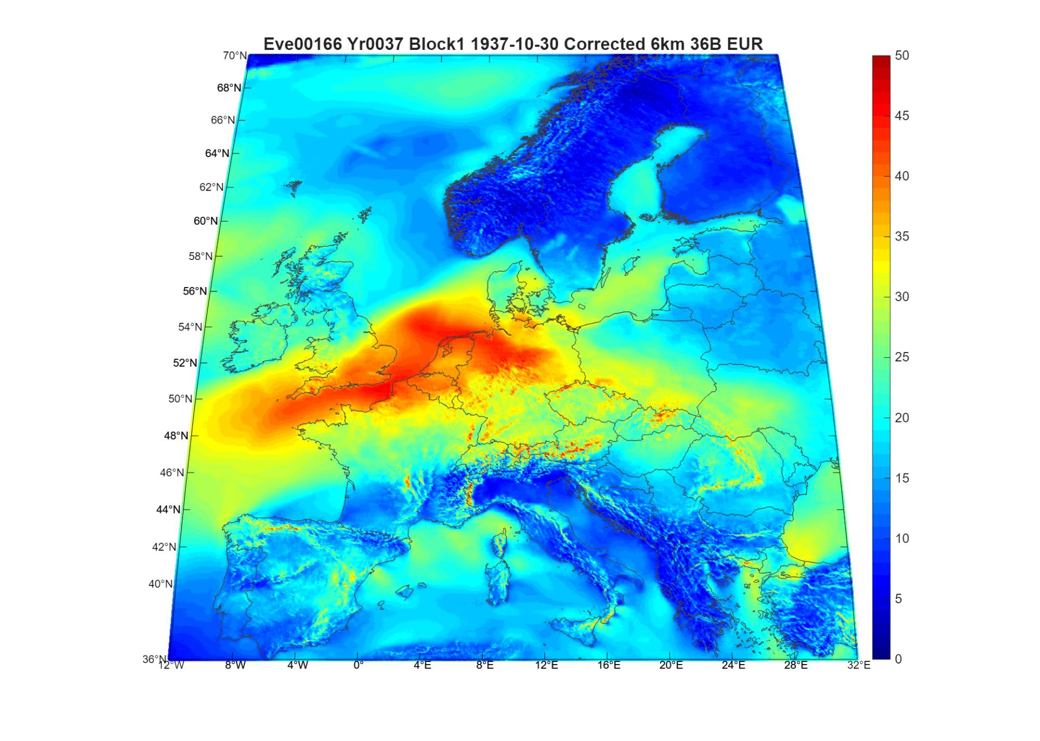
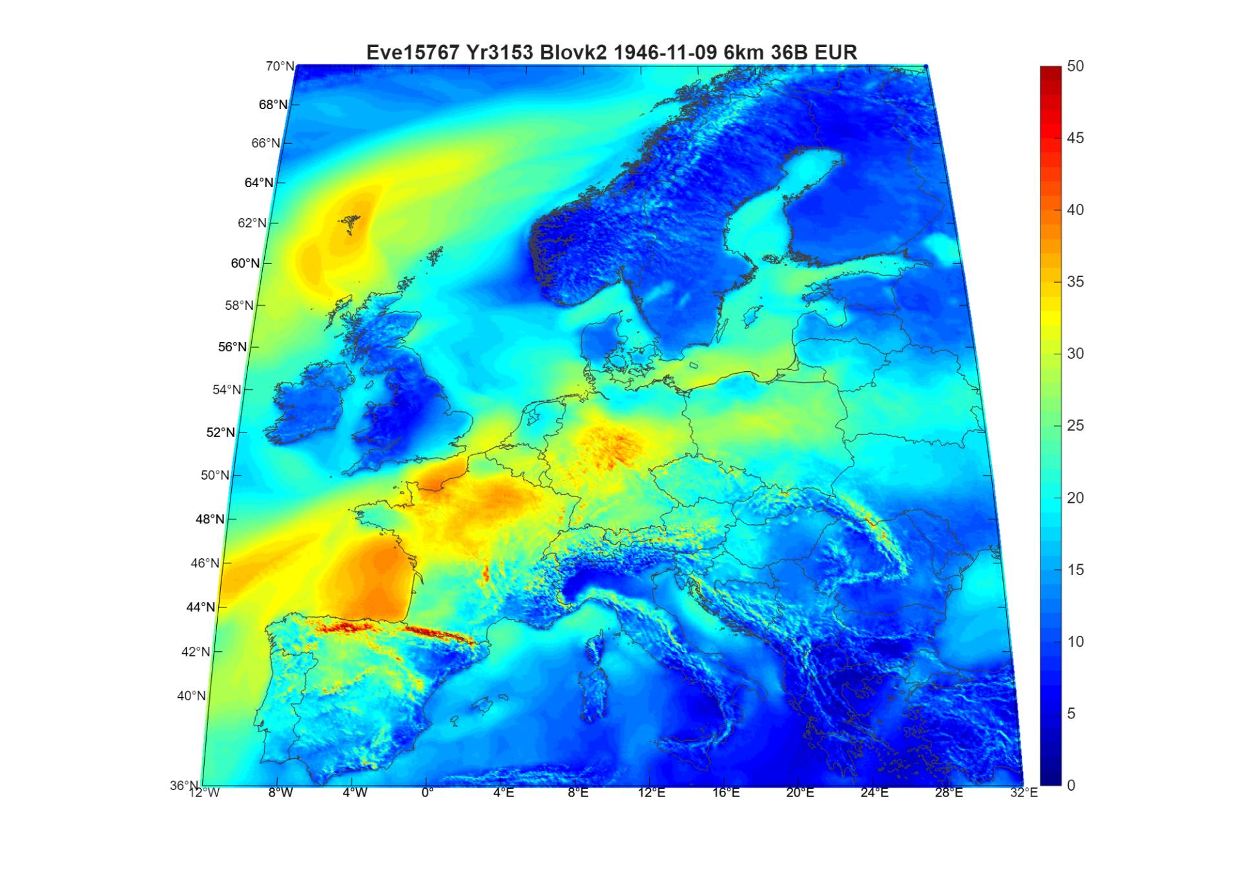
Stochastic hazard – final look
High loss events > 30B EURs

Slide 27
5
Conclusions & take away messages

Slide 28
Conclusions & take away messages
Input MPI-LAERTES stochastic data
Robust climatology (clustering, NAO, WR frequencies)
Low Intensities compared against 60yrs historical baseline
Calibration
Applied only after the downscaling step
Focusing only on intensity correction
Final product
Stochastic gusts over the land increased by 5-25%
The clustering & frequency of the storms is retained as in the MPI-ESM runs
Two distinct steps
Based against met station data, aiming at the 5-10yrs RP gusts region
Stochastic gusts at costal areas and over the sea decreased a bit, 5-10%

Slide 29



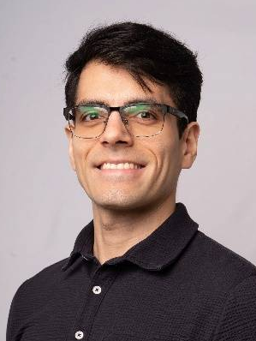
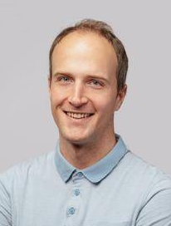

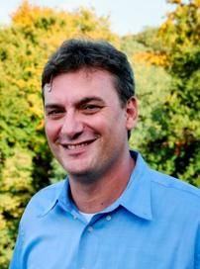
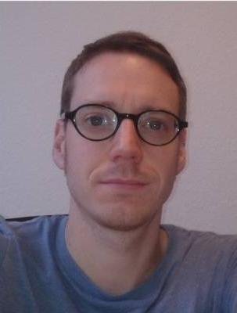

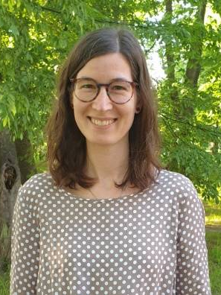


Our team
Thank you!!
Alexandros Georgiadis
  Head of Weather Risk model development, EMEA
Lukas Braun
  Weather Risk model development Lead - Prague
Aidan Brocklehurst
  Weather Risk model development Lead - London
Lubos Sokol
  Catastrophe Model Specialist
Tathagata Roy
  Vulnerability model development Lead - Wind
Ricardo Sanchez
  Vulnerability Model Developer
David Simonik
  Catastrophe Model Developer
Ivan Mrekaj
  Catastrophe Model Developer
  Prof. Joaquim Pinto
  Head of Work Group "Regional Climate and Weather Hazards"
  Dr. Patrick Ludwig
  Work Group Leader
  Dr. Florian Ehmele
  Research Assistant
  Kim Stadelmaier
  PhD Student
  Dr. Lea Eisenstein
  Post-Doctoral Researcher
  Dr. Alexandre Urabano
  Research Assistant
  Dr. Athul R. Satheesh
  Post-Doctoral Researcher
  Hendrick Feldmann
  Research Assistant

Slide 30
Disclaimer
Legal Disclaimer
Aon’s Reinsurance Solutions business, part of Aon UK Limited (for itself and on behalf of each subsidiary company of Aon plc) (“Aon”) reserves all rights to the content of this report (“Report”). This Report is for distribution to Aon and the organisation to which it was originally delivered only. Copies may be made by that organisation for its own internal purposes but this Report may not be distributed in whole or in part to any third party without both (i) the prior written consent of Aon. and (ii) the third party having first signed a “recipient of report” letter in a form acceptable to Aon. Aon cannot accept any liability to any third party to whom this Report is disclosed, whether disclosed in compliance with the preceding sentence of otherwise.
To the extent this Report expresses any recommendation or assessment on any aspect of risk, the recipient acknowledges that any such recommendation or assessment is an expression of Aon opinion only, and is not a statement of fact. Any decision to rely on any such recommendation or assessment of risk is entirely the responsibility of the recipient. Aon will not in any event be responsible for any losses that may be incurred by any party as a result of any reliance placed on any such opinion. The recipient acknowledges that this Report does not replace the need for the recipient to undertake its own assessment.
The recipient acknowledges that in preparing this Report Aon may have based analysis on data provided by the recipient and/or from third party sources. This data may have been subjected to mathematical and/or empirical analysis and modelling. Aon has not verified, and accepts no responsibility for, the accuracy or completeness of any such data. In addition, the recipient acknowledges that any form of mathematical and/or empirical analysis and modelling (including that used in the preparation of this Report) may produce results which differ from actual events or losses.
The Aon analysis has been undertaken from the perspective of a reinsurance broker. Consequently this Report does not constitute an opinion of reserving levels or accounting treatment. This Report does not constitute any form of legal, accounting, taxation, regulatory or actuarial advice.
Limitations of Catastrophe Models
This report includes information that is output from catastrophe models of Impact Forecasting, LLC (IF). The information from the models is provided by Aon Benfield Services, Inc. (Aon) under the terms of its license agreements with IF. The results in this report from IF are the products of the exposures modelled, the financial assumptions made concerning deductibles and limits, and the risk models that project the pounds of damage that may be caused by defined catastrophe perils. Aon recommends that the results from these models in this report not be relied upon in isolation when making decisions that may affect the underwriting appetite, rate adequacy or solvency of the company. The IF models are based on scientific data, mathematical and empirical models, and the experience of engineering, geological and meteorological experts. Calibration of the models using actual loss experience is based on very sparse data, and material inaccuracies in these models are possible. The loss probabilities generated by the models are not predictive of future hurricanes, other windstorms, or earthquakes or other natural catastrophes, but provide estimates of the magnitude of losses that may occur in the event of such natural catastrophes. Aon makes no warranty about the accuracy of the IF models and has made no attempt to independently verify them. Aon will not be liable for any special, indirect or consequential damages, including, without limitation, losses or damages arising from or related to any use of or decisions based upon data developed using the models of IF.
Additional Limitations of Impact Forecasting, LLC
The results listed in this report are based on engineering / scientific analysis and data, information provided by the client, and mathematical and empirical models. The accuracy of the results depends on the uncertainty associated with each of these areas. In particular, as with any model, actual losses may differ from the results of simulations. It is only possible to provide plausible results based on complete and accurate information provided by the client and other reputable data sources. Furthermore, this information may only be used for the business application specified by Impact Forecasting, LLC and for no other purpose. It may not be used to support development of or calibration of a product or service offering that competes with Impact Forecasting, LLC. The information in this report may not be used as a part of or as a source for any insurance rate filing documentation.
THIS INFORMATION IS PROVIDED “AS IS” AND IMPACT FORECASTING, LLC HAS NOT MADE AND DOES NOT MAKE ANY WARRANTY OF ANY KIND WHATSOEVER, EXPRESS OR IMPLIED, WITH RESPECT TO THIS REPORT; AND ALL WARRANTIES INCLUDING WARRANTIES OF MERCHANTABILITY AND FITNESS FOR A PARTICULAR PURPOSE ARE HEREBY DISCLAIMED BY IMPACT FORECASTING, LLC. IMPACT FORECASTING, LLC WILL NOT BE LIABLE TO ANYONE WITH RESPECT TO ANY DAMAGES, LOSS OR CLAIM WHATSOEVER, NO MATTER HOW OCCASIONED, IN CONNECTION WITH THE PREPARATION OR USE OF THIS REPORT.

