Slide 1

On Robust Signals in the Variability of European Windstorm Risk
Philip Rupp, Elisa Spreitzer, Joel Zeder, Erik Lindgren
Workshop on European Storms
Delft – June 2026

Slide 2
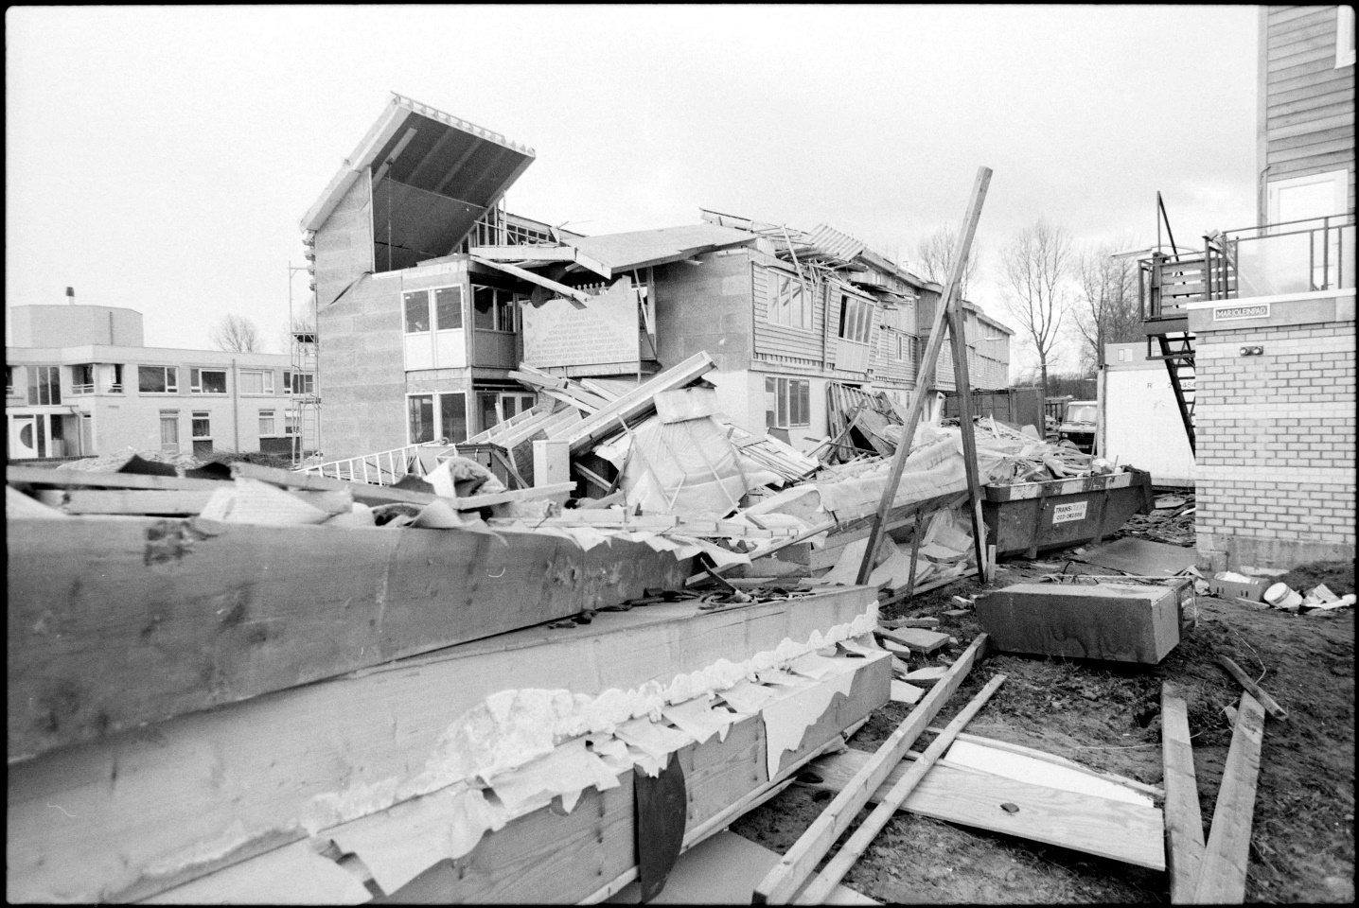

Can a storm season like 1989/90 happen again next year?
Storm damage in Haarlem, Netherlands, 26.01.1990
Source: Fotopersbureau De Boer, Stormschade diverse, Haar, CC0

Slide 3
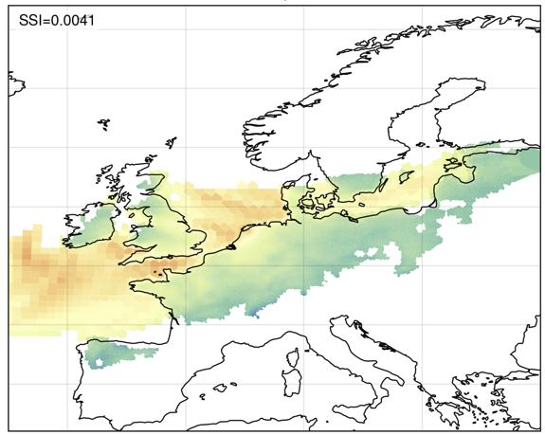
Datasets
Tracked storms (extratropical cyclones) over the Euro-Atlantic
Based on ERA5 re-analysis and SEAS5 seasonal hindcasts
ERA5: ca. 40 seasons, 500 storms
SEAS5: ca. 2700 seasons, 35000 UNSEEN storms
DJF season only
Daria (1990)
Methods
Storm footprints as maximum surface wind speed
Severity (SSI) computed for land-only
SSI accounts for strong winds in large area
Data collection and event identification in collaboration with G. Leckebush et al., Uni. of Birmingham

Slide 4
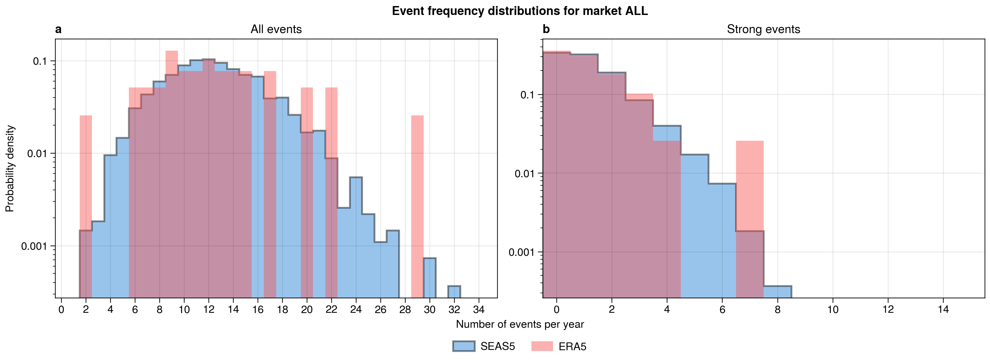
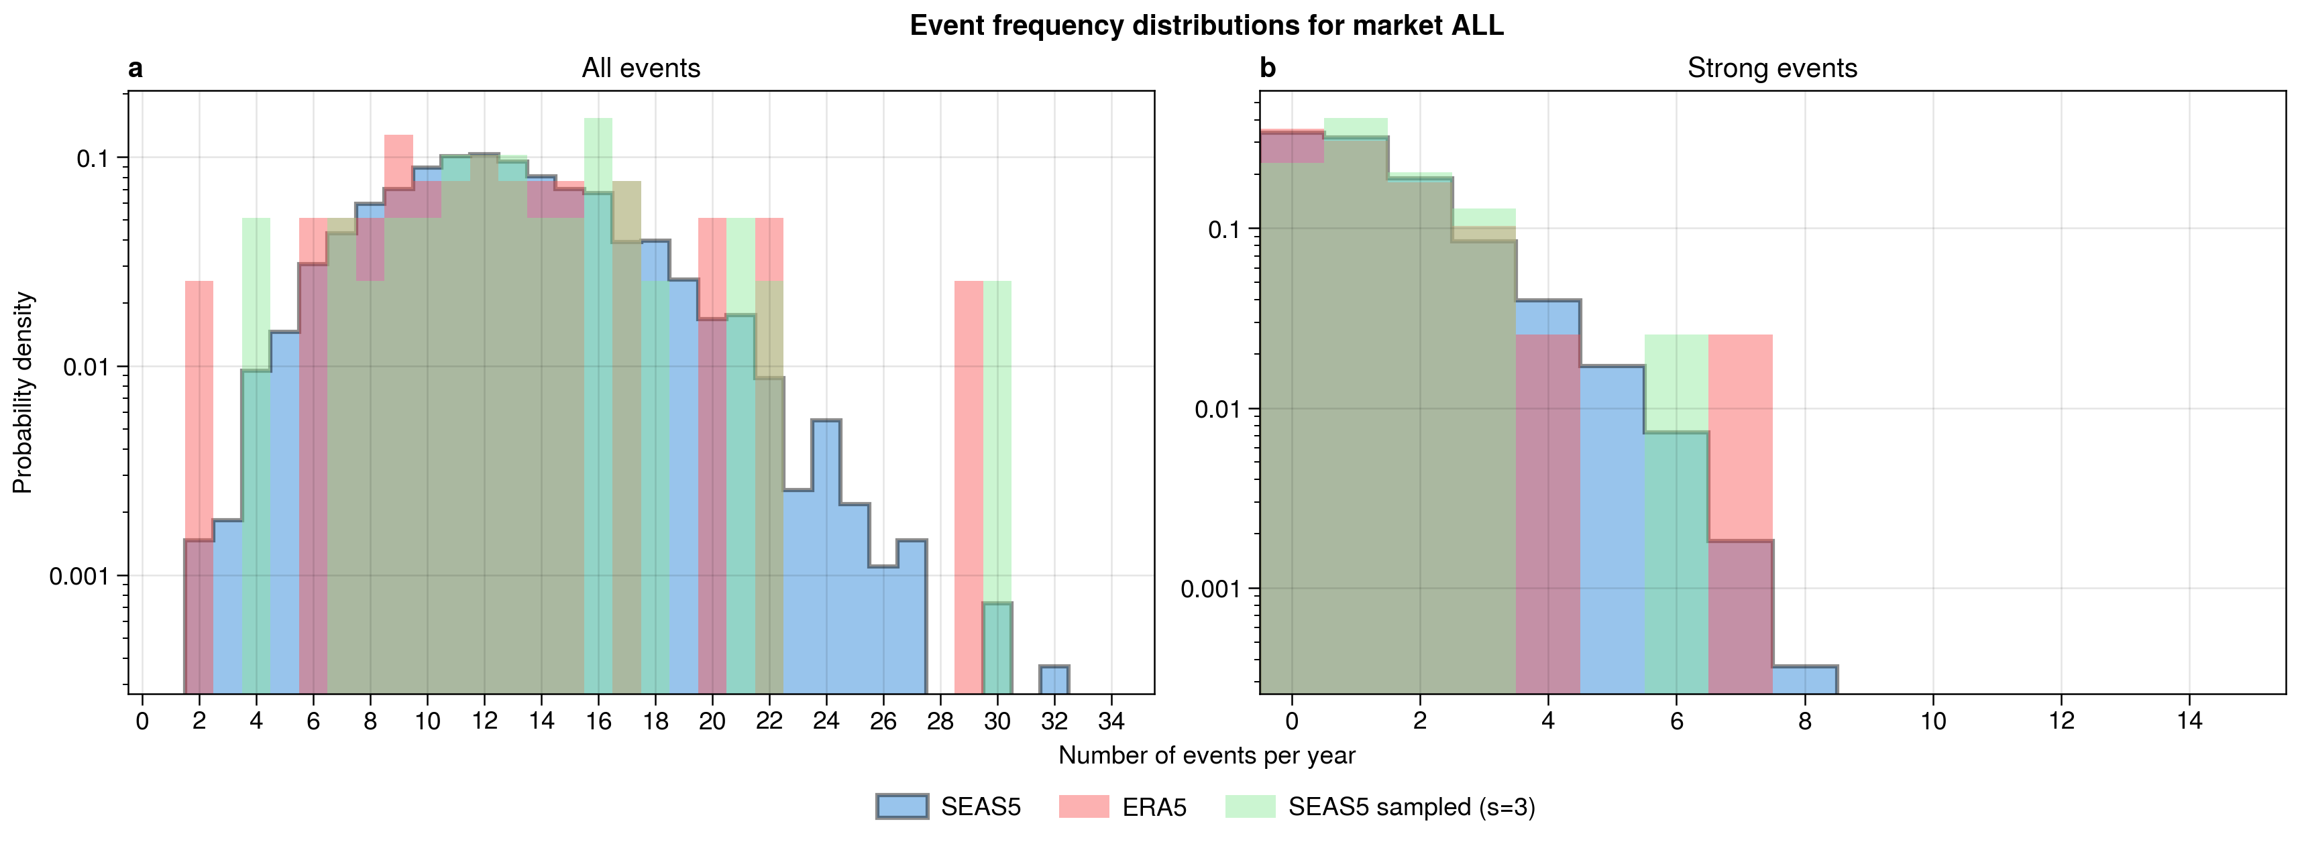
Event frequency distribution (Europe)
Top 90% based on SSI
1992
Both datasets agree on overall distribution, including extremes

Slide 5
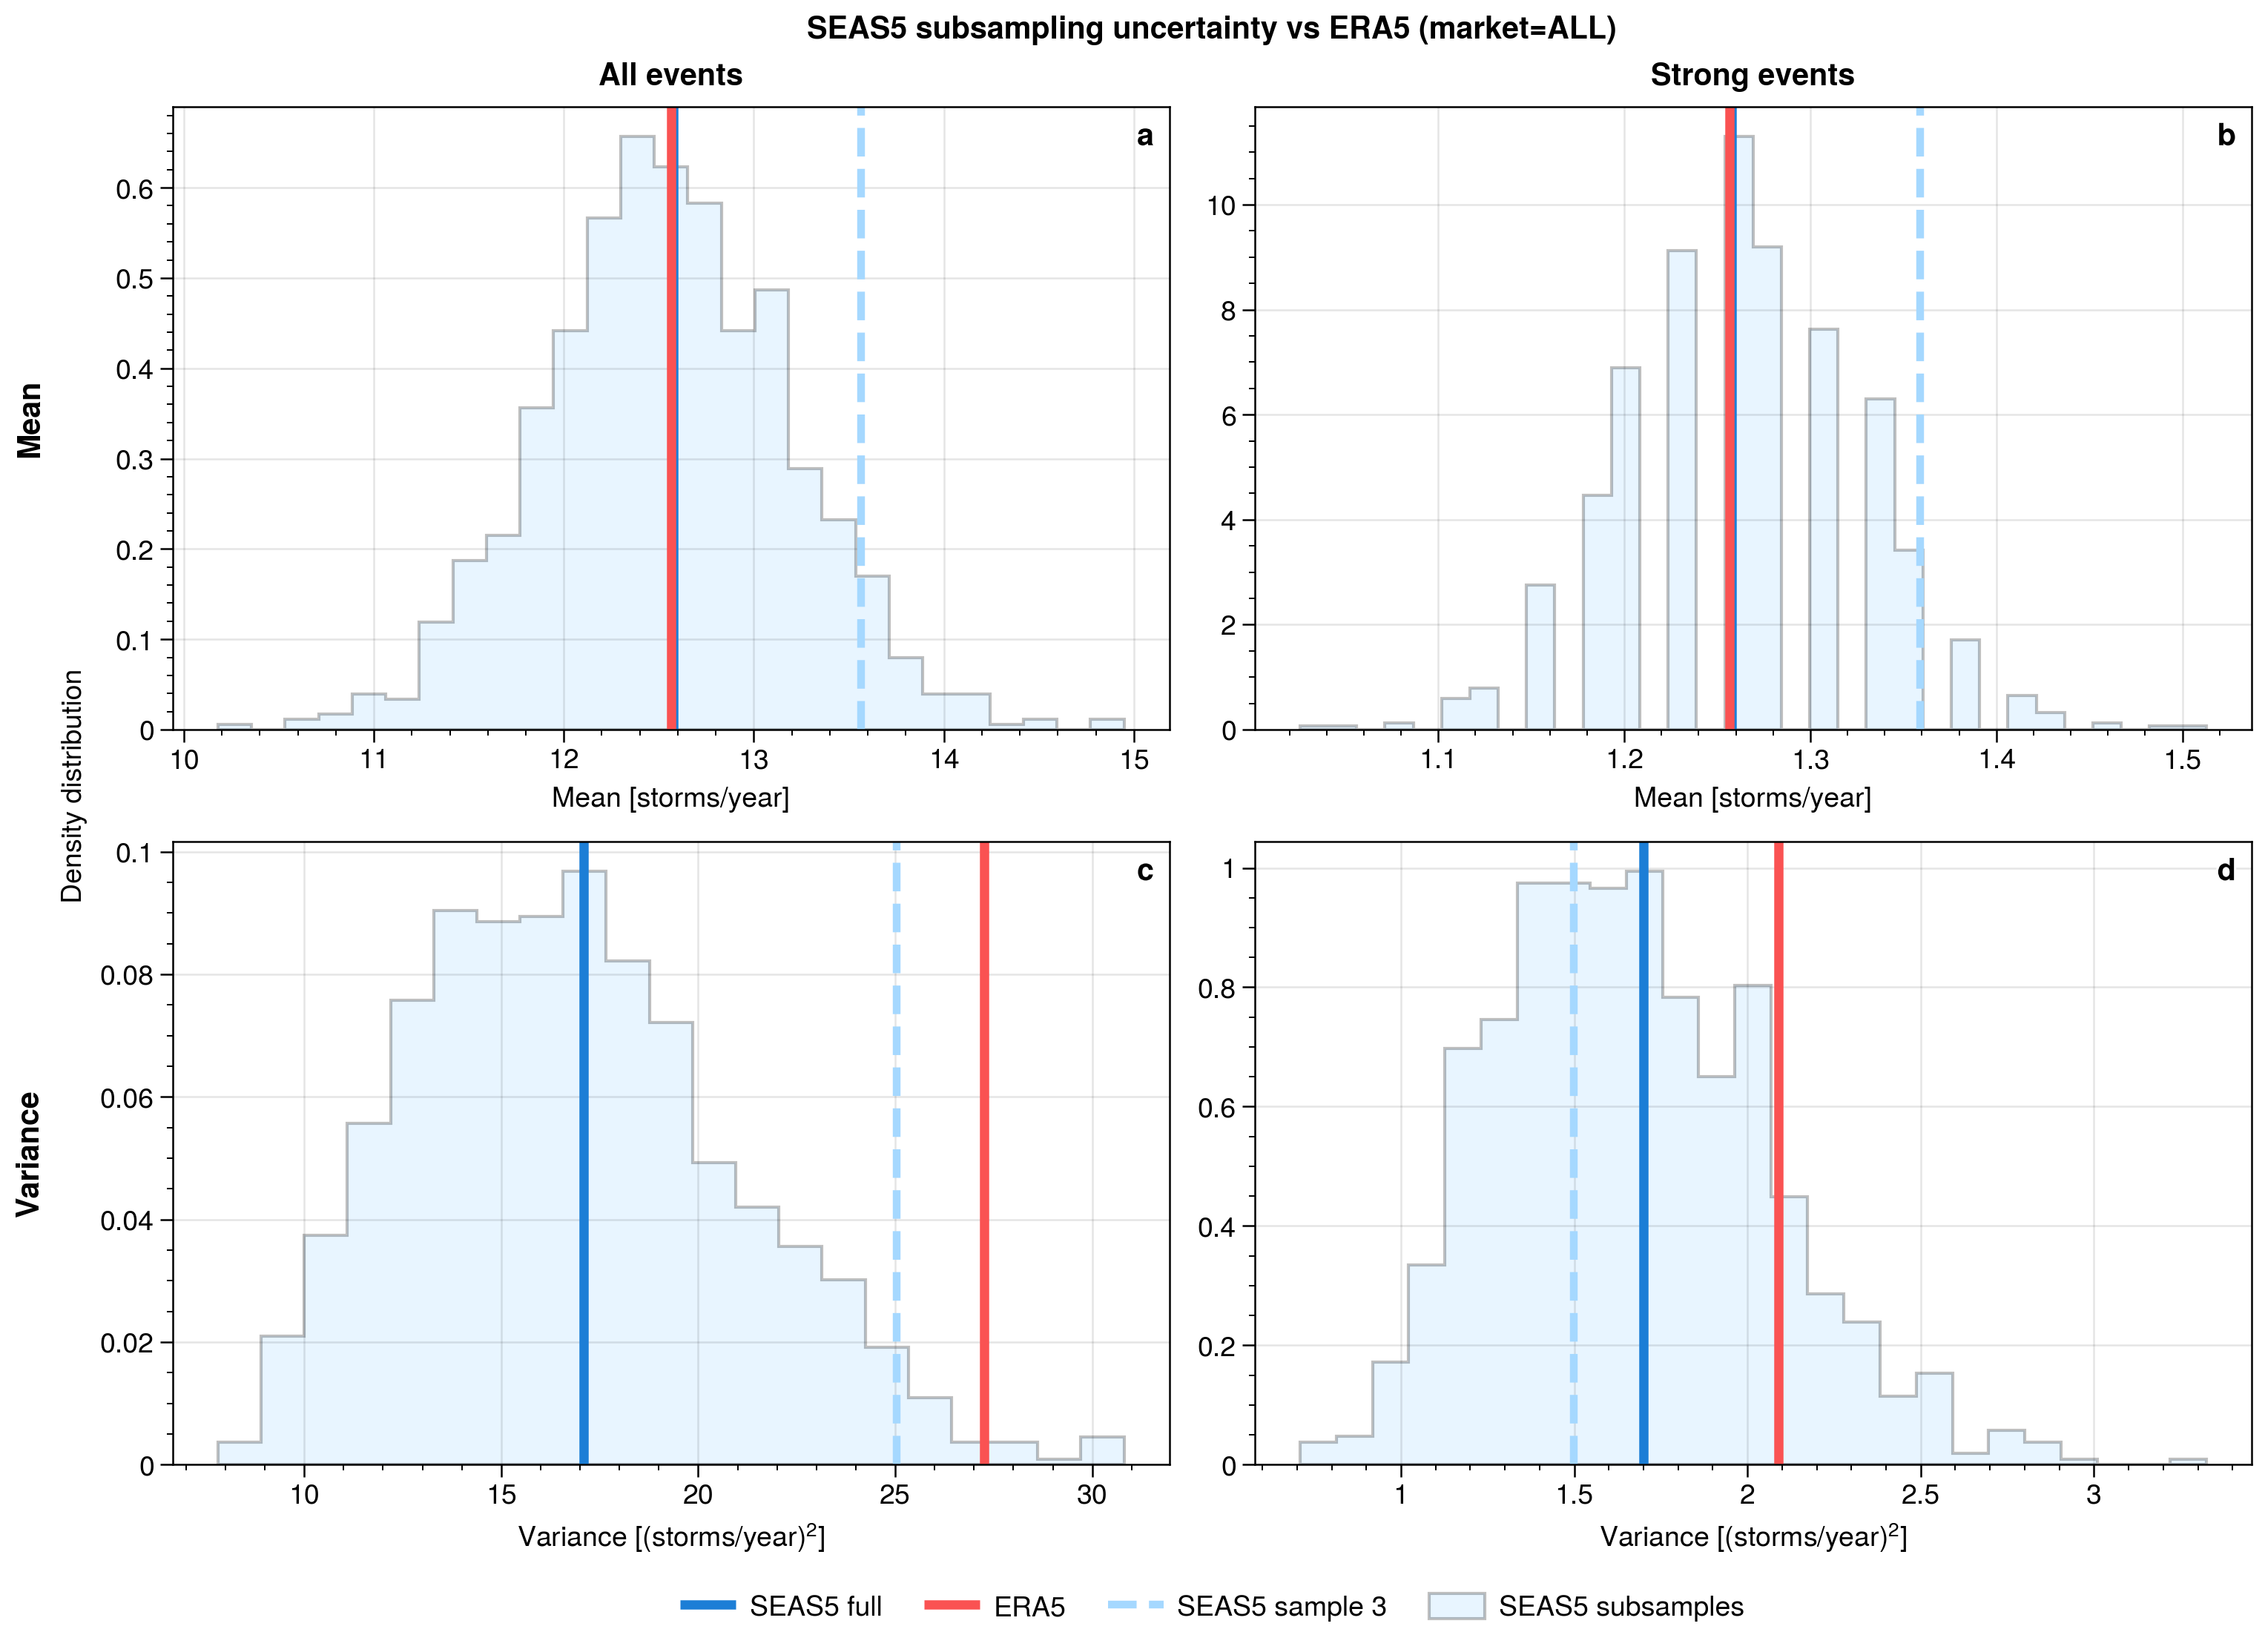
Average and variability in Frequency (Europe)
Average frequency is in ‘perfect’ agreement
ERA5 shows anomalous frequency variability, but within the distribution
Mostly due to single extreme year (1992)!

Slide 6
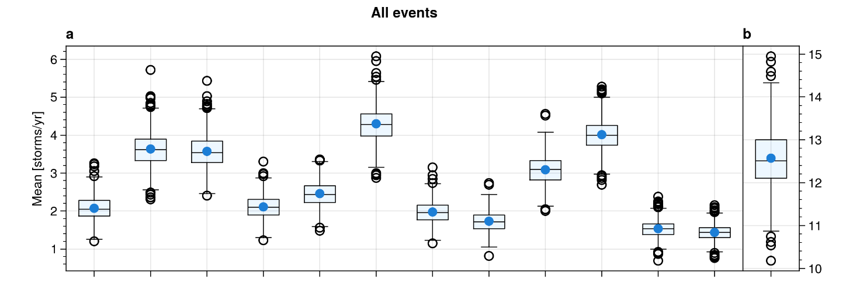
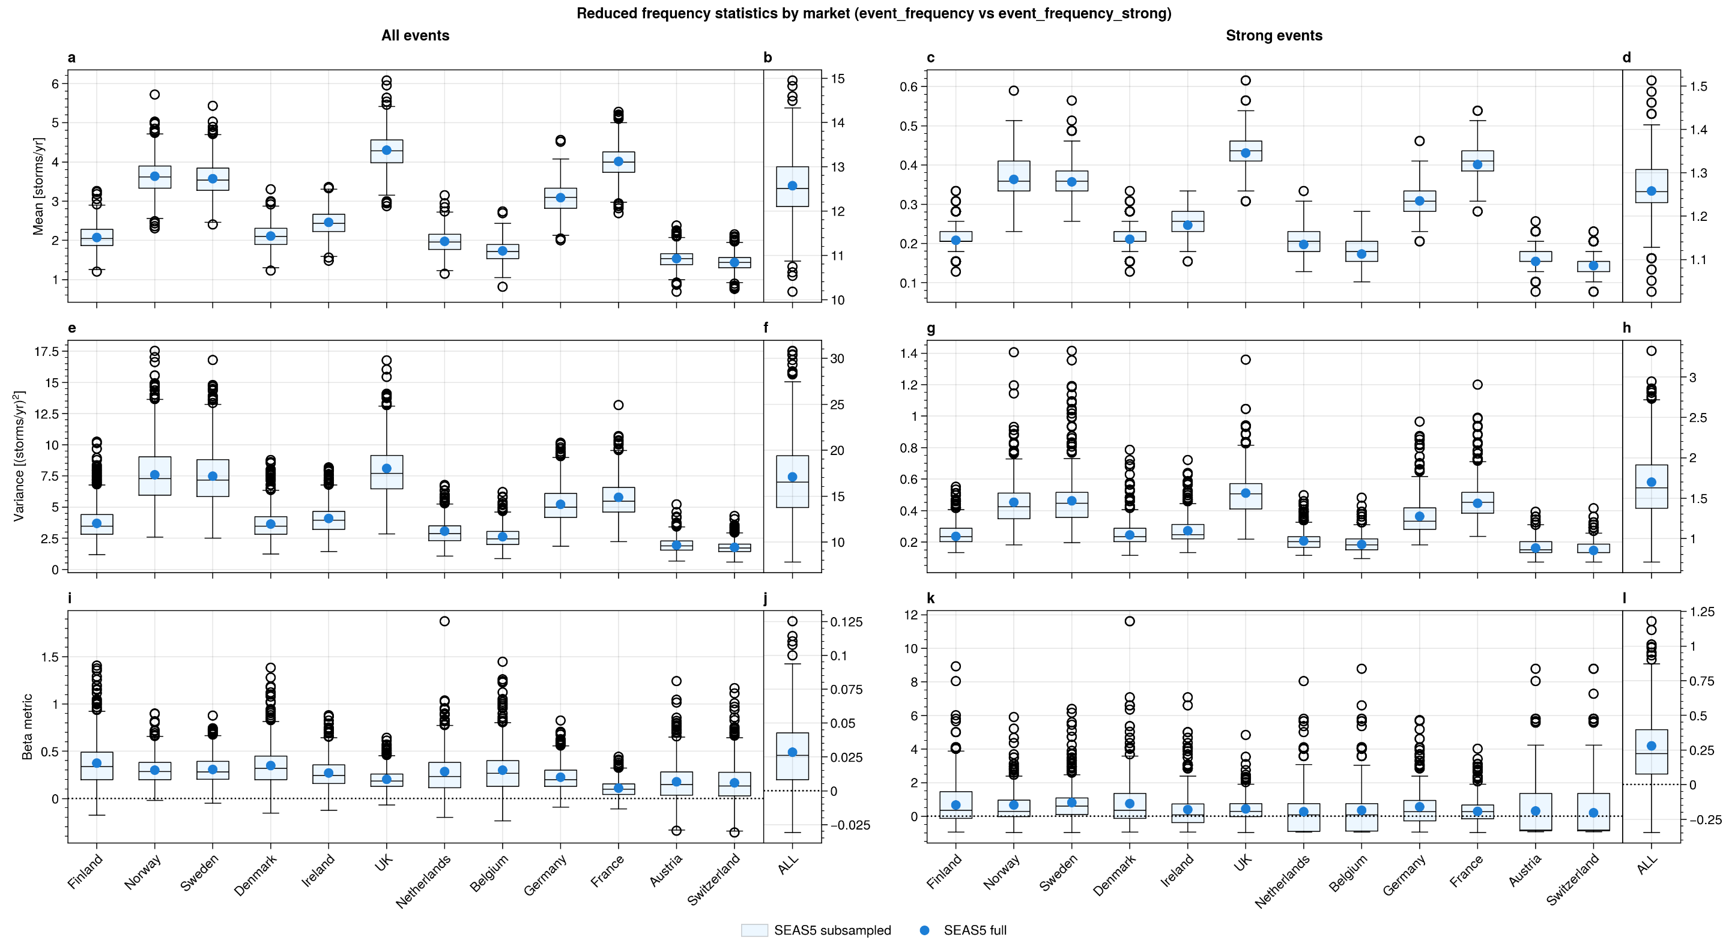

Frequency metrics for different markets
Large variability between markets

Slide 7
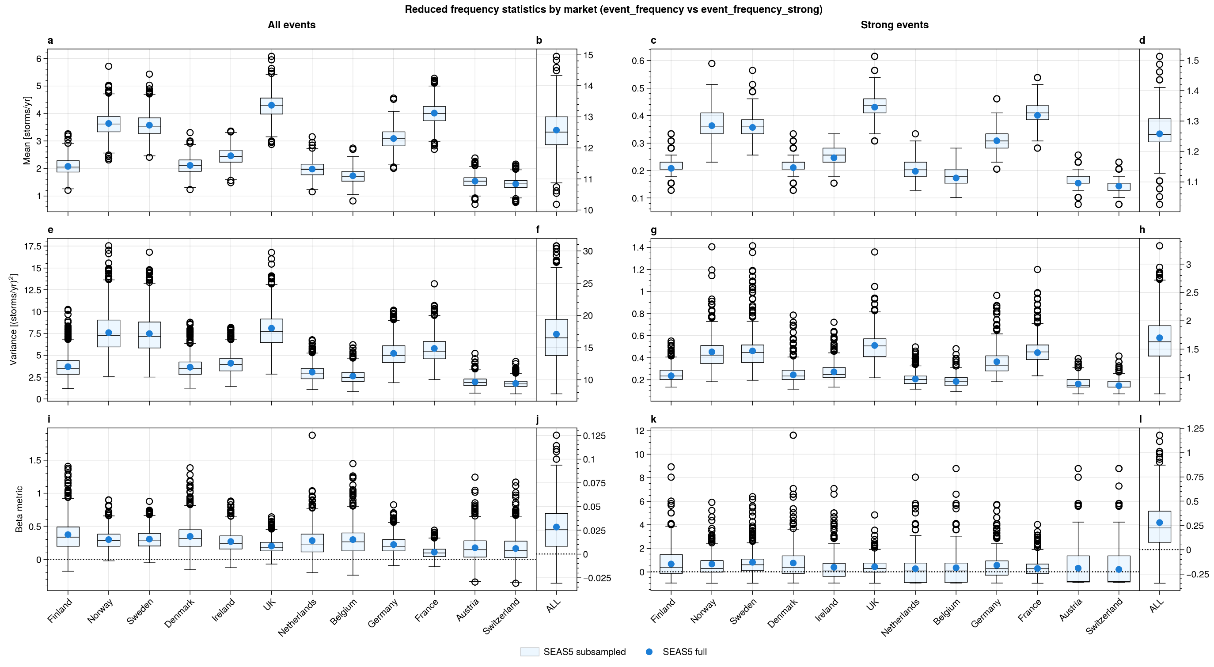
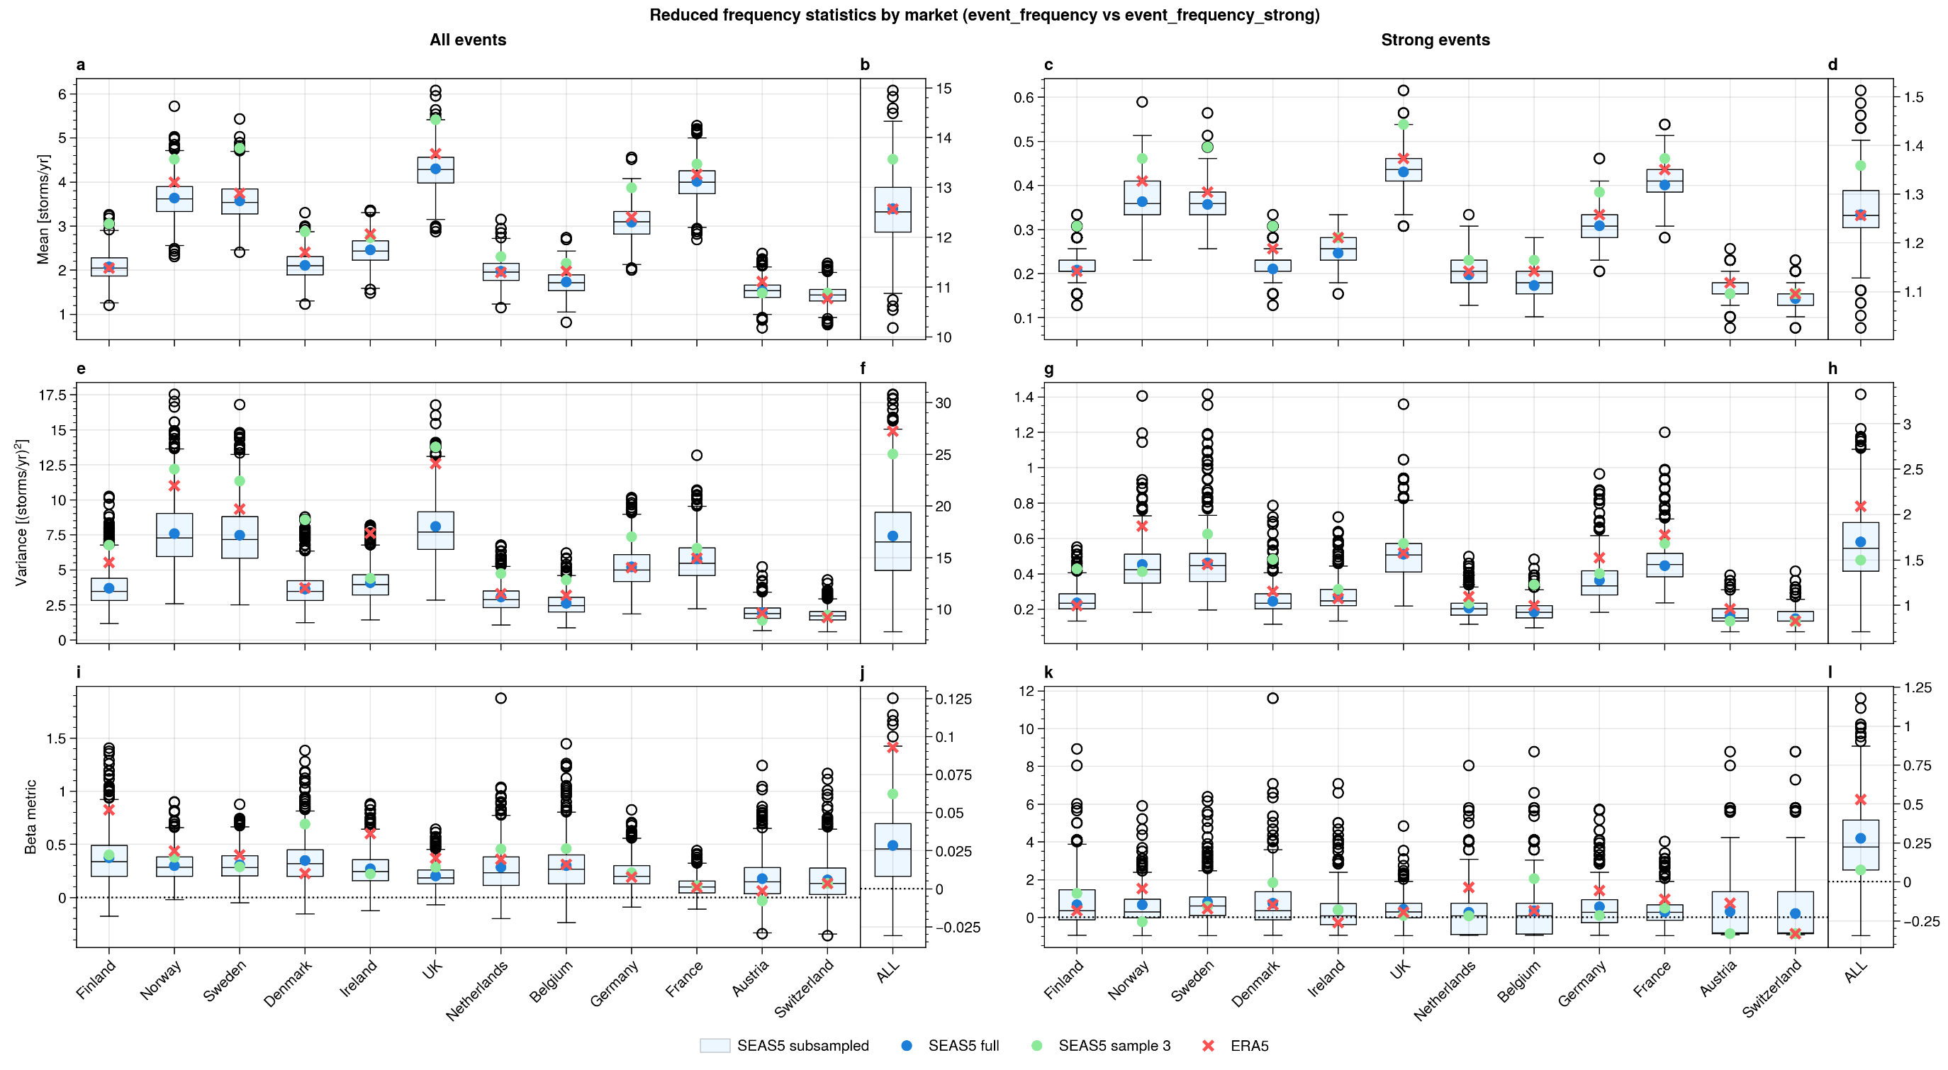
Positive values suggest
enhanced clustering
ERA5 variability strongly inherited from variance
Beta: (Var/Mean -1)/Mean

Slide 8
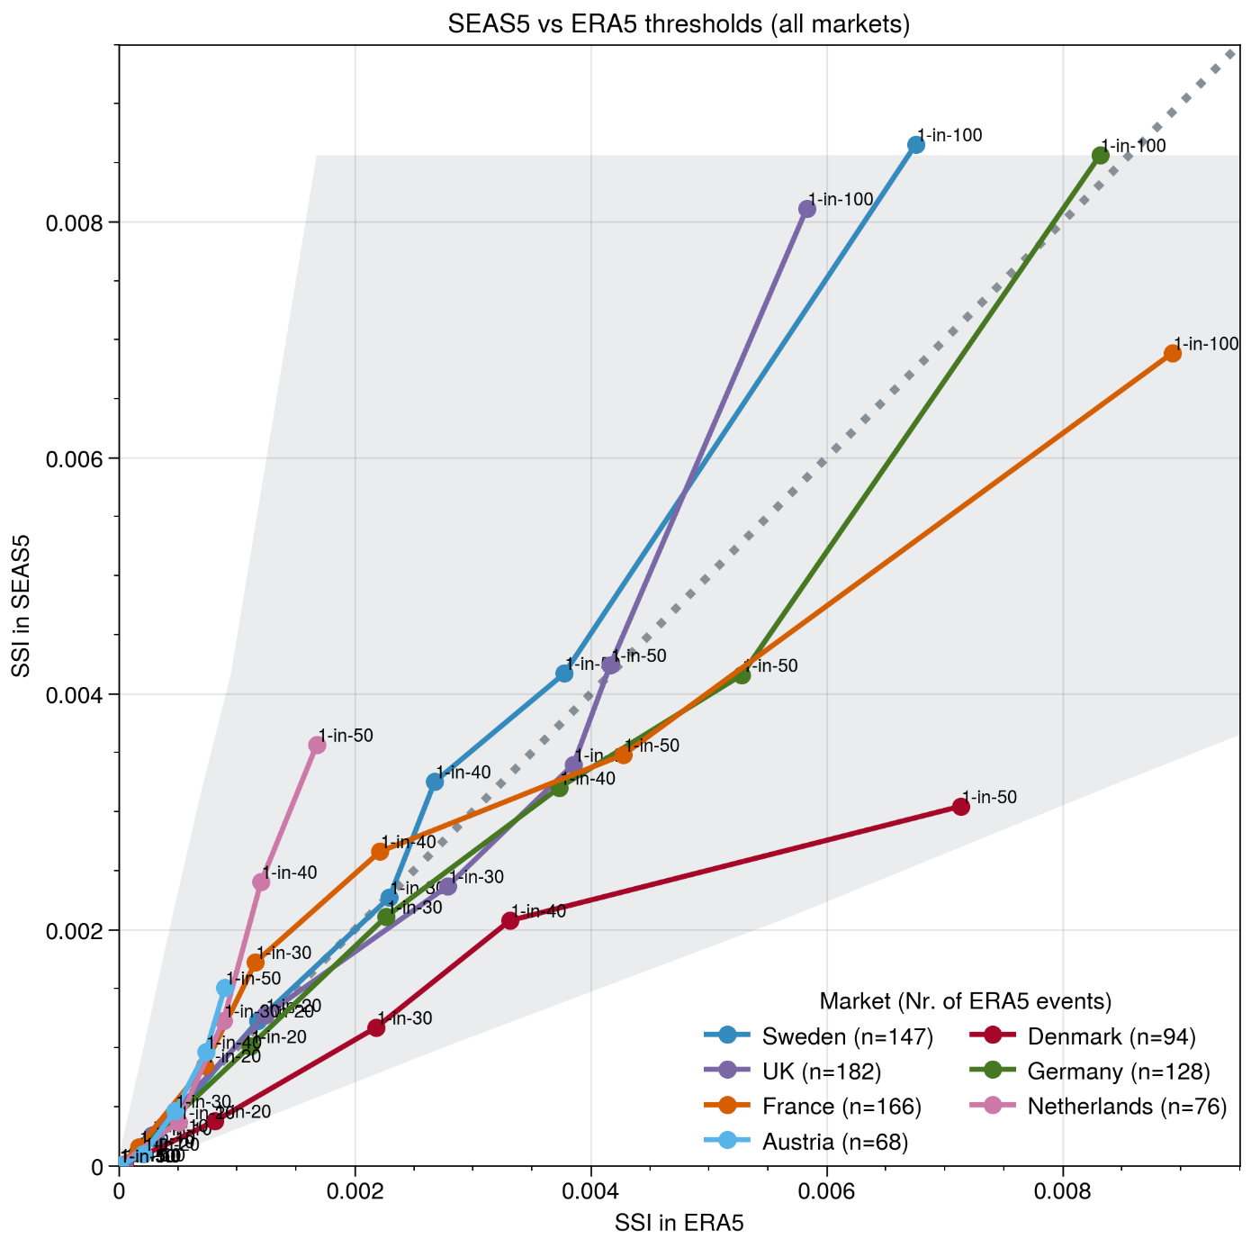
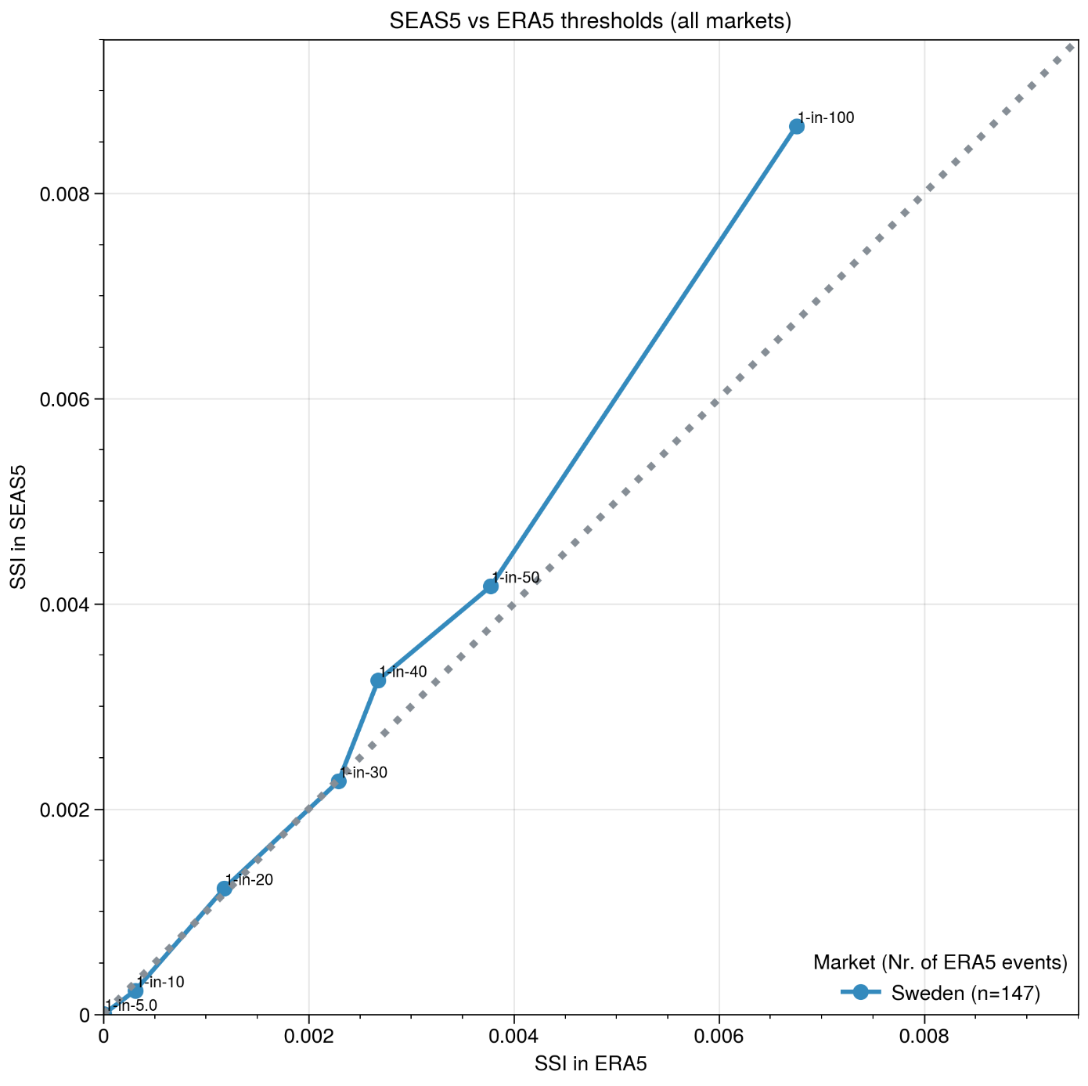
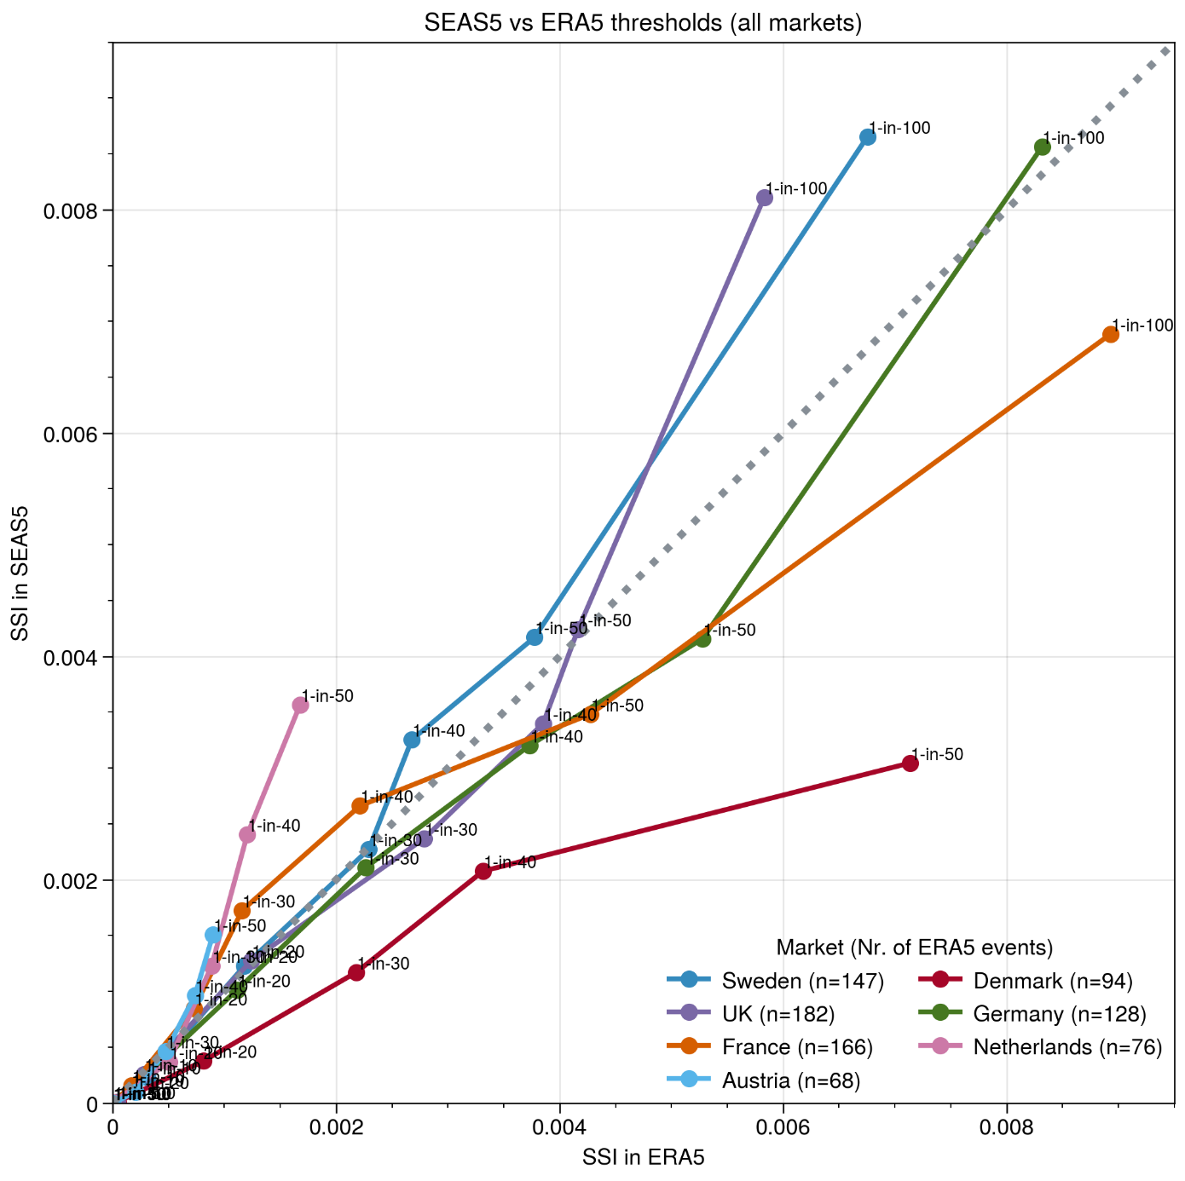
Comparing (tail) distributions
90%-confidence for Germany
We were lucky
We were lucky
We were unlucky
SSI in SEAS5
We were unlucky
Observed extremes in Netherlands Weaker than expected
Observed extremes in Denmark stronger than expected
SSI in ERA5

Slide 9
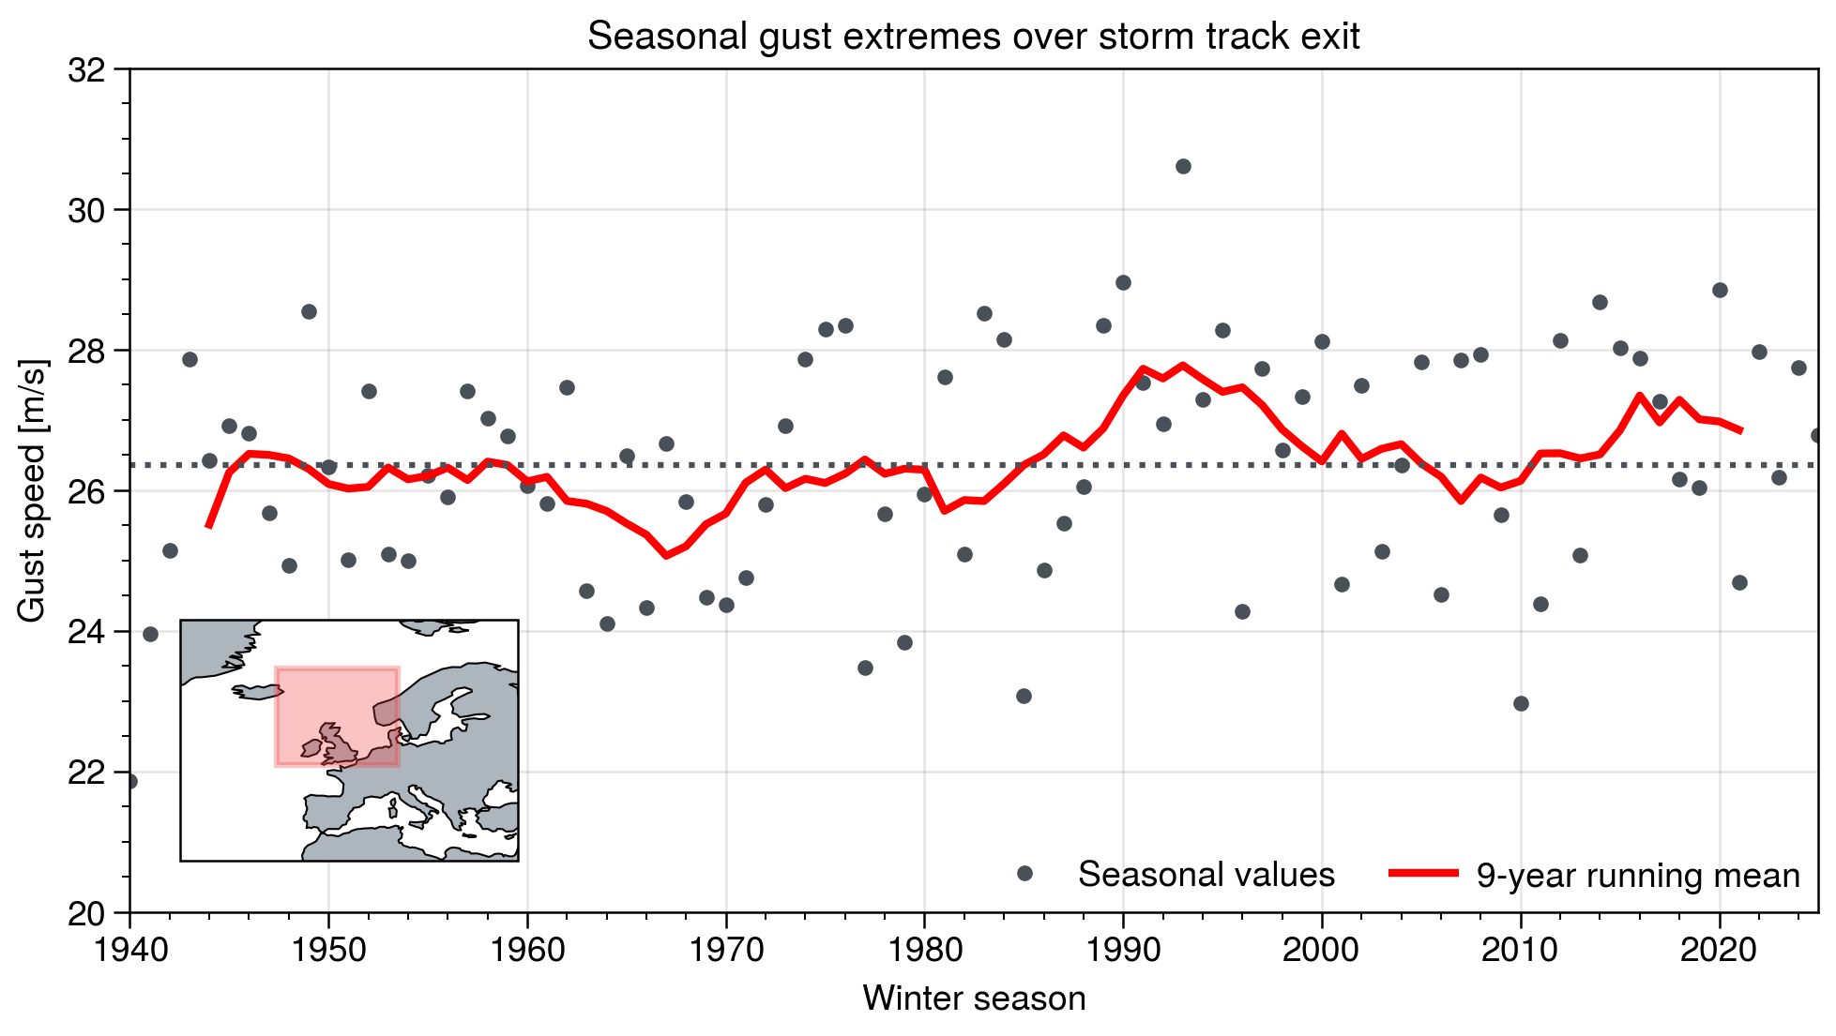
Evolution in gust severity
After Kruger et al. (2019)
But 2000s are not quiet!
Yes, peak in the 90s ….
95th percentile of DJF gusts

Slide 10
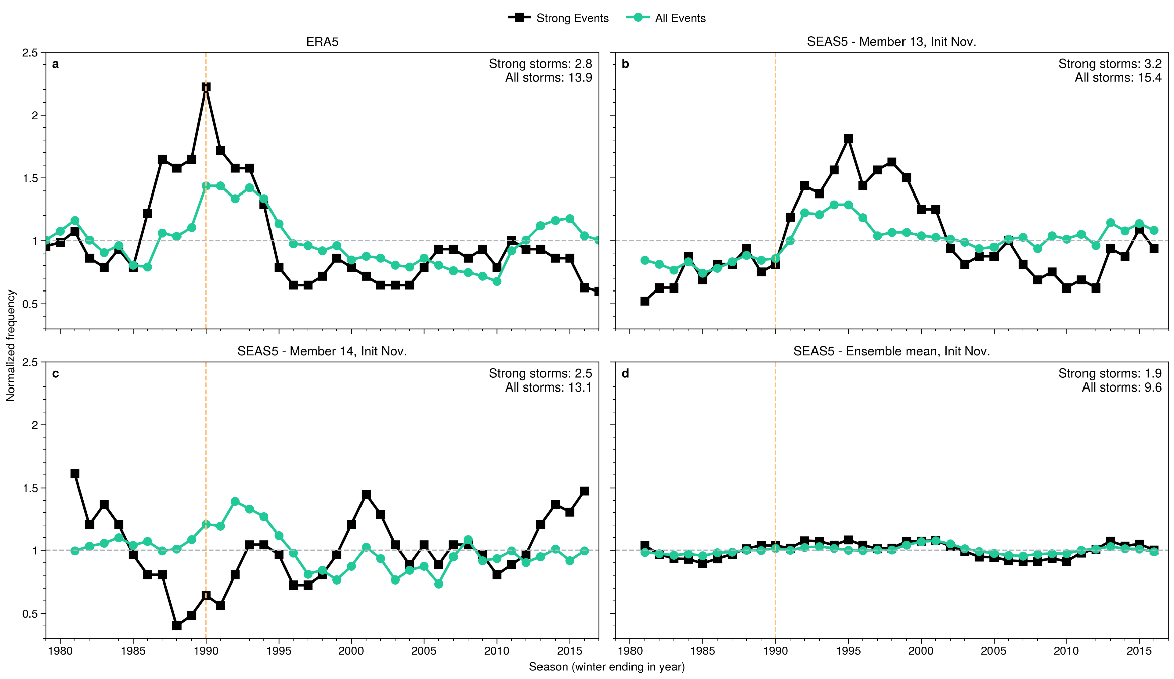
Frequency evolution
Pronounced peak in 1990
Peak at different time
Actual low in 1990
No pronounced variability!

Slide 11
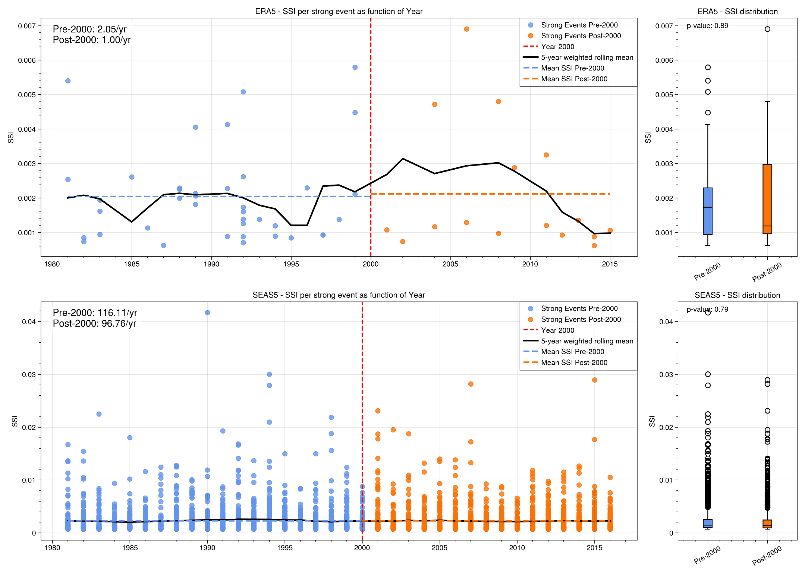
Evolution in event SSI (Europe)
Consistent frequency signal
ERA5 – SSI of strong events
But storm severity actual tends to be stronger post 2000!

Slide 12
Evolution in event SSI (Europe)
Only small frequency signal
SEAS5 – SSI of strong events
Severity evolution does not show pronounced variability

Slide 13
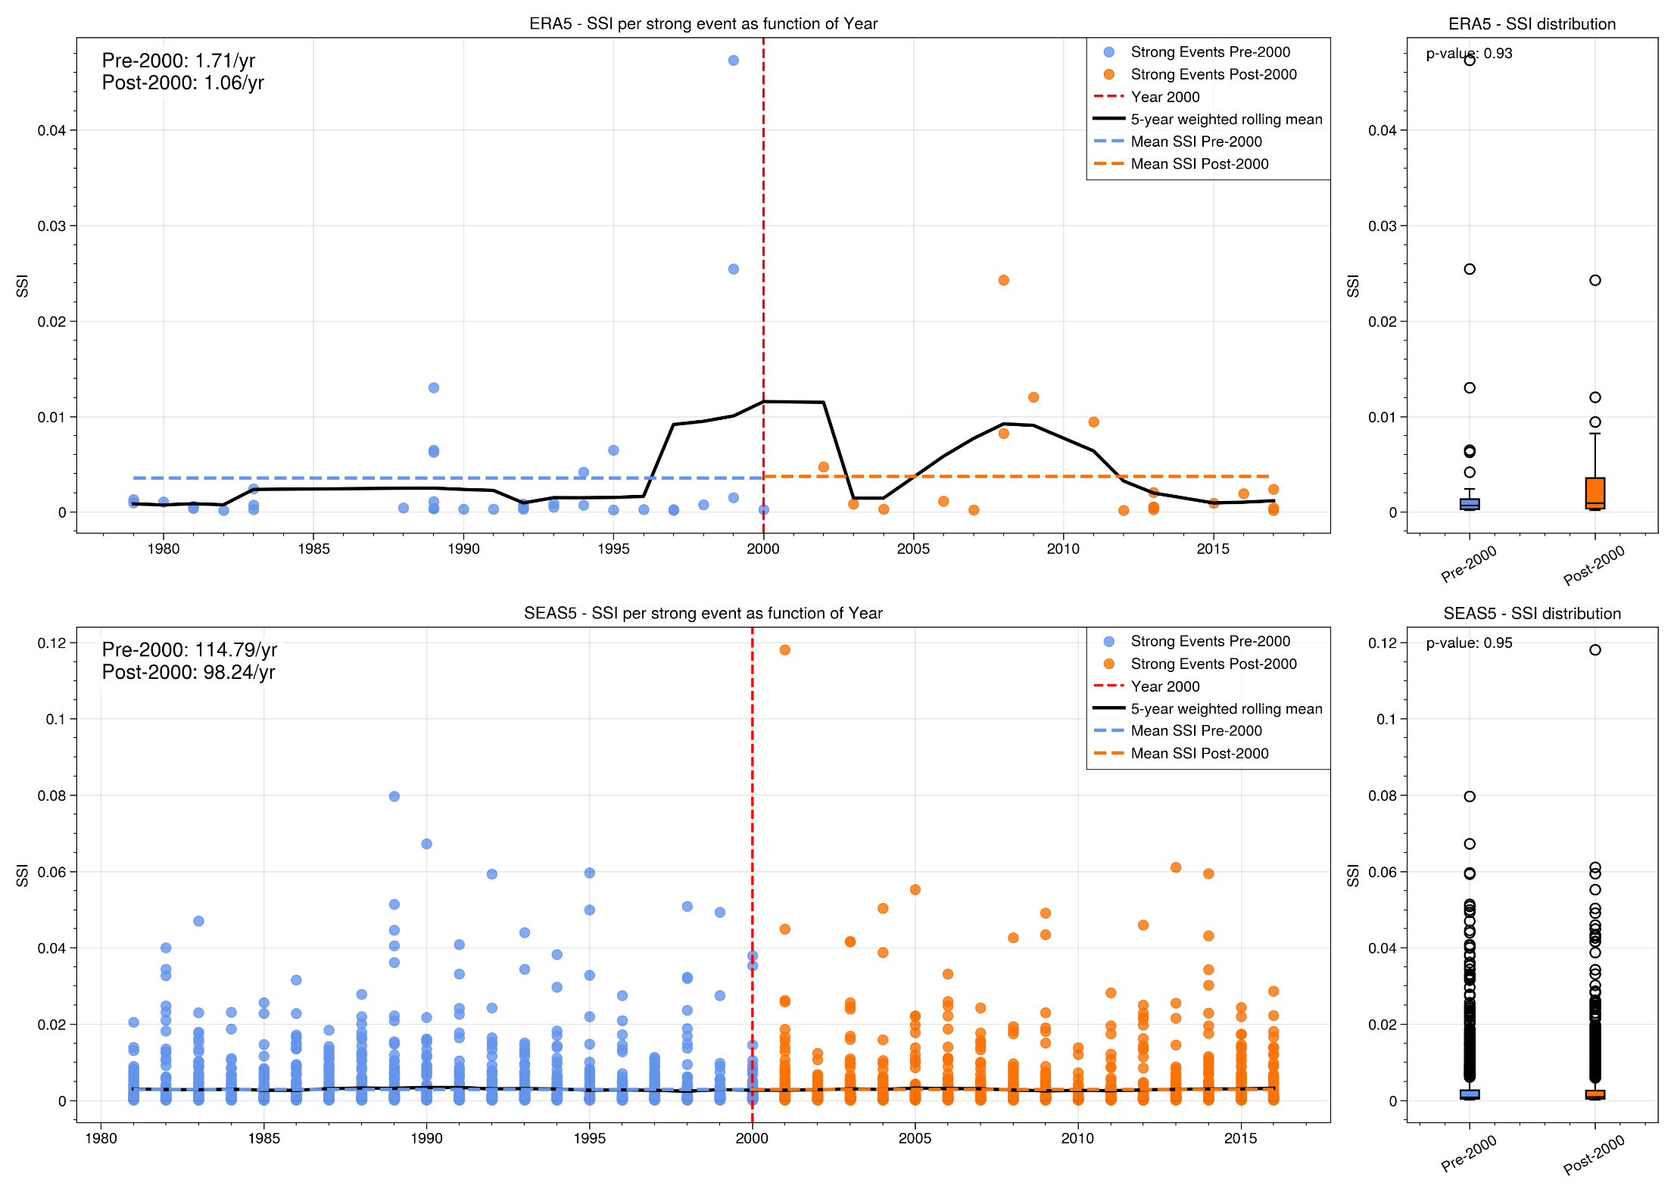
Example: France
Yes, maximum in 1999…
ERA5
… but post 2000 shows clear severity peaks
SEAS5
Seasonal forecasts again show no variability signal

Slide 14
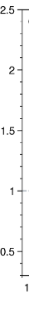
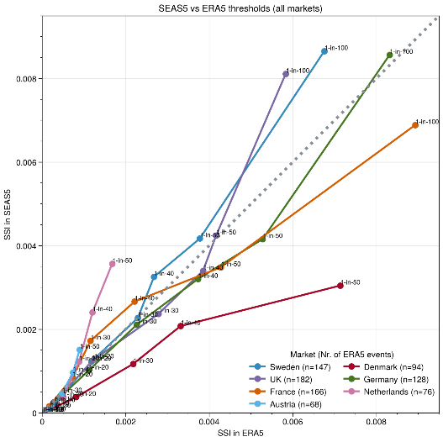
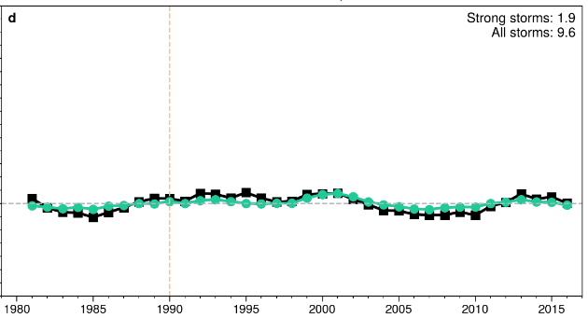
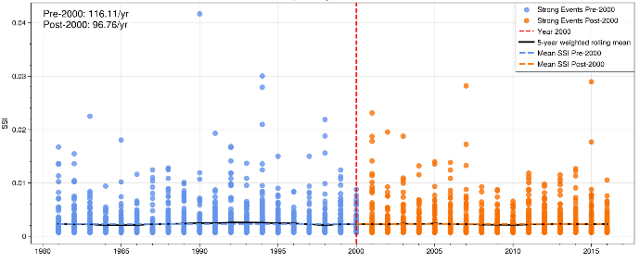
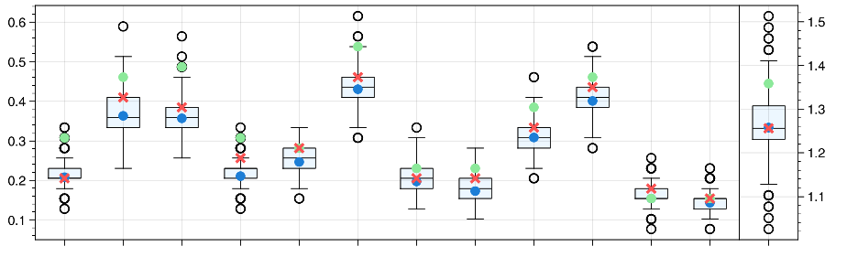
Can storm seasons like 1989/90 happen again next year?
Extremes
Frequency
Yes!
Severity
Average
All our analyses show past evolution within range of possibilities and distributions seem unchanged

Slide 15

Any questions?
Philip Rupp | June 2026 | Workshop on European Storms

Slide 16
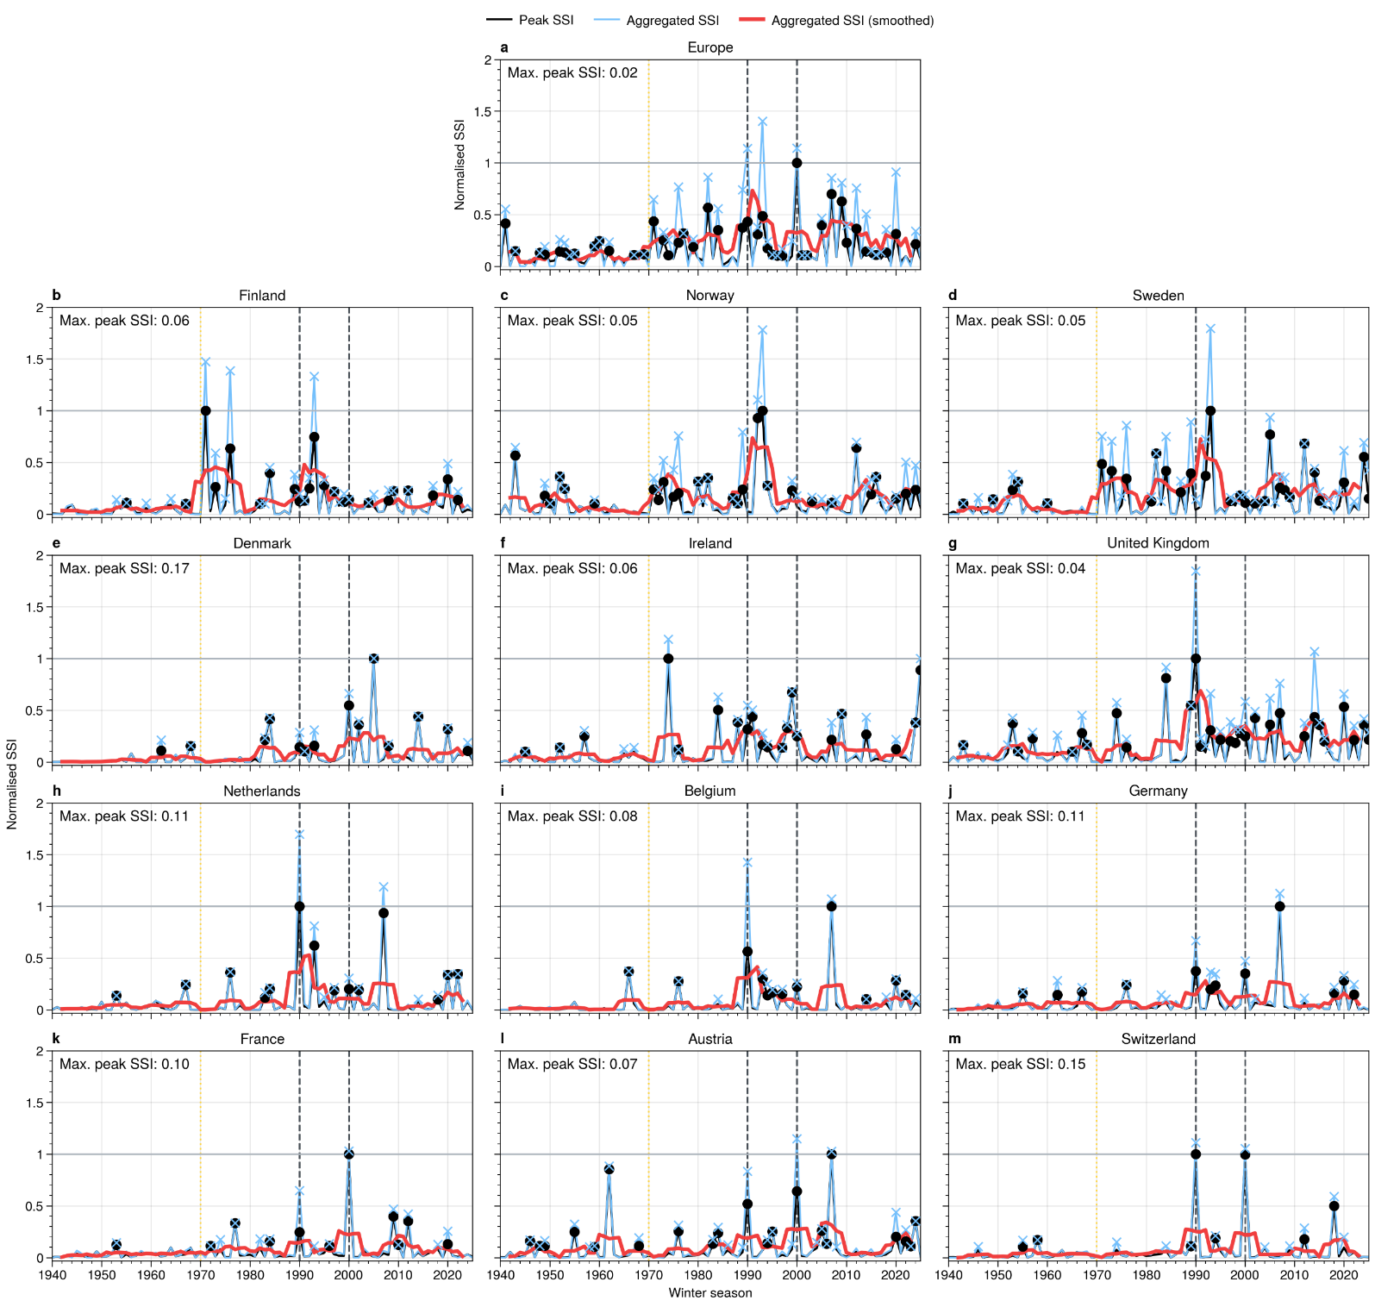

Slide 17
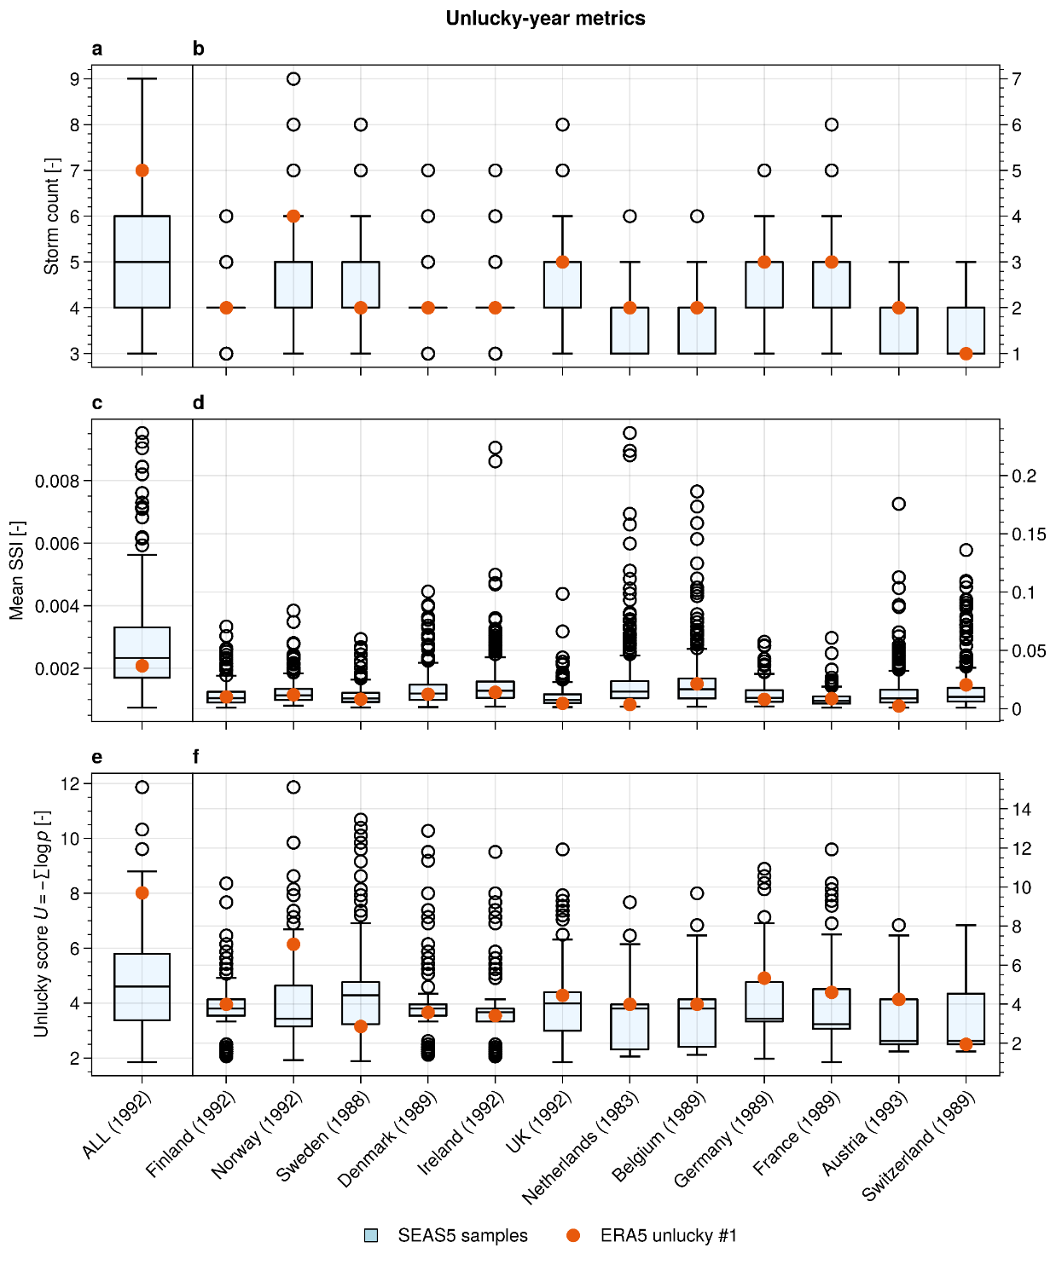
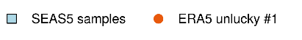

Were we just unlucky?
Unlucky score: Assuming no clustering,
how unlikely is it to observe a certain storm season?
Frequency
Unlucky, but within distribution!
Severity
On the lucky side

Slide 18
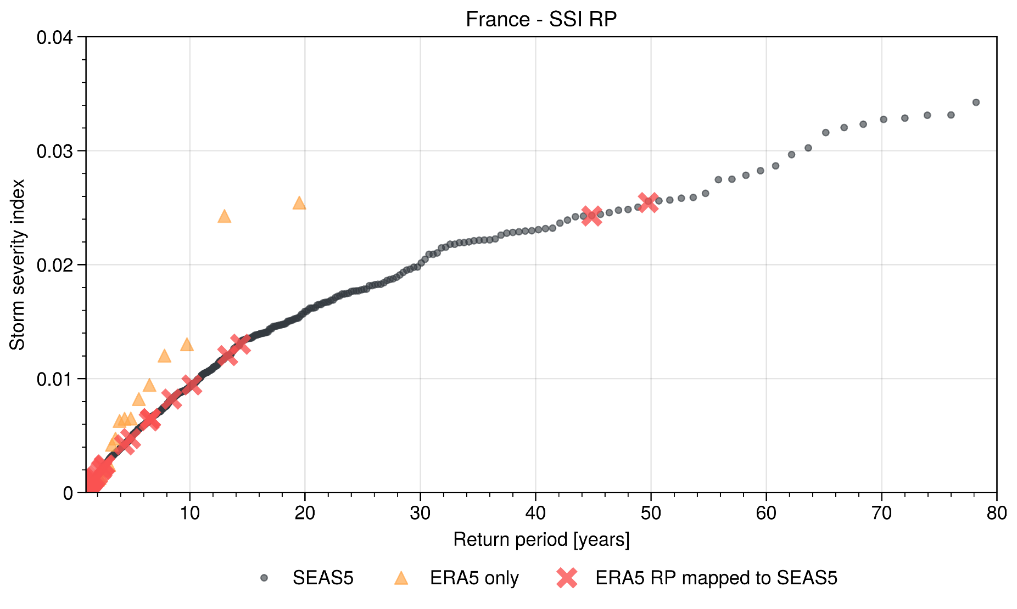

Slide 19
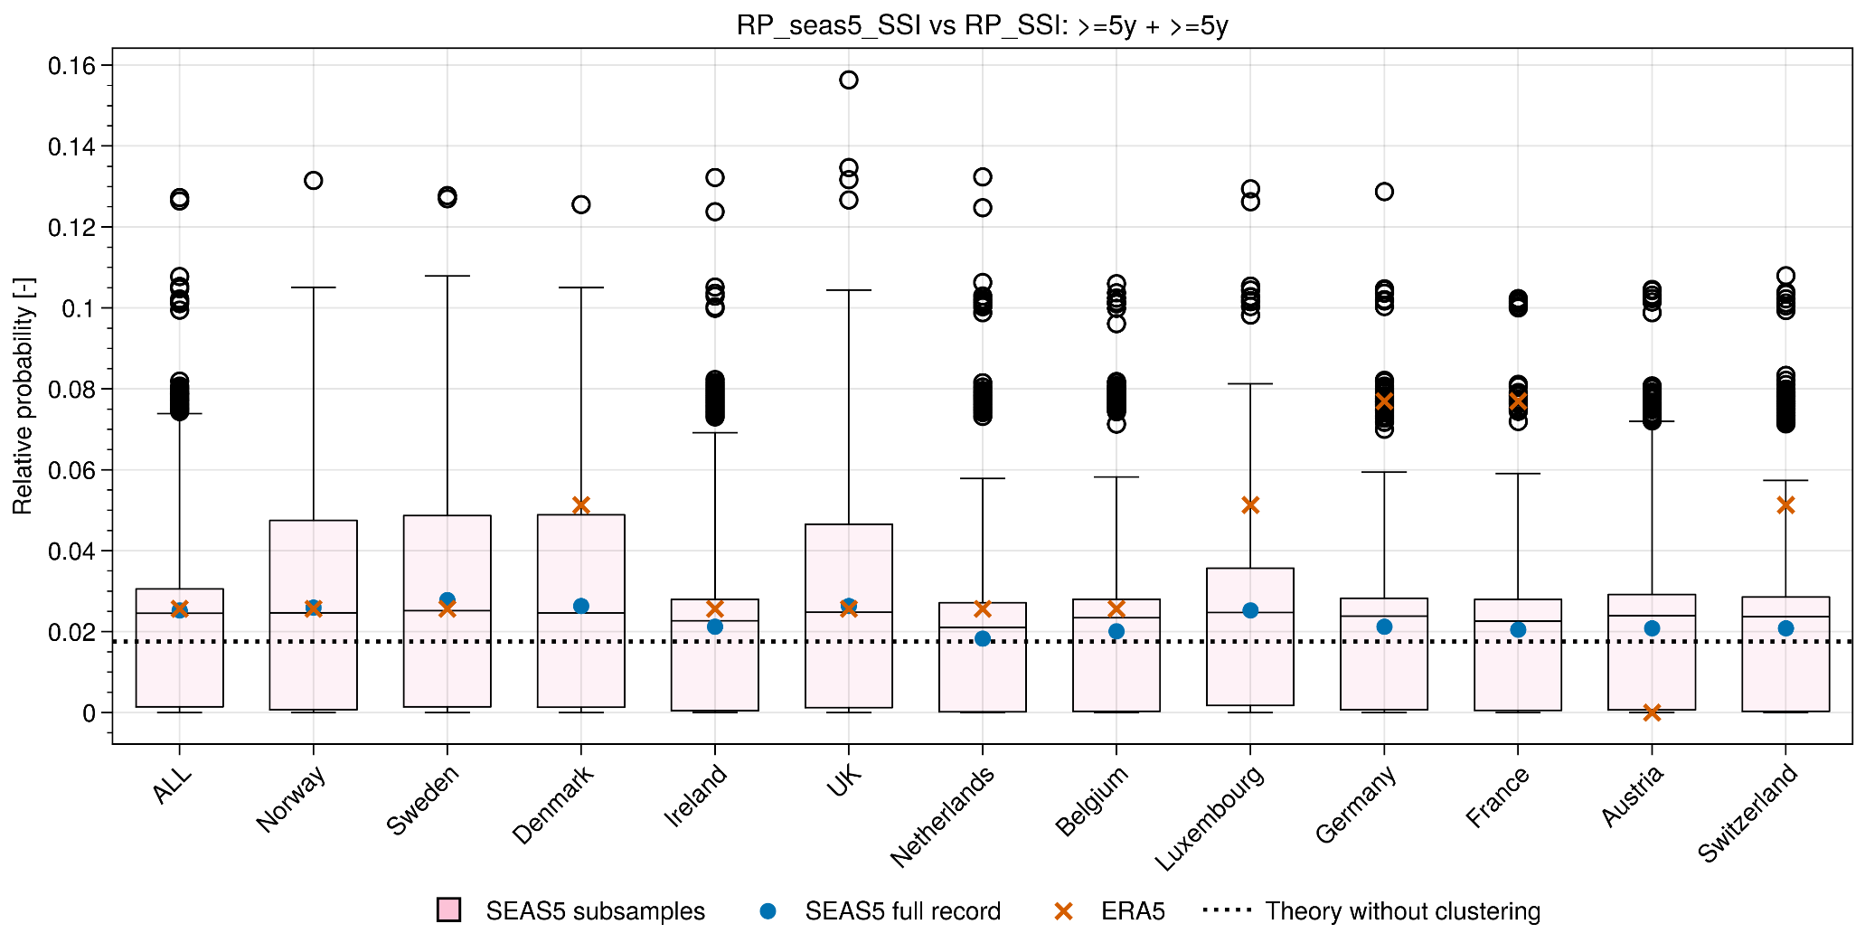

Slide 20
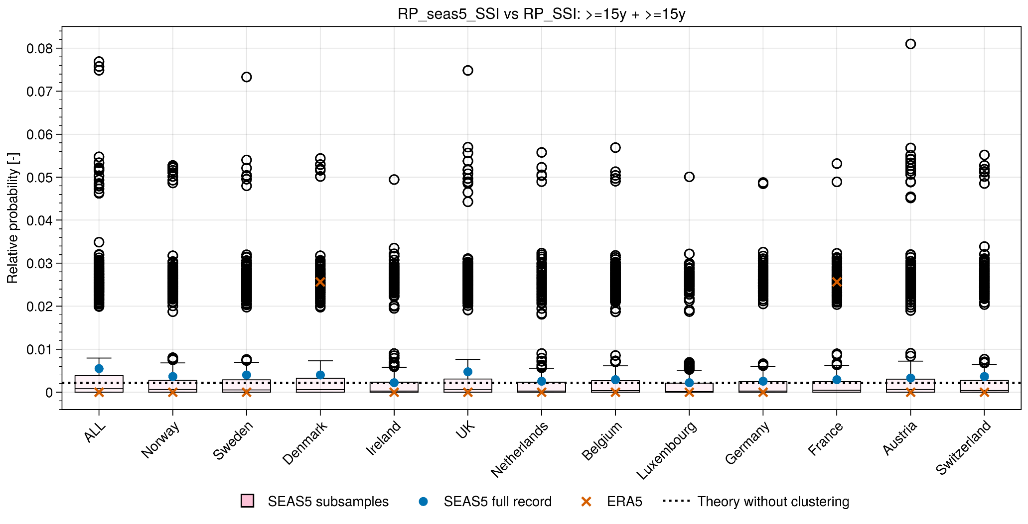

Slide 21
Legal notice
©2026 Swiss Re. All rights reserved.
You may use this document and the information contained herein for private or internal purposes only, and any copyright or other proprietary notices must not be removed. You are not permitted to modify, reproduce, create any derivative works of this document, or distribute or use it for commercial or other public purposes, without the prior written permission of Swiss Re.
This document is for informational purposes only and is not advice or a recommendation to engage in any transaction with or use services provided by Swiss Re or any other person. The information and opinions contained herein are provided as of the date of the presentation and may be subject to change at any time without notice. Although the information is taken from reliable sources, Swiss Re shall not be liable for any loss or damage arising in connection with its use, or from any inaccuracy or incompleteness, nor is it under any obligation to update it. Swiss Re further undertakes no obligation to publicly revise or update any forward-looking statements, whether as a result of new information, future events or otherwise.
This document and its contents are not directed to, or intended for use by, any person or entity in any jurisdiction where such distribution, publication or use would be unlawful or where it would require licences or authorisations that have not been obtained.
This document does not constitute or form part of an offer, solicitation, or invitation to buy or sell any securities, derivatives or (re)insurance or transact with, or use services provided by, any member of the Swiss Re Group. It is not an invitation or inducement to participate in investment activities described in any applicable financial promotion regime.

