Slide 1
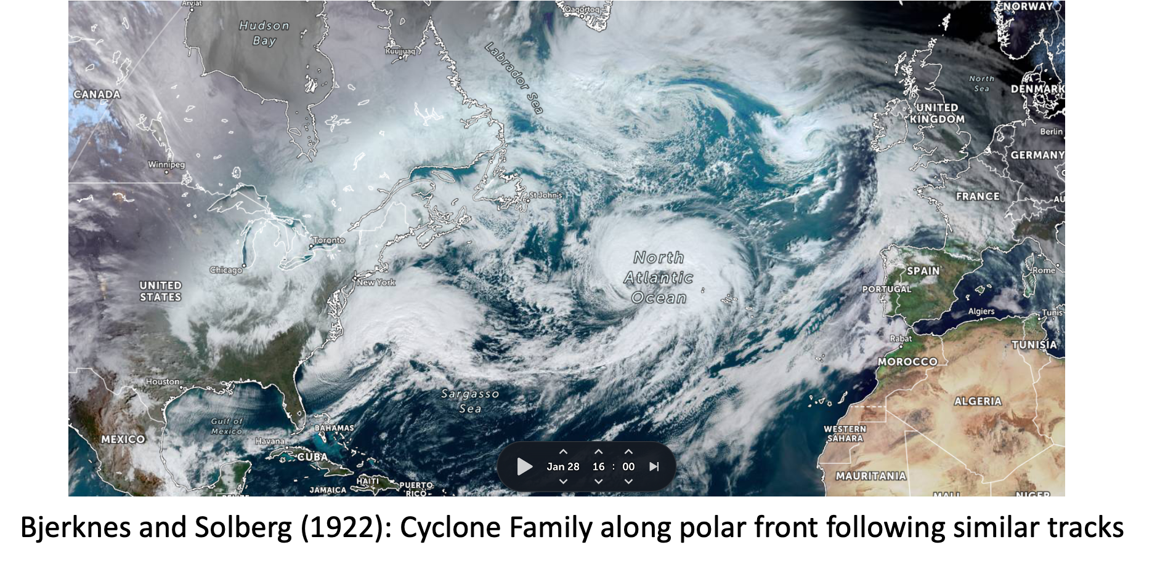
Synoptic structure of two types of spatio-temporally clustered cyclones
Chris Weijenborg, University of Wageningen
Thomas Batelaan, Jeroen Oostdam, Thomas Spengler (University of Bergen)
Notes:
Cut off low: stationary because cut off from main westerly flow
Visible as minimum in Geopotential height (moisture transport indicated by arrows).
Connection local scale: Lifting in Eiffel/Ardennes regions

Slide 2
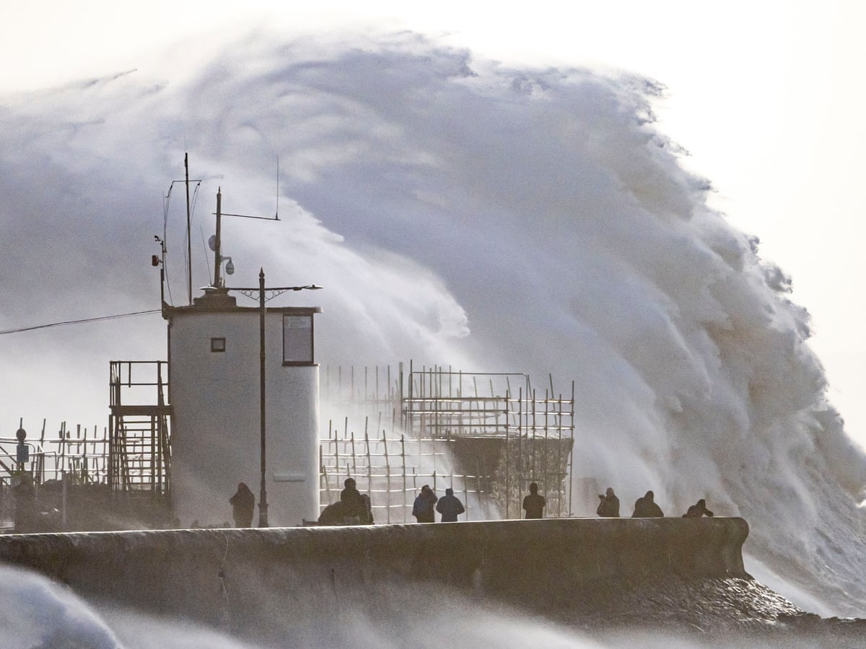
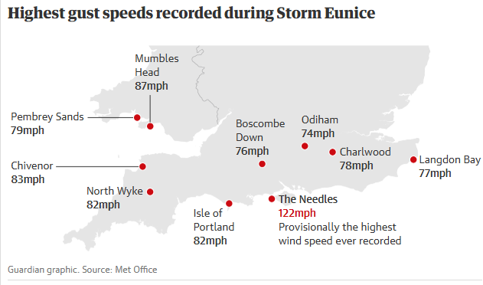
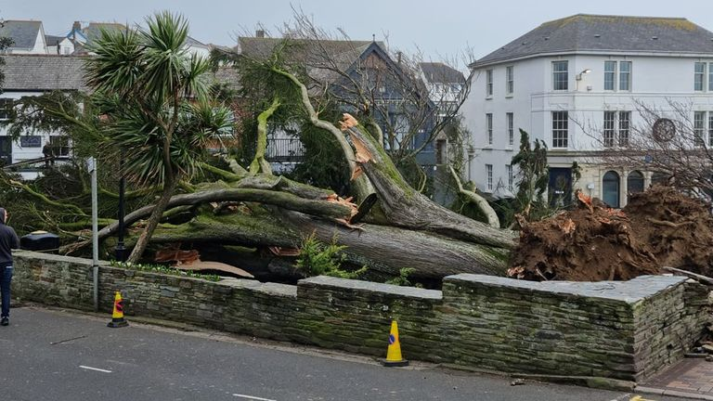
Eunice (18-02-2022)
The Guardian
Extratropical cyclones determine
extremes and weather!
Especially cyclone clustering has a
huge socio-economic impact
Sky news
Notes:
Case study
We see that RWB takes pal
How can we quantify the influence of heating?

Slide 3
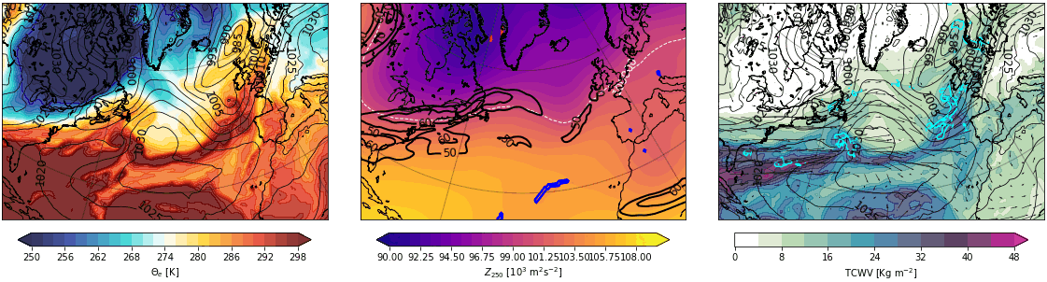
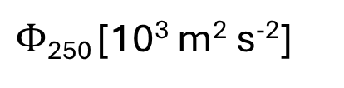
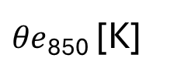
Synoptic patterns associated with Dudley, Eunice
Eunice, Dudley case (13 to 20 February 2022)
Strong jet (streak), with strong moisture transport
How much does moisture (latent heating) influence the jet/baroclinicity
Contours: MSLP [hPa]
Contours: Jet at 250 [m s⁻¹]
Vectors: IVT [Kg s⁻¹ m⁻¹]
$θe$₈₅₀ [K]
$Φ$₂₅₀ [10³ m² s⁻²]
Total Column Water Vapour
[kg m⁻²]
Figures: Luuk Eijkelkamp
Notes:
Case study
We see that RWB takes pal
How can we quantify the influence of heating?

Slide 4
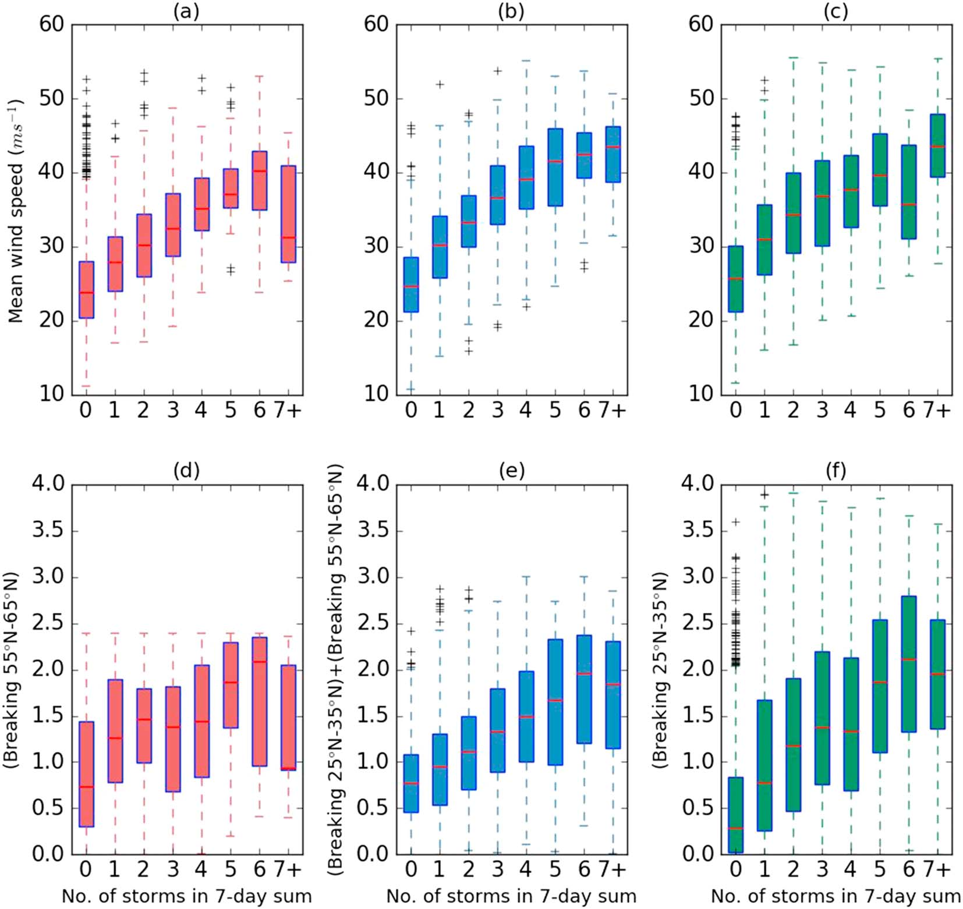
What is/was known?
Clustering related to a strong jet:
Often formed at cold front of previous cyclones (secondary cyclogenesis)
These cyclones tend to be associated with strong baroclinicity (e.g. Weijenborg & Spengler, 2020)
Therefore also strong wind and wind extremes
Nr. of storms
(Passing within a 700 km distance
at 65N, 5W)
Priestley et. al. (2017)
Notes:
Cut off low: stationary because cut off from main westerly flow
Visible as minimum in Geopotential height (moisture transport indicated by arrows).
Connection local scale: Lifting in Eiffel/Ardennes regions

Slide 5
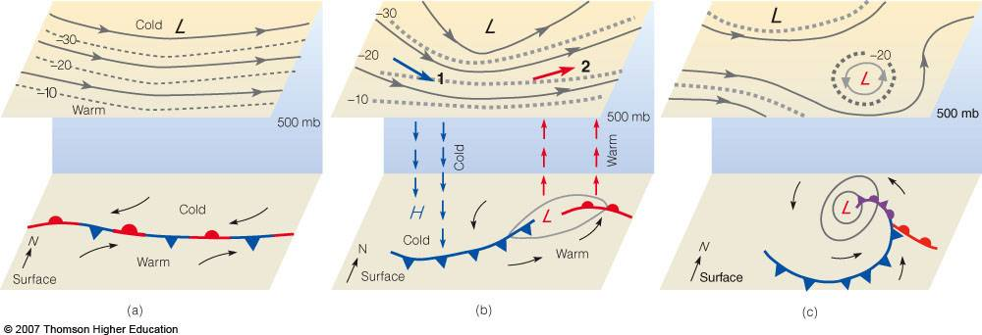
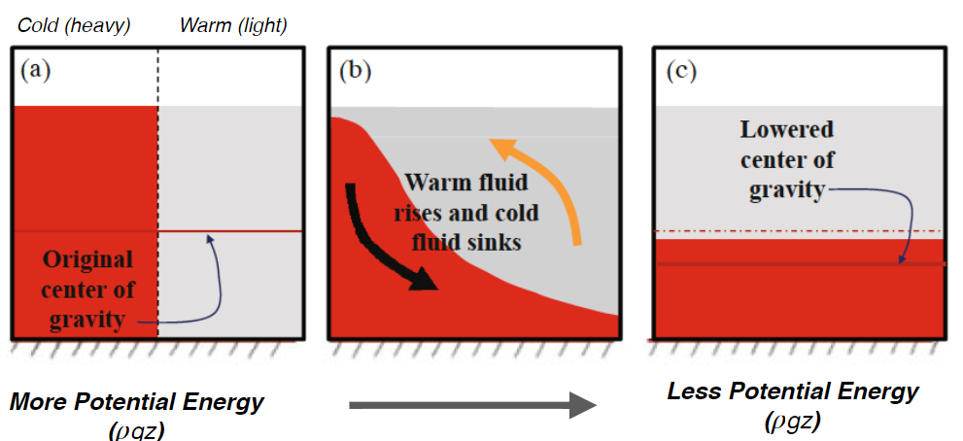
Cyclogenesis and clustering: a paradox
Cyclones in the North Atlantic form from baroclinic instabilites
From an energy perspective, cyclone clustering is counter-intuitive. → How is the jet and baroclinicity maintained?
Potential energy -> kinetic energy
Notes:
Why do we care?
found that clustering is most frequent along the storm tracks. Along these storm tracks, cyclones generally form as a result of shear instabilities of the jet, called baroclinic instabilities. This instability depends on the meridional temperature gradient through the thermal wind balance. This meridional temperature gradient is proportional to the available potential energy of the mean flow. The instability grows by consuming this APE and converting it to KE. Hence, a logical consequence of this baroclinic growth mechanism is that cyclones reduce the baroclinicity, and thereby the PE availability. This is unfavourable to the formation of a subsequent cyclone. Given this general understanding of cyclogenesis on the storm track, clustering of cyclones is counter-intuitive.

Slide 6
Goal & Research Questions
Goal:
1. Structure of clustered and non-clustered cyclones?
2. Quantifying the effect of diabatic heating during cyclone clustering: What maintains the cross-jet temperature gradient?
Hypothesis:
Latent heating contributes to baroclinic environments for cyclone clustering
Notes:
Following contradiction, dynamics behind it not well understood.
P&P argued relation to enhanced jet kept in place and strengthened by two sided RWB (through TWB enhancing thermal gradient)
Weijenborg and Spengler found case in which cyclones increased baroclinicity through diabatic heating facilitated by enhanced moisture fluxes
contrary to the generally accepted idea that they reduce baroclincity.
Facilitates secondary cyclogenesis on the front, provides an alternative pathway to clustering.

Slide 7
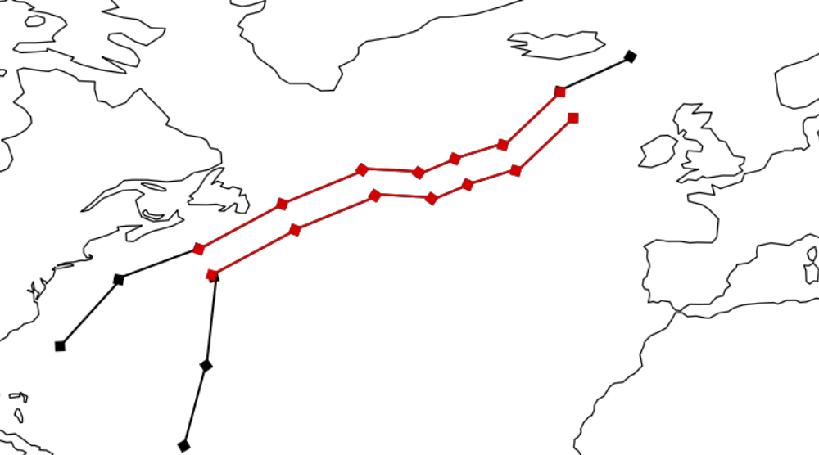
Spatio-temporal cyclone clustering
Focused on dynamics: Similar path of multiple cyclones
Dynamics of cyclone clustering?
Main Idea: spatiotemporal overlap between different tracks
Input: Tracks from Murray & Simmonds (1990) algorithm
Determine points within 1.5 days and 1 Rossby Radius in spacetime
Track 1
Track 2
Weijenborg & Spengler (2026)
Notes:
Cut off low: stationary because cut off from main westerly flow
Visible as minimum in Geopotential height (moisture transport indicated by arrows).
Connection local scale: Lifting in Eiffel/Ardennes regions

Slide 8
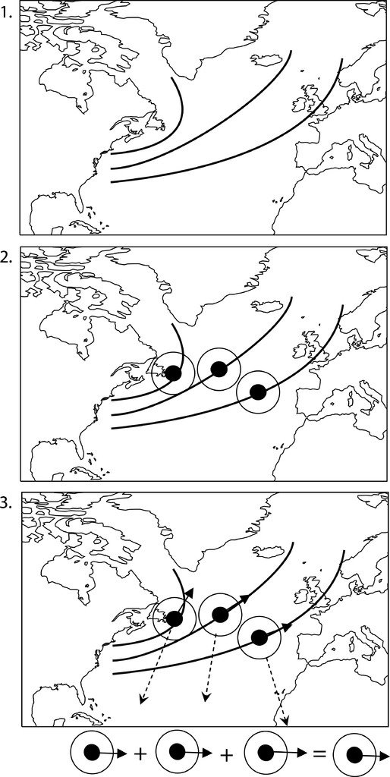
Composites of clustered cyclones
Cyclone centred compositing after Bengtsson (2007)
Focus on maximum intensification stage
For synoptics, we also show cyclogenesis
Composites of synoptic variables, and weather features (fronts, jets, moisture transport axis)
Figure: Bengtsson (2007)
Notes:
Cut off low: stationary because cut off from main westerly flow
Visible as minimum in Geopotential height (moisture transport indicated by arrows).
Connection local scale: Lifting in Eiffel/Ardennes regions

Slide 9
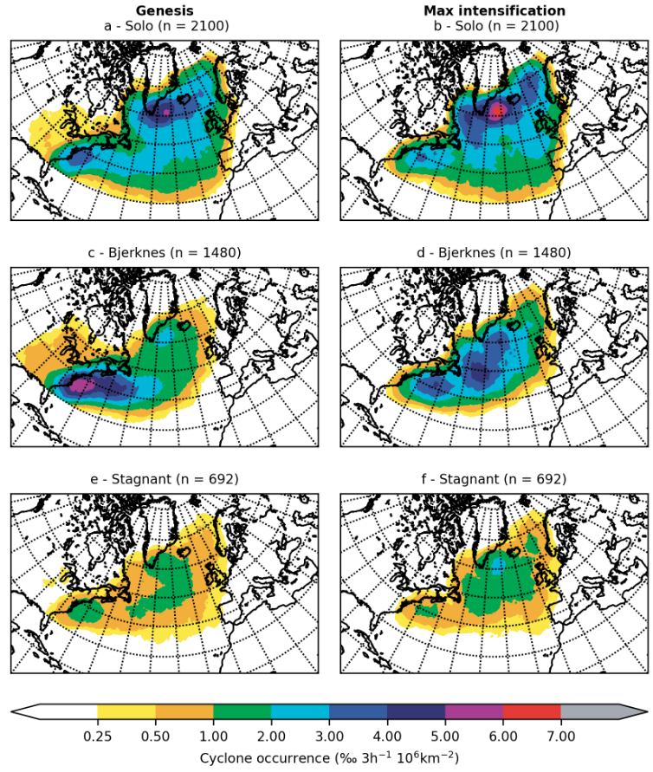
Where do clustered cyclones occur?
Tracking local minima of (mean sea level) pressure
Division of cyclones into Sequential (follow same track over long distance) and Stagnant (follow same track over long period)
Sequential (n=1480)
Sequential (n=1480)
Figure of Jeroen Oostdam
Notes:
Cut off low: stationary because cut off from main westerly flow
Visible as minimum in Geopotential height (moisture transport indicated by arrows).
Connection local scale: Lifting in Eiffel/Ardennes regions

Slide 10
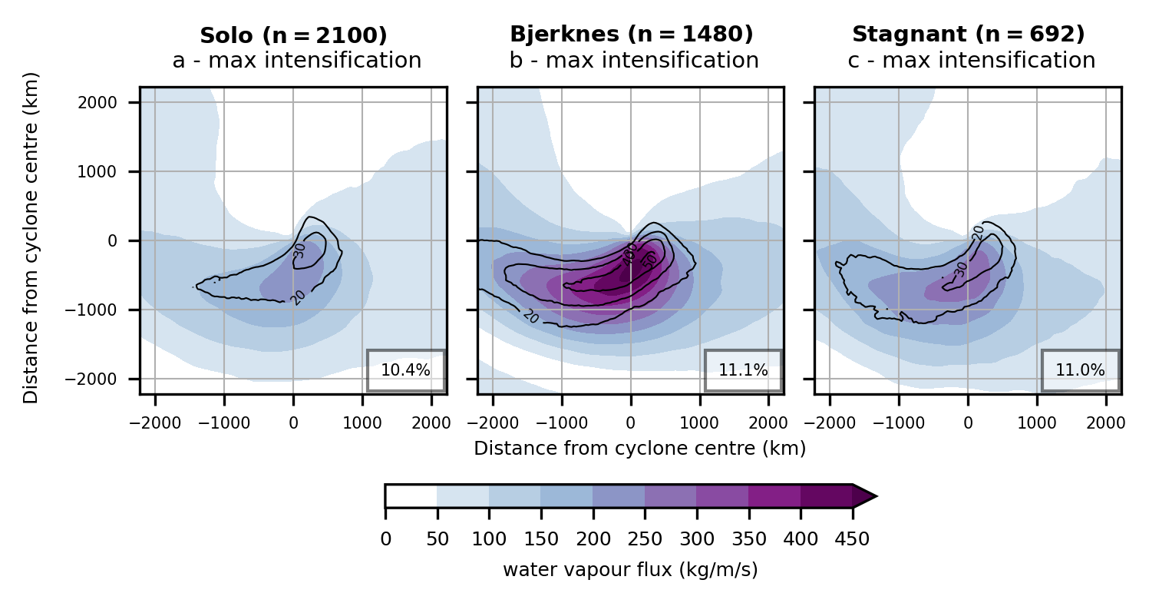
Clustered cyclones: In general stronger
Cyclone centred composites of mean sea level pressure and geopotential
Sequential (n=1480)
Figure: Jeroen Oostdam
Notes:
Cut off low: stationary because cut off from main westerly flow
Visible as minimum in Geopotential height (moisture transport indicated by arrows).
Connection local scale: Lifting in Eiffel/Ardennes regions

Slide 11
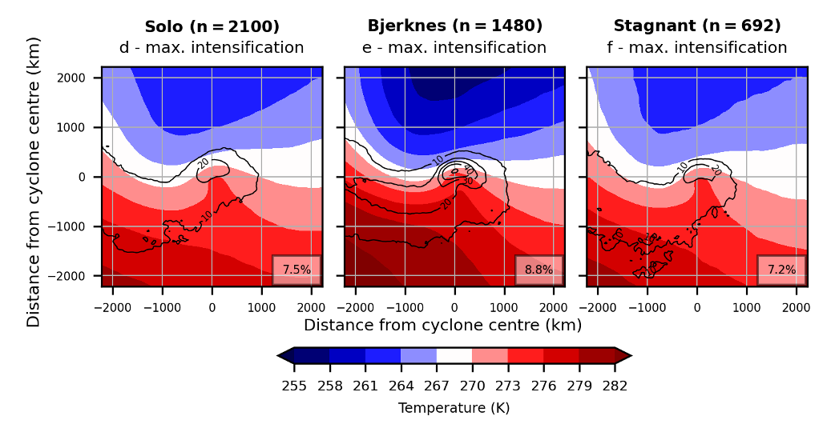
Clustered cyclones: Stronger fronts/baroclinicity
Cyclone centred composites of Front frequency and Temperature (850 hPa)
Sequential (n=1480)
Figure: Jeroen Oostdam
Notes:
Cut off low: stationary because cut off from main westerly flow
Visible as minimum in Geopotential height (moisture transport indicated by arrows).
Connection local scale: Lifting in Eiffel/Ardennes regions

Slide 12
Clustered cyclones: Stronger moisture transport
Cyclone centred composites of moisture transport axis + water vapour flux
Moisture transport axis: Atmospheric river like feature (Spensberger et al, 2024)
Sequential (n=1480)
Figure: Jeroen Oostdam
Notes:
Cut off low: stationary because cut off from main westerly flow
Visible as minimum in Geopotential height (moisture transport indicated by arrows).
Connection local scale: Lifting in Eiffel/Ardennes regions

Slide 13
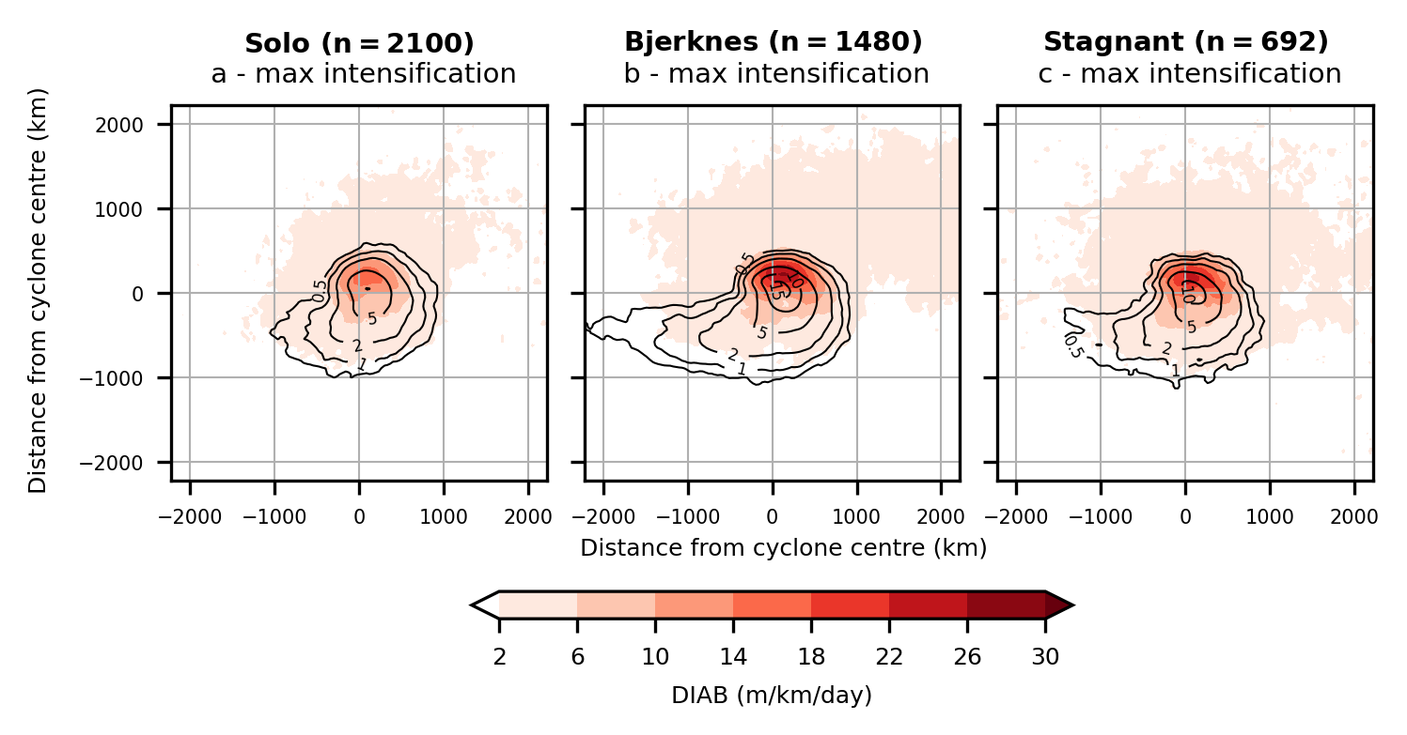
Clustered cyclones: Stronger latent heating
Increased diabatic heating leads to increased baroclinicity
Diabatic heating & Diabatic slope tendency
Sequential (n=1480)
Figure: Jeroen Oostdam
Notes:
Cut off low: stationary because cut off from main westerly flow
Visible as minimum in Geopotential height (moisture transport indicated by arrows).
Connection local scale: Lifting in Eiffel/Ardennes regions

Slide 14
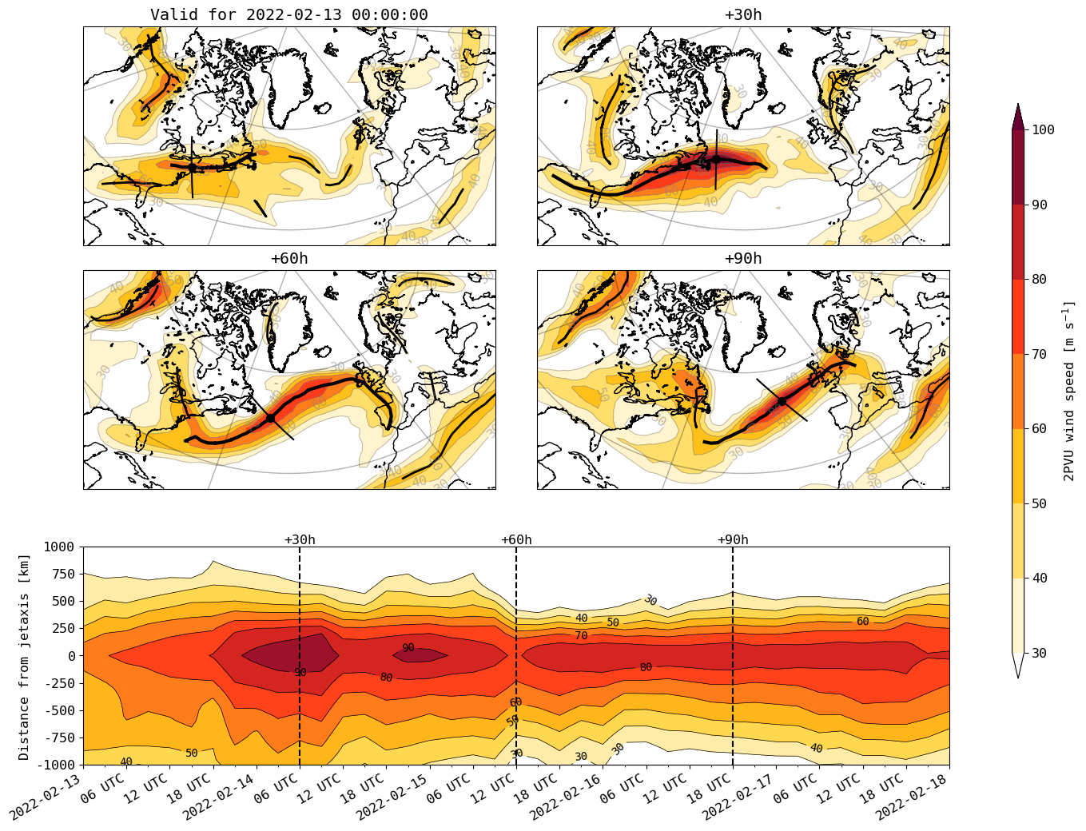
OpenIFS experiments: quantify influence latent heating?
Goal: quantify influence moisture (latent heating) on jet stream
Reforecast starting at 13-06 (short before jet intensification)
Along jet intensification —> We would expect more diabatic heating at ‘warm’ side
Jet axis detection of Spensberger et al.
Sensitivity tests with decreased (50%) and increased (150%) latent heating
150% LH
Lv x 1.5
CNTRL
Lv x 1
50% LH
Lv x 0.5
Notes:
Cut off low: stationary because cut off from main westerly flow
Visible as minimum in Geopotential height (moisture transport indicated by arrows).
Connection local scale: Lifting in Eiffel/Ardennes regions

Slide 15
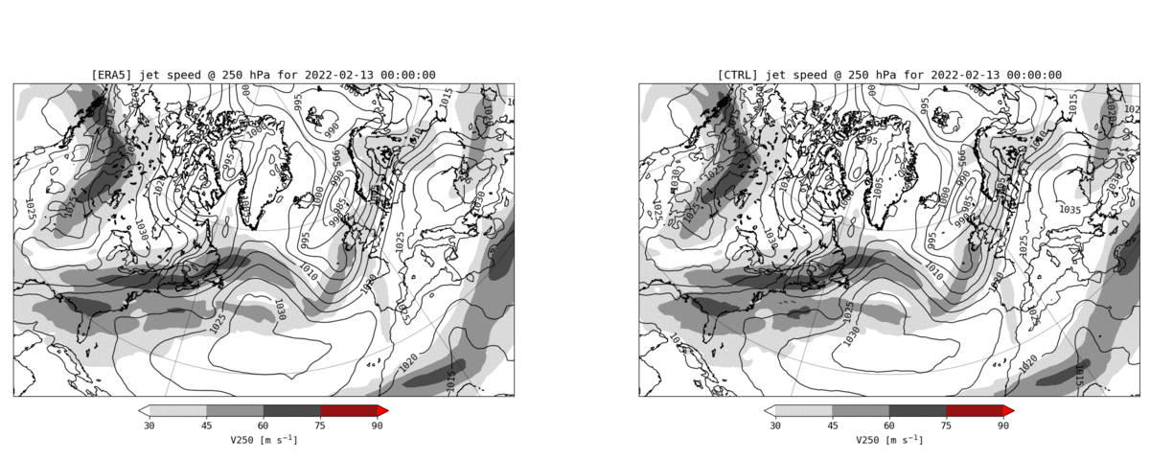
OpenIFS validation
IFS capable of reproducing jet intensification
ERA5
OpenIFS
Contours: MSLP
250 hPa wind speed [m s⁻¹]
250 hPa wind speed [m s⁻¹]
Notes:
Cut off low: stationary because cut off from main westerly flow
Visible as minimum in Geopotential height (moisture transport indicated by arrows).
Connection local scale: Lifting in Eiffel/Ardennes regions

Slide 16
Jet intensification
Jet axis detection and strengthening of jet
Figure: Thomas Batelaan
Notes:
Cut off low: stationary because cut off from main westerly flow
Visible as minimum in Geopotential height (moisture transport indicated by arrows).
Connection local scale: Lifting in Eiffel/Ardennes regions

Slide 17
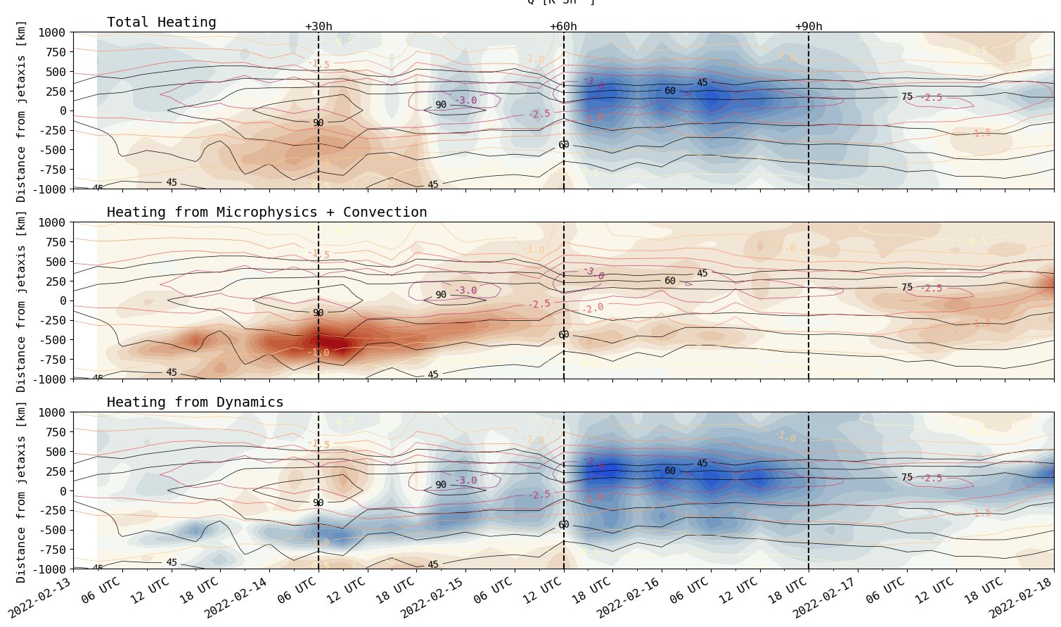
Diabatic jet intensification
Intensification, consistent with temperature gradient, mainly latent heating
50/150 % runs consistent
850-350 hPa vertical averages
Total (diabatic) heating
Cool
Warm
Microphysics + Convection
Cool
Warm
Dynamics (advection + compression/expansion)
Cool
Warm
Figure: Thomas Batelaan
Notes:
Cut off low: stationary because cut off from main westerly flow
Visible as minimum in Geopotential height (moisture transport indicated by arrows).
Connection local scale: Lifting in Eiffel/Ardennes regions

Slide 18
Take home messages
Structure of (spatio-temporal) clusters show more latent heating, stronger moisture transport, and
Latent heating important in strengthening jet streak
Further studies necessary to further quantify the effect of adiabatic and diabatic effects
Notes:
Cut off low: stationary because cut off from main westerly flow
Visible as minimum in Geopotential height (moisture transport indicated by arrows).
Connection local scale: Lifting in Eiffel/Ardennes regions

Slide 19
Extra slides

Slide 20
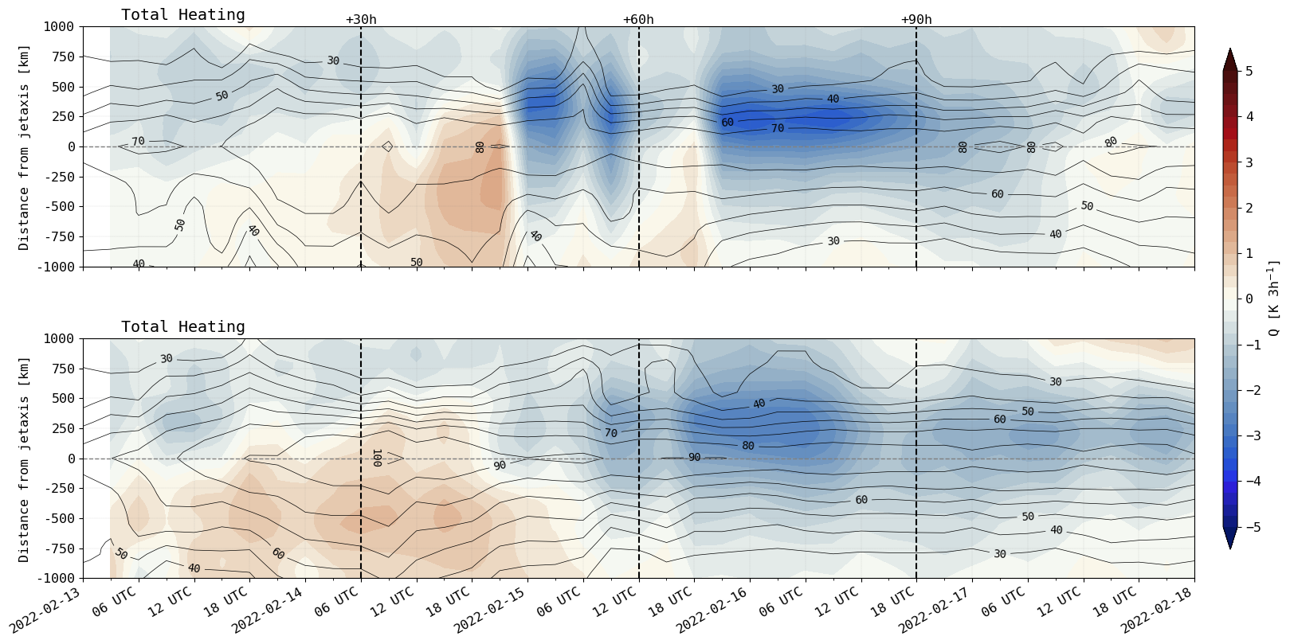
Diabatic jet intensification
50/150 % runs consistent
850-350 hPa vertical averages
Total (diabatic) heating
Cool
50% Lv
Warm
Cool
150% Lv
Warm
Figure: Thomas Batelaan
Notes:
Cut off low: stationary because cut off from main westerly flow
Visible as minimum in Geopotential height (moisture transport indicated by arrows).
Connection local scale: Lifting in Eiffel/Ardennes regions

Slide 21
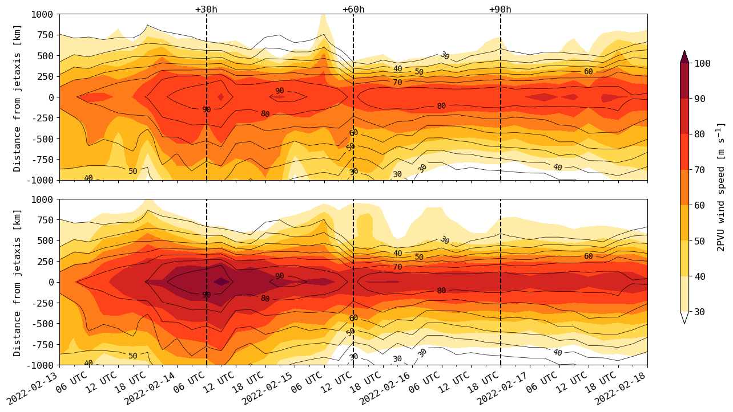
Sensitivity tests changing latent heat of vaporization
50/150 % runs consistent
Jet (streak) strength
50% Lv
150% Lv
Figure: Thomas Batelaan
Notes:
Cut off low: stationary because cut off from main westerly flow
Visible as minimum in Geopotential height (moisture transport indicated by arrows).
Connection local scale: Lifting in Eiffel/Ardennes regions

Slide 22
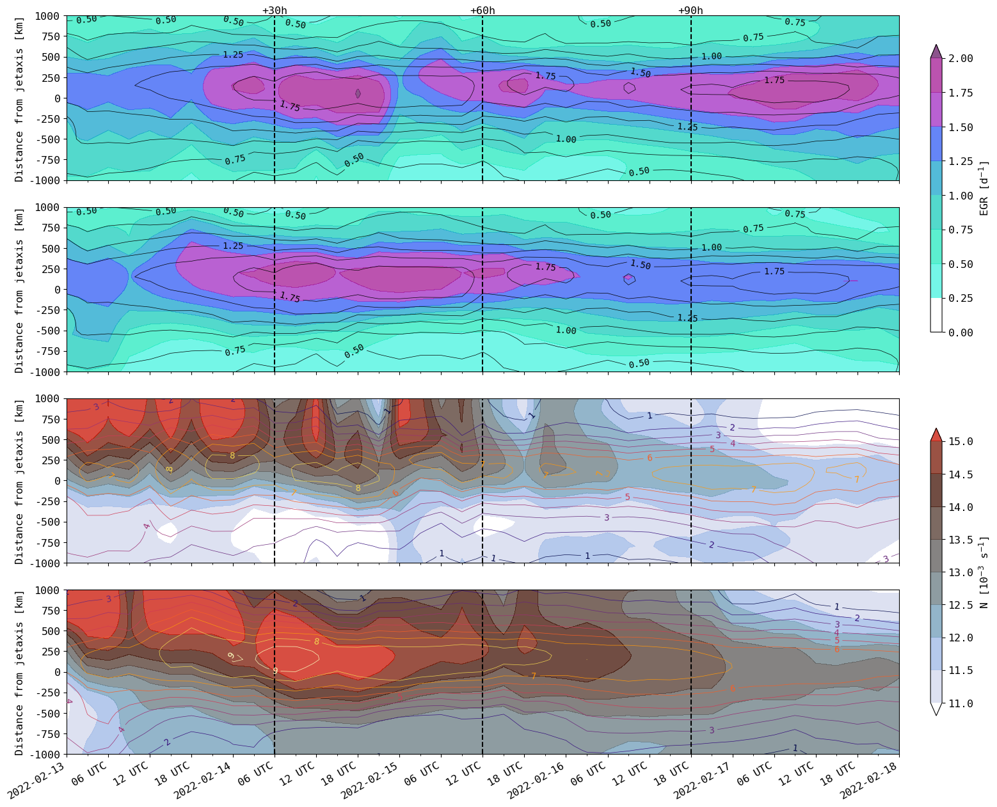
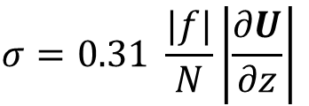
Eady growth rate response
50/150 % runs consistent
50% Lv
$$σ=0.31 \frac{|f|}{N}\left|\frac{∂U}{∂z}\right|$$
Colors: EGR [d⁻¹]
Contours: control EGR [d⁻¹]
150% Lv
850-350 hPa vertical averages
50% Lv
Colors: N [10⁻³ s⁻¹]
Contours: dU/dz [10⁻³ s⁻¹]
150% Lv
Figure: Thomas Batelaan
Notes:
Cut off low: stationary because cut off from main westerly flow
Visible as minimum in Geopotential height (moisture transport indicated by arrows).
Connection local scale: Lifting in Eiffel/Ardennes regions

Slide 23
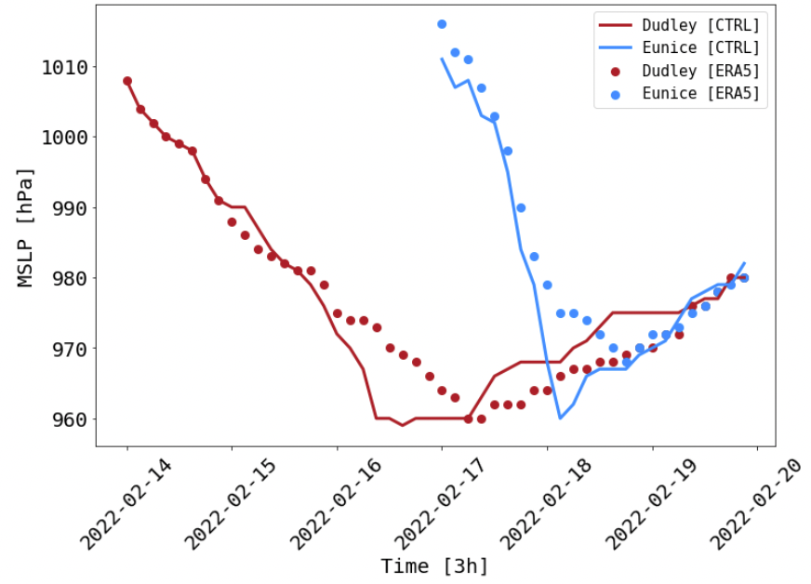
Verification
Notes:
Why do we care?
found that clustering is most frequent along the storm tracks. Along these storm tracks, cyclones generally form as a result of shear instabilities of the jet, called baroclinic instabilities. This instability depends on the meridional temperature gradient through the thermal wind balance. This meridional temperature gradient is proportional to the available potential energy of the mean flow. The instability grows by consuming this APE and converting it to KE. Hence, a logical consequence of this baroclinic growth mechanism is that cyclones reduce the baroclinicity, and thereby the PE availability. This is unfavourable to the formation of a subsequent cyclone. Given this general understanding of cyclogenesis on the storm track, clustering of cyclones is counter-intuitive.

