Slide 1
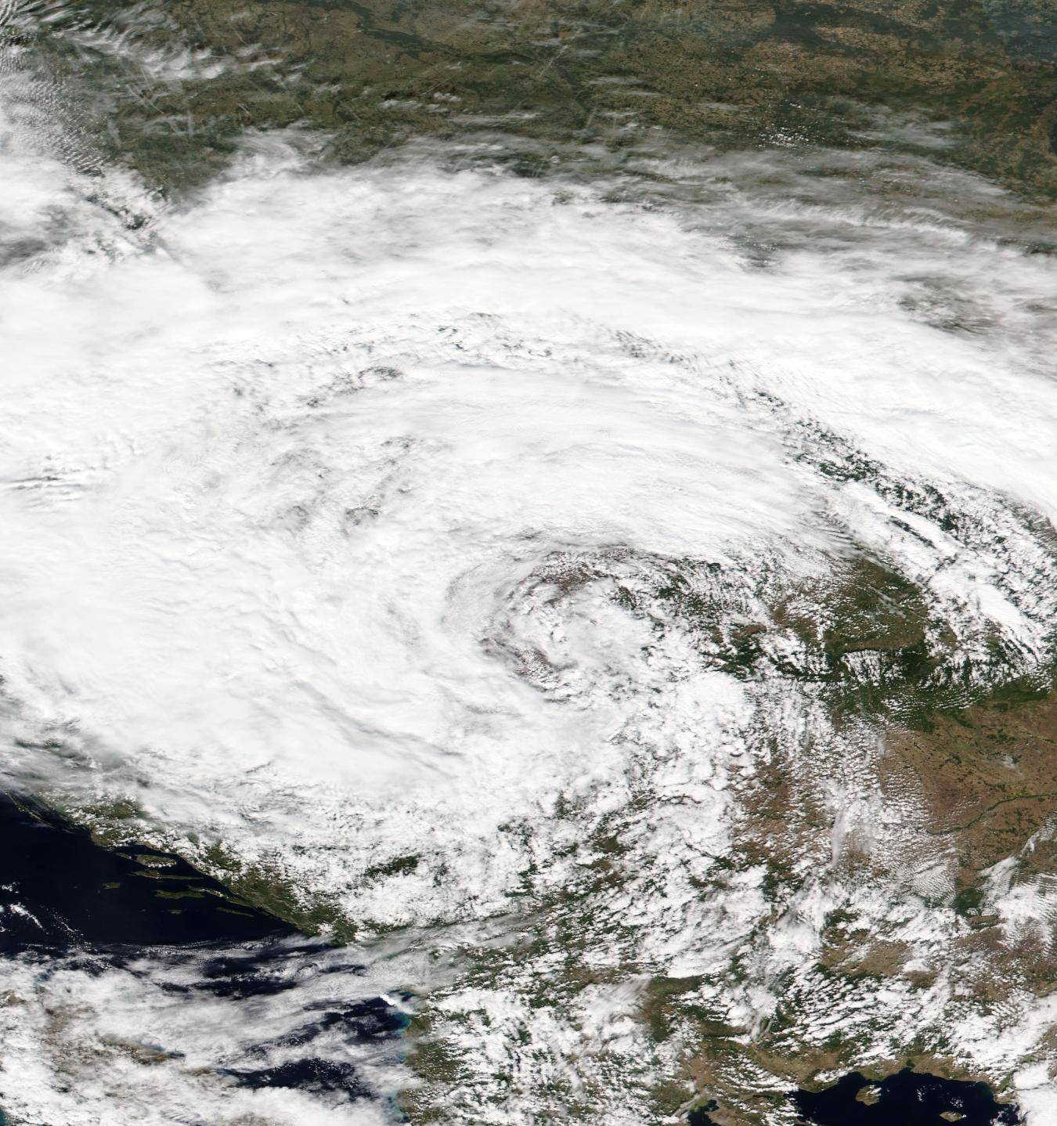

Thermodynamic sensitivity of Storm Boris to sea surface temperature anomalies
Fulden Batibeniz
Martina Messmer | Christoph C. Raible
Nasa worldviewhttps://worldview.earthdata.nasa.gov/
Notes:
“Good morning, and thank you for the invitation.
Today I’ll talk about climate extremes in a warming world.
I’ll first briefly summarize where we stand in terms of mean climate change, then show how this translates into changes in extremes, and finally zoom in on a recent high-impact event — Storm Boris — to illustrate how we can study thermodynamic sensitivity using high-resolution modelling.”

Slide 2

Impact of Storm Boris
13-16 September 2024
Affected countries: Poland, Germany, Slovakia, Austria, and Italy
27 people died
Notes:
In today’s climate, which is 1.3°C warmer than at the beginning of the industrial period, a rainfall event of this magnitude is a very rare event expected to occur about once every 100 to 300 years. As the event is by far the heaviest ever recorded, the exact return time is difficult to estimate based on only about 100 years of observed data.
When looking at the regional-scale described above, heavy four-day rainfall events have become about twice as likely and 10% more intense since the pre-industrial era.

Slide 3
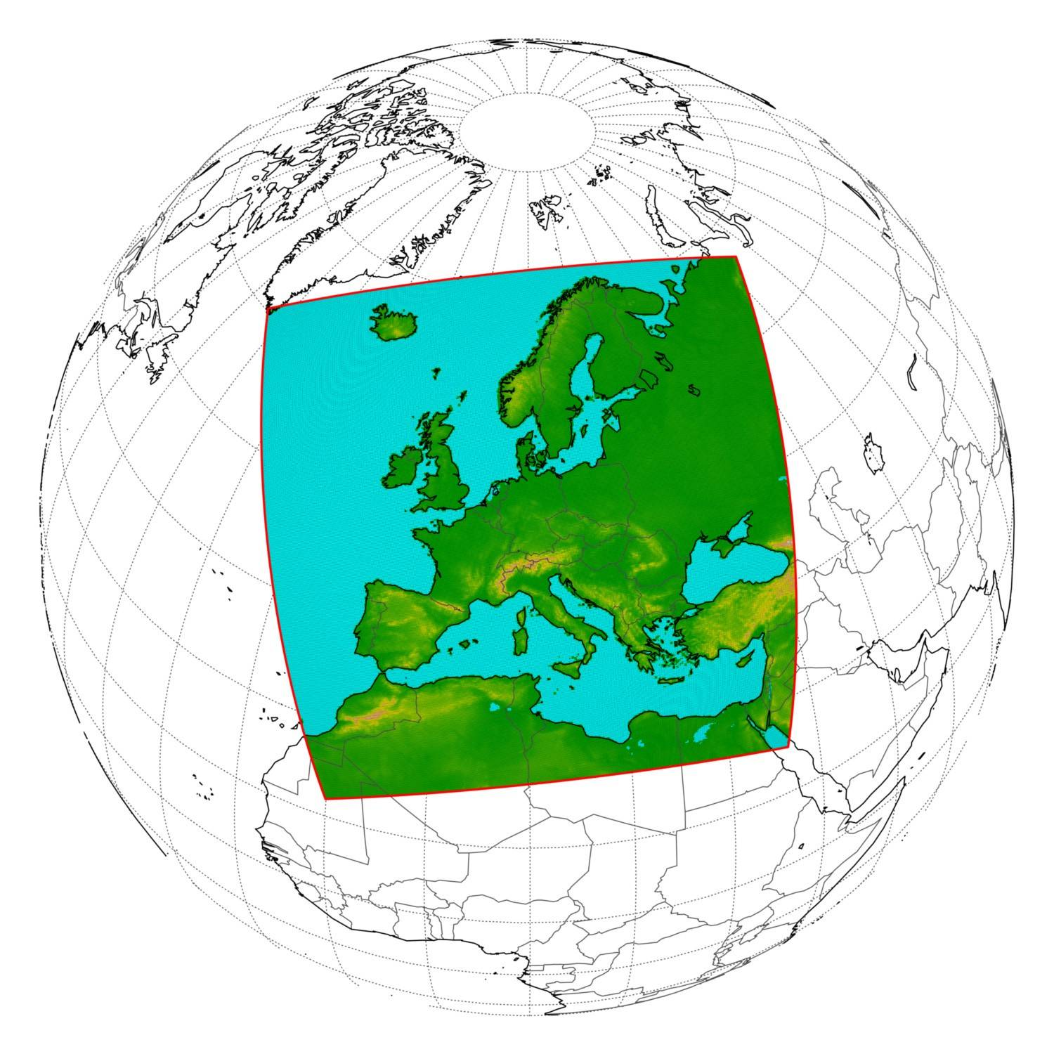
Model Setup
Model: ICON (convection-permitting)
Resolution: 3 km horizontal
Simulation period: 1 month including Storm Boris
Atmospheric forcing: ERA5 reanalysis (initial & lateral boundaries)
Domain: EURO-CORDEX
Notes:
How would Storm Boris have evolved under the same circulation, but without anomalously warm SSTs?

Slide 4
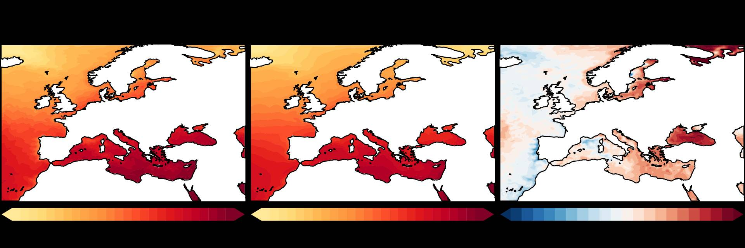
Experimental Setup
Simulations
2024 run:
Observed 2024 SSTs
CLIM run:
SSTs replaced by 1981–2010 climatological mean
Notes:
Winter medicanes are largely
influenced by dynamic effects and systems originating
from the Atlantic (Batibeniz et al., 2020), primarily driven
by external forcing through wind strength. In contrast,
during the transition seasons, thermodynamic effects such
as local recycling (Batibeniz et al., 2020) play a more significant
role in medicane development.
average difference maximum value is 6.43 in Black Sea
13th up 7.18, 14th up to 7.18, 15th up to 6.84, 16th up to 7.45

Slide 5
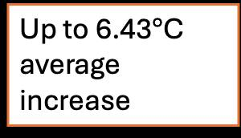
Experimental Setup
Simulations
2024 run:
Observed 2024 SSTs
CLIM run:
SSTs replaced by 1981–2010 climatological mean
Up to 6.43$°$C average increase
Notes:
Winter medicanes are largely
influenced by dynamic effects and systems originating
from the Atlantic (Batibeniz et al., 2020), primarily driven
by external forcing through wind strength. In contrast,
during the transition seasons, thermodynamic effects such
as local recycling (Batibeniz et al., 2020) play a more significant
role in medicane development.
average difference maximum value is 6.43 in Black Sea
13th up 7.18, 14th up to 7.18, 15th up to 6.84, 16th up to 7.45

Slide 6
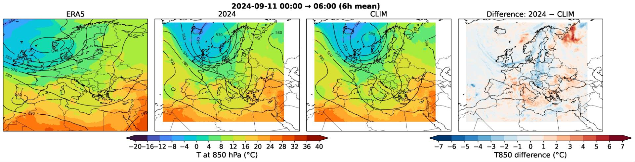
850mb Temperature (lower atmosphere) &
500mb Geopotential (middle atmosphere)
Notes:
What it is (in simple terms):
The temperature of the air about 1–1.5 km (roughly 5,000 feet) above the ground.
Why we use it instead of surface temperature:
It’s above hills, buildings, and daily heating effects
It shows the true air mass (warm or cold air moving in)
The September 2024 Climate Bulletin from the Copernicus Climate Change Service (implemented by ECMWF on behalf of the EU) provides further information on the precipitation extremes during storm Boris. The study shows that more than three months' worth of rainfall fell during the event (12 to 16 September) in eastern Austria and on the border between Czechia and Poland.
“Storm Boris was a severe mid-latitude cyclone that affected large parts of Central Europe in September 2024.”
“Cold air was advected southward, meeting warm and moist air to the east, creating a strong temperature gradient.”
“The system became quasi-stationary due to blocking, leading to prolonged and intense rainfall.”
In the days before storm Boris, unusually cold air was driven south across the UK. During 11 and 12 September this cold air continued on across France into the western Mediterranean to meet warm, moist air to the east, creating a strong temperature contrast across central Europe (Figure 1a).
A low-pressure system formed along the interface and was named Boris by the Italian Meteorological Service (under the EUMETNET storm naming activity) when it first formed over northern Italy on Wednesday, 11 September. It moved erratically east and then north, and a cut-off low developed (Figure 1b). High-pressure ridges built to the northeast and the northwest (Figure 1b), which helped to anchor the system and its very active rainfall zone for several days over central Europe (Figure 1c).

Slide 7
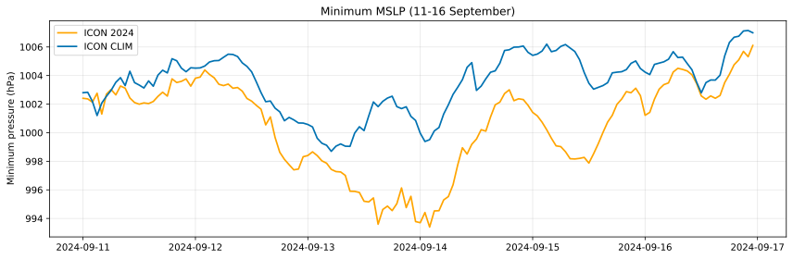
Minimum Mean Sea Level Pressure
In the 2024 SST case, Storm Boris reaches a substantially deeper minimum mean sea level pressure, indicating a more intense cyclone.
Notes:
In the 2024 SST case, Storm Boris reaches a substantially deeper minimum mean sea level pressure and produces markedly higher precipitation totals, indicating a more intense cyclone. This highlights the role of warmer SSTs in enhancing surface fluxes, moisture supply, and diabatic processes that feed back onto cyclone deepening and rainfall intensity.

Slide 8
Minimum Mean Sea Level Pressure
In the 2024 SST case, Storm Boris reaches a substantially deeper minimum mean sea level pressure, indicating a more intense cyclone.
Notes:
In the 2024 SST case, Storm Boris reaches a substantially deeper minimum mean sea level pressure and produces markedly higher precipitation totals, indicating a more intense cyclone. This highlights the role of warmer SSTs in enhancing surface fluxes, moisture supply, and diabatic processes that feed back onto cyclone deepening and rainfall intensity.

Slide 9
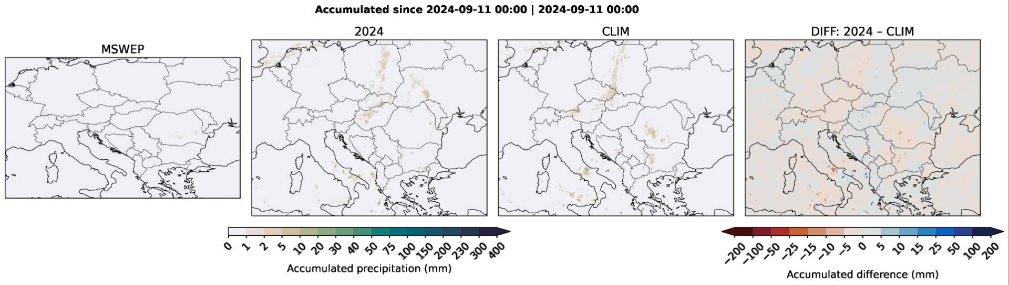
Accumulated Precipitation

Slide 10
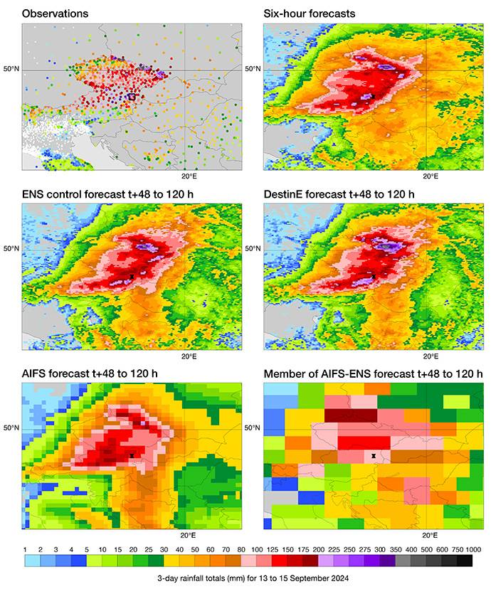
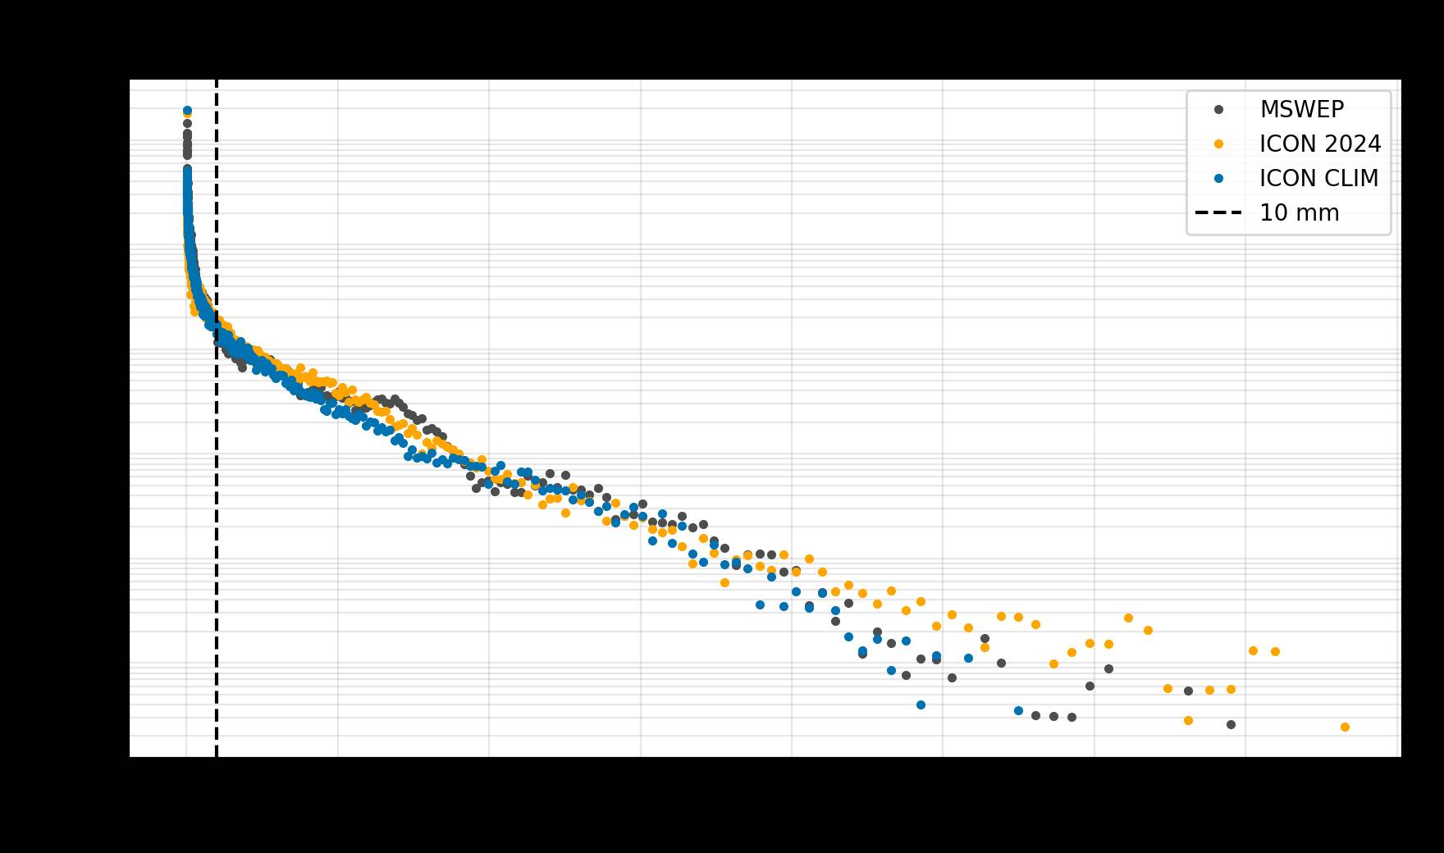
Exceptional Rainfall from storm Boris
A three-day total of 442 mm in the mountains in northern Czechia was the highest value found in observed station data. (ECMWF, 23 October 2024)
Notes:
Sample sizes (cells in bbox): MSWEP 49300 SST2024 28693 CLIM 28693
The largest three-day rainfall totals (from 13 – 16 September) occurred over eastern Austria and along the border between Czechia and Poland.
2024 produces more wet grid cells (excess extremes) compared with MSWEP.
Whereas CLIM produces less as expected.
MSWEP is a merged product (gauges/satellite/reanalysis) and has its own biases, especially in mountains and convective regimes.
In its original form ICON 2024 reaches to 4

Slide 11
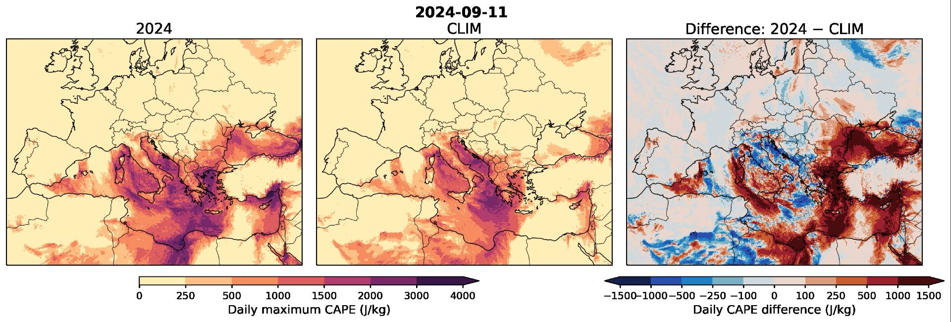
CAPE (Convective Available Potential Energy)
CAPE is a measure of how much energy the atmosphere has to make air rise and form storms.
CAPE is markedly higher in the SST2024 experiment, reflecting enhanced low-level moisture and instability driven by warmer sea surface temperatures.
Notes:
Warm air near the ground wants to rise. If the air above it is cooler, that rising air can keep going, building clouds and storms. CAPE tells us how strong that upward push can be
Imagine pushing down on a spring. The more you compress it, the more energy is stored. When you let go, the spring shoots upward.
This increased convective potential supports more intense precipitation and contributes to the amplified impacts of Storm Boris compared to the climatological SST case.

Slide 12
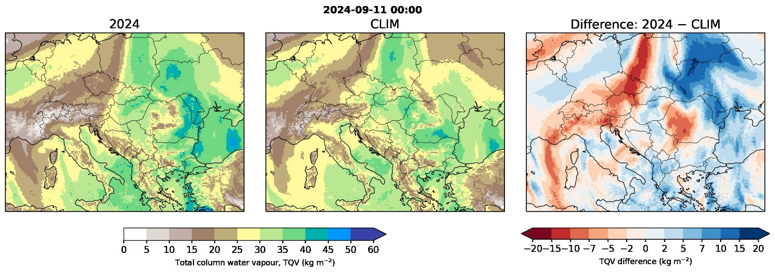
Total column integrated water vapour
The decrease in total column integrated water vapour in regions of heavy precipitation indicates efficient moisture consumption by the storm, as water vapour is rapidly converted into precipitation.
Notes:
6hrly mean TQV
The total column integrated water vapour shows a clear north–south contrast, with higher values in the northern part of the domain and reduced moisture in the south in the 2024 SST case compared to the climatology. This suggests that SST anomalies modulate large-scale moisture transport, enhancing moisture availability along the cyclone’s main inflow region while reducing it in subsiding or post-frontal areas to the south.”
This drying signal is consistent with strong ascent and rainfall, especially in the southern part of the domain, while moisture is replenished or maintained in the northern inflow region.

Slide 13

Warmer SSTs intensify storms by fueling moisture and energy
Much warmer SST -> Wetter storm
Exceptionally warm SSTs in 2024 over the Mediterranean & Black Sea provide a much stronger moisture and energy source for the cyclone
ICON shows strong skill in representing the storm dynamics and precipitation response to SST warming
Notes:
The much higher SSTs in 2024—up to about 6.5 °C warmer on average over the Mediterranean and Black Sea—provide a substantially enhanced moisture and energy source for the cyclone. This thermodynamic boost helps explain the stronger deepening, increased moisture transport, and heavier precipitation in the 2024 storm compared to the climatological SST case.
ICON shows strong skill in representing the storm dynamics and precipitation response to SST warming
This thermodynamic boost explains:
Stronger cyclone deepening
Enhanced moisture transport
Heavier precipitation compared to climatological SSTs
Results are consistent with expected climate-change impacts on extreme rainfall
These results are consistent with expected climate-change impacts:
Warmer SSTs amplify storm moisture and rainfall intensity via thermodynamic processes

Slide 14
Ongoing work
Ensemble simulations to test robustness
Basin-masking experiments: Mediterranean, Black Sea, combined
Aim: isolate source-region contributions to cyclone intensity and extreme precipitation
Notes:
“I am currently extending this analysis with ensemble simulations to better assess robustness and internal variability. In parallel, I am running additional sensitivity experiments in which SST anomalies are masked separately over the Mediterranean, the Black Sea, and both basins together. This will help isolate the relative contribution of different moisture and energy source regions to the intensification of Storm Boris.”

Slide 15
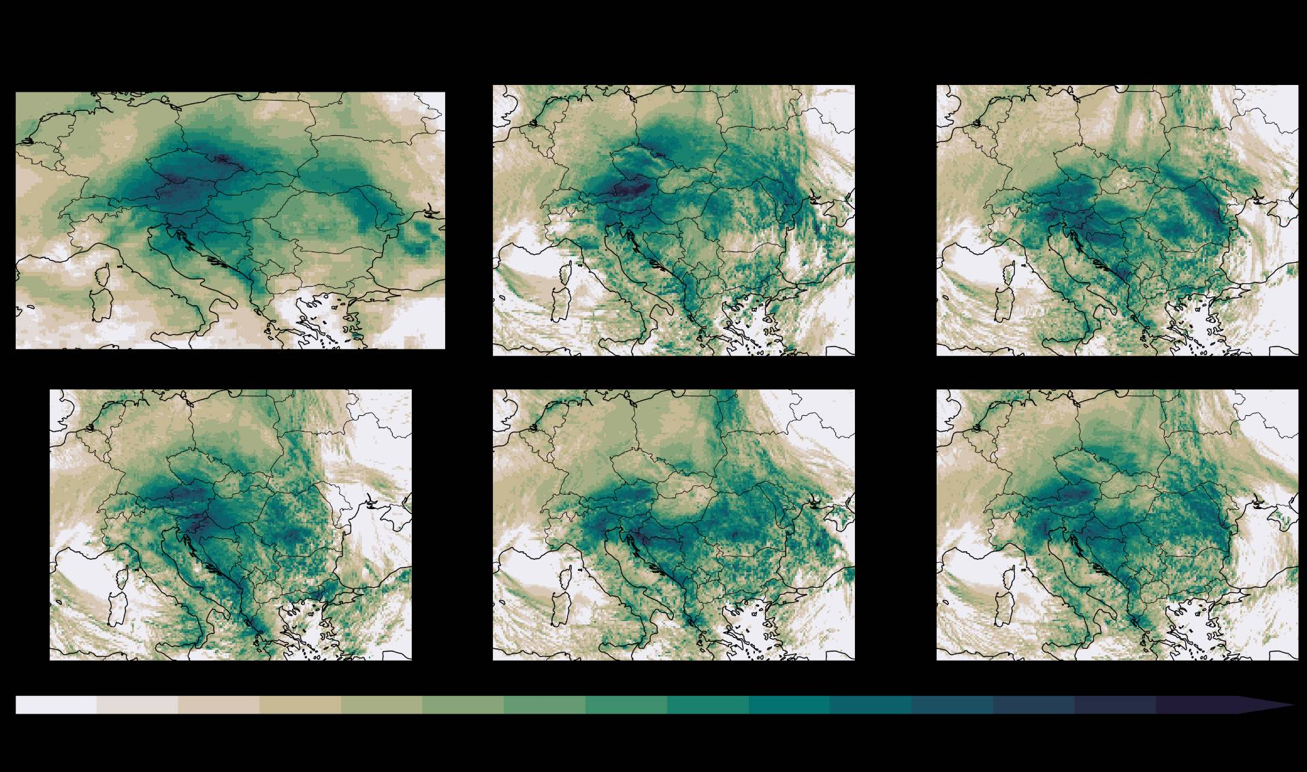
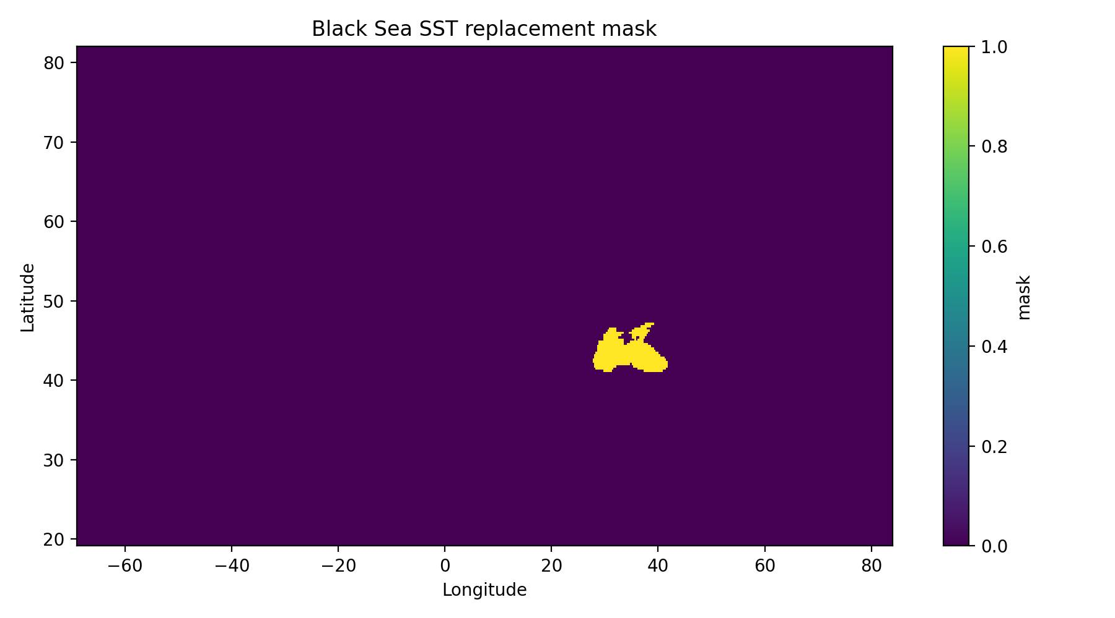
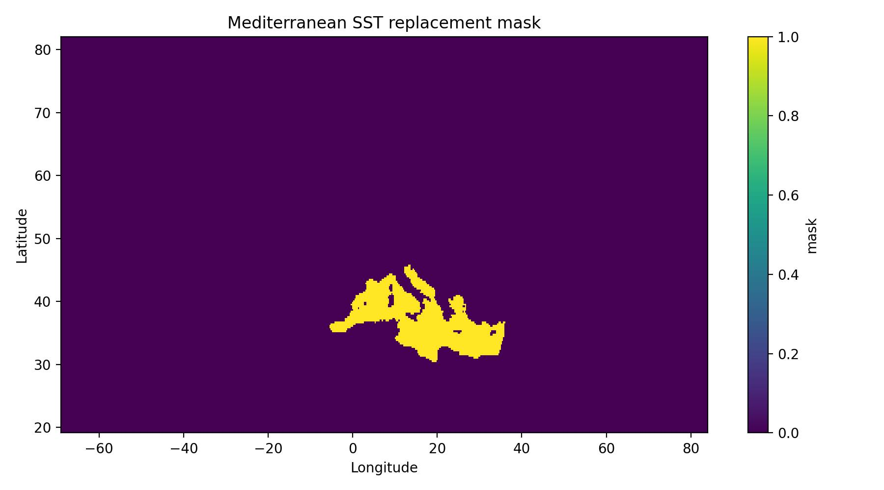
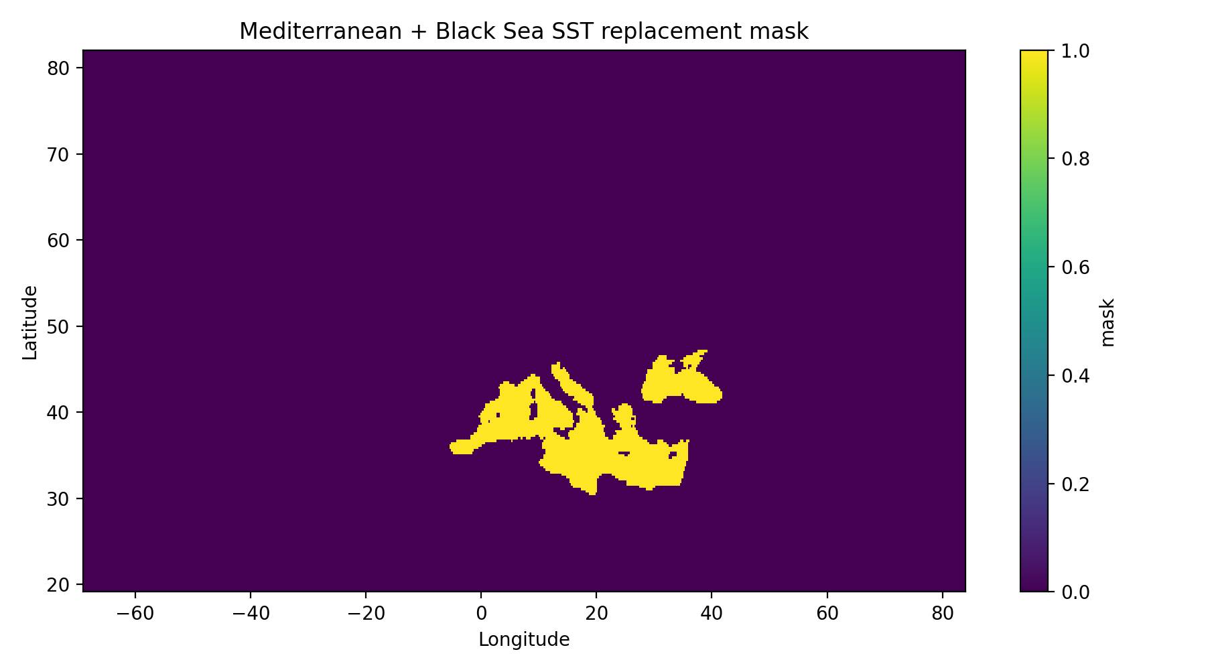

Slide 16

Mean precipitation reduction relative to 2024
Basin-masking experiments isolate regional SST-anomaly contributions.
35.4%
34.6%
22.5%
18.7%
Replacing only Mediterranean SSTs with the 1981–2010 climatology produces a precipitation reduction close to the full CLIM response, suggesting a dominant Mediterranean contribution to the Central European rainfall enhancement.
Replacing only Black Sea SSTs produces a smaller but still clear reduction, indicating a secondary contribution from the Black Sea.
Notes:
Basin-masking experiments isolate regional SST-anomaly contributions.

Slide 17
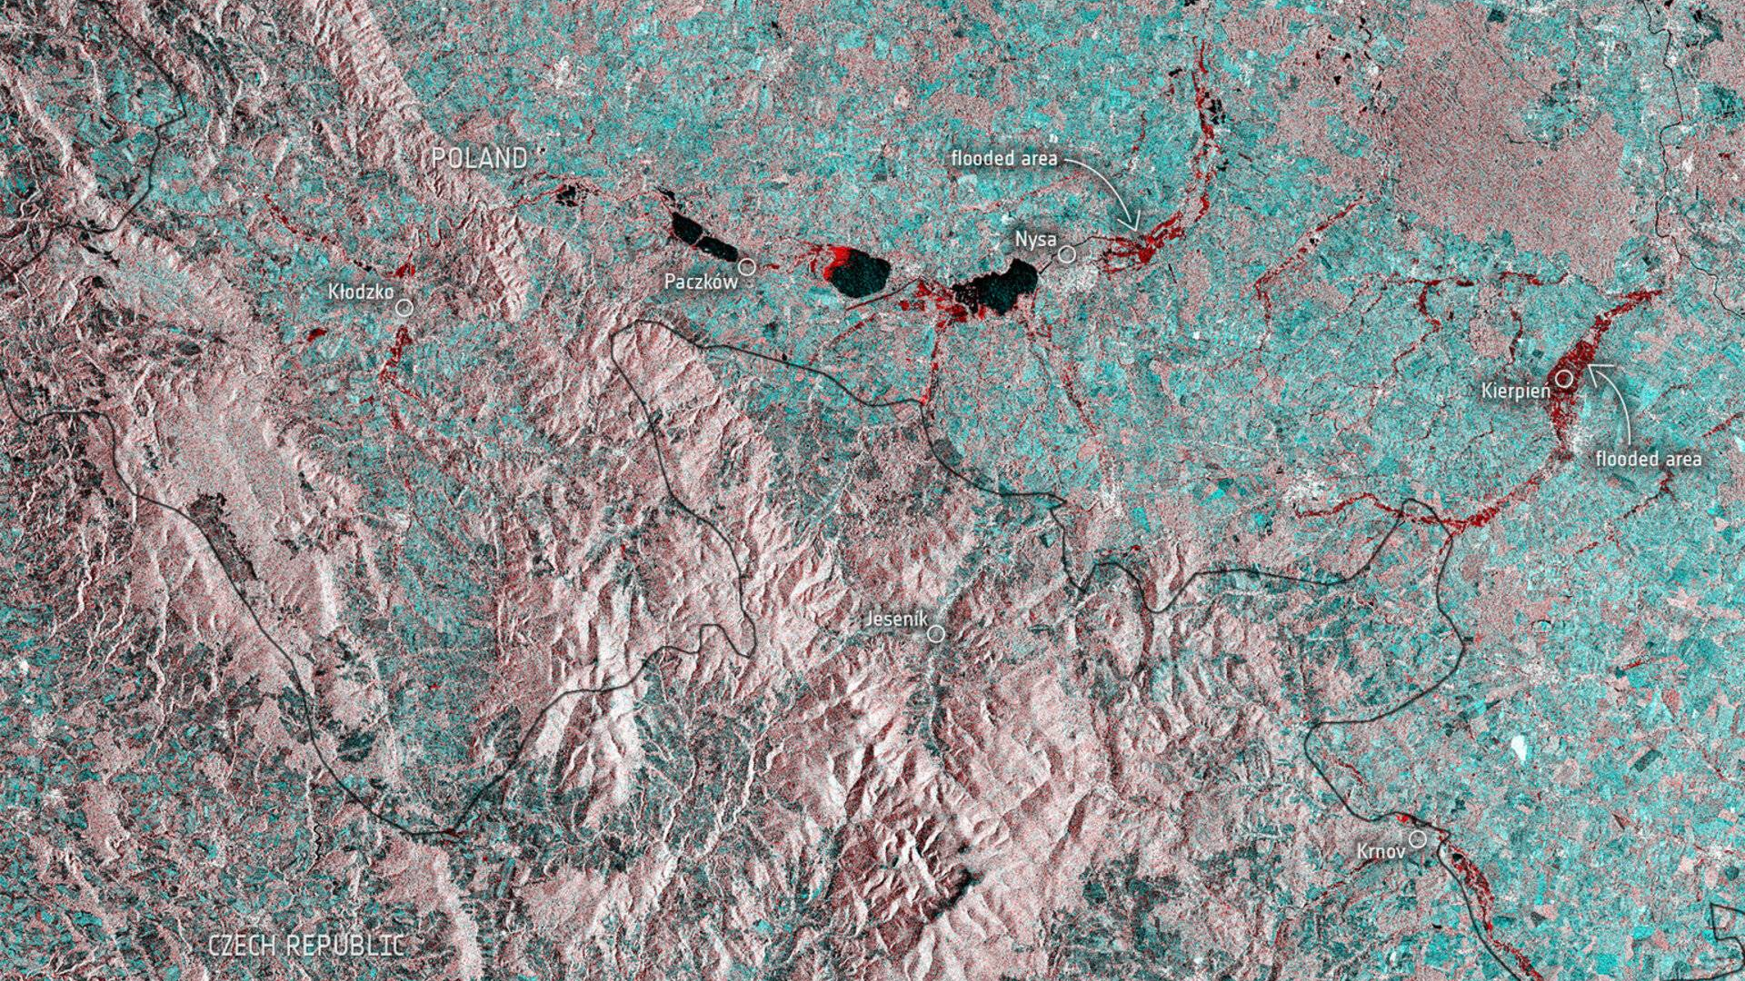
Thank you
Satellite-based flood/impact imagery highlights the spatial footprint of the event.
Source: ESA/Copernicus Sentinel-1, 2024.

